Slide 1
Advanced IUM Understanding – Session 1.2
  Presenter:
  Date:
  Duration:
  Ujjwal Barman
  June,2009
  1 days

Slide 2
Agenda
Basic Code Understanding
Encapsulator,Aggregator,Datastore
Commands Discussion.
Working with the collectors
Creating Collectors
How to Customize Collectors
How to Create a Collector Using Config Files
The Deployment Editor in LaunchPad, Linked Collectors, Collector Creation Model, Editing the NME Schema
How to Validate a Collector
Types of Encapsulator, LogFileEncapsulator Overview
Aggregator Architecture, Types of Rules, Simple Rule Scheme

Slide 3
Basic Code Understanding
Important Coding Tips:
We should always follow the naming conventions. All collector configurations and NMESchemas should be named as .config file.
Once the collector is developed use launchpad/command prompt to load the configuration and its associated NMESchema file into config server.
Also place the associated map files and scripts in the correct location. Create the input directory as per the configuration.
Make sure config server, adminagent , Solid DB is running.
Start the collector using launchpad/Command prompt.
Note: Before starting the collectors all are requested to go through the command reference document to get acquainted with the commands.

Slide 4
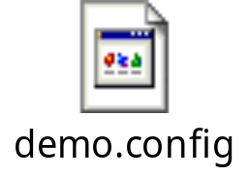

Basic Code Understanding Continued…
Please go through the following demo collector code and demo NMESchema.
1) Collector code.
2) NME Schema

Slide 5
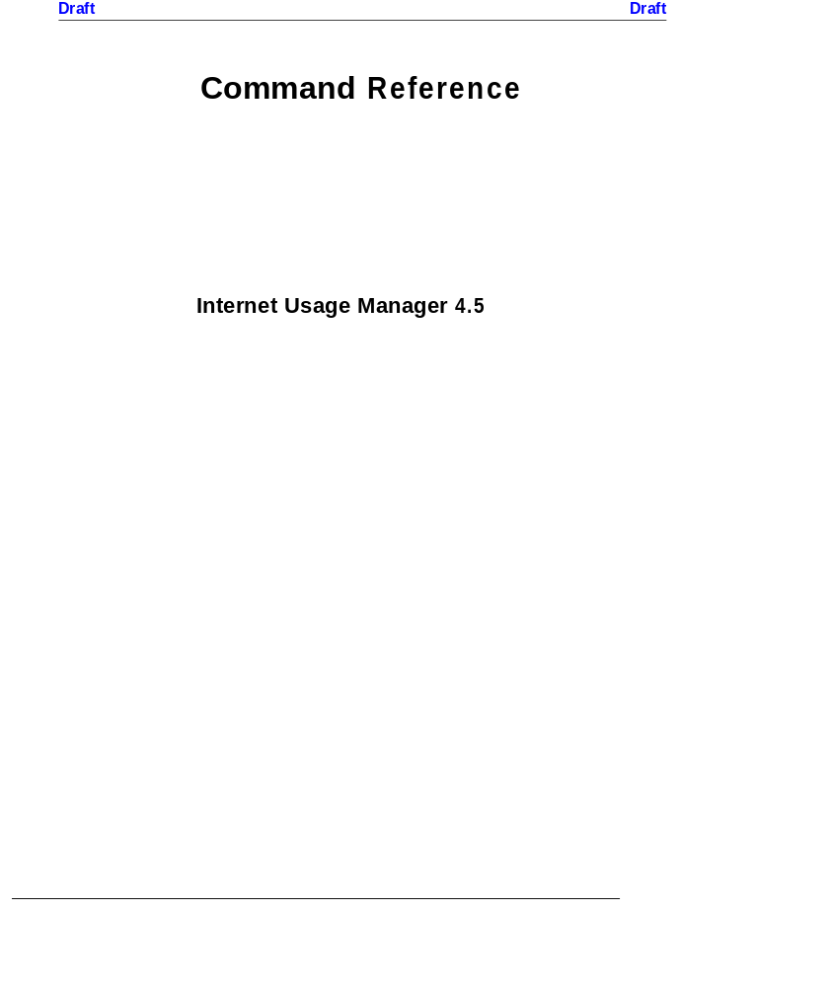
Commands Discussion

Slide 6
Working with Collectors
You can select multiple collectors at the same time. For example, if you want to stop all the collectors at once. In the right-hand pane, use your mouse to draw a box around all the collectors you want to select.
When making lots of changes to collector configurations, cleanup the collector before re-starting. Cleanup deletes all the data and log files for a collector, as if the collector had never been run. Beware though of using cleanup in a production environment!
When you have a chain of collectors, do not start all the collectors at once. Start the Level 1 (Leaf) collectors first, make sure they are running and producing data.Next start the Level 2 collectors and so forth.

Slide 7
Working with Collectors continued..
If you don’t use Launchpad, you can do everything via the command line.
For example, here are the commands for managing collectors. They can be found in
C:\Siu\bin or /opt/SIU/bin:
1. To start a Collector:
siucontrol –n <collector_name> -c startProc
2. To stop a Collector:
siucontrol –n <collector_name> -c stopProc
3. To cleanup a Collector:
siucontrol –n <collector_name> -c cleanProc
4. To save a Collector to a file:
saveconfig –n <collector_name> -f <filename>
5. To load a Collector from a file:
loadconfig –merge –f <file_name>
Note: Commands to start and stop IUM on UNIX:
/sbin/init.d/siu/start
/sbin/init.d/siu/stop
All details can be found in the Tools manual.

Slide 8
Working with Collectors continued..
We can have more then one instance of IUM running under one deployment. If we take the earlier code as reference, deployment is the name of the Deployment and ium1 was the name of one instance. We can also install one more instance of ium named ium2,3…etc under the same deployment.
Each instance can have multiple collectors under then deployed. Even one whole production system can be defined under one instance. So in scenarios where we need to have duplicate copies of production for load balancing, we can do it under one deployment having multiple instances for multiple production copies.

Slide 9
Working with Collectors Continued …
How to invoke a launchpad of a remote system (can be of a production system)
Each ium deployment will have its specified IOR path. This is a path or address which is understood by IUM and it helps us to invoke that IUM instance. So we can just put that path in the command prompt and can remotely open any IUM instance.
Example:
c:\SIU\bin\SIUJavaw -Xmx456m com.hp.siu.gui.launchpad.LaunchPad -iorURL http://<ip address>:<port number>
Note:
To do this we should have IUM installed in the local system because using the local instance , the remote IOR path will be invoked.
For local running of launchpad, please use the launchpad Icon.

Slide 10
Creating Collectors
The 3 components of a collector – Encapsulator, Aggregator,
Datastore are independent objects.
There are MANY different types of Encapsulators, Aggregator Rules and
Datastores.
One type of Encapsulator can be exchanged for a different type within a
collector and so can an Aggregator and a Datastore.
To understand what type of Encapsulator, Aggregator and Datastore
is inside a collector, look at the CLASSNAME attribute inside it. This is
the java class or object name.
For example, ClassName=LogFileEncapsulator is a type of Encapsulator
that is programmed to read log files.
ALL the many different types of Encapsulators, Aggregators
and Datastores are defined in the Component Reference
manual.
Agg.
Encap
DDS

Slide 11
Creating Collectors (continued)
Inside each Encapsulator, Aggregator, and Datastore are
sub-objects with their own Classnames.
For example, a Record Encapsulator has the sub-objects Record Factory,
Stream Source and File Roll Policy. Each can be of different types and
have their own classnames to identify them.
In the Aggregator, each rule is its own sub-object with its own classname
associated with it. Rules can be added, modified and deleted and moved
around as independent objects.
As before ALL the many different types of sub-objects in the
Encapsulators, Aggregators and Datastores are defined in the
Component Reference manual.
Agg.
Encap
DDS

Slide 12
How to Create Collectors
There are three methods to create Collectors:
Create collectors from Templates and modify them in LaunchPad. This method is best for beginners.
Edit Config Files and import them into LaunchPad. This method is more advanced and alot more flexible. The sooner you learn this method, the better.
Use the Deployment Editor in LaunchPad. This method is also advanced and very useful.

Slide 13
Collector Templates
A Collector Template is a set of objects (Encapsulator,
Aggregator, Datastore and their sub-objects) that HP has decided
to group together as a collector, to serve a specific purpose.
Each template has a name to reflect its purpose.
Templates can be easily re-used to create similar collectors.
In launchpad when you “create a collector” you are instantiating
a copy of a template. Typically then you need to make some
modifications to it to exactly fit your needs.
You can also create your own templates.

Slide 14
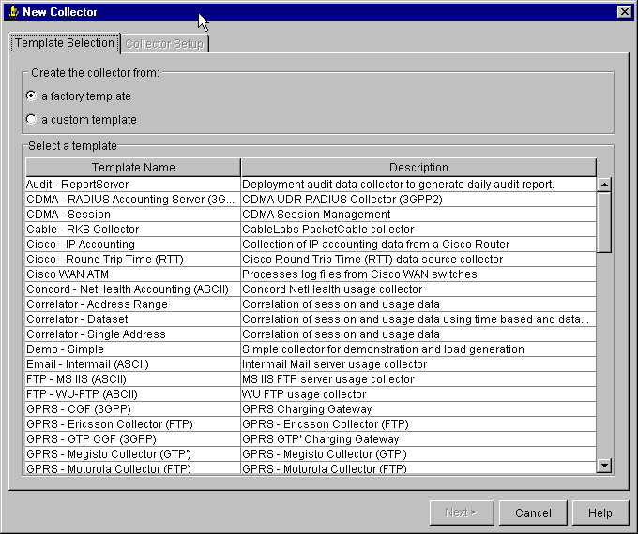
Collector Templates (continued)
Choose a Template that most closely reflects your objective. It automatically generates an Encapsulator, Aggregator and Datastore.
Customize the Collector created from the Template to reflect your specific requirements.

Slide 15
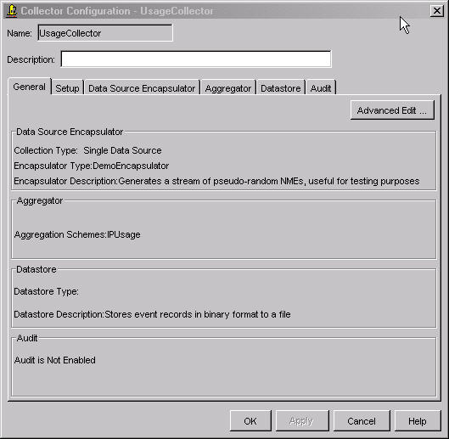
How to Customize Collectors
In Launchpad, highlight the collector, right-click
and select “Edit”. This opens the Collector Configuration window.
You can select the Tab to customize the Encapsulator, Aggregator and Datastore.

Slide 16
How to Create a Collector Using Config Files
Config Files are ASCII files that define a collectors configuration.
They contain sections for the Encapsulator, Aggregator and
Datastore.
The whole structure is hierarchical, within each section are
subsections that contain configuration values.
They are very flexible but beware of typing mistakes. You can
cut-and-paste sections from one file to another, email your file to
your support team, etc.
You can also export a currently running collector to a file. So they
can be used to back-up a collectors configuration.

Slide 17
How to Create a Collector Using Config Files
(continued)
1. In Launchpad use the File → Export Configuration option or the
saveconfig command to save a collector’s configuration to a
config file. Either in /opt/SIU/bin or C:\Siu\bin:
saveconfig –n <collector name> -f <config file name>
2. Edit the Config File using any text editor. Save the file.
3. In Launchpad use the File → Import Configuration option or the
loadconfig command to load a collector’s configuration from a
config file. Either in /opt/SIU/bin or C:\Siu\bin:
loadconfig –f <config file name> [-merge]

Slide 18
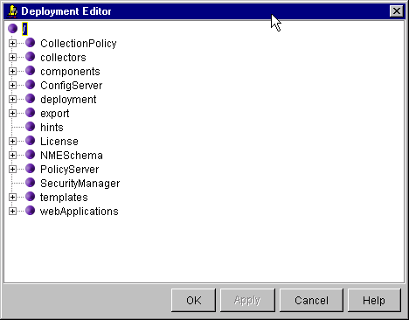
The Deployment Editor in LaunchPad
The Deployment Editor gives a global static view of an IUM installation.
Templates section - list of all the available Templates.
Deployment section - all the servers and collectors you have configured.
You can copy a collector from one machine to another, or cut-and-paste
collectors or components of collectors.

Slide 19
Linked Collectors
What if you had to create a large number of collectors that were nearly
all the same? For example, you have 40 switches on your network and
need one collector for each switch. The configuration for the collector’s
Encapsulators, Aggregators and Datastores would be nearly identical,
the only difference is the switch id you are connecting to using ftp to read
the data.
Instead of having to create 40 collectors from scratch and then have to
edit them all individually when you have to make changes, you can use
Linked Collectors.
Master Collector
Contains global attributes
Stored in the Templates Section
Agg.
Enc
DDS
Linked Collectors
Contain only over-ridden attributes specific to that collector. Managed in launchpad or via
command line like
any other collectors
Agg.
Agg.
Agg.
Agg.
Enc
DDS
Enc
DDS
Enc
DDS
Enc
DDS
Collector1
Collector1
Collector1
Collector1

Slide 20
Linked Collectors (continued)
How to create Master and Linked Collectors:
1. Create the Master collector first. Configure the Encapsulator, Aggregator and Datastore with all the global attributes. Save this collector as a Custom Template in Launchpad or as a config file.
2. Create a new config file for each Linked Collector. In the Config File create only the components and/or subcomponents that are different from the default attributes in the Master.
3. At the top level in the file add the line Link to link to the Master Collector in the Templates Section, for example:
[/deployment/hostname/collectorname]
AdminInterface=
ClassName=com.hp.siu.adminagent.procmgr.CollectorProcess
Description=
Link=/templates/custom/mastercollectorname
QueryInterface=
NOTE: Do not save your Custom Template under the Factory section as they may be over written!

Slide 21
Linked Collectors (continued 2)
How to create Master and Linked Collectors, continued:
4. Save the file and load / import the collector. This will load /import all the default or global attributes from the Master into this collector. You can now start, stop and manage that collector like any collector.
When you want to make changes across all the collectors, edit the
Master collector. Stop and restart the Linked Collectors and they
will automatically be updated.
If you want to make changes to any individual collector, just edit it
as normal using Launchpad or config file.

Slide 22
Collector Creation Model
Data Sources
Business
Applications
For whatever type of Collectors you are creating, remember
Collectors are building blocks:
  build the Encapsulator, test and modify.
  build the Aggregator, test and modify.
  build the Datastore, test and modify.
Do this for each collector one-by-one before moving onto the next.

Slide 23
Collector Creation Model (continued)
Tips to help you build and test collector components:
1. Encapsulator – you will need some real input data or simulated input data. Configure the encapsulator and its subcomponents. To test, add just a Store Rule in the Aggregator and a simple Datastore, for example, the IDR+ datastore with text or html output. Or if lots of data, use the JDBCDatastore and query it.
2. Aggregator – use your new Encapsulator. Add one rule at a time. Use the WriteToFile rule to test the output of each rule. Use a simple datastore as for the Encapsulator.
3. Datastore – use your new working Encapsulator.
Use just a StoreRule or your new Aggregation
Scheme.
Agg.
Encap
DDS

Slide 24
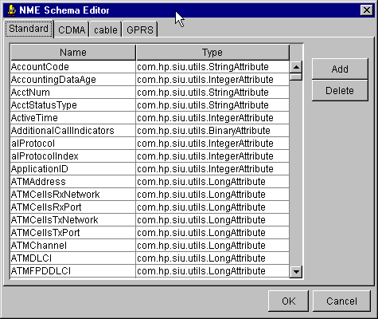
Editing the NME Schema
You can use the NME Schema Editor Tool in Launchpad to add any new NME Attributes.
Go to Launchpad Menu bar → Tools → NME Schema Editor

Slide 25
Editing the NME Schema (continued)
You can edit the NME Schema using configuration files.
This method is easier if you have a large number of new NME Attributes to add.
For example, create a text file called new NMESchema.config and add the new attributes like this:
[/NMESchema]
Attributes=NASPortType,com.hp.siu.utils.IntegerAttribute
Attributes=AcctAuthentic,com.hp.siu.utils.StringAttribute
Attributes=TermCause,com.hp.siu.utils.IntegerAttribute
Attributes=ServiceType,com.hp.siu.utils.StringAttribute
Attributes=AcctSessionTime,com.hp.siu.utils.IntegerAttribute
Attributes=AcctDelayTime,com.hp.siu.utils.IntegerAttribute
Attributes=PseudoReqSrc,com.hp.siu.utils.IPAddrAttribute
Attributes=PseudoReqType,com.hp.siu.utils.StringAttribute
Use either the Import option in Launchpad or the command loadconfig
to update the NME Schema using this file.

Slide 26
How to Validate a Collector
Don’t just assume that if a collector is running then its OK. You need to validate the collector.
Whichever method you use to create a Collector, you validate them in the same way:
Check the Collector Stats Tab in Launchpad or siucontrol command. Either in /opt/SIU/bin or C:\Siu\bin:
siucontrol –n <collectorname> -c showStats
Check the Collector Log file Tab in Launchpad or <collectorname>.log in either /var/opt/SIU/log or C:\Siu\varlog.
Query the collector using the Query Data option in Launchpad or siuquery command.
siuquery –n <collectorname> -scheme <schemename> (-session) –f <filename>.htm –html
Validate the output data. Is the data from your query approximately what you expect ?

Slide 27
Types of Encapsulators
Read data from network data sources
(Level 1 Collectors):
Read data from collectors
(Level 2+ Collectors):
Stream/Packet
NME
NME
BatchCollector
Collector
Dataset
DatasetMux
PollingMux
SimpleMux
Report
Dataset Report
NMEFile
Record
BERFile
CiscoWAN
IPDRv3
IPAcct
JDBC
LogFile
P-Cube
SingleFile
File
HybridMux
NortelUMTS
Protocol
SNMP
DynamicSNMP
Netflow
RMON
RttMIB
SFlow
UDP
Demo
All Encapsulators and their attributes are documented in full detail in the Component Reference manual.

Slide 28
LogFileEncapsulator
Objective – Learn about the LogFileEncapsulator and some of its
features:
  Its an encapsulator specifically designed to read log files = LogFileEncapsulator
  It reads delimiters between records in the log files = Delimiters
  It knows the location and name of files to read = FileRollPolicy
  It controls how much data is passed to the Aggregator = FlushPolicy
  It reads data from each record in the log file and creates NMEs = Parser

Slide 29
LogFileEncapsulator – Overview
Radius Ascii
Log Files
In File System
Log File Encapsulator
Delimiters
Delimiters - Define the delimiters between the records in a log file.
FileRollPolicy - Defines
the location and naming
convention of file or files
to be read.
FileRollPolicy
Aggregator
Datastore
Parser
Parser – Defines the
structure of the NME.
Parser the records in a
file and populates NME.
NME
Flush Policy
Flush Policy – Defines
how many NMEs are
passed to the Aggregator
and onto the Datastore

Slide 30
Aggregator Architecture
MEMORY
Scheme1
Scheme2
Tree1
Tree 2
FilterRule
AdornmentRule
MatchRule
MatchRule
LookupRule
StoreRule
AggregationRule
Flush Processor
Collector Datastore
NME Data
Meta Data:
History & Recover Tables

Slide 31
Types of Rules
Matching:
HashMatchRule
SessionMatchRule
CorrelatorMatchRule
CorrelatorSessionMatch Rule
CountUniqueMatchRule
HistogramMatchRule
RangeCorrelatorMatchRule
VectorMatchRule
Modifying:
AdornmentRule
BinaryToIPRule
ConvertCaseRule
DNSLookupRule
DoubleToIntegerRule
DuplicateCDRDetectorRule
DuplicateNMEDetectorRule
IndexSplitRule
IPRangeRule
JDBCLookupRule
JDBCUpdateRule
JNDILookupRule
MultiLookupRule
PerlRegExStringRule
PercentileRule
ProxyURLRule
RMONIPProtocolMapRule
RttTypeMapRule
SequenceRule
SplitListAttributeRule
SplitNMERule
SplitStringRule
Modifying(continued):
SplitURLRule
SubstrRule
TimeAdornmentRule
TimeGapDetectionRule
TAP3Rule
UsageActivityLookupRule
Conditional:
FilterRule
ConditionalRule
ConditionRangeRule
SwitchConditionRule
All Rules are documented in full detail in the Component Reference manual.
Event related
PushRule
DuplicateNMEDetectorRule
CloseAllSessionsRule
LogNMERule
VOIPClossAllSessionsRule
WriteToFileRule
Important and commonly-used Rules are highlighted in bold.
Storing
AggregationRule
StoreRule
SessionAggregationRule

Slide 32
Simple Rule Scheme
Objective – Learn about a simple Rule Scheme and some Aggregator
features:
  How to add new rules to an existing Scheme
  How to match values based on a key = Hash Match Rule
  How to access external information = UsageActivityLookupRule
  How to add new data to the NMEs = Adornment Rule
  How to summarise and writes out results = Aggregation Rule

Slide 33
Simple Rule Scheme – Overview (1)
SrcIP DstIP NumPackets NumBytes StartTime EndTime SrcPort DstPort
15.1.2.3. 5.10.41.57 35 4200 12.01:38 2.01:40 15 60
Scheme
Flush Processor
Datastore

Slide 34
Simple Rule Scheme – Overview (2)
Incoming
NME
SrcIP DstIP NumPackets NumBytes StartTime EndTime SrcPort DstPort
15.1.2.3. 5.10.41.57 35 4200 12.01:38 2.01:40 15 60
Scheme
Adornment Rule – Adds 4 new fields to the NME and initialises those fields.
SrcIP DstIP NumPackets NumBytes StartTime EndTime SrcPort DstPort
15.1.2.3. 5.10.41.57 35 4200 12.01:38 2.01:40 15 60
AdornmentRule
TXCode TXOption RXCode RXOption
Volume_Usage_TX Volume_Usage/TX Volume_Usage_RX Volume_Usage/RX
Flush Processor
Datastore

Slide 35
Simple Rule Scheme – Overview (3)
Incoming
NME
SrcIP DstIP NumPackets NumBytes StartTime EndTime SrcPort DstPort
15.1.2.3. 5.10.41.57 35 4200 12.01:38 2.01:40 15 60
Scheme
Adornment Rule – Adds 4 new fields to the NME and initialises those fields.
SrcIP DstIP NumPackets NumBytes StartTime EndTime SrcPort DstPort
15.1.2.3. 5.10.41.57 35 4200 12.01:38 2.01:40 15 60
AdornmentRule
TXCode TXOption RXCode RXOption
Volume_Usage_TX Volume_Usage/TX Volume_Usage_RX Volume_Usage/RX
UsageActivityLookupRule – Reads file, gets value for the 4 new fields and populates NME.
UsageActivity
LookupRule
SrcIP DstIP NumPackets NumBytes StartTime EndTime SrcPort DstPort
15.1.2.3. 5.10.41.57 35 4200 12.01:38 2.01:40 15 60
TXCode TXOption RXCode RXOption
Discount 70% Volume_Usage/TX Discount 50% Volume_Usage/RX
Flush Processor
Datastore

Slide 36
Simple Rule Scheme – Overview (4)
Incoming
NME
SrcIP DstIP NumPackets NumBytes StartTime EndTime SrcPort DstPort
15.1.2.3. 5.10.41.57 35 4200 12.01:38 2.01:40 15 60
Scheme
Adornment Rule – Adds 4 new fields to the NME and initialises those fields.
SrcIP DstIP NumPackets NumBytes StartTime EndTime SrcPort DstPort
15.1.2.3. 5.10.41.57 35 4200 12.01:38 2.01:40 15 60
AdornmentRule
TXCode TXOption RXCode RXOption
Volume_Usage_TX Volume_Usage/TX Volume_Usage_RX Volume_Usage/RX
UsageActivityLookupRule – Reads file, gets value for the 4 new fields and populates NME.
UsageActivity
LookupRule
SrcIP DstIP NumPackets NumBytes StartTime EndTime SrcPort DstPort
15.1.2.3. 5.10.41.57 35 4200 12.01:38 2.01:40 15 60
TXCode TXOption RXCode RXOption
Discount 70% Volume_Usage/TX Discount 50% Volume_Usage/RX
HashMatchRule
HashMatchRule - Match NME with other NMEs based on key values.
SrcIP DstIP NumPackets NumBytes StartTime EndTime SrcPort DstPort
15.1.2.3. 5.10.41.57 35 4200 12.01:38 2.01:40 15 60
TXCode TXOption RXCode RXOption
Discount 70% Volume_Usage/TX Discount 50% Volume_Usage/RX
Flush Processor
Datastore

Slide 37
Simple Rule Scheme – Overview (5)
Incoming
NME
SrcIP DstIP NumPackets NumBytes StartTime EndTime SrcPort DstPort
15.1.2.3. 5.10.41.57 35 4200 12.01:38 2.01:40 15 60
Scheme
Adornment Rule – Adds 4 new fields to the NME and initialises those fields.
SrcIP DstIP NumPackets NumBytes StartTime EndTime SrcPort DstPort
15.1.2.3. 5.10.41.57 35 4200 12.01:38 2.01:40 15 60
AdornmentRule
TXCode TXOption RXCode RXOption
Volume_Usage_TX Volume_Usage/TX Volume_Usage_RX Volume_Usage/RX
UsageActivity
LookupRule
UsageActivityLookupRule – Reads file, gets value for the 4 new fields and populates NME.
SrcIP DstIP NumPackets NumBytes StartTime EndTime SrcPort DstPort
15.1.2.3. 5.10.41.57 35 4200 12.01:38 2.01:40 15 60
TXCode TXOption RXCode RXOption
Discount 70% Volume_Usage/TX Discount 50% Volume_Usage/RX
HashMatchRule
HashMatchRule - Match NME with other NMEs based on key values.
SrcIP DstIP NumPackets NumBytes StartTime EndTime SrcPort DstPort
15.1.2.3. 5.10.41.57 35 4200 12.01:38 2.01:40 15 60
AggregationRule
TXCode TXOption RXCode RXOption
Discount 70% Volume_Usage/TX Discount 50% Volume_Usage/RX
AggregationRule – Summaries any matched NMEs and write result NME to Datastore
Flush Processor
SrcIP DstIP NumPackets NumBytes StartTime EndTime TXCode
15.1.2.3 15.10.41.57 35 4200 12.01:38 12.01:40 Discount70%
Datastore
TXOption RXCode RXOption SrcPort DstPort
Volume_Usage/TX Discount50% Volume_Usage/RX 15 60

Slide 38
Types of Datastores
Driver Name
FileJDBCDatastore
IDRJDBCDatastore
ExternalJDBCDatastore
MuxDatastore
JDBCDatastore
Accumulation FileJDBCDatastore
Application JDBCDatastore
NME Data
Meta Data
This table shows the relationship between the Datastore Driver configuration attribute and the physical storage they represent.
For full details of all Datastores, see the Collector Component manual.
Binary
Solid or
Oracle
Ascii
HTML
XML
IPDR
Solid or
Oracle
Solid or
Oracle
Solid or
Oracle
Solid or
Oracle
Solid or
Oracle
Solid or
Oracle
Binary
Solid or
Oracle
SDK
Solid or
Oracle

Slide 39
Recommended Datastores
Driver Name |  | Meta Data | Usage
FileJDBCDatastore |  |  | Typically used for Level1 collectors reading large quantities of files, for example any CDR-reading collector. The performance of this datastore is the best of all datastores.
IDRJDBCDatastore | Ascii HTML XML IPDR |  | Collectors which need to write out to a specific format, typically for output collectors to consuming applications, for example Billing systems. Can use the Data Delivery Agent to guarantee data transfer centralized DB or any external system or application.
External JDBCDatastore |  |  | External DB storage or centralized DB for geographically dispersed collectors. Used for Session Collectors and any other collectors where you need to do long queries. Gives control by specifying table and column configuration in the DB. Recommend Data Delivery Agent with FileJDBCDatastore instead if possible.
NME Data
Binary
Solid or
Oracle
Solid or
Oracle
Solid or
Oracle
Solid or
Oracle

Slide 40
FileJDBC Datastore
Objective – Learn about the JDBCDatastore and some of its features:
  It outputs NMEs as BinaryFiles in the file system = FileDBCDatastore Driver.
  It controls how long NMEs are stored = Table Aging and Table Rolling.
  The filenames and locations are configurable = FileNameTemplate and DataDir.
  It stores MetaData in a Solid Database = Location of Solid DB.
  The Datastore can be queried to see the output NME Data = Query Data Tool and siuquery command.

Slide 41
FileJDBC Datastore - Overview
FileJDBCDatastore
Database - The host and port values used to access the database.
Database
TableAgeLimit - The lifespan of NME data in the database. Also affects the amount of storage required for the binary files.
Solid
TableAge
Limit
Encapsulator
Aggregator
FileNameTemplate - Defines the pattern used to name output files from the collector.
DataDir
DataDir - The directory where the collector will place the NME files, using the naming convention specified by FileNameTemplate.
Binary
FileName
Template
TableRollLimit - a new file is created to hold the next set of NMEs at each flush.
TableRoll
Limit

Slide 42
End of session 2 on Advanced HP IUM
Thanks a lot for your attention……

