Slide 1
Mediation System
Session 2
(for Mobility Line of Business)
  Presenter:
  Date:
  Duration:
  Daljit Kaur
  May 25, 2009
  1 Day
Notes:
IBM Confidential

Slide 2
Agenda
Processing Module
Processing Functions
    Conversion
    Sequence Validation
    Filtration
    Duplicate CDR Detection
    Partial CDR Aggregation
    Correlation
    Cloning , Sorting
    Buffering
23 Feb 2009 IBM VODAFONE SPAIN
Notes:
IBM Confidential

Slide 3
Agenda…
Distribution Application Interface
Other Mediation Activities
Error Messages & Alarms
Auditing and Reporting
    Type of Logs
    Report Generation
Centralized Mediation Deployment
Deployment Example
23 Feb 2009 IBM VODAFONE SPAIN
Notes:
IBM Confidential

Slide 4
Data Processing
Apply Business rules
Act of analyzing contents of the network events
Applying processing rules so that downstream systems can use the
network events in an effective and meaningful manner.
Allows user to control processing by defining a processing plan.
Executes correct processing rule for each data file received.
Automatically applies processing rule when data arrives from
network elements.
23 Feb 2009 IBM VODAFONE SPAIN
Notes:
IBM Confidential

Slide 5


Data Processing
Apply Business rules
User Interface
Input Format Output Format
Description Description
Processing Module
Input and Output Processing Functions
Output CDR
Files
23 Feb 2009 IBM VODAFONE SPAIN
Notes:
IBM Confidential

Slide 6
Data Processing
Apply Business rules
User-defined Business Logic includes :
Conversion : formatting
Sequence Validation
Filtration
Duplicate CDR detection
Partial CDR Aggregation
Correlation
Guiding of data to appropriate destinations.
23 Feb 2009 IBM VODAFONE SPAIN
Notes:
IBM Confidential

Slide 7
Data Processing…
Apply Business rules
Enrichment of data. It is a process of combining the subscriber
information with the CDR data.
On system recovery, automatically restarts interrupted
processing.
Creates detailed statistics logs of all processing activities.
23 Feb 2009 IBM VODAFONE SPAIN
Notes:
IBM Confidential

Slide 8
Processing Functions
Input
Output
Stream
Stream
Data &
Data &
Format
Format
Translation
Field
Translation
Mapping
Input
Input
Output
Output
Form
Form
Normalized
Normalized
Form
Form
Various Stages in Conversion Process
23 Feb 2009 IBM VODAFONE SPAIN
Notes:
IBM Confidential

Slide 9
Processing Functions…
Filtration
    This processing function filters CDRs based on configurable criteria specified by the operator.
    If a CDR matches the filtration criteria then it is filtered out, otherwise it is allowed to go to output stream.
    e.g. Filter usage records based on :
        Network elements
        Filtering of CDR from toll free number.
        Calls made to customer services etc..
23 Feb 2009 IBM VODAFONE SPAIN
Notes:
IBM Confidential

Slide 10
Processing Functions…
Sequence Validation
This processing function validates the file collected from an NE.
Validation is done on the basis of a given record sequence number.
This processing function raises an alarm on detection of such violation and/or terminates further processing of the stream, as specified by the user. e.g.
    Header type and trailer values
23 Feb 2009 IBM VODAFONE SPAIN
Notes:
IBM Confidential

Slide 11
Processing Functions…
Sequence Validation …
    Header and trailer lengths
    Header format version
    Charging block size
    Actual data length in block as against the value put in header
    Record count and match with record count in trailer
23 Feb 2009 IBM VODAFONE SPAIN
Notes:
IBM Confidential

Slide 12
Processing Functions…
Partial CDR Aggregation
Based on the time interval to generate CDR, the switch may generate partial CDRs, which may span through different CDR files.
The Aggregation processing function determines whether the CDR is a partial CDR and aggregates the partial CDRs to a single billing record.
The partial CDRs are stored in a separate location with their cumulative time durations until the last partial CDR of the set is received by the system.
23 Feb 2009 IBM VODAFONE SPAIN
Notes:
IBM Confidential

Slide 13
Processing Functions…
Partial CDR Aggregation…
For long call assembly we need to find the partial records belonging to the same session
Hold on to partials for configurable amount of time when one or more are missing
Create single output record for all available partials after predefined period of time.
The consolidated CDR has :
    Start time of the first available CDR
    End time of the last available CDR
23 Feb 2009 IBM VODAFONE SPAIN
Notes:
IBM Confidential

Slide 14
Processing Functions…
Partial CDR Aggregation…
    Elapsed time : Sum of the individual durations
In case of 1st partial CDR is missed, aggregate all the remaining records and send the aggregated CDR to downstream application.
The consolidated CDR has the start time of the first available CDR, the end time of the last available CDR and an elapsed time, which is the sum of the individual durations
23 Feb 2009 IBM VODAFONE SPAIN
Notes:
IBM Confidential

Slide 15
Processing Functions…
Duplicate CDR Detection
This processing function detects duplicate CDRs based on configurable criterion, which is a list of fields to be checked for detecting duplication.
On detection of duplication, Mediation System generates:
    Logs containing filename in which duplicate CDR is detected
    Details of the duplicate CDR
The Mediation System continues processing with other CDRs.
Duplicate CDRs are not sent to downstream applications.
23 Feb 2009 IBM VODAFONE SPAIN
Notes:
IBM Confidential

Slide 16
Processing Functions…
Correlation
This processing function correlates (compares) usage records from different streams on the basis of one or more common field values.
Basically it correlates two or more usage records to generate a consolidated usage record.
Mediation allows Multi level correlation
23 Feb 2009 IBM VODAFONE SPAIN
Notes:
IBM Confidential

Slide 17
Position of Processing Module
Corrupt
Logs
Data
CDR
Raw Call
Processed
Files
Data
PROCESSING
MODULE
Data
Collection
Module
Distribution
Module
Configuration
Filtered Data
data
(O A & M)
Local Manager
23 Feb 2009 IBM VODAFONE SPAIN
Notes:
IBM Confidential

Slide 18
Distribution Application Interface
The Distribution Module of the Mediation System transfers the converted file to the application host by using a number of bulk data transfer protocols. An instance of the Distribution process transfers data files for a single application as shown :
Mediation
Distributor 1
Distributor 2
Distributor r
Application 1
Application 2
Application
n
23 Feb 2009 IBM VODAFONE SPAIN
Notes:
IBM Confidential

Slide 19
Distribution Application Interface…
One Distributor can distribute to n number of down stream applications based on the format of the data.
The Mediation System supports FTP for bulk data transfer.
After transferring the CDR files to the application, Distribution Module deletes the translated files from the host machine.
23 Feb 2009 IBM VODAFONE SPAIN
Notes:
IBM Confidential

Slide 20
Other Mediation Activities
Cloning
Cloning is the process of creating an identical copy of CDR.
Sorting
Sorting is process of arranging CDRs in some sequence
Buffering
A process that stores CDR data in memory for a set period of time before transmitting it to the recipient.
23 Feb 2009 IBM VODAFONE SPAIN
Notes:
IBM Confidential

Slide 21
Error Messaging and Alarms
An alarm is a notification that warns the user of a divergence from the normal functioning of processes.
Alarm Manager displays all the alarms with their severity levels.
Alarms are color-coded based on severity.
Alarm Manager performs the following:
    Listing Alarms
    Sorting Alarms
    Filtering Alarms
    Acknowledging and Clearing Alarms
23 Feb 2009 IBM VODAFONE SPAIN
Notes:
IBM Confidential

Slide 22
Error Messaging and Alarms…
Listing Alarms
The Alarm display shows all the outstanding alarms generated by Mediation System.
The Alarms are color-coded to indicate the severity of the particular alarm.
The Alarm Manager also provides details about each alarm.
Sorting Alarms
The User can specify the criteria for sorting the displayed alarms.
23 Feb 2009 IBM VODAFONE SPAIN
Notes:
IBM Confidential

Slide 23
Error Messaging and Alarms…
Filtering Alarms
Filtering implies specifying criteria or conditions that restrict the display of alarms.
The User can specify the criteria for filtering the displayed alarms.
Acknowledging and Clearing Alarms
The User can clear alarms so that, the display is not cluttered with alarms that have already been managed.
The User has to acknowledge an alarm before clearing it.
23 Feb 2009 IBM VODAFONE SPAIN
Notes:
IBM Confidential

Slide 24
Auditing and Reporting
The Mediation System maintains the Audit Log files for all events in the system and these can be audited anytime by the system administrator.
The Log Viewer of Mediation System provides a useful and convenient feature to view the log files generated by Mediation System.
The logs maintained by the system provide detailed records about the messages resulting from the processes running in the system.
23 Feb 2009 IBM VODAFONE SPAIN
Notes:
IBM Confidential

Slide 25
Types of Logs
Audit Log
An Audit log contains the information regarding :
    Number of CDRs received
    Number of CDRs processed
    Number of corrupt CDRs
    Number of CDRs filtered
    Number of partial CDRs
    Start time of processing and end time of processing for each CDR file.
23 Feb 2009 IBM VODAFONE SPAIN
Notes:
IBM Confidential

Slide 26
Types of Logs…
Error Log
It maintains error messages generated from all Mediation processes.
User Log
It maintains the record of all user operations and activities.
Host Log
It maintains the record of all host monitoring data. Host monitoring includes :
    CPU usage
    Memory Usage
    Disk Usage
23 Feb 2009 IBM VODAFONE SPAIN
Notes:
IBM Confidential

Slide 27
Report Generation
The Report Generation feature of Mediation System is used to generate detailed reports about :
    Configuration Manager
    Software Manager
    Alarm Manager
    Performance Manager
    Audit Trail report.
23 Feb 2009 IBM VODAFONE SPAIN
Notes:
IBM Confidential

Slide 28
Report Generation…
Configuration Manager Report
The user can specify any combination of the following three criteria to generate the Configuration Manager Report:
    Configuration Type
    Action Taken
    Time Interval
23 Feb 2009 IBM VODAFONE SPAIN
Notes:
IBM Confidential

Slide 29
Report Generation…
Software Manager Report
The Software Management Report is generated to show the states of processes over a specified time interval.
The user can specify any combination of the following three criteria to generate a Software Manager Report:
    Process Instance
    Process Status
    Time Interval
23 Feb 2009 IBM VODAFONE SPAIN
Notes:
IBM Confidential

Slide 30
Report Generation…
Alarm Manager Report
The user can specify any combination of the following four criteria to generate the Alarm Manager Report:
    Process Instance
    Alarm Severity
    Specific Problem
    Time Interval
23 Feb 2009 IBM VODAFONE SPAIN
Notes:
IBM Confidential

Slide 31
Report Generation…
Performance Manager Report
The user can specify any combination of the following four criteria to generate the Performance Manager Report:
    Host Performance
    Mediation System Performance
    Printer/Link Status
    Time Interval
23 Feb 2009 IBM VODAFONE SPAIN
Notes:
IBM Confidential

Slide 32
Centralized Mediation Deployment
Centralized
Inter-
Mediation
Billing
Roaming
connect
Fraud
Central
Mediation
Central
Router
Local
Local
Router
Router
Circle
Circle
LAN
LAN
Local
Local
Mediation
Mediation
Switch
Switch
23 Feb 2009 IBM VODAFONE SPAIN
Notes:
IBM Confidential

Slide 33
Centralized Mediation Deployment …
The Core system and the Local systems will run and exchange data at regular interval so that If any one fails the data can be fetched.
If the Local system dies the Centralized system will take care about the traffic coming to that local system.
23 Feb 2009 IBM VODAFONE SPAIN
Notes:
IBM Confidential

Slide 34
Mediation Deployment Example
23 Feb 2009 IBM VODAFONE SPAIN

Slide 35
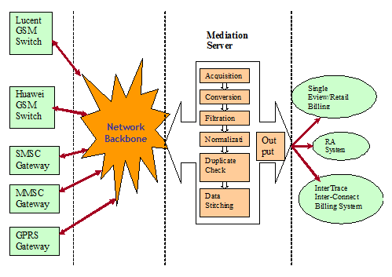
High-level interface between external systems and downstream applications
23 Feb 2009 IBM VODAFONE SPAIN

Slide 36
Entities in MedDy System
Network
Lucent
Huawei
MMSC
SMSC
Hardware Interfaces/Protocols
MedDy
Connection Manager
Scheduler
Data Collector
Reference Data
Usage Data
Conversion Adapters
Database
UI for Configuration
Filtering
Normalization
Reports
(Time Gap, Data Integrity etc)
Downstream Applications
23 Feb 2009 IBM VODAFONE SPAIN

Slide 37
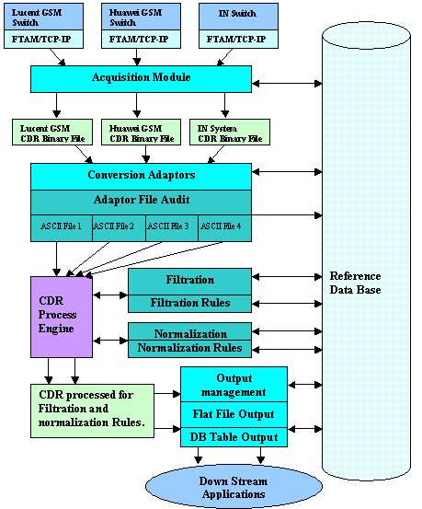
Mediation
Sub- System
Detailed Flow
23 Feb 2009 IBM VODAFONE SPAIN

Slide 38

Thanks
Notes:
IBM Confidential

