Slide 1
Mediation System
Session 3
(for Mobility Line of Business)
  Presenter:
  Date:
  Duration:
  Daljit Kaur
  May 28, 2009
  1 Day
Notes:
IBM Confidential

Slide 2
Agenda
Raw CDR
Converted CDR
Wireless Basic Record – Voice CDR
Wireless Auxiliary Record – SMS CDR
CDR Field Description
CDR Field Mapping
Partial CDR Aggregation
Duplicate CDR Detection
Filtration
Normalization
23 Feb 2009 IBM VODAFONE SPAIN
Notes:
IBM Confidential

Slide 3
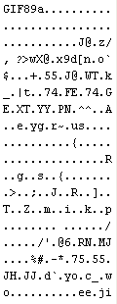
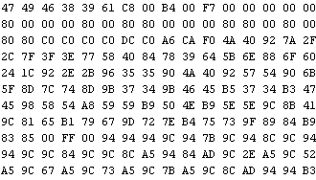
Raw CDR
Binary Format
30468223636B696E64657230312E6575726F70652E636F72702E6D6963726F736F66742E636F6D A01F06092B0601040182371901A012041063303530353634346161313364326338
Binary file in Hex Editor
ASN.1
23 Feb 2009 IBM VODAFONE SPAIN
Notes:
IBM Confidential

Slide 4
Converted CDR
CDR fields after Data Conversion :
122 aa 10 26997 02 404680000400887 35882200273625ff 919868392695ffffff 30032007 161422 0 00 ffffffffffffffffff 0 fffffffffffffff ffffffffffffffff 9313641477fffffffffffffffffffff 000020 03f2 30012 00 1 0 0 0 0 0 0 0000 00000 01385 1914 01 ffff ffff 0982 0543 03f2 753c 0000 0000 0 0 0560 0 0 000
23 Feb 2009 IBM VODAFONE SPAIN
Notes:
IBM Confidential

Slide 5
Processing Directories
While Collection
/xmeddy_data3/cdrs/acquiredcdrs/gsm/msc/lucent/kb
After Collection CDR - for processing
/xmeddy_data3/cdrs/Mediation/gsm/msc/lucent/kb/
After Conversion
/xmeddy_data3/cdrs/Mediation/Converted/gsm/msc/lucent/kb/
Output Directory for Retail billing
/xmeddy_data3/cdrs/Mediation/Retail_Billing/gsm/msc/lucent
23 Feb 2009 IBM VODAFONE SPAIN
Notes:
IBM Confidential

Slide 6
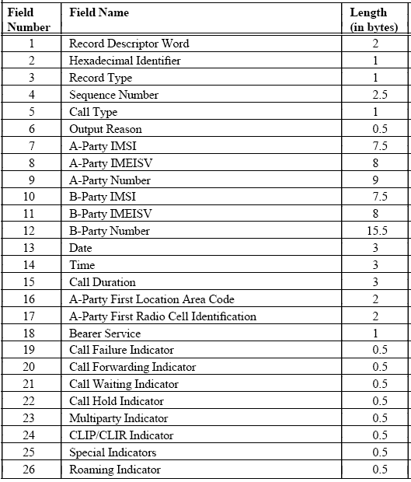
Wireless
Basic Record
23 Feb 2009 IBM VODAFONE SPAIN
Notes:
IBM Confidential

Slide 7
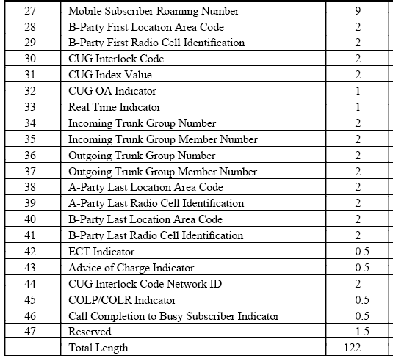
Wireless
Basic Record…
23 Feb 2009 IBM VODAFONE SPAIN
Notes:
IBM Confidential

Slide 8
CDR Field Description
Record Descriptor Word
122 = Length of Wireless Basic Record
282 = Length of Wireless IN/CAMEL Record
45 = Length of Wireless Supplementary Service Record
50 = Length of Wireless Auxiliary Service Record
Record Type
10 = Wireless Basic Record
20 = Wireless IN/CAMEL Record
30 = Wireless Supplementary Service Record
40 = Wireless Auxiliary Service Record
23 Feb 2009 IBM VODAFONE SPAIN
Notes:
IBM Confidential

Slide 9
CDR Field Description…
Hexadecimal Identifier
AA = Record does not contain characters known to be missing or in error
AB = Record contains one or more characters known to be missing or in error
Examination of this field provides quick indication of whether or not there
is a formatting error in any of the fields of the current record
Sequence Number
Running sequence number assigned by the Call Accounting system
23 Feb 2009 IBM VODAFONE SPAIN
Notes:
IBM Confidential

Slide 10
CDR Field Description…
Call Type
01 = Mobile-to-Mobile
02 = Mobile-to-Trunk
03 = Trunk-to-Mobile
04 = Trunk-to-Trunk (transit)
05 = Mobile Terminated Short Message Service (MT-SMS)
06 = Interrogation of the HLR
07 = Location update at the HLR
08 = Supplementary Service Action
09 = Mobile Originated Short Message Service (MO-SMS)
Output Reason
0 = Non-LDC record
1 = Initial LDC record
2 = Subsequent LDC record
3 = Final LDC record
4 = Unanswered Call
23 Feb 2009 IBM VODAFONE SPAIN
Notes:
IBM Confidential

Slide 11
CDR Field Description…
IMSI - International Mobile Subscriber Identity
MCC = Mobile Country Code
MNC = Mobile Network Code
MSIN = Mobile Station Identification Number
IMEISV - International Mobile Equipment Identity with Software Version
1-6 TAC = Type Approval Code
7-8 FAC = Final Assembly Code
9-14 SNR = Serial Number
15-16 SVN = Software Version Number
Valid digit range = 0 through 9
23 Feb 2009 IBM VODAFONE SPAIN
Notes:
IBM Confidential

Slide 12
CDR Field Description…
MS-ISDN Number
A-Party Number" in Wireless Basic and Wireless IN/CAMEL Records
Date
Format = YYMMDD
-For answered calls, set to date call was answered
-For unanswered calls, set to date record was generated
-For LDC records, set to date the current initial/subsequent period began
Time
Format = HHmmSS
-For answered calls, set to time call was answered
-For unanswered calls, set to time record was generated
-For LDC records, set to time the current initial/subsequent period began
23 Feb 2009 IBM VODAFONE SPAIN
Notes:
IBM Confidential

Slide 13
CDR Field Description…
Call Duration
Format = HHmmSS
For answered calls (non-LDC), set to elapsed time from answer to release
For LDC calls, set to elapsed time for that portion of the LDC call
Radio Cell Identification
bits 15-9 = Base Station Controller (BSC)
bits 8-4 = Radio Base Station (RBS)
bits 3-0 = Base Transceiver Station (BTS)
Bearer Service
00 = Speech
01 = Data call
02 = Group 3 Fax call
24 = Asynchronous 2400 bps data service
25 = Asynchronous 4800 bps data service
23 Feb 2009 IBM VODAFONE SPAIN
Notes:
IBM Confidential

Slide 14
CDR Field Description…
Call Failure Indicator
1 = Calling Party Clears
2 = Called Party Clears
3 = Abnormal Call Clearing
Call Forwarding Indicator
0 = Call Forwarding not invoked
1 = Call Forwarding Unconditional
2 = Call Forwarding No Reply
3 = Call Forwarding Busy
4 = Call Forwarding Mobile Subscriber Not Reachable
Call Waiting Indicator
0 = Call Waiting not invoked
1 Call Waiting invoked
23 Feb 2009 IBM VODAFONE SPAIN
Notes:
IBM Confidential

Slide 15
CDR Field Description…
Call Hold Indicator
0 = Call Hold not invoked
1 = Call Hold invoked by A-Party
2 = Call Hold invoked by B-Party
3 = Call Hold invoked by A-Party and B-Party
Multiparty Indicator
0 = Multiparty not invoked
1 = Multiparty invoked by A-Party
2 = Multiparty invoked by B-Party
3 = Multiparty invoked by A-Party and B-Party
CLIP/CLIR Indicator : Calling Line Identification Presentation / Restriction
0 = Neither CLIP nor CLIR invoked
1 = CLIP invoked
2 = CLIR invoked
3 = Both CLIP and CLIR invoked
23 Feb 2009 IBM VODAFONE SPAIN
Notes:
IBM Confidential

Slide 16
CDR Field Description…
Special Indicators
0 = Default
1 = Emergency Call
Roaming Indicator
0 = Not a roamer originator or roamer terminated mobile call
1 = Roamer originated mobile call
2 = Roamer terminated mobile call
Mobile Subscriber Roaming Number
- country code of the country in which the VLR is located
- national destination code of the visitor GSM PLMN ( Public Land Mobile Network ) or numbering area
- subscriber number with appropriate structure for that numbering area
23 Feb 2009 IBM VODAFONE SPAIN
Notes:
IBM Confidential

Slide 17
CDR Field Description…
CUG Interlock Code
Range 00000 through 65535
Every CUG within a network and the switch is identified by a unique interlock code.
Interlock code same for all members of the CUG.
CUG Index Value
Range 00000-32767
CUG Index is assigned by the administration for each CUG to which the user belongs. The index code has only a local meaning between the user and the serving switch.
CUG OA Indicator
0 = Closed User Group Outgoing Access not invoked
1 = Closed User Group Outgoing Access invoked
23 Feb 2009 IBM VODAFONE SPAIN
Notes:
IBM Confidential

Slide 18
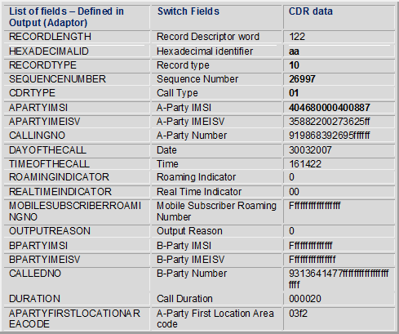
CDR Field Mapping
23 Feb 2009 IBM VODAFONE SPAIN
Notes:
IBM Confidential

Slide 19
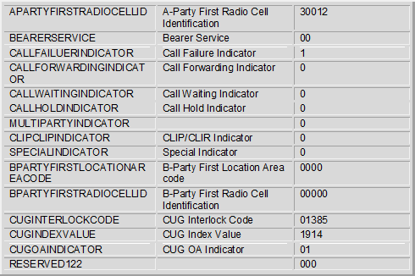
CDR Field Mapping…
23 Feb 2009 IBM VODAFONE SPAIN
Notes:
IBM Confidential

Slide 20
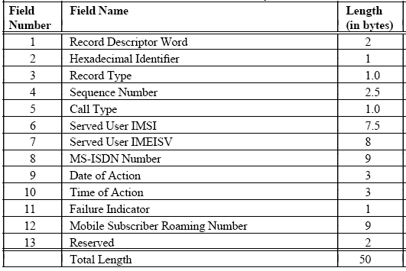
Wireless Auxiliary Service Record - SMS
23 Feb 2009 IBM VODAFONE SPAIN
Notes:
IBM Confidential

Slide 21
Sample SMS CDR
List of fields – Defined in Output (Adaptor) | Switch - Fields | CDR Data
RECORDLENGTH | Record Descriptor word | 050
HEXADECIMALID | Hexadecimal identifier | aa
RECORDTYPE | Record type | 40
SEQUENCENUMBER | Sequence Number | 08057
CDRTYPE | Call Type | 09
DAYOFTHECALL | Date of Action | 30032007
TIMEOFTHECALL | Time of Action | 155759
SERVEDUSERIMSI | Served User IMSI ( Sub requesting Service ) | 904686600122444
SERVEDUSERIMEISV | Served User IMEISV | 35538500522867ff
MSISDNNUMBER | MS-ISDN Number (B party No) | 919868199994ffffff
FAILUERINDICATOR | Failure Indicator | 00
MOBILESUBSCRIBERROAMINGNO | Mobile Subscriber Roaming Number (A Party Number ) | 919968232444ffffff
RESERVED50 | Reserved | 0000
23 Feb 2009 IBM VODAFONE SPAIN
Notes:
IBM Confidential

Slide 22
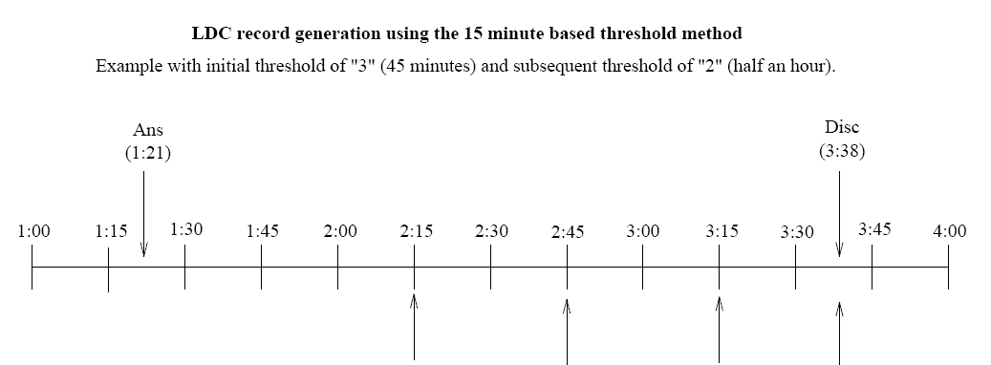




Partial CDR Aggregation
23 Feb 2009 IBM VODAFONE SPAIN
Notes:
IBM Confidential

Slide 23
Partial CDR Aggregation…
List of fields – Defined in Output (Adaptor) | Switch Manual – Fields | Initial LDC | Subsequent LDC | Subsequent LDC | Last LDC
RECORDLENGTH | Record Descriptor word | 122 | 122 | 122 | 122
HEXADECIMALID | Hexadecimal identifier | aa | aa | aa | aa
RECORDTYPE | Record type | 10 | 10 | 10 | 10
SEQUENCENUMBER | Sequence Number | 26997 | 26997 | 26997 | 26997
CDRTYPE | Call Type | 02 | 02 | 02 | 02
CALLINGNO | A-Party Number | 919868392695ffffff | 919868392695ffffff | 919868392695ffffff | 919868392695ffffff
DAYOFTHECALL | Date | 30032007 | 30032007 | 30032007 | 30032007
TIMEOFTHECALL | Time | 132100 | 141500 | 144500 | 151500
ROAMINGINDICATOR | Roaming Indicator | 0 | 0 | 0 | 0
REALTIMEINDICATOR | Real Time Indicator | 0 | 0 | 0 | 0
RESERVED45 | Reserved
OUTPUTREASON |  | 1 | 2 | 2 | 3
CALLEDNO
DURATION |  | 54 | 30 | 30 | 23
23 Feb 2009 IBM VODAFONE SPAIN
Notes:
IBM Confidential

Slide 24
Duplicate CDR Detection
List of fields – Defined in Output (Adaptor) | Switch Manual – Fields | CDR - 1 | CDR – 2
RECORDLENGTH | Record Descriptor word | 122 | 122
HEXADECIMALID | Hexadecimal identifier | aa | Aa
RECORDTYPE | Record type | 10 | 10
SEQUENCENUMBER | Sequence Number | 26997 | 26997
CDRTYPE | Call Type | 02 | 02
CALLINGNO | A-Party Number | 919868392695ffffff | 919868392695ffffff
DAYOFTHECALL | Date | 30032007 | 30032007
TIMEOFTHECALL | Time | 132100 | 141500
ROAMINGINDICATOR | Roaming Indicator | 0 | 0
REALTIMEINDICATOR | Real Time Indicator | 0 | 0
RESERVED45 | Reserved
OUTPUTREASON |  | 1 | 2
CALLEDNO |  | 9313641477fffffffffffffffffffff | 9313641477fffffffffffffffffffff
DURATION |  | 54 | 30
23 Feb 2009 IBM VODAFONE SPAIN
Notes:
IBM Confidential

Slide 25
Filtration Rules
S. No | Filtration Scenario | Configuration Rules | Description
1. | Mobile Originated Calls | If Call Type is equal to “01”(Mobile-To-Mobile) or “02”(Mobile-To-Trunk) then CDRs are provided to Retail Billing. | All the mobile originated call to be included
2. | Zero duration Calls | Duration is not equal to zero | Suppress zero duration calls
3. | Call Forwarding | If Call Forwarding Indicator =1
4. | Prepaid User CDRs. | If Record Type = 20
23 Feb 2009 IBM VODAFONE SPAIN
Notes:
IBM Confidential

Slide 26
Normalization Rules
S. No | Field Name | Normalization Rules Applied | Description
1. | TIMESTAMPDUP | substr(DAYOFTHECALL,1,2) || '-' || substr(DAYOFTHECALL,3,2) || '-' || substr(DAYOFTHECALL,5,4) || ' ' || substr(TIMEOFTHECALL,1,2) || ':' || substr(TIMEOFTHECALL,3,2) || ':' || substr(TIMEOFTHECALL,5,2) | Normalization of DAYOFTHECALL and TIMEOFTHECALL fields in the format of DD-MM-YYYY HH24:MM:SS
2. | APARTYNUMBER | CASE WHEN LENGTH(LTRIM(TRIM('f' FROM APARTYNUMBER),'0')) <=10 THEN '91' || LTRIM(TRIM('f' FROM APARTYNUMBER),'0') WHEN LENGTH(LTRIM(TRIM('f' FROM APARTYNUMBER),'0')) >10 THEN LTRIM(TRIM('f' FROM APARTYNUMBER),'0') END | Trailing ‘f’ is removed. Leading zero’s are removed. Normalization of APARTYNUMBER field into National Numbering format.
3. | CALLTYPE | DECODE(CALLTYPE,'01','101','02','102','103') | If CALLTYPE value is ‘01’ then print ‘101’ If CALLTYPE value is ‘02’ then print ‘102’ If CALLTYPE value is other than ‘01’ and ‘02’ then print ‘103’
4. | APARTYIMEISV | trim('f' from APARTYIMEISV) | Remove Leading and Trailing ‘f’ from A Party IMEISV
23 Feb 2009 IBM VODAFONE SPAIN
Notes:
IBM Confidential

Slide 27

Thanks
Notes:
IBM Confidential

