Slide 1


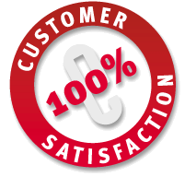
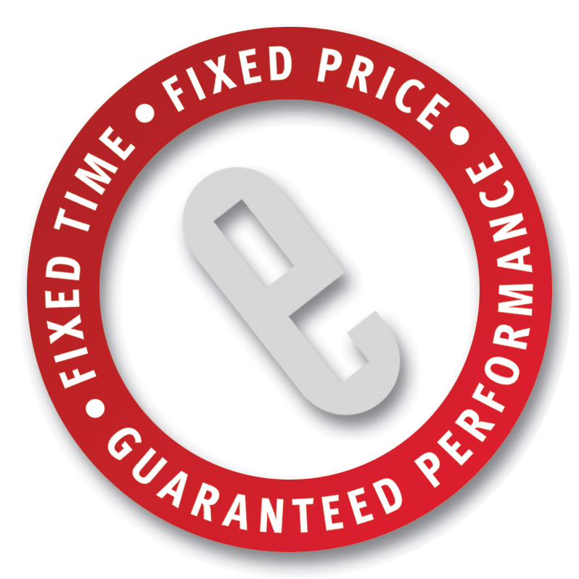
Service Oriented Architecture:
Planning and Implementation Best Practices
Innovate. Execute.TM
w w w . e f o r c e g l o b a l . c o m

Slide 2


Discussion Outline
eFORCE Introduction
Why You Might Be Interested
Service Oriented Architecture (SOA): What Is It, And Why Should You Care?
Moving Forward With SOA: Planning The Process
SOA Technology and Implementation: The Good, The Bad, And The Ugly
Case Study: Multinational Logistics
Q&A

Slide 3
eFORCE Background - Snapshot
Overview
Solutions and Services
IT Solution Projects for Global 2000 Since 1999
Offices in SF, LA, Denver, Dallas, Houston, Boston, NY/NJ, London, Calcutta, Chennai
Fixed-Price, Fixed-Time Specialists
Standards-Based Approach
Commitment to Customer Satisfaction
Enterprise Portals
Digital Information Management
Enterprise Application Integration
Customer Relationship Management
Enterprise Infrastructure
Creative Services
Managed Services, SQA
eFORCE Overview
Industries
Partners
Financial Services/Insurance
Publishing/Media and Entertainment
Telecommunications
Hi-Technology Manufacturing/Automotive
Life Sciences/Pharmaceutical
Energy/Oil and Gas
Application: Agentis Software, MatrixOne, Interwoven, Stellent, E.piphany, ATG, Vignette, Siebel Systems, Plumtree, SeeBeyond, BroadVision, Verity, webMethods, TIBCO
Infrastructure: Sun, Microsoft, Oracle, IBM, BEA
Hosting: Digex, NTT Verio

Slide 4





























eFORCE Clients (Partial List)

Slide 5
Discussion Outline
eFORCE Introduction
Why You Might Be Interested
Service Oriented Architecture (SOA): What Is It, And Why Should You Care?
Moving Forward With SOA: Planning The Process
SOA Technology and Implementation: The Good, The Bad, And The Ugly
Case Study: Multinational Logistics
Q&A

Slide 6

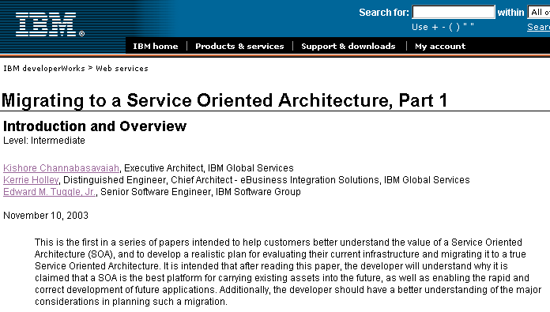
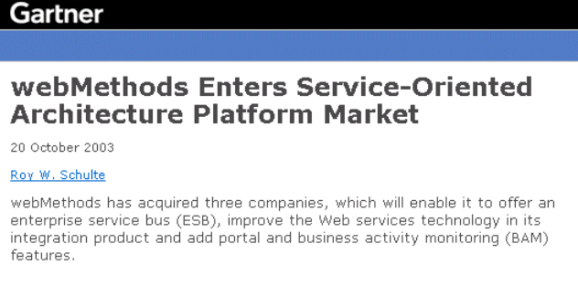
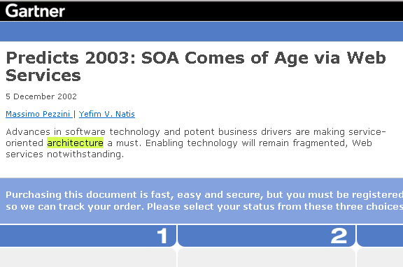
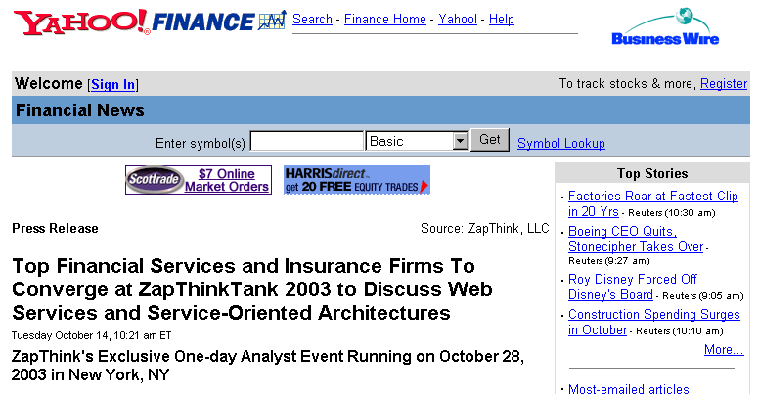
Why you might be interested…
“SOA” is showing up in the technical press
The "New Interwoven" the industry's only next-generation Enterprise Content Management (ECM) platform…on the industry's only Service-Oriented Architecture. - Martin Brauns, CEO

Slide 7
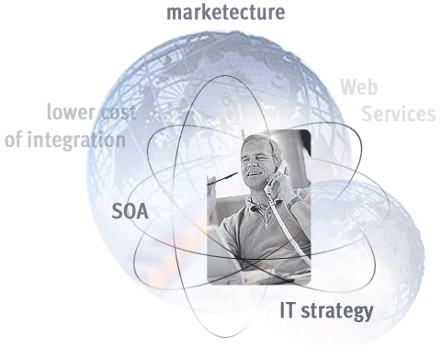
Why you might be interested…
If you are a CIO, CTO or Architect
Working on IT strategy which delivers a message promising:
  support for breakthrough innovation
  lower cost of integration
Looking for an innovative new approach
to your critical business processes
Wondering if SOA is right for your
organization, program or project
Wondering if your organization has
the skills to deliver a new solution
Worried about choosing the best,
highest-performing, most
manageable technology base on
which to implement SOA
shorter development cycles
more flexibility

Slide 8
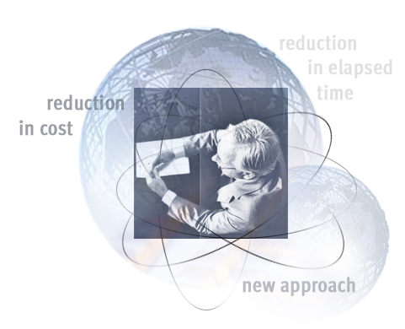
Why you might be interested…
If you are a Project Manager
Need order-of-magnitude reduction in cost of operation only available through loose coupling of systems
Need order-of-magnitude reduction
in elapsed time and labor
hours to handle error & exception processes
Need more flexibility in scheduling evolution and growth of business systems

Slide 9
Why you might be interested…
If you are in Operations and Support
Need to be able to diagnose and resolve problems more effectively
Need more flexibility in system deployment and maintenance
Need improved monitoring for fault detection, SLA conformance
Need to be able to perform more effective load balancing across systems and sites

Slide 10
Discussion Outline
eFORCE Introduction
Why You Might Be Interested
Service Oriented Architecture (SOA): What Is It, And Why Should You Care?
Moving Forward With SOA: Planning The Process
SOA Technology and Implementation: The Good, The Bad, And The Ugly
Case Study: Multinational Logistics
Q&A

Slide 11
What is it ?…
What is a Service?
A unit of work done by a service provider to achieve desired end results for a service consumer. The results of a service are usually the change of state for the consumer but can also be a change of state for the provider or for both
Benefit: Loose coupling between the participating software agents, enabled by:
  A small set of simple and ubiquitous interfaces.
  Descriptive messages constrained by an extensible schema delivered through the interfaces. None, or only minimal, system behavior is prescribed by messages.
  Extensibility
  Service discovery
Focus on exposing business functions, not technology

Slide 12
What is it ?…
What is Service Oriented Architecture?
A Service-Oriented Architecture (SOA) is a way of designing a software system and its surrounding environment to provide services either to end-user applications, to executable business processes or to other services through published and discoverable service interfaces.
Benefits:
  Loose coupling among interacting software agents
  A mechanism for integrating software components on dissimilar platforms
  Supports non-intrusive reuse of software components in ways not specifically predicted at development time
  Can enable easier insourced/outsourced development by breaking systems down into smaller chunks

Slide 13
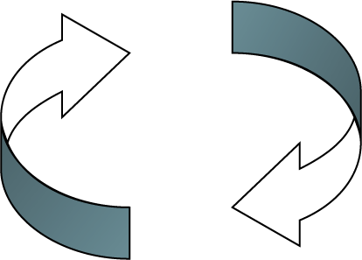
What is it ?…
The Service Oriented Architecture
Service
Broker
Company A
Company B
Discover
Publish
Application A
Application B
ObjectA
-----------------------------
-----------------------------
----------------------------
---------------------------
Service
Interface
ObjectB
------------
------------
------------
------------
New? No
Rocket science? Not really
A change in thinking? Most definitely!
Can you run right out and buy one? Well…..

Slide 14

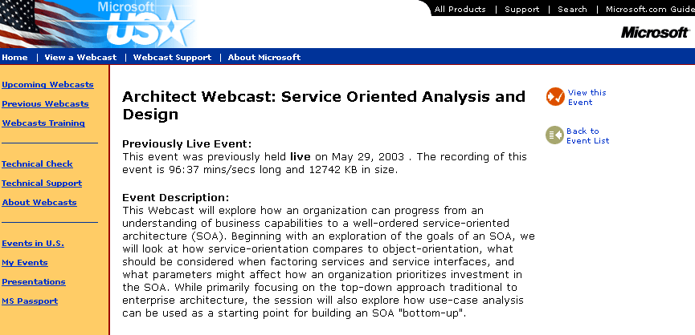
What is it ?…
Not quite Zen, but…
Applications or Services
Services
Services
Locator
It’s an architectural
concept, not a
shrink-wrapped product…
Services
Requestor
Services
Broker
Services
Provider
…with immense industry support in the form of
standards and products, and momentum is growing

Slide 15
What is it ?…
Where Do Web Services Play?
Web Services are a great way to realize SOA, within limits
BUT, despite what the press might have you believe…
  Web Services are only ONE way to accomplish the goal
  If not implemented correctly – and in the right context – Web Services can create new problems
  Some challenges that Web Services are still struggling with have already been solved in other technologies
SOA can be implemented using more than just Web Services… including some technologies you probably already have

Slide 16
Discussion Outline
eFORCE Introduction
Why You Might Be Interested
Service Oriented Architecture (SOA): What Is It, And Why Should You Care?
Moving Forward With SOA: Planning The Process
SOA Technology and Implementation: The Good, The Bad, And The Ugly
Case Study: Multinational Logistics
Q&A

Slide 17

Planning the Process…
#1: Understand Your Motivations
SOA can help an organization save money and react to market forces faster… but it’s not a “slam-dunk”
If your motivation is… | Then you’re likely to be…
Greater software development and deployment responsiveness | Pleased as punch, once the SOA reaches critical mass
Massive component reuse | Slapping yourself in the head
Significant cost savings | Digging into your pockets in the short term, but whistling “We’re In The Money” in the longer term
Stay at the forefront of technology, and find new ways of leveraging technology for business benefit | One happy camper

Slide 18
Planning the Process…
#2: Take a Multi-Dimensional View
Architecting around the “services” concept requires a long-view approach
Unless you’re fortunate enough to be in an IT-driven organization, plan on explaining to The Business why SOA is a good thing
Plan on identifying what systems own what functions and what data: Business Domain Model
Define your technology standards, and use them consistently
Defining rules governing the scope of services and components is a non-trivial task
How do you define business process as services – BPM/Workflow?
Hard-coded?
The care and feeding of SLAs
Think about SOA during the product procurement process
Security, transactionality and exception handling can be thorny issues

Slide 19
Planning the Process…
#2: Take a Multi-Dimensional View (cont’d.)
Remember Your Friends
These teams need to be involved:
  Computer Operations
  Physical Architecture (both systems and network)
  Technical Support
  Customer Support
  Business and Systems Analysts
  Disaster Recovery and Business Continuity Planning Team
  Performance Analysts and Capacity Planners
Development staff training - not just technology, but thought patterns as well

Slide 20
Planning the Process…
#3: Beware disappointment born of 2 vocabularies
SOA design involves two orthogonal vocabularies: business and technology … beware of misunderstandings in early efforts
To avoid disappointment with design deliverables, stick to well-defined terms and graphics within UML and be explicit about the difference between ‘Logical Business View’ and ‘Logical Technical View’
Professional Services groups within hardware companies tend to deliver ‘Logical View’ that is a Bill-of-Materials and generic technical description of node interaction. This can be useful but may be disappointing if you expected to see business vocabulary
Semantic gaps are common in pre-implementation deliverables definition

Slide 21
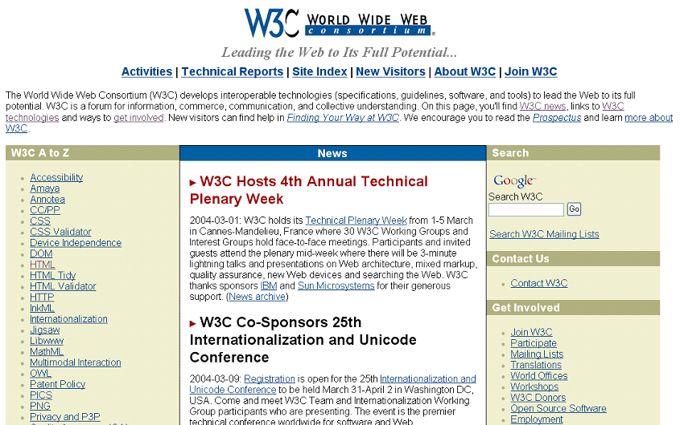


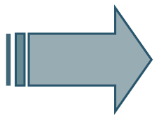
Planning the Process…
#4: One Step At A Time
Don’t lay the foundation and construct the building at the same time
Service Layer
Component Layer
Object/Class Layer
Standards
Products
Implementation

Slide 22
Planning the Process…
#5: Services are a new Architectural Layer
There are many prerequisites to ‘Services’, but, you can start with a narrow point-of-view in your first build
Without a Component-Oriented Architecture and administrative control in place, ‘Services’ will grow unchecked; long-chain processes needed to support ‘Services’ will be super-brittle
Don’t stifle experimentation in an ‘Early Learning’ stage, but be prepared to add administrative functions. Remember how client/server changed the role of the Corporate Data Modeler
A business function view is required to partition complexity and responsibility for data (‘System-of-record’) and business rules. This view will not look like your organization chart. There are many important standards here
Reuse in OO from good class hierarchy; reuse in SOA from good Process/Service composition
Service Layer
Component Layer
Object/Class Layer

Slide 23
Discussion Outline
eFORCE Introduction
Why You Might Be Interested
Service Oriented Architecture (SOA): What Is It, And Why Should You Care?
Moving Forward With SOA: Planning The Process
SOA Technology and Implementation: The Good, The Bad, And The Ugly
Case Study: Multinational Logistics
Q&A

Slide 24

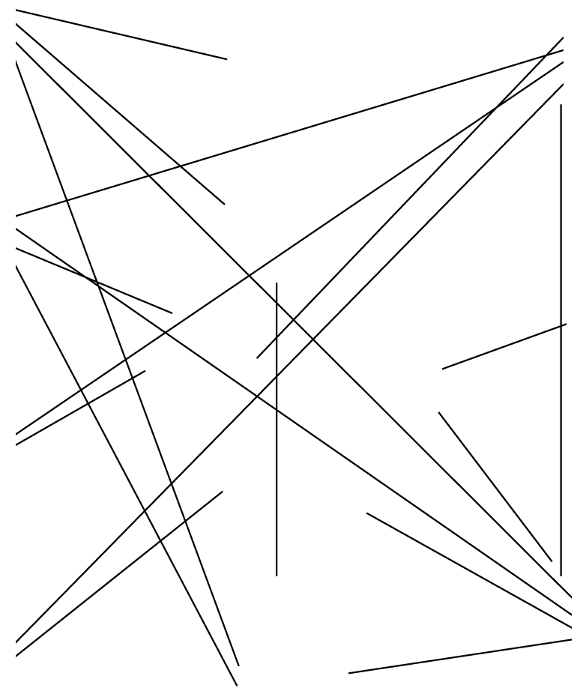

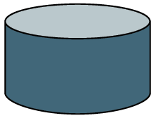
Service Oriented Architecture: The Good, Bad and Ugly
The Two Faces of Integration
Customers
Enterprise
Customer
Services
Management
Finance
Partners
Operations
HR
Suppliers
Billing
Business
Development
Procurement
Marketing

Slide 25









Service Oriented Architecture: The Good, Bad and Ugly
The Two Faces of Integration
Customers
Enterprise
Customer
Services
Management
Finance
Partners
Operations
HR
Suppliers
Billing
Business
Development
Procurement
Marketing

Slide 26
Service Oriented Architecture: The Good, Bad and Ugly
External Integration Infrastructure Checklist
Web Services infrastructure
  UDDI directory and WSDL service definitions
  Services, with associated firewalls, proxies, web servers and application servers
  Make sure customers have the ability to load balance and have redundant services available
Security, in the form of:
  X.509 certificates and associated infrastructure, especially “user” identity management
  SSL/TLS connectivity (hardware accelerators, etc.)
  Message encryption/decryption facilities
Services management and operational monitoring
Business process facilities for request validation and routing

Slide 27
Service Oriented Architecture: The Good, Bad and Ugly
Internal Integration Infrastructure Checklist
All of the above, plus more…
Think about EAI/messaging as a transactional service invocation transport
Consider:
  network and hardware implications
  fault tolerance facilities
  geographic distribution and load balancing
  disaster recovery and business continuity

Slide 28
Service Oriented Architecture: The Good, Bad and Ugly
SOA Implementation Checklist
Business domain model – allocation of responsibility
Technology standards and development guidelines
  Transaction taxonomy
  Generic service invocation with back-end routing based on requests
  Error and exception handling
  Service scoping guidelines, to maximize use by both systems and business processes, and re-use by developers
Service directory – is UDDI always the right approach?
Service “layering”
  On top of COTS or bespoke systems – hide system implementation details
  On top of each other – coarse-grained services lead to finer-grained re-usable components
  Determine the best way to support multiple instances of a service
  Don’t focus so much on “infrastructure” services (e.g., XML parsing, etc.)
Service level agreements

Slide 29
Discussion Outline
eFORCE Introduction
Why You Might Be Interested
Service Oriented Architecture (SOA): What Is It, And Why Should You Care?
Moving Forward With SOA: Planning The Process
SOA Technology and Implementation: The Good, The Bad, And The Ugly
Case Study: Multinational Logistics
Q&A

Slide 30
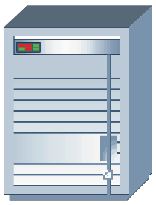
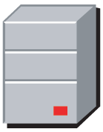






Case Study: Multinational Logistics Corporation
Example: Logical Architecture
Presentation Layer
Business Process Layer
Business Logic Layer
Data
Layer
Business
Process
Data
Service Provider
System of
Record
Business
Process
Business
Process
Business
User
Data
Database of Record
User
Interface
Service Provider
System of
Record
?
Business
Process
Data
STOP
Service Provider
System of
Record
Business-Function Oriented View
Invokes 0, 1 or Many Services to Accomplish Work
Provides Services and Accompanying Business Logic and Data
Synchronizes Business Systems at Data Level

Slide 31
Discussion Outline
eFORCE Introduction
Why You Might Be Interested
Service Oriented Architecture (SOA): What Is It, And Why Do You Care?
Moving Forward With SOA: Planning The Process
SOA Technology and Implementation: The Good, The Bad, And The Very, Very Ugly
Case Study: Multinational Logistics
Q&A

Slide 32


Slide 33
Service Oriented Architecture
Innovate. Execute.TM
w w w . e f o r c e g l o b a l . c o m

