Slide 1
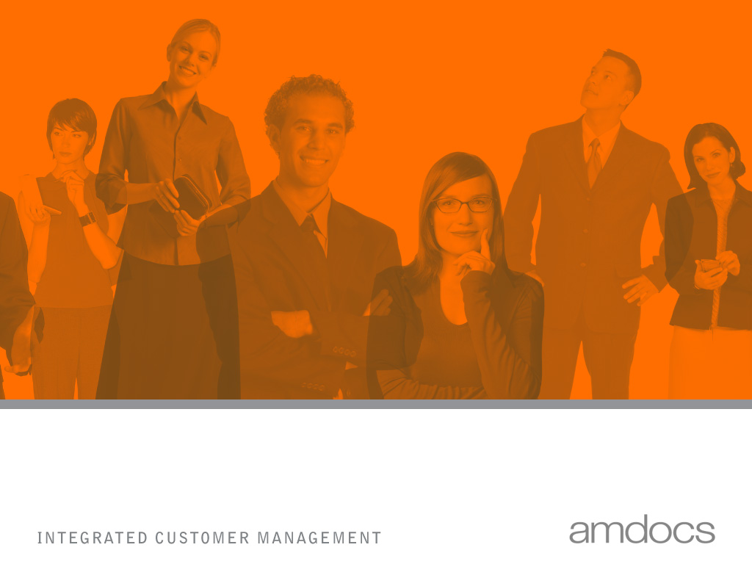
© 2004 - Proprietary and Confidential Information of Amdocs
eTOM
Enhanced Telecom Operations Map
Deodatta Natekar
25-Jan-08
1
Notes:
refined, purified, condensed / לזקק, להתפיל; לטפטף

Slide 2
TMF

Slide 3
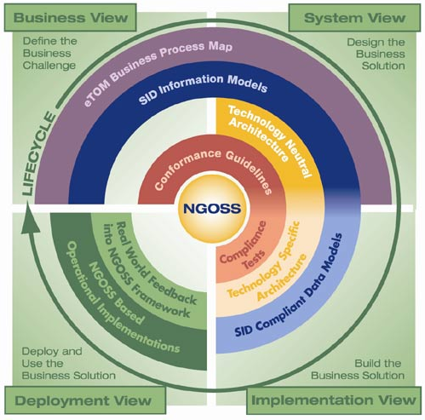
eTOM – The Big Picture New Generation Operations Systems and SW (NGOSS)
A particular strength of eTOM as a business process framework is that it is a part of the TMF NGOSS initiative (represent its business view) and links with other work underway in NGOSS (work in progress)

Slide 4
eTOM: The Need
Customers’ increasing demands for superior services and to stiffer competition leads SPs to market’s expansion beyond their self-contained boundaries
In-spite of different regulatory environment, business strategies and competitive approaches, there are common characteristic:
Dependency on effective info Mngt to remain competitive
Adopting a service Mngt approach to business/NW run
Moving towards a customer point of view - E2E BP approach
Automation of processes across operations
Need to integrate new BSSs/OSSs with legacy systems & old technologies with new ones
Focus on data services offerings
Emphasis on “Buy” rather on “Build” approach (integrate multiple suppliers)
Notes:
Customers’ increasing demands for superior services and to stiffer competition leads SPs to market’s expansion beyond their self-contained boundaries and as a result their business relationship are broadened
Emphasis on “Buy” rather on “Build” approach (integrate multiple suppliers)
DWDM (Dense Wavelength Division Multiplex) טכנולוגיית שידור נתונים בגלי אור דרך סיבים אופטיים (לכל סיגנל אורך גל-אור משלו - ניתן להעביר עד 80 ערוצים שונים על סיב אופטי יחיד) –
• technology for transmitting data by light waves via optical fibers (each signal is sent on its own wavelength - up to 80 channels can be sent through a single optical fiber). Dense Wavelength Division Multiplexing is an optical technology used to increase bandwidth over existing fiber optic backbones. DWDM works by combining and transmitting multiple signals simultaneously at different wavelengths on the same fiber.

Slide 5
What is eTOM?
A telecommunications Service Provider process framework,
Based on members’ contribution - Represents industry-consensus on SP processes
Provide a standard structure, terminology and classification scheme.
Offer a foundation to the development of business process and enable consistent E2E process flows to be created and enables re-use.
Represent the basis for understanding and managing portfolios of IT applications in terms of business process
Notes:
* Consistent in terms of framework, hierarchy, terminology

Slide 6
eTOM – What Is It Not?
eTOM does not seek to constrain:
Organization
Differentiation
Implementation
eTOM is a framework for defining your own processes, not the final answer itself!
It is not a methodology
It is not a set of system specifications
It is not a ready made service provider business model
Therefore, eTOM must be tailored/ extended for individual companies
Notes:
Org – structure
Diff – go to market strategies
Imp – business policies, work flows
Not ready made Bus model–BP links, Coverage, order of flows, etc – must be defined locally

Slide 7
eTOM – Key Concepts Horizontal layers
Product: External Marketing View
Market/Sales, Product and Customer
Service
Service & Resource: Internal Engineering View
Resource
(Application, Computing and Network)
Supplier/Partner
Supplier/Partner
Enterprise
Notes:
The Market, Product and Customer processes include those dealing with sales and channel/Mrkt & Product & Offer management, as well as Operational processes such as managing the Customer’s interface, ordering, problem handling, SLA Management and billing. (see Ops BP level 2 on this horizontal layer).
Service processes include BP dealing with service development and delivery of service capability: examples of Ops level 2 BP: service configuration, service problem management and quality analysis, and rating.
Example of a service :- " Web HOSTING SERVICES“ OR “MVNO services”.
Product - is before sales process
Service - is the install base of products after the sales process. Therefore more in CRM/SM area.
Service is managed while Product is "sold" as per traditional Telcos.
Product: how the end customer view/perceive the product he/she bought
Services: the elements one use to configure & create products & bundles
Resource processes include those dealing with development and delivery of resources (NW & IT) infrastructure, and it’s operational Mngt including aspects such as provisioning, trouble Mngt and performance Mngt. Recourse infrastructure supports products and services as well as supporting the enterprise itself. - Resources: NW, Infrastructure, equipment
The Supplier/Partner processes include those dealing with the enterprise interaction with its suppliers and partners. This involves both processes that develop & manage the Supply Chain that underpins product and infrastructure, as well those that support the Operations interface with its suppliers and partners.

Slide 8
eTOM BP Framework - Conceptual Structure Interaction With Major Entities - Level 0
Customer
Strategy,
Infrastructure &
Product
Operations
Sell Side
Market, Product and Customer
Service
Resource
(Application, Computing and Network)
External environment
Supplier/Partner
Buy Side
Suppliers/Partners
Enterprise Management
Shareholders
Employees
Other Stakeholders
Notes:
Customers, the focus of the business! to whom service is provided to i.e., products sold by the enterprise:!
Suppliers, who provides resources or other capabilities, bought or used by the enterprise directly or indirectly to support its business
Partners, with whom the enterprise co-operates in a shared area of business
Employees, who work for the enterprise to pursue its business goals
Shareholders, who have invested in the enterprise and thus own stock
Stakeholders, who have a commitment to the enterprise other than through stock ownership.

Slide 9
eTOM Business Process Framework – SIP - Level 0
Customer
Strategy, Infrastructure & Product
Operations
Processes involved with strategic planning, infrastructure, product lifecycle management and supply chain relationships in support of the enterprise’s operations
Suppliers/Partners
Enterprise Management
Shareholders
Employees
Other Stakeholders
Notes:
The Strategy, Infrastructure & Product Process Area includes processes that develop strategy, commit to the firm, build infrastructure, develop and manage products, and that develop and manage the Supply Chain. In the eTOM, infrastructure refers to more than just the IT and resource infrastructure that supports products and services. It includes the infrastructure required to support functional processes, e.g., CRM. These processes direct and enable Operations.

Slide 10
eTOM Business Process Framework – Enterprise - Level 0
Customer
Strategy, Infrastructure & Product
Operations
Suppliers/Partners
Covering corporate or business support Mngt
Enterprise Management
Shareholders
Employees
Other Stakeholders
Notes:
Corporate functions that focus on Enterprise level processes to run the business: interfaces with almost all processes in the Enterprise
The Enterprise Management Process Area includes basic business processes required to run any business. These processes focus on Enterprise Level processes, goals and objectives. These processes have interfaces with almost every other process in the enterprise whether operational or product or infrastructure processes. These are sometimes considered corporate functions and/or processes, e.g., Financial Management, Human Resources Management processes, etc.
The enterprise co-operates in a shared area of business
Employees, who work for the enterprise to pursue its business goals
Shareholders, who have invested in the enterprise and thus own stock
Stakeholders, who have a commitment to the enterprise other than through stock ownership.
Amdocs security Mngt, Amdocs monitoring & control, Amdocs Process Mngt, Amdocs error Mngt – effectiveness processes
Fraud – Fraud Mngt

Slide 11
eTOM Business Process Framework – Operations - Level 0
Customer
Strategy, Infrastructure & Product
Operations
Covering the Core of operational Mngt.
Processes that support the customer’s operations and management of services. These processes include both day-to-day and operational support & readiness processes
Suppliers/Partners
Enterprise Management
Shareholders
Employees
Other Stakeholders
Notes:
The Operations
Process Area is the heart of eTOM.
In addition to operations & management support , it enable direct customer operations with the customer.
In addition to support & readiness of the 4 layers (customers, services, resources & supplier/partner) The eTOM view of Operations also includes sales management.

Slide 12
The eTOM Level 1: The Big Picture Vertical vs. Horizontal Grouping
Customer
Customer
Strategy, Infrastructure & Product
Strategy, Infrastructure & Product
Operations
Operations
Strategy &
Strategy &
Product
Product
Operations
Operations
Fulfillment
Fulfillment
Assurance
Assurance
Billing
Infrastructure
Billing
Infrastructure
Commit
Commit
Lifecycle
Lifecycle
Support &
Lifecycle
Support &
Lifecycle
Management
Management
Readiness
Management
Readiness
Management
Marketing & Offer Management
Marketing & Offer Management
Customer Relationship Management
Customer Relationship Management
Service Development & Management
Service Development & Management
Service Management & Operations
Service Management & Operations
Resource Development & Management
Resource Development & Management
Resource Management & Operations
Resource Management & Operations
Supply Chain Development & Management
Supply Chain Development & Management
Supplier/Partner Relationship Management
Supplier/Partner Relationship Management
Supplier/Partner
Supplier/Partner
Enterprise Management
Enterprise Management
Knowledge & Research
Strategic &
Knowledge & Research
Strategic &
Enterprise Risk
Enterprise Risk
Enterprise Effectiveness
Enterprise Effectiveness
Management
Enterprise Planning
Management
Enterprise Planning
Management
Management
Management
Management
Stakeholder & External Relations
Stakeholder & External Relations
Human Resources
Financial & Asset
Human Resources
Financial & Asset
Management
Management
Management
Management
Management
Management
Shareholders
Shareholders
Employees
Employees
Other Stakeholders
Other Stakeholders
Notes:
Horizontal – functional grouping, please note that horizontals are in line with the conceptual level i.e. Service is the union of Service Development & Management + Service Management & Operations
Vertical – End-to-End grouping
eTOM provides the Business View for NGOSS

Slide 13
Level 1 Processes - Vertical
Fulfillment: Provides customers with their requested products in a timely and correct manner
Assurance: Executes proactive and reactive. maintenance activities to ensure that services provided are available and performing to SLA / QoS levels
Billing: Collects usage records and Produces timely and accurate bills for providing pre-bill/bill info and for processing and collecting payments, and handles billing enquiries
Operations Support & Readiness: The processes are concerned with activities that are less "real-time" than those in FAB, and which are typically concerned less with individual customers and services and more with groups of these and ensuring effective run of the vertical processes.
Customer
Customer
Operations
Operations
Operations
Operations
Fulfillment
Fulfillment
Assurance
Assurance
Billing
Billing
Support and
Support and
Readiness
Readiness
Responsible for providing management, logistics and admin supports for FAB processes and ensuring its operational readiness
“FAB” (Fulfillment, Assurance, Billing) is the core of the Operations area
Notes:
Fulfillment: this process is responsible for providing customers with their requested products in a timely and correct manner. It translates the customer's business or personal need into a solution, which can be delivered using the specific products in the enterprise’s portfolio. These processes informs the customers of the status of their purchase order, ensures completion on time, as well as a delighted customer.
Assurance: this process is responsible for the execution of proactive and reactive maintenance activities to ensure that services provided to customers are continuously available and to SLA or QoS performance levels. It performs continuous resource status and performance monitoring to proactively detect possible failures. It collects performance data and analyzes them to identify potential problems and resolve them without impact to the customer.
Billing: this process is responsible for the production of timely and accurate bills, for providing pre-bill use information and billing to customers, for processing their payments, and performing payment collections. In addition, it handles customer inquiries about bills, provides billing inquiry status and is responsible for resolving billing problems to the customer's satisfaction in a timely manner. This process also supports prepayment for services.
Operations Support & Readiness: this process is responsible for support to the “FAB” processes, and for ensuring operational readiness in the fulfillment, assurance and billing areas. In general, the processes are concerned with activities that are less “real-time” than those in FAB, and which are typically concerned less with individual customers and services and more with groups of these.
They reflect a need in some organizations to divide their processes between the immediate customer-facing and real-time operations of FAB and other Operations processes which act as a “second-line” in carrying out the operational tasks.

Slide 14
CRM Processes Level 1 - 2
Customer Relationship Management processes considers the fundamental knowledge of customers needs and includes all functionalities necessary for the acquisition, enhancement and retention of relationship with a customer.
Operations
“FAB”
Operations
Fulfillment
Assurance
Billing
Support &
Readiness
Customer Relationship Management
Service Management & Operations
Level 2
Resource Management & Operations
(Application, Computing and Network)
CRM Support & Readiness
Customer Interface Management
Marketing Fulfillment Response
Selling
Order handling
Supplier/Partner Relationship Management
Problem handling
Customer QoS/SLA Mngt
Billing & Collection Mngt
Retention & Loyalty
Notes:
Customer Relationship Management (CRM): this process grouping considers the fundamental knowledge of customers needs and includes all functionalities necessary for the acquisition, enhancement and retention of a relationship with a customer.
It is about customer service and support in all channels - whether storefront, telephone, web or field service.
it is also about retention management, cross-selling and up-selling, and direct marketing for the purpose of selling to customers.

Slide 15
SM&O Processes Level 1 - 2
Operations
“FAB”
Service Management & Operations processes focuses on the knowledge of services (Access, Connectivity, Content, etc) and includes all functionalities necessary for the Mngt and operations of communications and information services required by or proposed to customers
Operations
Fulfillment
Assurance
Billing
Support &
Readiness
Customer Relationship Management
Service Management & Operations
Resource Management & Operations
(Application, Computing and Network)
Level 2
Supplier/Partner Relationship Management
SM&O Support & Readiness
Service Configuration & Activation
Service Problem Mngt
Service Quality Mngt
Service & Specific Instance rating
Notes:
Service Management & Operations (SM&O): this process grouping focuses on the knowledge of services (Access, Connectivity, Content, etc.) and includes all functionalities necessary for the management and operations of communications and information services required by or proposed to customers.
The focus is on service delivery and management as opposed to the management of the underlying network and information technology.

Slide 16
RM&O Processes Level 1- 2
Resource Management & Operations: handles resources (application, computing and network infrastructures) utilized to deliver and support services required by or proposed to customers.
Operations
“FAB”
Operations
Fulfillment
Assurance
Billing
Support &
Readiness
Customer Relationship Management
Service Management & Operations
Level 2
Resource Management & Operations
(Application, Computing and Network)
RM&O Support & Readiness
Resource Provisioning
Resources Data Collection & Processing
Resource trouble Management
Resources Performance Management
Supplier/Partner Relationship Management
Notes:
Resource Management & Operations (RM&O): this process grouping maintains knowledge of resources (application, computing and network infrastructures) and is responsible for managing all these resources utilized to deliver and support services required by or proposed to customers. It also includes all functionalities responsible for the direct management of all such resources (network elements, computers, servers, etc.) utilized within the enterprise.

Slide 17
S/PRM Processes Level 1 - 2
Supplier/Partner Relationship Management: supports the core operational processes, both instance (Vertical) & functional (Horizontal) FAB processes, through interaction with external suppliers and/or partners. These Processes are closely aligned with S/PRM CRM processes
Operations
“FAB”
Operations
Fulfillment
Assurance
Billing
Support &
Readiness
Customer Relationship Management
Service Management & Operations
Level 2
Resource Management & Operations
S/PR support & Readiness
S/P Requisition Management
S/P Interface Management
S/P Problem Reporting and Management
(Application, Computing and Network)
Supplier/Partner Relationship Management
S/P Performance Management
S/P settlements & Billing Management
Notes:
Supplier/Partner Relationship Management (S/PRM): this process grouping supports the core operational processes, both the customer instance processes of Fulfillment, Assurance and Billing and the functional operations processes. Supplier/Partner Relationship Management (S/PRM) processes align closely with a supplier’s or partner’s Customer Relationship Management processes.

Slide 18
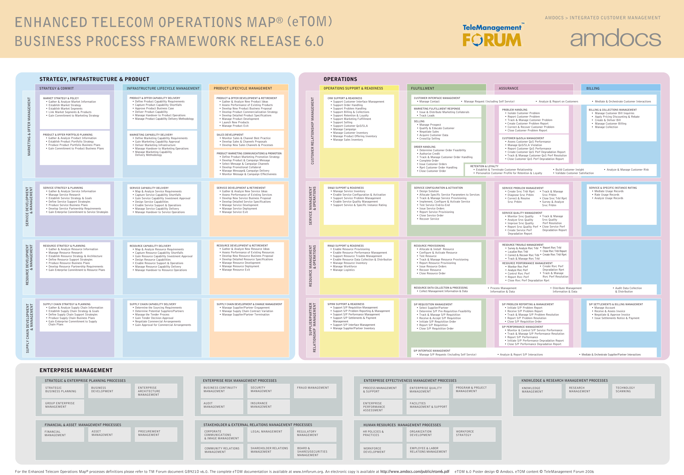
eTOM Map: All Levels
eTOM is a structured catalogue of process elements, which can be viewed in different levels of decompositions and point of view.
Horizontal – functional grouping.
Vertical – End-to-End grouping

Slide 19
eTOM: What is it used for?
Provides business-oriented view
Useful for planners/ managers/ strategists
Emphasizes structure/ process components/ process interactivity/ roles/ responsibilities
Sets requirements for (but is neutral towards) system solution/ architecture/ technology/ implementation and support requirements Mngt

Slide 20
Areas Of eTOM Application
Process Flow, Events
Process Re-engineering/ Alignment/Metrics**
System & Data
IT Requirements
IT alignment
IT Re-use
Managing Operational Workflows
Managing Automation
eTOM Level 3
Financial
Activity Base Mngt
Activity Framework
Business Rules
Consistent Application
Managing Operational Costs
Operational Constrains & Directions
“Activities We Do”
People
Org alignment & Re-arrangement
Business Strategy Initiatives
Cohesive Enterprise programs
Organization Structure & KPIs
Operational Drivers
Notes:
**Assist Sis sigma –
One of org methodologies for process design.
Based on construct improvement teams working in the business to reduce the variance in processes and to ensure efficiency & effectiveness

Slide 21
In Summary:
eTOM sets a vision for the industry to enable it to compete successfully through the implementation of business process-driven approaches to managing the enterprise
The focus is on the enterprise BP, the linkage between them, the identification of interfaces and the use of customer, service, resource, supplier/partner and other information by multiple processes
eTOM uses hierarchical decomposition approach to structure the BP definitions & its analysis framework
The framework can be used to analyze current/future BP (description, not flows!) and identify duplications, gaps, needed interactions with partners, etc, and therefore speed up the overall design and reduce variance. It can also support assessing the value, cost and performance of BP

Slide 22
Thank You

