Slide 1

©Taxmann/Dr. Vinod K. Singhania
Taxmann’s
TAX PAYERS’ PRESENTATION
RETURN OF INCOME
[ITR - 1]
By
Dr. Vinod K. Singhania

Slide 2
Form ITR - 1
INDIAN INCOME TAX RETURN
[For individuals having income from salary/ pension/ family pension and interest]
©Taxmann/Dr. Vinod K. Singhania

Slide 3
Points to be noted while filing ITR-1 in paper format
No document (including TDS certificate) should be attached to this form.
Please fill acknowledgement slip and then submit the return.
The return form is not required to be filed in duplicate.
©Taxmann/Dr. Vinod K. Singhania

Slide 4
Modes of filing Income-tax return ITR-1
Mode of filing | Acknowledgment slip | ITR-V
Paper Form | ✓ | ⎯
E-filing without DSC | ⎯ | ✓
Bar Code Return | ✓ | ⎯
E-filing with DSC | ⎯ | ⎯
©Taxmann/Dr. Vinod K. Singhania

Slide 5
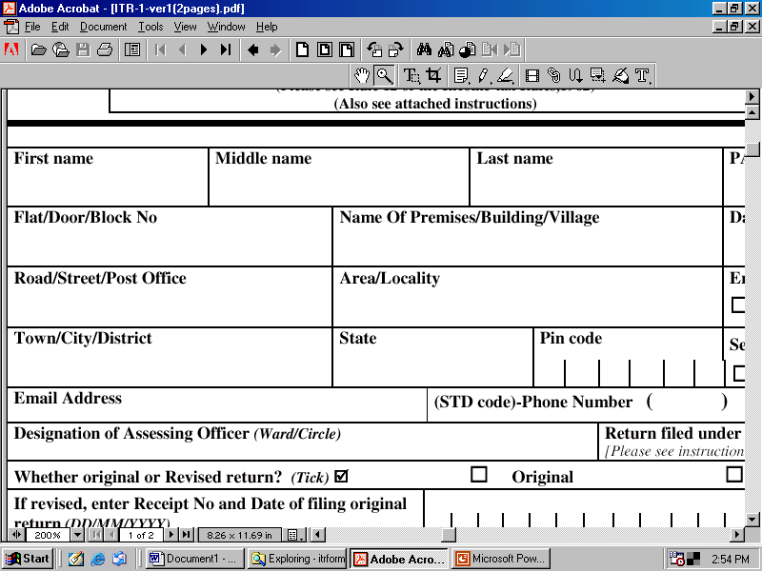
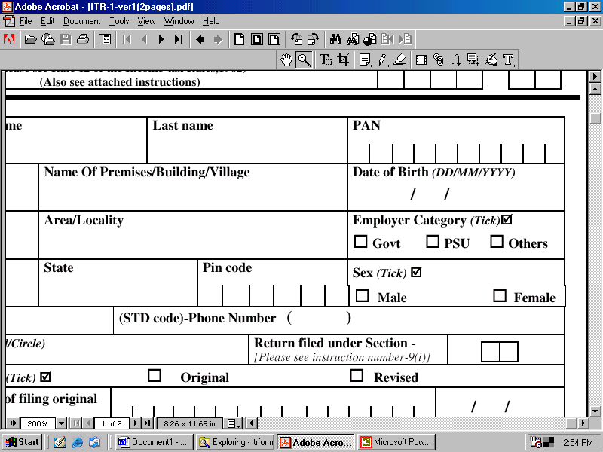
Personal information
Write 10 digit PAN, please ensure that first five letters of PAN are alpha and next four letters are numeric and the last one is alpha. For, e.g., – AMUPK0123N
Write first name
Write middle name (If no middle name leave blank)
Write surname
©Taxmann/Dr. Vinod K. Singhania

Slide 6
Personal information
Write Flat/Door/ Block No.
Write Premises/ Building/ Village
Write Area/ Locality
Write Road/ Street/ Post Office
Write Town/ City/ District
Write State name
Write 6 digit PIN Code
©Taxmann/Dr. Vinod K. Singhania

Slide 7
Personal information
Write Employer Category
Write Date of Birth
Optional
Optional
Write Gender
©Taxmann/Dr. Vinod K. Singhania

Slide 8
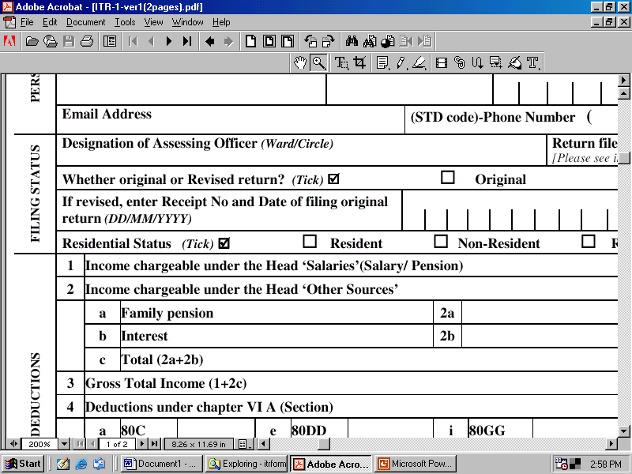
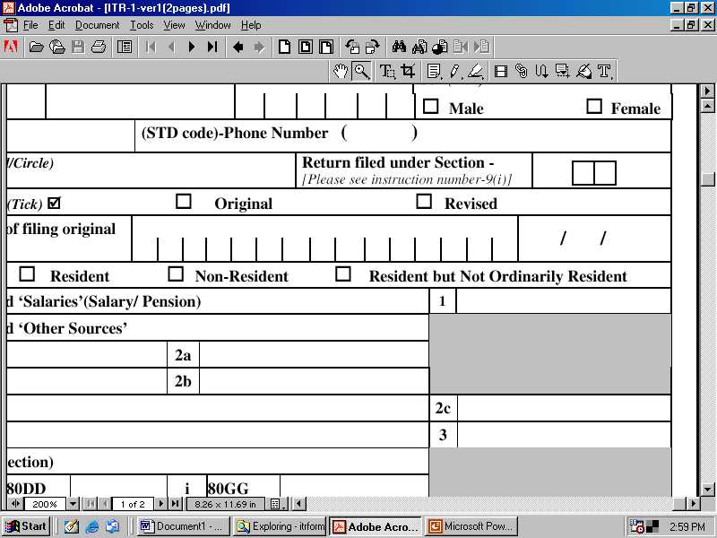
Filing status
Write Ward/ Circle
Description
Code
Voluntarily before the due date
11
Voluntarily after the due date
12
In response to notice under section 142(1)
13
In response to notice under section 148
14
In response to notice under section 153A
15
©Taxmann/Dr. Vinod K. Singhania

Slide 9
Filing status
If it is not revised return tick on original.
Tick the residential status. A person is resident if he is in India in the previous year for 182 days or more.
©Taxmann/Dr. Vinod K. Singhania

Slide 10
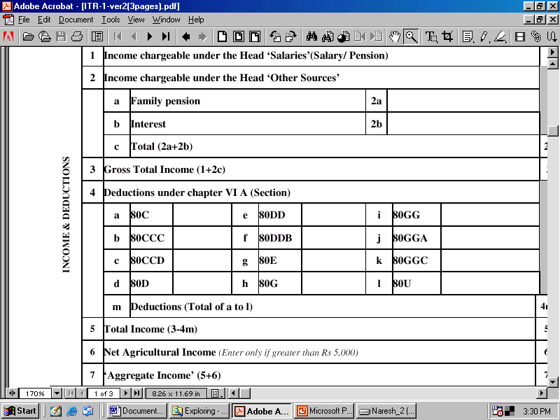
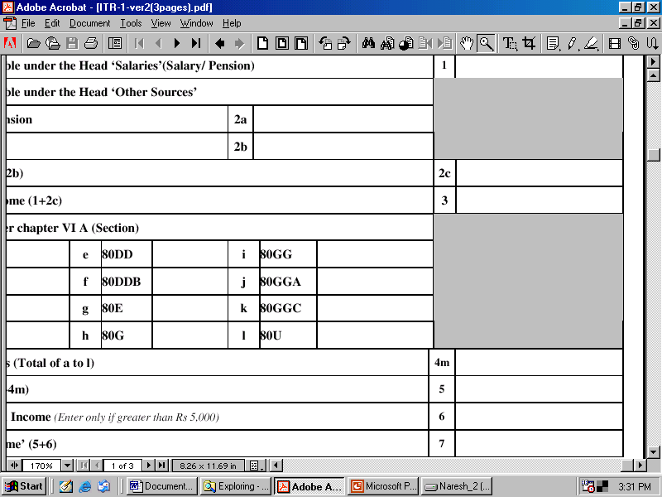
Income and deductions
It can be taken from Form No. 16 given by the employer.
Alternatively it calculated as follows –
Salary
XXX
Allowances
XXX
Perquisites
XXX
Gross salary
XXX
Less : Deduction under section 16
Standard deduction [Sec. 16(i)]
Nil
Entertainment allowance deduction [Sec. 16(ii)]
XXX
Professional tax [Sec. 16(iii)]
XXX
Income under the head “Salaries”
XXX
©Taxmann/Dr. Vinod K. Singhania

Slide 11
Income and deductions
In case of family pension
Standard deduction = 33¹/₃% or Rs. 15,000 lower of these to be deducted and net amount to be shown as family pension.
“Family pension” means regular monthly amount payable by employer to a person belonging to family of deceased employee.
©Taxmann/Dr. Vinod K. Singhania

Slide 12
Income and deductions
Interest means
- Post office interest
Interest on NSCs/KVP
Bank Interests
Interest on company deposits
Note – Exempt interest income shall not be filled here but to be filled in Item No. 25.
©Taxmann/Dr. Vinod K. Singhania

Slide 13
Income and deductions
80C - Deduction in respect of LIC premium, contribution to PF, amount paid under Home Loan Account Scheme of NHB, etc.
©Taxmann/Dr. Vinod K. Singhania

Slide 14
Income and deductions
80CCC - Deduction in respect of contribution to Pension Fund.
©Taxmann/Dr. Vinod K. Singhania

Slide 15
Income and deductions
80CCD - Deduction in respect of contribution to Pension Scheme.
©Taxmann/Dr. Vinod K. Singhania

Slide 16
Income and deductions
The aggregate amount of deduction under sections 80C, 80CCC and 80CCD shall not, in any case exceed one lakh rupees.
©Taxmann/Dr. Vinod K. Singhania

Slide 17
Income and deductions
Deduction in respect of maintenance of a handicap dependant who is with disability, maximum amount Rs. 50,000 (Rs. 75,000 where disability is over 80%).
Deduction in respect of Medical Insurance Premium maximum amount of Rs. 10,000
©Taxmann/Dr. Vinod K. Singhania

Slide 18
Income and deductions
Deduction in respect of Medical Treatment, maximum amount Rs. 40,000 or Rs. 60,000
Deduction in respect of loan taken for higher education. Entire payment of interest is deductible for maximum of 8 years
©Taxmann/Dr. Vinod K. Singhania

Slide 19
Income and deductions
Deduction in respect of rent paid
Deduction in respect of donations to certain funds, charitable institutions, etc. 100% or 50%
©Taxmann/Dr. Vinod K. Singhania

Slide 20
Income and deductions
Deduction in respect of certain donations for scientific research or rural development
Deduction in respect of contributions given by any person to political parties
Deduction in case of a person with disability
©Taxmann/Dr. Vinod K. Singhania

Slide 21
Income and deductions
Enter if amount is greater than Rs. 5,000 otherwise write Nil
©Taxmann/Dr. Vinod K. Singhania

Slide 22
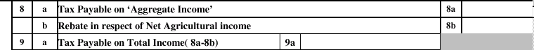
Tax computation
Calculate tax on aggregate income
Resident woman | Resident senior citizen | Any other | Slab rate
0 – 1,35,000 | 0 – 1,85,000 | 0 – 1,00,000 | Nil
1,35,000 – 1,50,000 | – | 1,00,000 – 1,50,000 | 10%
1,50,000 – 2,50,000 | 1,85,000 – 2,50,000 | 1,50,000 – 2,50,000 | 20%
Above 2,50,000 | Above 2,50,000 | Above 2,50,000 | 30%
©Taxmann/Dr. Vinod K. Singhania

Slide 23
Tax computation
Illustration showing calculation of rebate in case of an individual whose total income includes agricultural income also.
Non-agricultural income: Rs. 3,00,000
Net agricultural income: Rs. 1,50,000
Contribution towards PPF: Rs. 40,000
Calculation:
Non-agricultural income is Rs. 2,60,000 (3,00,000 – Rs. 40,000)
Income-tax on Rs. 4,10,000
(Agricultural Income: Rs. 1,50,000 +
Non-agricultural income Rs. 2,60,000)
Income-tax on Rs. 2,50,000 (Agriculture income
Rs. 1,50,000 + Exempted slab: Rs. 1,00,000)
Rs. 73,000
(Working Note 1)
Rs. 25,000
(Working Note 2)
©Taxmann/Dr. Vinod K. Singhania

Slide 24
Working Notes
Working note 1 Income-tax on Rs. 4,10,000 Income-tax = Nil (up to Rs. 1,00,000) + 10% of 50,000 + 20% of 1,00,000 + 30% of Rs. 1,60,000 (4,10,000 – 2,50,000) = Nil + 5,000 + 20,000 + 48,000 =73,000 | Rs. 73,000
Working note 2 Income-tax on Rs. 2,50,000 Income-tax = Nil (up to Rs. 1,00,000) + 10% of 50,000 + 20% of 1,00,000 = Nil + 5,000 + 20,000 = 25,000 | 25,000
©Taxmann/Dr. Vinod K. Singhania

Slide 25
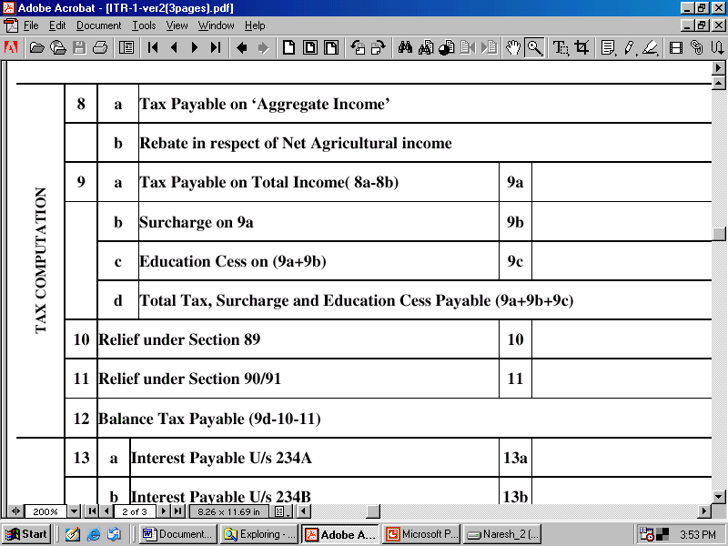
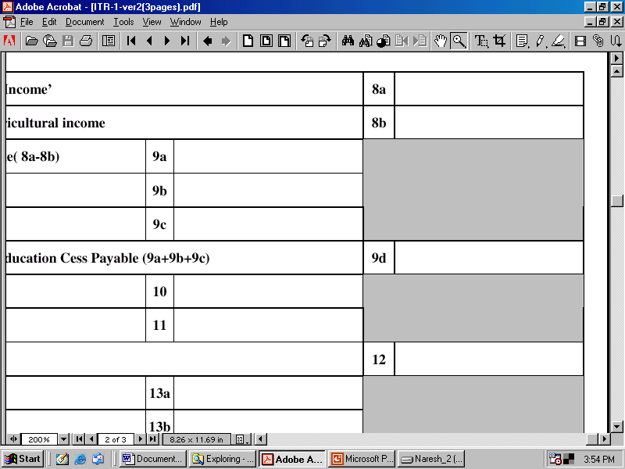
Tax computation
Calculate Surcharge
Individuals/HUF/AOP/BOI if net income does not exceed Rs. 10 lakh | Nil
Individuals/HUF/AOP/BOI if net income exceeds Rs. 10 lakh | 10%
©Taxmann/Dr. Vinod K. Singhania

Slide 26
Tax computation
Calculate Education Cess
Education cess is 2% of (income-tax plus surcharge).
©Taxmann/Dr. Vinod K. Singhania

Slide 27
Tax computation
This relief is available when salary or family pension has been received in arrears or in advance
©Taxmann/Dr. Vinod K. Singhania

Slide 28
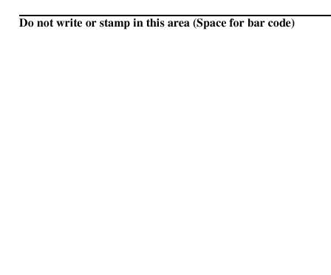
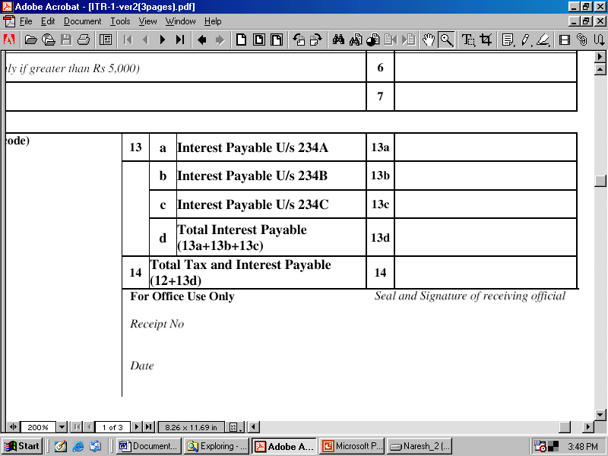
Tax computation
Simple interest is levied when return is furnished after due date or no return has been furnished @ 1% per month or part of the month (even part of month will be taken as full month).
Interest will be calculated as –
1% per month or part of month of amount of tax [as determined on the regular assessment and assessment u/s 143(1)] – Advance tax – Tax deducted/Tax collected at source – Relief u/s 90, 90A and 91.
©Taxmann/Dr. Vinod K. Singhania

Slide 29
Tax computation
When interest is payable | Amount on which interest is payable | Rate of interest | Period for which interest is payable
When assessee who is liable to pay advance tax, has failed to pay such tax | On assessed tax* | Simple interest @ 1% for every month or part of month | From April 1 of the AY to the date of determination of total income u/s 143(1) or where regular assessment is made to the date of such regular assessment
When advance tax paid but it is less than 90% of assessed tax | Assessed tax* – Advance tax | - do - | - do -
*Assessed tax means tax on total income on the basis of regular assessment or assessment u/s 143(1) – Tax deducted/collected at source
©Taxmann/Dr. Vinod K. Singhania

Slide 30
Tax computation
Simple interest is levied when advance tax is not paid or under estimated instalments of advance tax @ 1% per month.
When interest is payable | Rate of interest | Period of interest | Amount on which interest is payable
If advance tax paid on or before September 15 is less than 30% of (a) – (b) | Simple interest @ 1% per month | 3 months | 30% (a – b) – c
If advance tax paid on or before December15 is less than 60% of (a) – (b) | Simple interest @ 1% per month | 3 months | 60% (a – b) – d
If advance tax paid on or before March 15 is less than 100% of (a) – (b) | Simple interest @ 1% per month | – | 100% (a – b) – e
a. Tax on total income declared in the return. b. Tax deducted/collected at source (double tax relief u/s 90, 90A and 91. c. Amount of advance tax paid on or before September 15 of the financial year immediately preceding the relevant AY. d. Amount of advance tax paid on or before December 15 of the financial year immediately preceding the relevant AY. e. Amount of advance tax paid on or before March 15 of the financial year immediately preceding the relevant AY.
©Taxmann/Dr. Vinod K. Singhania

Slide 31
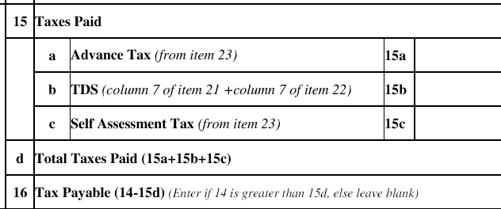
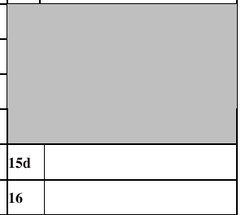
Tax paid
Assessee is liable to pay advance tax where tax payable is Rs. 5,000 or more.
This amount is to be taken from Form 16 or Form 16A.
This amount is to be taken from Challan 280 if Self Assessment Tax is deposited.
©Taxmann/Dr. Vinod K. Singhania

Slide 32
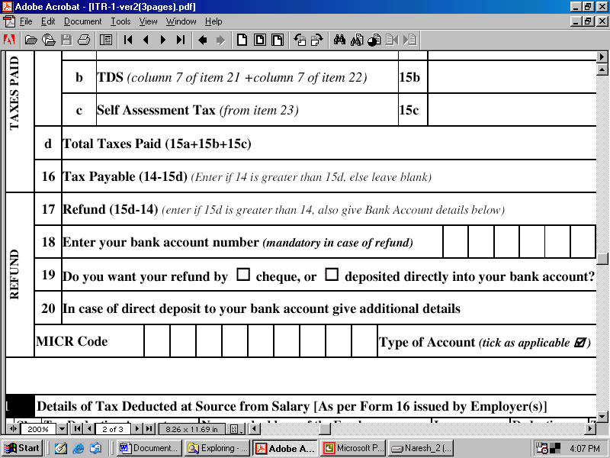
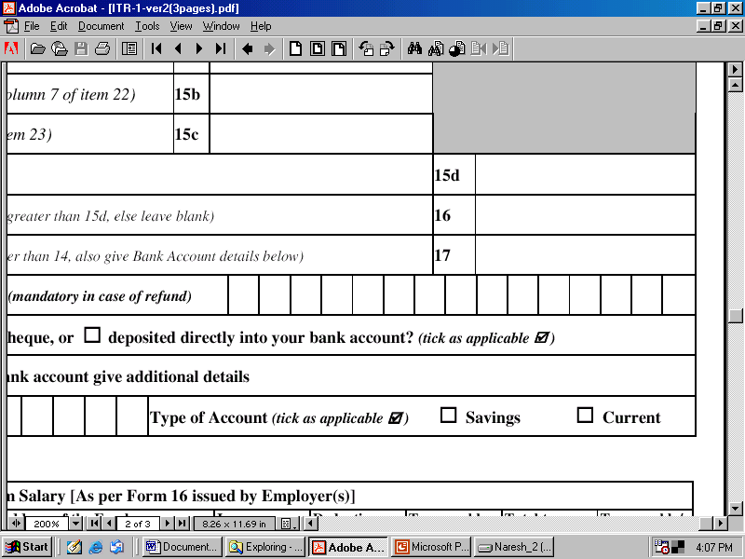
Refund
Enter bank account number (essential in case of refund)
Magnetic Ink Character Recognition (MICR) may be taken from cheque leaf of the assessee
©Taxmann/Dr. Vinod K. Singhania

Slide 33
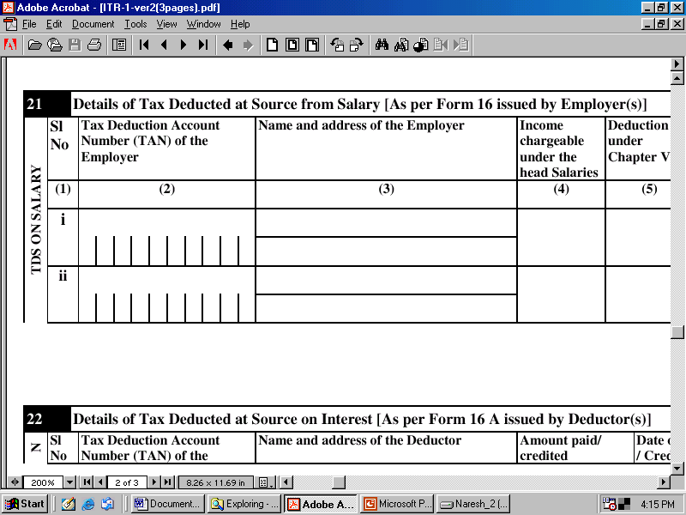
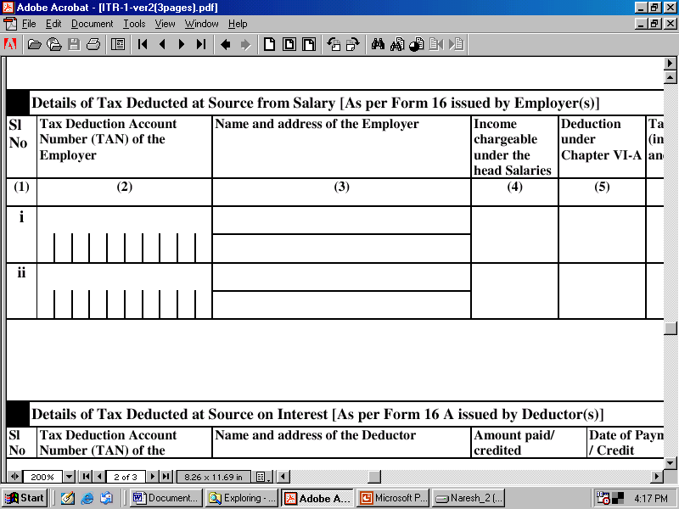
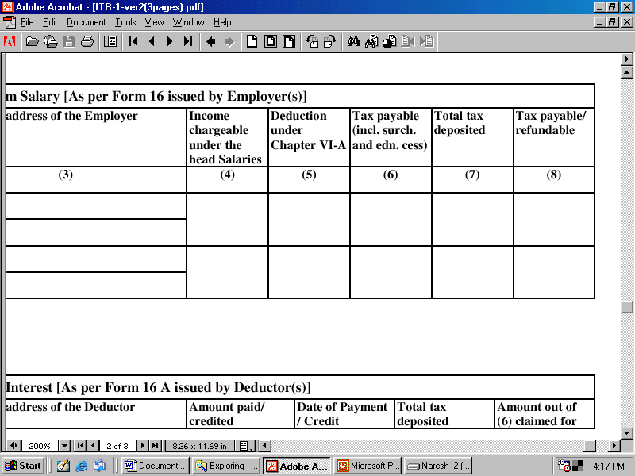
TDS on salary
These details can be taken from Form 16
©Taxmann/Dr. Vinod K. Singhania

Slide 34
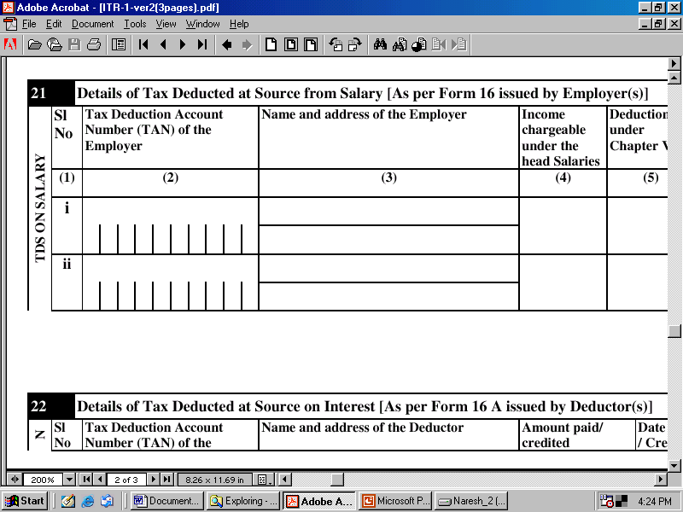
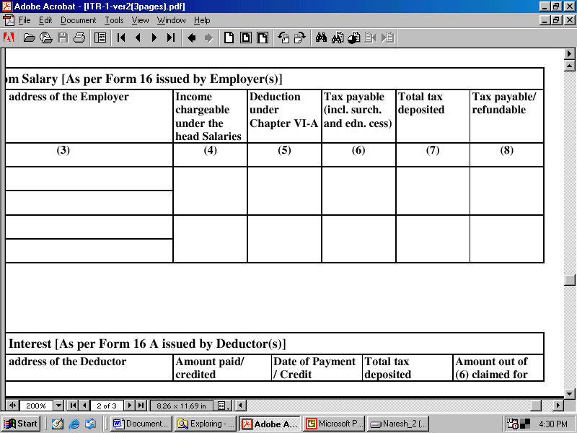
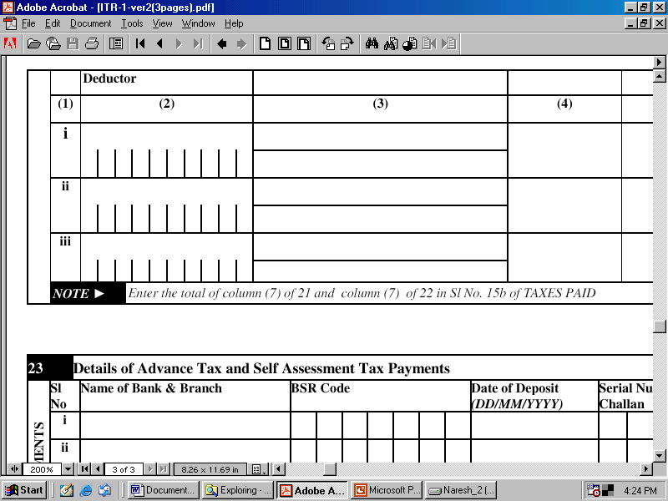
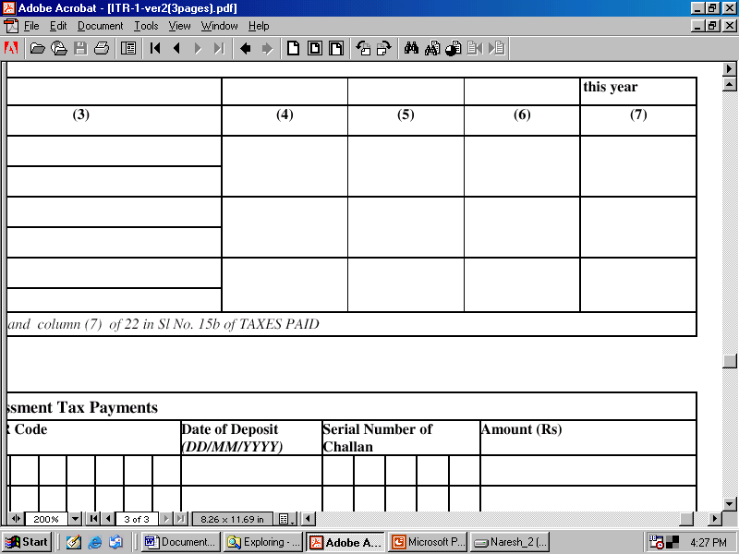
TDS on interest
These details can be taken from Form 16A
©Taxmann/Dr. Vinod K. Singhania

Slide 35
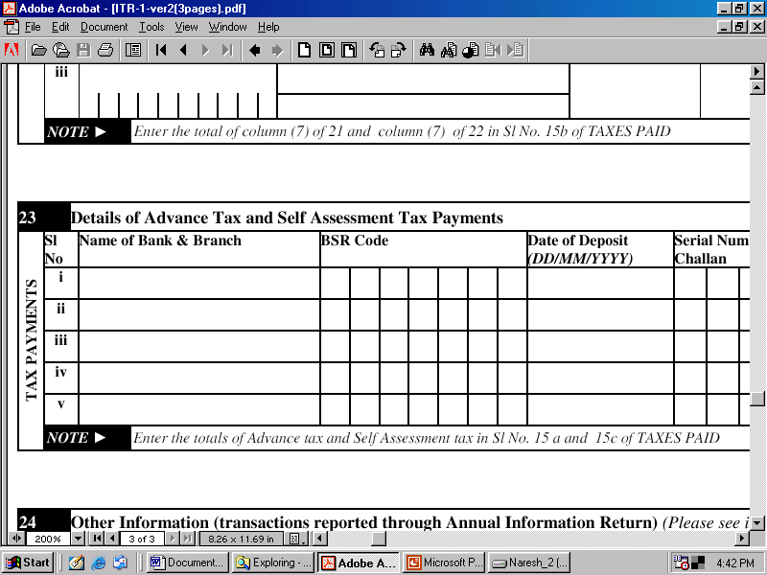
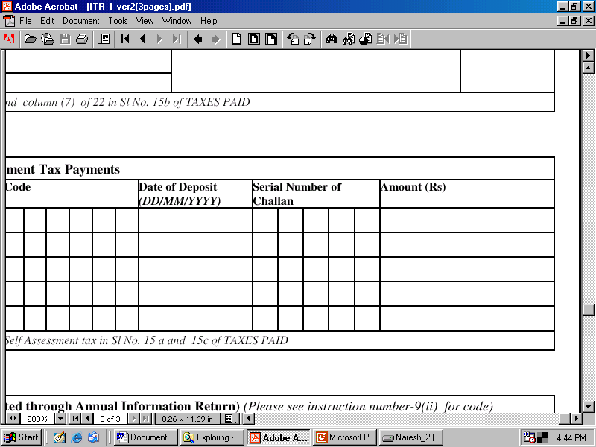
Tax Payments
These will be taken from the counter foil of the Challan 280
©Taxmann/Dr. Vinod K. Singhania

Slide 36
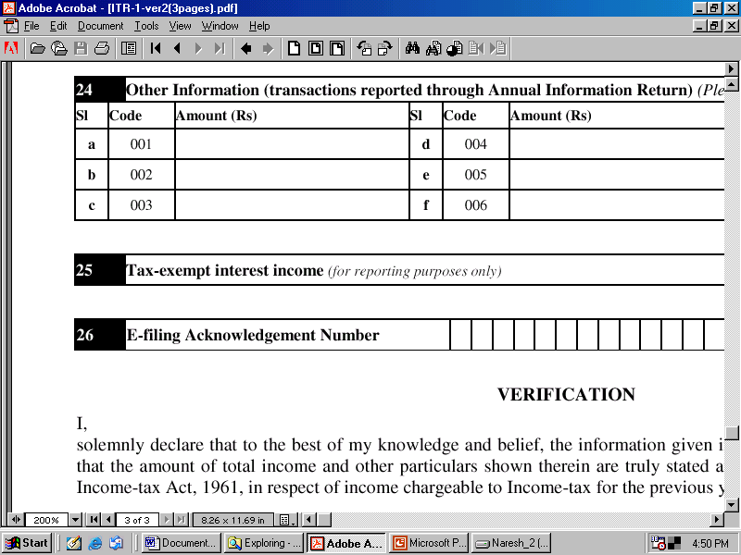
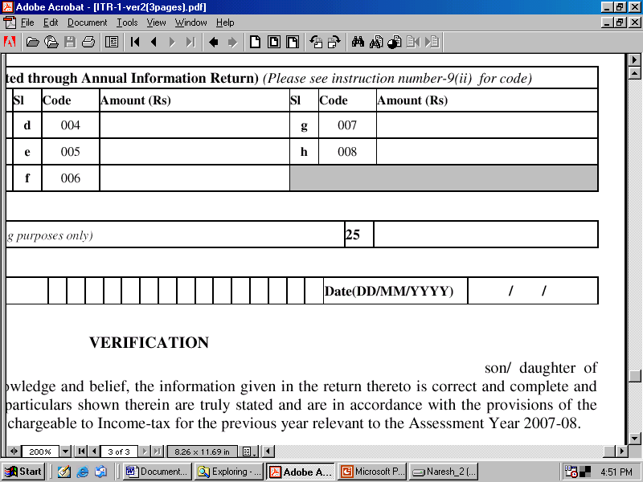
Other information
  Interest income from UTI, Mutual Fund, etc. Dividend from domestic companies. Long-term capital gain on transfer of equity shares/units of equity oriented mutual funds where securities transaction tax is applicable. Net agricultural income in India. Other incomes which are exempt under section 10, i.e., exempted portion of house rent allowance, gratuity, pension, transport allowance, education allowance, etc.
©Taxmann/Dr. Vinod K. Singhania

Slide 37
Other information
To be filled in case return is submitted electronically.
©Taxmann/Dr. Vinod K. Singhania

Slide 38
Write your name
Write your father’s name
VERIFICATION
I, …………………………., son of …………………………solemnly declare that to the best of my knowledge and belief, the information given in the return thereto is correct and complete and that the amount of total income and other particulars shown therein are truly stated and are in accordance with the provisions of the Income-tax Act, 1961, in respect of income chargeable to income-tax for the previous year relevant to the assessment year 2007-08.
Place: Date: Sign here…………
Write place
Write date
Put signature here
©Taxmann/Dr. Vinod K. Singhania

Slide 39
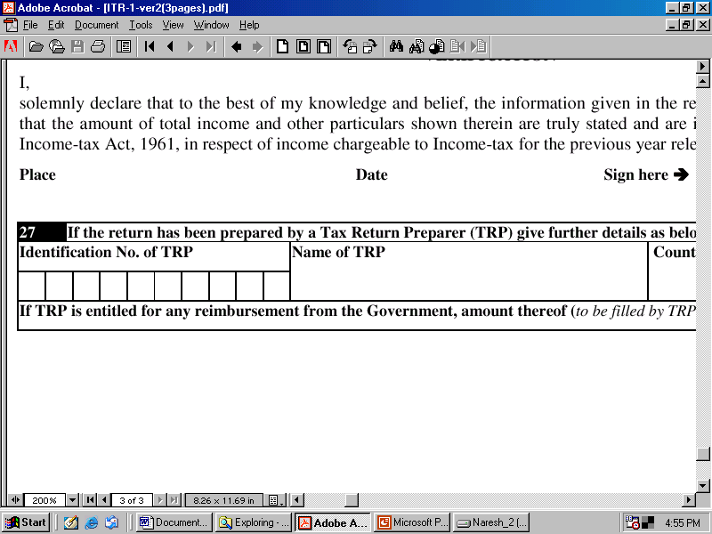
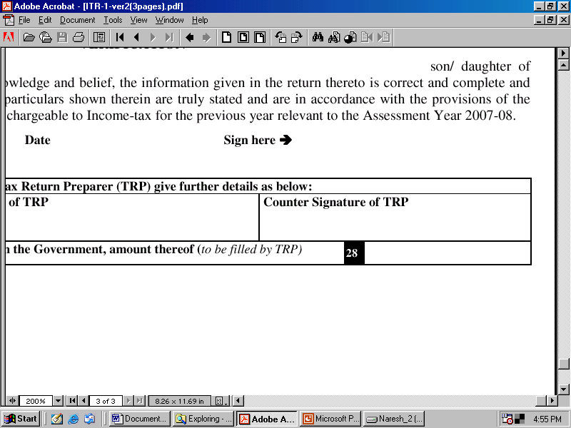
If you are filing your return yourself then these columns are not to be filled up
TRP means, Tax Return Preparer who has been issued as per Tax Return Preparer Scheme, 2006, a Tax Return Preparer Certificate and a unique Identification Number to prepare return of income of Tax Payers
Write identification number of TRP, if return is prepared by TRP
Write name of TRP, if return is prepared by TRP
©Taxmann/Dr. Vinod K. Singhania

Slide 40
ITR - 1 of an assessee, whose income details are given below –
Piyush Kumar Shrivastava, a regular employee of Taxmann Publications (P.) Ltd., gets the following emoluments during the previous year 2006-07 –
Basic Salary | Rs. 8,250 per month
Dearness Allowance | Rs. 4,500 per month
©Taxmann/Dr. Vinod K. Singhania

Slide 41
Education Allowance | Rs. 550 per month (for 4 children)
Medical Allowance | Rs. 450 per month
Transport Allowance | Rs. 1,150 per month (out of which Rs. 100 per month for covering journey between office and residence and Rs. 250 for other purposes)
©Taxmann/Dr. Vinod K. Singhania

Slide 42
House Rent Allowance | Rs. 5,500 per month (rent paid at Noida: Rs. 5,500 per month)
NSC, LIC, PPF | NSC: Rs. 5,000 on 1-2-2002 LIC during previous year Rs. 10,000 (sum assured Rs. 40,000) PPF: Rs. 10,000
Saving bank interest | Rs. 2,500
©Taxmann/Dr. Vinod K. Singhania

Slide 43
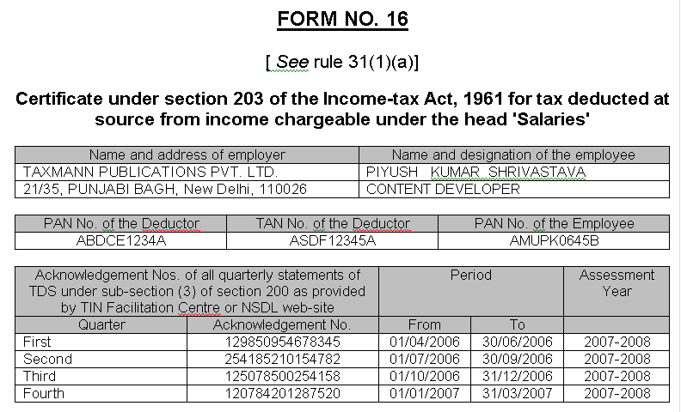
Form - 16
©Taxmann/Dr. Vinod K. Singhania

Slide 44
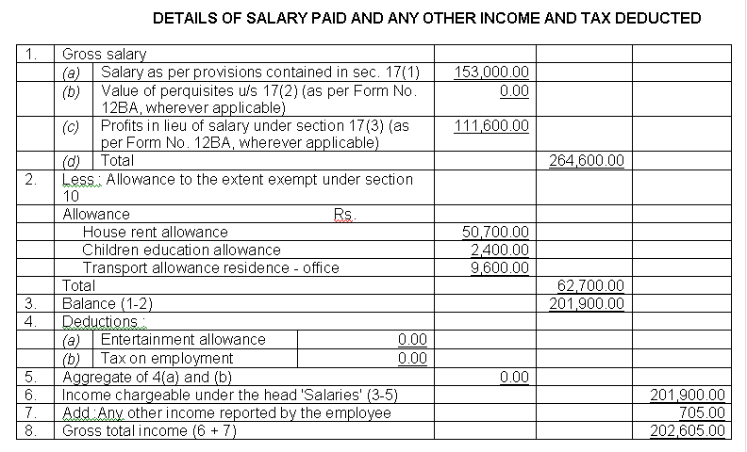
Form - 16 contd…
©Taxmann/Dr. Vinod K. Singhania

Slide 45
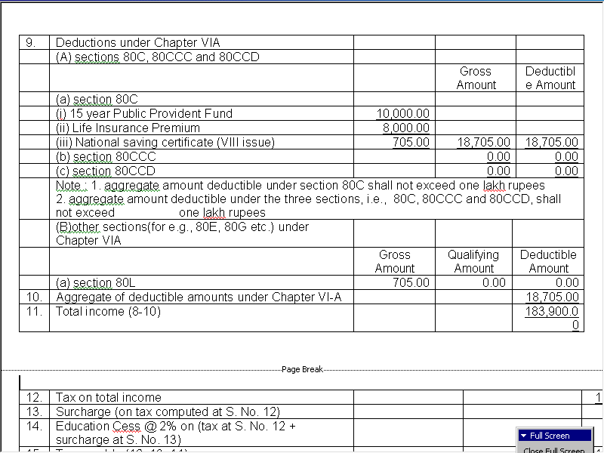
Form - 16 contd…
©Taxmann/Dr. Vinod K. Singhania

Slide 46
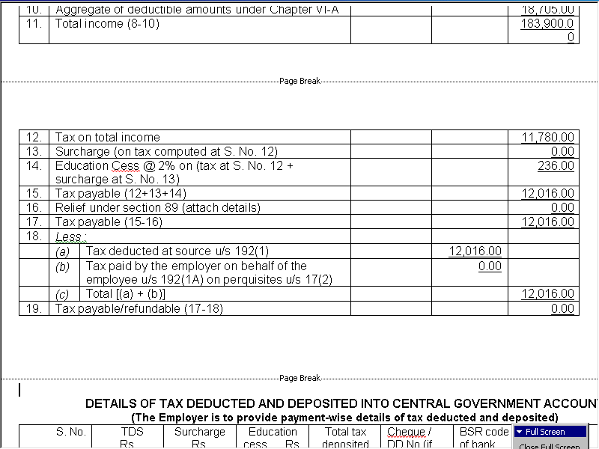
Form - 16 contd…
©Taxmann/Dr. Vinod K. Singhania

Slide 47
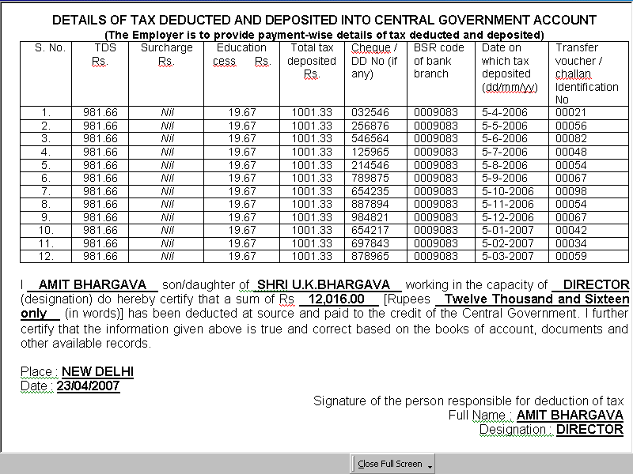
Form - 16 end.
©Taxmann/Dr. Vinod K. Singhania

Slide 48
ITR - 1 of an assessee, whose income details are given below –
First Name
Middle Name
Last Name
Name: Piyush Kumar Shrivastava
Flat/Door/Block No.
Name of Premises/Building/Village
Address: 93-94, Pocket G-20, Astha Niwas,
Sector – 7, Rohini,
Area/Locality
Road/Street/Post Office
New Delhi – 110085
Pin Code
Town/City/District
Delhi
State
©Taxmann/Dr. Vinod K. Singhania

Slide 49
ITR - 1 of an assessee, whose income details are given below –
PAN
PAN: AMAPD0645 B
Date of Birth
Date of Birth: 01/04/1972
Email Address
e-mail: piyush@taxmann.com
(STD code)-Phone Number
Ph: 011 – 12345678
©Taxmann/Dr. Vinod K. Singhania

Slide 50
Personal information
PIYUSH
KUMAR
SHRIVASTAVA
A M A P D 0 6 4 5 B
93-94, POCKET G-20
ASTHA NIWAS
01 04 1972
SECTOR - 7
ROHINI
✓
NEW DELHI
DELHI
✓
1 1 0 0 8 5
piyush@taxmann.com
011 12345678
©Taxmann/Dr. Vinod K. Singhania

Slide 51
Filing status
33(2)
1 1
✓
✓
©Taxmann/Dr. Vinod K. Singhania

Slide 52
Income and deductions
2,01,900
NIL
3,205
3,205
2,05,105
Statement showing computation of taxable salary | Rs.
Basic salary (Rs. 8,000 x 9 + Rs. 9,000 x 3) | 99,000
Dearness allowance (Rs. 4,500 x 12) | 54,000
Education allowance (see working note 1) | 24,000
Medical allowance (see working note 2) | 5,400
Transport allowance (see working note 3) | 4,200
House rent allowance (see working note 4) | 15,300
Income chargeable under the head “Salaries” | 2,01,900
Rs. 2,01,900
©Taxmann/Dr. Vinod K. Singhania

Slide 53
Working Notes
Working note 1 Children education allowance Taxable = Education allowance received – Education allowance @ Rs. 100 per month for 2 children = 2,200 x 12 – 2 x 100 x 12 = 26,400 – 2,400 = 24,000 | Rs. 24,000
©Taxmann/Dr. Vinod K. Singhania

Slide 54
Working Notes
Working note 2 Medical allowance Fully taxable = Rs. 450 x 12 | Rs. 5,400
Working note 3 Transport allowance Taxable = Transport allowance received – Transport allowance @ Rs. 800 per month = 1,150 x 12 – 800 x 12 = 13,800 – 9,600 = 4,200 | 4,200
©Taxmann/Dr. Vinod K. Singhania

Slide 55
Working Notes
Working note 4 Rs. House rent allowance (a) 40% of salary 61,200 (b) HRA received (5,500 x 12) 66,000 (c) Rent paid – 10% of salary 50,700 (66,000 – 15,300) Salary = 99,000 (Basic Salary) + 54,000 (DA) + 0 (Commission) = 1,53,000 Taxable HRA = 66,000 – 50,700 | Rs. 15,300
©Taxmann/Dr. Vinod K. Singhania

Slide 56
Income and deductions
18,705
Nil
Nil
Nil
Nil
Nil
Nil
Nil
Nil
Nil
Nil
Nil
18,705
1,86,400
Nil
1,86,400
NSC VIII Issue (interest) 705
PPF 10,000
LIC premium 8,000*
Total 18,705
*LIC premium should not exceed 20% of sum assured
©Taxmann/Dr. Vinod K. Singhania

Slide 57
Tax computation
Income-tax payable = Nil (up to Rs. 1,00,000) + 10% of 50,000 + 20% of 36,400 (1,86,400 – 1,50,000)
= Nil + 5000+7280
=12,280
12,280
Nil
12,280
2% of 12,280
Nil
245.60
12,526
Nil
Nil
12,526
©Taxmann/Dr. Vinod K. Singhania

Slide 58
Tax computation
Nil
Nil
Nil
Nil
12,526
©Taxmann/Dr. Vinod K. Singhania

Slide 59
Tax paid
Taken from Form 16
Taken from Challan 280
Nil
12,016
510
12,526
Nil
©Taxmann/Dr. Vinod K. Singhania

Slide 60
Refund
Nil
- N / A -
©Taxmann/Dr. Vinod K. Singhania

Slide 61
TDS on salary
TAXMANN PUBLICATIONS (P.) LTD.,
2,01,900
18,705
12,016
12,016
Nil
A S D F 1 2 3 4 5 A
21/35, PUNJABI BAGH (WEST), NEW DELHI - 110026
©Taxmann/Dr. Vinod K. Singhania

Slide 62
TDS on interest
- N / A -
©Taxmann/Dr. Vinod K. Singhania

Slide 63
Tax Payments
SBI Bank, Punjabi Bagh
0 0 0 9 0 8 3
25-6-2007
0 0 0 5 1
510.00
©Taxmann/Dr. Vinod K. Singhania

Slide 64
Other information
Nil
Nil
Nil
Nil
Nil
Nil
Nil
Nil
Nil
©Taxmann/Dr. Vinod K. Singhania

Slide 65
VERIFICATION
I, Piyush Kumar Shrivastava, son of Shri L. P. Shrivastava solemnly declare that to the best of my knowledge and belief, the information given in the return thereto is correct and complete and that the amount of total income and other particulars shown therein are truly stated and are in accordance with the provisions of the Income-tax Act, 1961, in respect of income chargeable to income-tax for the previous year relevant to the assessment year 2007-08.
Place: New Delhi Date: 10-7-2007 Sign here…………
0 1 2 5 6 8 9 2 0 8
VIREN SINGH
©Taxmann/Dr. Vinod K. Singhania

Slide 66
House rent allowance
[Sec. 10(13A)]
1. 40 per cent of salary (50 per cent of salary in Delhi, Bombay, Calcutta, Madras) 2. House rent allowance received 3. Rent paid minus 10% of salary (if difference is negative, then take it as zero. Salary means = Basic Salary + DA (if forming part of Retirement Benefit) + Commission (based on a fixed percentage of turnover achieved).
Taxable HRA = HRA received – Least of (1, 2 and 3) If difference is negative nothing will be taxable.
©Taxmann/Dr. Vinod K. Singhania

Slide 67
Children education allowance
The amount exempt is limited to Rs. 100 per month per child up to a maximum of two children (exemption is available for two children only).
©Taxmann/Dr. Vinod K. Singhania

Slide 68
Hostel expenditure allowance
It is exempt from tax to the extent of Rs. 300 per month per child (exemption is available for two children only).
©Taxmann/Dr. Vinod K. Singhania

Slide 69
Allowance for transport employees
It is an allowance granted to an employee working in any transport system to meet his personal expenditure during his duty performed in the course of running of such transport from one place to another place provided that such employee is not in receipt of daily allowance.
The amount of exemption is— a. 70 per cent of such allowance; or b. Rs. 6,000 per month, whichever is lower.
©Taxmann/Dr. Vinod K. Singhania

Slide 70
Transport allowance
Transport allowance is granted to an employee to meet his expenditure for the purpose of commuting between the place of his residence and the place of his office.
It is exempt up to Rs. 800 per month.
©Taxmann/Dr. Vinod K. Singhania

Slide 71
Allowances exempt on the basis of actual expenditure
Travelling/transfer allowance | To meet the cost of travel on tour or on transfer
Conveyance allowance | To meet the expenditure on conveyance in performance of duties of an office.
Helper allowance | To meet the expenditure on a helper for the performance of official duties.
Research allowance | For encouraging the academic research and other professional pursuits.
Uniform allowance | To meet the expenditure on the purchase or maintenance of uniform for wear during the performance of duties of an office.
The amount of exemption in the above cases is amount of allowance or the expenditure incurred for the specific purpose for which allowance is given, whichever is lower.
©Taxmann/Dr. Vinod K. Singhania

Slide 72
Perquisites when taxable/not taxable
Taxable | Exceptions
Category A - Obligation of the employee is met by the employer | No
Category B - In any other case (i.e., not being an employee’s obligation met by the employer), only the following perquisites are taxable in the hands of employees -
1. Furnished/unfurnished house without rent or at concessional rent | Few exceptions
2. Service of a sweeper, gardener, watchman or personal attendant | Non-specified employee
©Taxmann/Dr. Vinod K. Singhania

Slide 73
Perquisites when taxable/not taxable
Taxable | Exceptions
3. Supply of gas, electricity or water for household purposes | Non-specified employee
4. Education facility to employee’s family members | Non-specified employee
5. Leave travel concession (not being the case given in the next column) | LTC given twice in a block of four years
6. Amount payable by an employer directly or indirectly to effect an assurance on the life of employee or to effect a contract of an annuity | Few exceptions
©Taxmann/Dr. Vinod K. Singhania

Slide 74
Perquisites when taxable/not taxable
Taxable | Exceptions
7. Interest-free/concessional loan | Few exceptions
8. Providing use of movable asset | Providing use of computer/laptop
9. Transfer of movable asset | No
10. Medical expenditure reimbursement in excess of Rs. 15,000 | Few exceptions
©Taxmann/Dr. Vinod K. Singhania

Slide 75
VALUATION OF UNFURNISHED HOUSE
Meaning of Government employees 1. Employees of the Central Government. 2. Employees of the State Governments. 3. Employees of the Central /State Governments on deputation to a public sector undertaking but the accommodation is provided by the Central/State Governments. The following are not Government employees 1. Employees of local authority. 2. Employees of public sector undertakings. 3. Employees of foreign Governments.
©Taxmann/Dr. Vinod K. Singhania

Slide 76
VALUATION OF UNFURNISHED HOUSE
In the case of Government employees
Mode of valuation
The value of perquisite in respect of accommodation provided to a Government employee is equal to the licence fee which would have been determined by the Central or State Government in accordance with the rules framed by the Government for allotment of houses to its officers.
©Taxmann/Dr. Vinod K. Singhania

Slide 77
VALUATION OF UNFURNISHED HOUSE
In the case of non-Government employees
City population 2001 census | Accommodation owned by employer | Accommodation taken on lease by employer
More than 25 lakh | 15 per cent of salary | Lease rent paid or payable or 15 per cent of salary, whichever is lower
Between 10 and 25 lakh | 10 per cent of salary | Same as above
Up to 10 lakh | 7.5 per cent of salary | Same as above
©Taxmann/Dr. Vinod K. Singhania

Slide 78
VALUATION OF UNFURNISHED HOUSE
In the case of non-Government employees
Meaning of salary It includes the following - 1. Basic salary ; 2. Dearness allowance/pay, if terms of employment so provide ; 3. Bonus ; 4. Commission ; 5. Fees ; 6. All other taxable allowances (excluding amount not taxable); and 7. Any monetary payment which is chargeable to tax (by whatever name called).
©Taxmann/Dr. Vinod K. Singhania

Slide 79
VALUATION OF UNFURNISHED HOUSE
In the case of non-Government employees
Meaning of salary It does not include the following - 1. Dearness allowance/pay, if not taken into account while calculating retirement benefits, like provident fund, gratuity, etc., or if term of employment does not so provide ; 2. Employer’s contribution to provident fund account of an employee ; 3. All allowances which are exempt from tax ; and 4. Value of perquisites [under section 17(2)].
©Taxmann/Dr. Vinod K. Singhania

Slide 80
VALUATION OF FURNISHED HOUSE
In the case of Government/non-Government employees
1. Step one - Find out value of unfurnished house. 2. Step two - Add value of furniture.
Value of furniture
1. If furniture is owned by employer | 10% per annum of original cost of furniture to the employer, irrespective of the age of furniture
2. If furniture is taken on hire | Hire charges paid/payable by the employer
Meaning of “furniture” - “Furniture” here includes radio sets, television sets, refrigerators, air-conditioners and other household appliances.
©Taxmann/Dr. Vinod K. Singhania

Slide 81
ACCOMMODATION PROVIDED IN A HOTEL
1. At the rate of 24 per cent of salary paid or payable for that part of the previous year during which such accommodation is provided; 2. Actual charges paid or payable for such hotel accommodation by the employer, whichever is lower.
©Taxmann/Dr. Vinod K. Singhania

Slide 82
FURNISHED OR UNFURNISHED HOUSE IN REMOTE AREA
In the case of Government/non-Government employees not chargeable to tax
Two cumulative conditions : 1. The accommodation located in a ‘remote area’ (i.e., an area located at least 40 kilometers away from a town having a population not exceeding 20,000) or an accommodation of temporary nature having plinth area of 800 square feet or less is provided which is located at least 8 kilometer away from the local units of a municipality. 2. It is provided to an employee working at a mining site or an onshore oil exploration site, or a project execution site or a dam site or a power generation site or an off-shore site. A project site for this purpose means site of project up to the stage of its commissioning.
©Taxmann/Dr. Vinod K. Singhania

Slide 83
FURNISHED OR UNFURNISHED HOUSE IN
CASE OF TRANSFER
In the case of Government/non-Government employees
Where on account of the transfer of an employee from one place to another, he is provided with accommodation at the new place of posting while retaining the accommodation at the other place, the value of perquisite shall be determined with reference to only one such accommodation which has the lower value for a period not exceeding 90 days and thereafter the value of perquisite shall be charged for both such accommodations.
©Taxmann/Dr. Vinod K. Singhania

Slide 84
HOTEL ACCOMMODATION IN THE CASE OF TRANSFER
In the case of Government/non-Government employees
Where accommodation is provided in hotel and the following two conditions are satisfied, nothing is chargeable to tax : The hotel accommodation is provided for a total period not exceeding in aggregate 15 days in a previous year; and Such accommodation is provided on an employee’s transfer from one place to another place.
©Taxmann/Dr. Vinod K. Singhania

Slide 85
Interest free loan/concessional loan
Interest would be calculated at the rate charged (per annum) by SBI as on 1st day of the previous year
Other related issues 1. Amount actually recovered from the employee during the previous year on account of interest shall be deducted from the aforesaid calculation. 2. Interest would be calculated on the basis of maximum outstanding monthly balance for each loan as on the last day of each month. 3. In the following cases, the perquisite is not chargeable to tax - (a) if such loan is made available for medical treatment in respect of diseases specified in rule 3A (the exemption is, however, not applicable to so much of the loan as has been reimbursed to the employee under any medical insurance scheme); or (b) where the amount loans are petty not exceeding in the aggregate Rs. 20,000.
©Taxmann/Dr. Vinod K. Singhania

Slide 86
INTEREST RATES CHARGED BY SBI
 |  |  | AY 2007-08
Housing loan | Up to 5 years |  | 8.5%
 | 5 – 10 years |  | 8.75%
 | 10 – 15 years |  | 9%
 | 15 – 20 years |  | 9.25%
Car loan | Up to 3 years (above Rs. 8 lakh) |  | 8%
 | Up to 3 years (below Rs. 8 lakh) |  | 8.5% (8.75%*)
 | 3 – 5 years |  | 8.75% (9%*)
 | 5 – 7 years |  | 8.75% (9.25%*)
Education loan | Up to Rs. 4 lakh |  | 10.5%
 | Above Rs. 4 lakh |  | 11.5%
Two wheelers |  |  | 11%
Personal loan |  |  | 12.75%
*Rural/semi-urban borrowings
©Taxmann/Dr. Vinod K. Singhania

Slide 87
Perquisite in respect of use of movable assets
 | Computer/ laptops | Any other assets
 |  | Owned by employer | Taken on hire by employer
Step 1 - Find out cost to the employer | Nil | 10% per annum of actual cost | Amount of rent paid or payable
Step 2 - Less: Amount recovered from the employee | Nil | Recovery from the employee | Recovery from the employee
Taxable value of the perquisite (Step 1 – Step 2) | Nil | Balancing amount (if it is positive) | Balancing amount (if it is positive)
©Taxmann/Dr. Vinod K. Singhania

Slide 88
Perquisite in respect of sale of movable assets to employees
 | Electronic items/computers | Motor car | Any other asset
Step 1 - Find out cost of the asset to the employer | Actual cost to the employer | Actual cost to the employer | Actual cost to the employer
Step 2 - Less: Normal wear and tear for completed years during which the asset was used by the employer for his business purposes | 50% for each completed year by reducing balance method | 20% for each completed year by reducing balance method | 10% for each completed year of actual cost
Step 3 - Less: Amount recovered from the employee | Consideration recovered from the employee | Consideration recovered from the employee | Consideration recovered from the employee
Taxable value of the perquisite(Step 1 – Step 2 – Step 3) | Balancing amount(if it is positive) | Balancing amount(if it is positive) | Balancing amount (if it is positive)
©Taxmann/Dr. Vinod K. Singhania

Slide 89
Medical facility in India
Medical facility in employer’s hospital | Not chargeable to tax
Medical facility in the following hospitals : 1. Hospital of the Central/State Governments. 2. Hospital of a local authority. 3. Hospital owned by a private party but recommended by the Central/State Governments for its employees. | Not chargeable to tax
Medical facility (as specified in rule 3A) in a hospital which is approved by Chief Commissioner | Not chargeable to tax
Mediclaim insurance premium paid by employer | Not chargeable to tax
Any other medical facility in India | Not chargeable to tax upto Rs. 15,000 per assessment year
Note : Fixed medical allowance is chargeable to tax without any exemption.
©Taxmann/Dr. Vinod K. Singhania

Slide 90
Medical facility outside India
Perquisite not chargeable to tax | Condition to be satisfied
Medical treatment of employee or any member of family of such employee outside India | Expenditure shall be excluded from perquisite only to the extent permitted by the Reserve Bank of India
Cost on travel of the employee/any member of his family and one attendant who accompanies the patient in connection with treatment outside India | Expenditure shall be excluded from perquisite only in the case of an employee whose gross total income, as computed before including therein the said expenditure, does not exceed Rs. 2,00,000
Cost of stay abroad of the employee or any member of the family for medical treatment and cost of stay of one attendant who accompanies the patient in connection with such treatment | Expenditure shall be excluded from the perquisite only to the extent permitted by the Reserve Bank of India
©Taxmann/Dr. Vinod K. Singhania

Slide 91
Leave travel concession (LTC) in India
1. Where journey is performed by air | Amount of air economy fare of the National carrier by the shortest route or the amount spent, whichever is less.
2. Where journey is performed by rail | Amount of air-conditioned first class rail fare by the shortest route or amount spent, whichever is less.
3. Where the places of origin of journey and destination are connected by rail and journey is performed by any other mode of transport | Amount of air-conditioned first class rail fare by the shortest route or the amount spent, whichever is less.
4. Where the places of origin of journey and destination (or part thereof) are not connected by rail
– Where a recognised public transport exists | First class or deluxe class fare by the shortest route or the amount spent, whichever is less.
– Where no recognised public transport system exists | Air-conditioned first class rail fare by the shortest route (as if the journey had been performed by rail) or the amount actually spent, whichever is less.
©Taxmann/Dr. Vinod K. Singhania

Slide 92
Tax rates
Assessment years 2006-07 and 2007-08
Resident woman | Resident senior citizen | Any other | Slab rate
0 – 1,35,000 | 0 – 1,85,000 | 0 – 1,00,000 | Nil
1,35,000 – 1,50,000 | – | 1,00,000 – 1,50,000 | 10%
1,50,000 – 2,50,000 | 1,85,000 – 2,50,000 | 1,50,000 – 2,50,000 | 20%
Above 2,50,000 | Above 2,50,000 | Above 2,50,000 | 30%
©Taxmann/Dr. Vinod K. Singhania

Slide 93
Surcharge
Assessment years 2006-07 and 2007-08
Individuals/HUF/AOP/BOI if net income does not exceed Rs. 10 lakh | Nil
Individuals/HUF/AOP/BOI if net income exceeds Rs. 10 lakh | 10%
Co-operative society, local authority | Nil
Firm, artificial juridical person | 10%
Domestic company | 10%
Foreign company | 2.5%
Note: The above surcharge is applicable on (income-tax minus rebate under section 88E).
©Taxmann/Dr. Vinod K. Singhania

Slide 94
EDUCATION CESS FOR THE Assessment years 2006-07 and 2007-08
Education cess is 2 per cent of (income-tax plus surcharge).
©Taxmann/Dr. Vinod K. Singhania

Slide 95
New section 80C
(Applicable from the AY 2006-07 onwards)
1. On the basis of qualifying investments/ contributions/deposits/payments by an individual/ HUF up to Rs. 1 lakh out of income chargeable to tax will be deductible from gross total income under section 80C. 2. Qualifying investments/contributions are the same as given in the existing section 88 except given in the next slide.
©Taxmann/Dr. Vinod K. Singhania

Slide 96
Section 80C vis-à-vis section 88
Section 88 | Section 80C
Rebate from income-tax | Deduction from gross total income
Tuition fees (not to exceed Rs. 24,000) | Tuition fees (no maximum limit)
Residential house (not to exceed Rs. 20,000) | Residential house (no maximum limit)
Notified ELSS (not to exceed Rs. 10,000) | Notified ELSS (no maximum limit)
Minimum investment of Rs. 30,000 in infrastructure sector to achieve the maximum target of Rs. 1,00,000 | No such requirement
Not available if GTI exceeds Rs. 5,00,000 | Available even if GTI exceeds Rs. 5,00,000
©Taxmann/Dr. Vinod K. Singhania

Slide 97
Thanks
©Taxmann/Dr. Vinod K. Singhania

