Slide 1
A REPORT ON SUMMER OLYMPIC FROM 1896-2012

Slide 2
A BRIEF ABOUT OLYMPICS:-
The Summer Olympic Games first held in 1896, is a major international multi-sport event held once every four years.
The most recent Olympics were held in Rio de Janeiro, Brazil.
The International Olympic Committee (IOC) organizes the Games and oversees the host city's preparations.
In each Olympic event, gold medals are awarded for first place, silver medals are awarded for second place, and bronze medals are awarded for third place; this tradition began in 1904.
The Winter Olympic Games were created due to the success of the Summer Olympics.
The Olympics have increased in scope from a 42-event competition with fewer than 250 male competitors from 14 nations in 1896, to 306 events with 11,238 competitors (6,179 men, 5,059 women) from 206 nations in 2016.
The Summer Olympics has been hosted on five continents by a total of nineteen countries.
The Games have been held four times in the United States (in 1904, 1932, 1984 and 1996); three times in the United Kingdom (in 1908, 1948 and 2012); twice each in Greece (1896, 2004), France (1900, 1924), Germany (1936, 1972) and Australia (1956, 2000); and once each in Sweden (1912), Belgium (1920), Netherlands (1928), Finland (1952), Italy (1960), Japan (1964), Mexico (1968), Canada (1976), Soviet Union (1980), South Korea (1988), Spain (1992), China (2008) and Brazil (2016).

Slide 3
ANALYSIS USING PYTHON
----------------------------------------------------------------------------------------------
Steps Followed:
----------------------------------------------------------------------------------------------
Step-1: Load the dataset
Step-2: Preprocess the data
Step-3: Cleansing the Data
Step-4: Process the data for anlysis

Slide 4
Analysis-1: - Medal Tally
Medal‘s Being won in form of Gold, Silver and Bronze are:-
----------------------------------------------------------------------------
Outcome:
its clear that there are around 174 entries missing who won Bronze and 115 entries are missing who won Silver.
CATEGORY | COUNT
GOLD | 10484
SILVER | 10369
BRONZE | 10310

Slide 5
Analysis-2: - Men and Women participation
It’s clear that Male participation is in large as compared to women participation,
Lets see the Year wise participation:=
GENDER | NUMBER
MEN | 22745
WOMEN | 8418

Slide 6
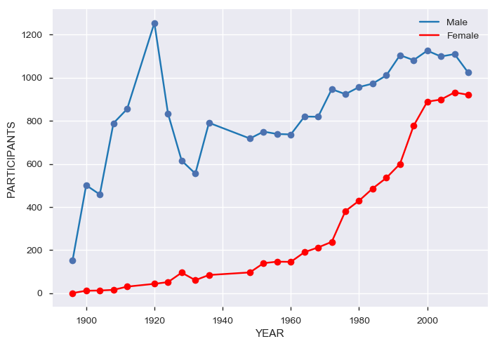
Outcome:
From the above graph its clear that Men participants are much more as compared to Women. But a good thing happen is that as year wise olympic progresses the women particpant also increases. Great sign for sports.

Slide 7
Analysis-3: - Sports in winning spot
TOP 5 SPORTS
SPORTS | MEDAL’s WON
ATHELETICS | 3638
ROWING | 2667
SWIMMING | 2628
ARTISTIC G | 2103
FENCING | 1613

Slide 8
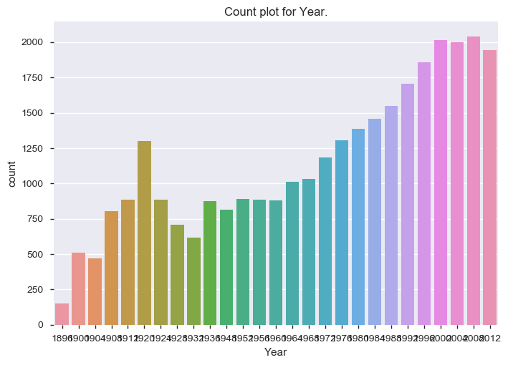
Analysis-4: - Year wise medal tally
From the fig its clear that the top of the year is: 2008 and 1896 is the lowest on medal tally

Slide 9
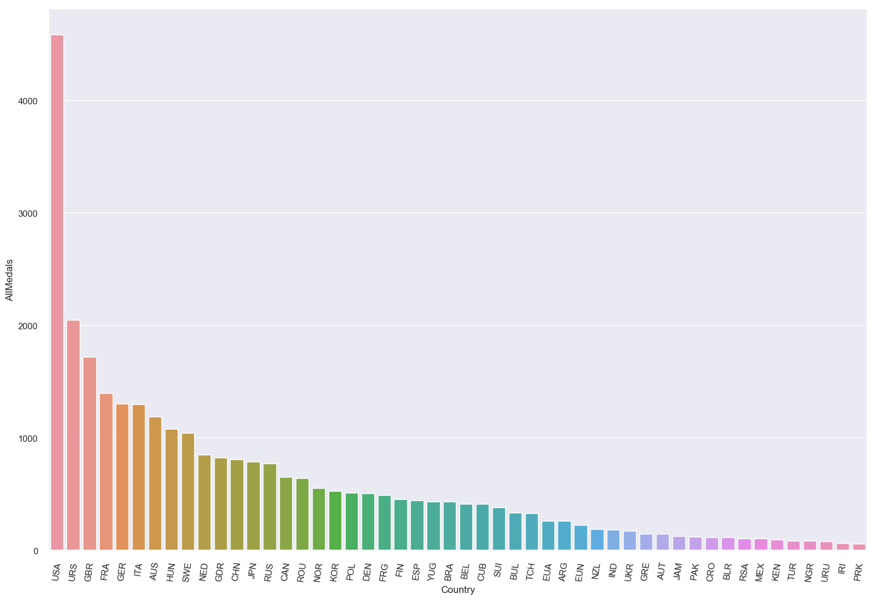
Analysis-5: - Country on Top
Outcome:
USA is the country who top in the mdeal tally than others.

Slide 10
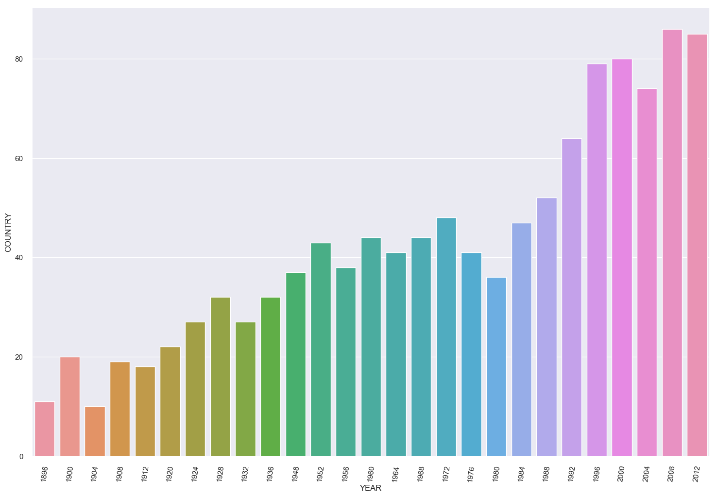
Analysis-6: - Year wise countries participation.
Outcome:
From the graph its clear that the no of participant country is increasing year by year. That means its gains popularity in different countries.

Slide 11
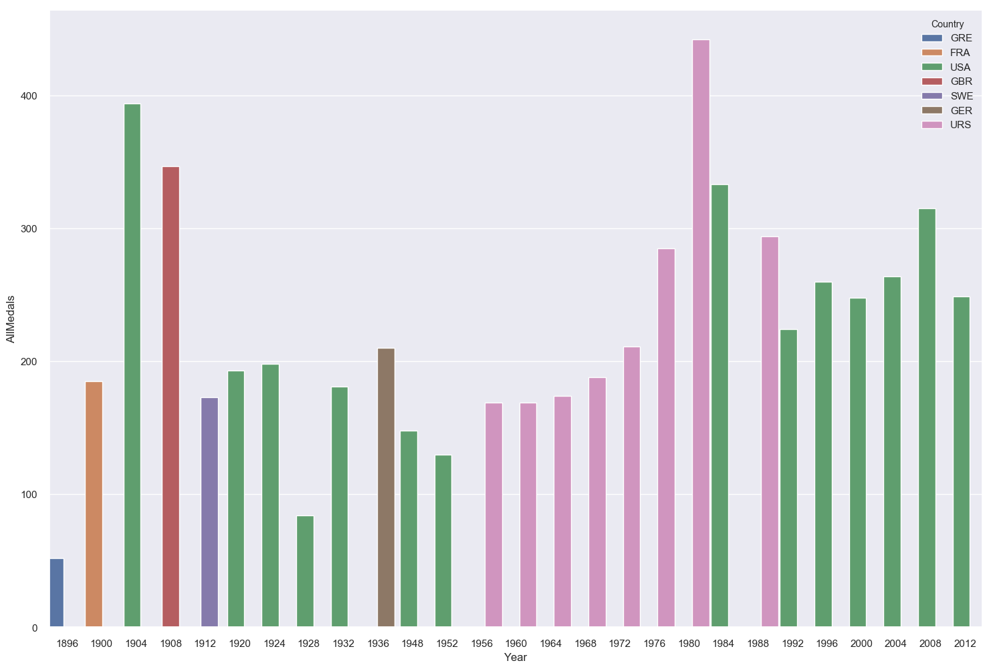
Analysis-7: - Sports in winning spot
outcome:
From the above its clear that from 1896 to 2012:- USA top for 14 times. And second is by USSR (Soviet Union)

Slide 12
Analysis-8: - Top players with no of medals
 | Bronze | Silver | Gold | AllMedals
Athlete
PHELPS, Michael | 2 | 2 | 18 | 22
LATYNINA, Larisa | 4 | 5 | 9 | 18
ANDRIANOV, Nikolay | 3 | 5 | 7 | 15
MANGIAROTTI, Edoardo | 2 | 5 | 6 | 13
SHAKHLIN, Boris | 2 | 4 | 7 | 13
ONO, Takashi | 4 | 4 | 5 | 13
FISCHER, Birgit | 0 | 4 | 8 | 12
NURMI, Paavo | 0 | 3 | 9 | 12
COUGHLIN, Natalie | 5 | 4 | 3 | 12
NEMOV, Alexei | 6 | 2 | 4 | 12

Slide 13
Analysis-9: - Athelete With most numbers of Gold medals
 | Gold
Athlete
PHELPS, Michael | 18
LEWIS, Carl | 9
SPITZ, Mark | 9
NURMI, Paavo | 9
LATYNINA, Larisa | 9
THOMPSON, Jenny | 8
FISCHER, Birgit | 8
KATO, Sawao | 8
BIONDI, Matthew | 8
EWRY, Ray | 8

Slide 14
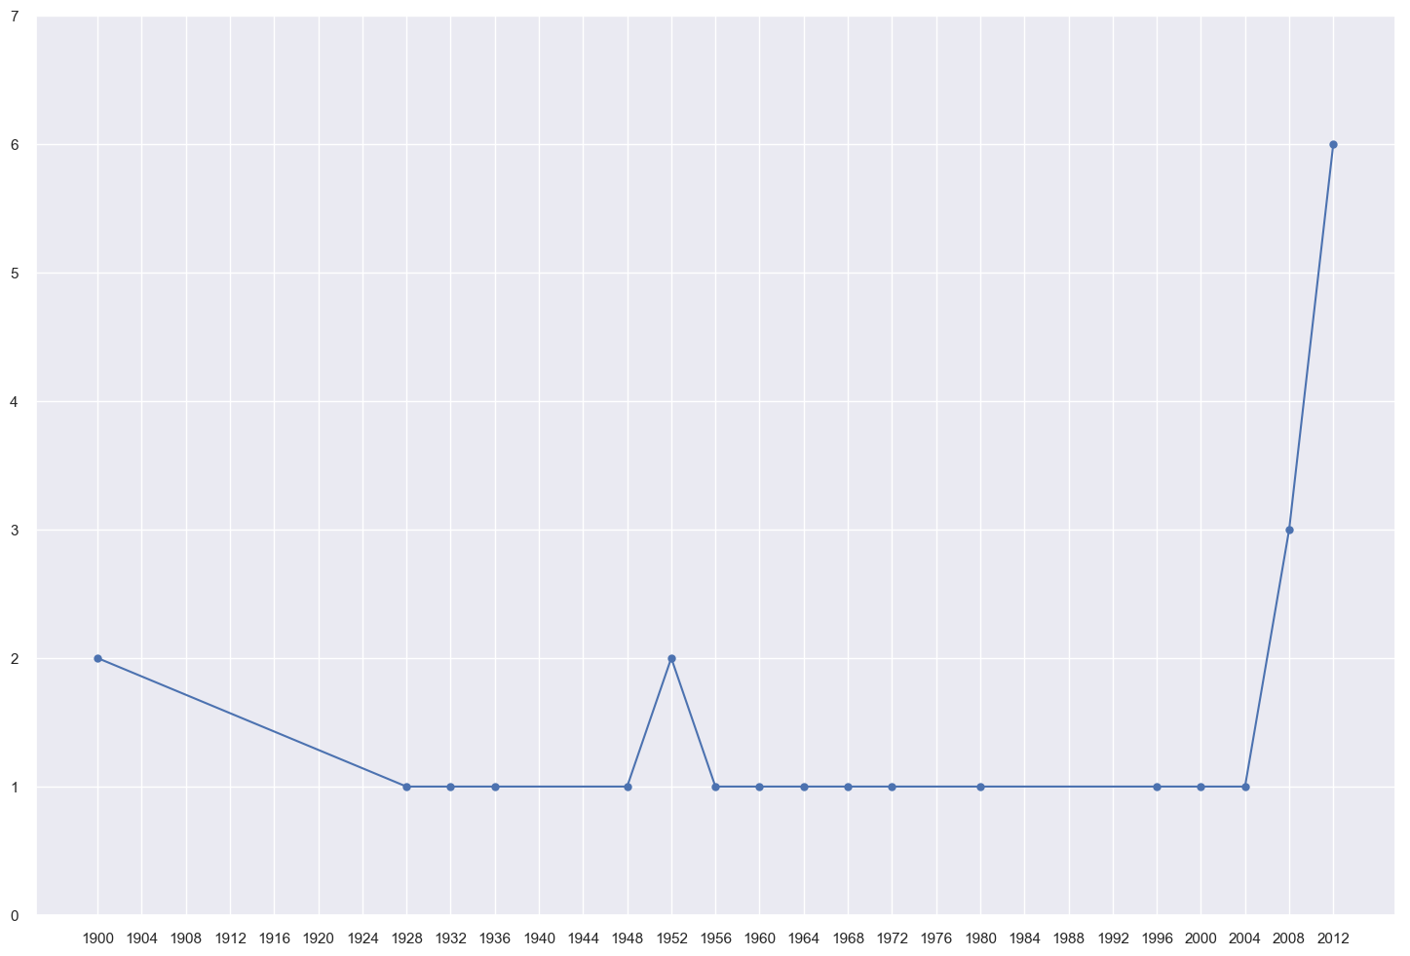
Analysis-10:- India on Olympic
From the Analysis its clear that India has won 6 as the highest no of medals in the year 2012.
Total no of Olympic medals won by India is 26

Slide 15
Conclusion:-
It’s a Basic analysis of summer Olympic. And used some resources from:
Wikipedia.com
Datascience.com
Kaggle
Stackoverflow
It can be furnished further with more analysis and clear graphs, and also some meaningful insights.

