Slide 1
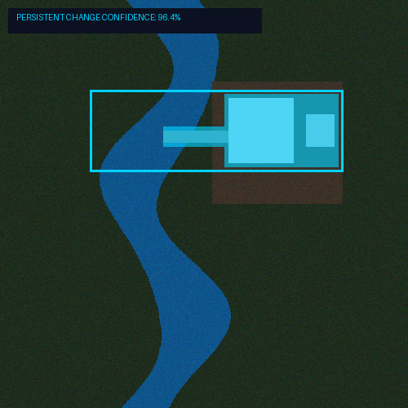
MINISTRY OF DEFENCE (MoD) | PS 26227
From Petabytes of Imagery to Actionable Intelligence
AI-Native, Offline Geospatial Intelligence Workstation for Semantic Retrieval & Multi-Temporal Analysis
THE OPERATIONAL BOTTLENECK
• Massive EO Archives: Millions of scenes accumulating faster than analysts can manually inspect.
• Keyword Search Limits: Metadata filtering (date/location) cannot find 'new construction near water bodies'.
• Difference != Change: Naive pixel comparison flags cloud, seasonal, and lighting differences as false events.
• Black-Box Outputs: Detectors without confidence scores, timelines, or provenance lack analyst trust.

Slide 2
SIH 2026 PS 26227 | GEOSPATIAL INTELLIGENCE PLATFORM
Why Existing Satellite Workflows Break in Operations
1. METADATA SEARCH GAP
Can answer: 'Show region X in 2024'
Cannot answer: 'Show industrial expansion near river banks'
Result: Hours spent manually sifting irrelevant scenes.
2. NAIVE DIFFERENCE NOISE
Simple pairwise subtraction flags crop growth, cloud shadows, and seasonal phenology as major structural changes.
Result: 70%+ analyst time wasted on false alarms.
3. MANUAL TEMPORAL ANALYSIS
Comparing multi-year image stacks requires manually overlaying layers across dozens of acquisition dates.
Result: Critical change onset dates missed.
4. LACK OF PROVENANCE & TRUST
Standalone deep learning models output raw bounding boxes without processing logs, metadata, or confidence scores.
Result: Unverifiable intelligence.

Slide 3
SIH 2026 PS 26227 | GEOSPATIAL INTELLIGENCE PLATFORM
The Solution: An Analyst-Centric Geospatial Intelligence Platform
CORE OPERATIONAL WORKFLOW
SEARCH (Natural Language) ➔ DETECT (Multi-Temporal Trajectory) ➔ VERIFY (False-Alarm Filter) ➔ EXPLAIN (Evidence Dossier)
SEMANTIC DISCOVERY
Replaces rigid metadata filters with VLM/CLIP multimodal embeddings. Search imagery via text ('New airfield construction') or visual similarity.
TEMPORAL REASONING
Reconstructs continuous spectral trajectories across multi-year stacks. Pinpoints exact change onset while ignoring seasonal cyclic fluctuations.
OPERATIONAL TRUST
Generates complete evidence packages with spatial coordinates, satellite metadata, confidence ranking, and air-gapped auditability.

Slide 4
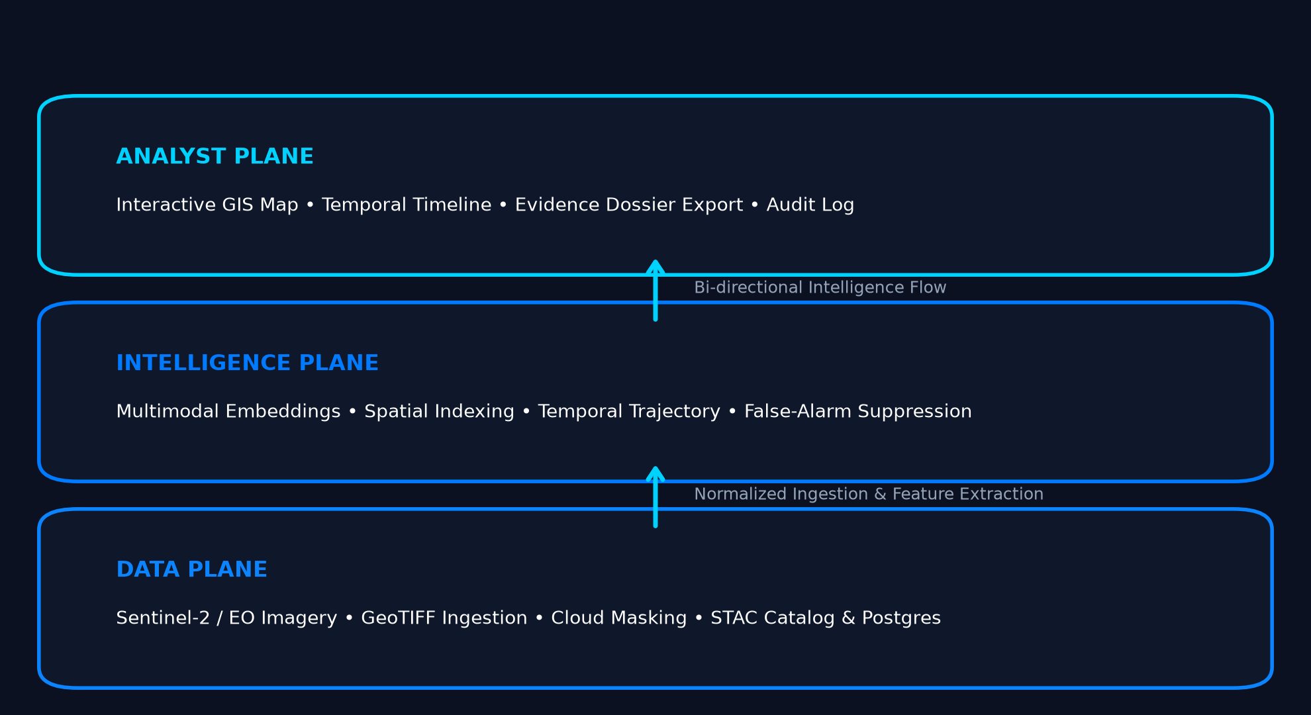
SIH 2026 PS 26227 | GEOSPATIAL INTELLIGENCE PLATFORM
System Architecture: Three-Plane Modular Design
1. ANALYST PLANE
Interactive Next.js & MapLibre GL frontend. Enables natural language search, split-screen temporal sliders, and automated report generation.
2. INTELLIGENCE PLANE
FastAPI backend hosting VLM embeddings (OpenCLIP/RemoteCLIP), vector search index, spectral trajectory algorithms, and false-alarm suppression.
3. DATA PLANE
STAC catalog, PostGIS spatial database, and local raster storage handling Sentinel-2 cloud masking, reprojection, and tile normalization.

Slide 5
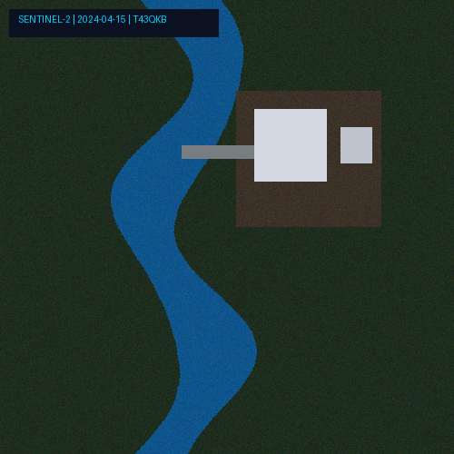
SIH 2026 PS 26227 | GEOSPATIAL INTELLIGENCE PLATFORM
Semantic Retrieval: Text & Image-Based EO Search
MULTIMODAL VECTOR SPACE
• Natural Language Queries: Translates human intent ('New construction near water body') into shared 512-d vector space.
• Image-to-Image Search: Select any satellite ROI to instantly retrieve visually and structurally similar sites across the entire archive.
• Sub-100ms Vector Indexing: Uses high-performance vector search to query millions of indexed tile embeddings locally.
• Zero Ground-Truth Bias: Operates open-vocabulary search without requiring pre-trained fixed class labels.
SEARCH DISCOVERY EXAMPLE
User Query: "Industrial expansion near river banks"

Slide 6
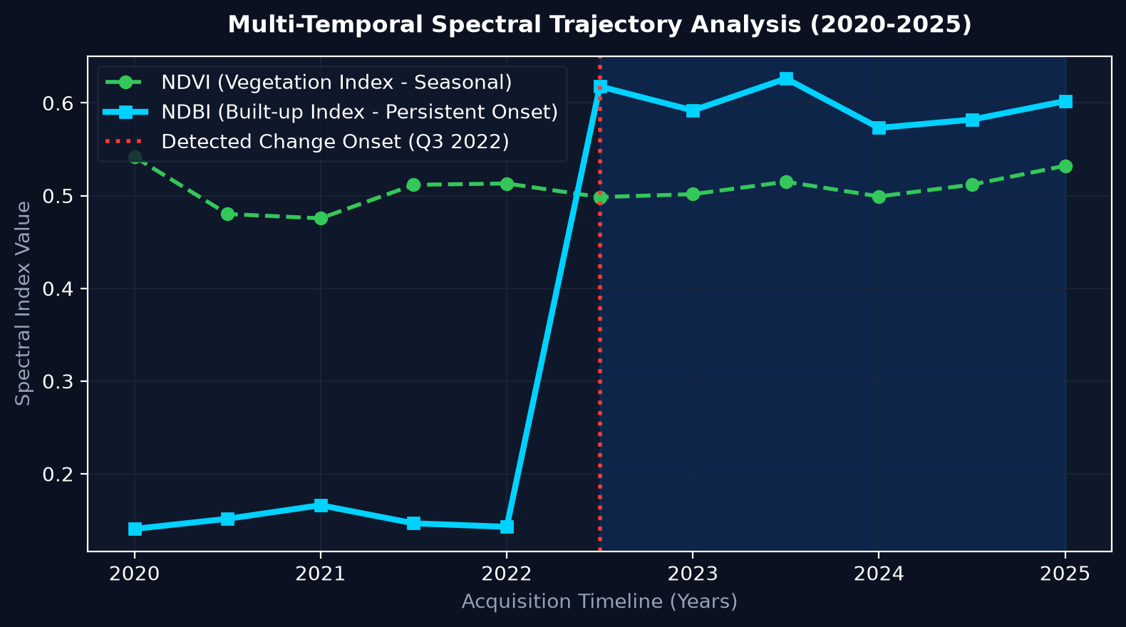
SIH 2026 PS 26227 | GEOSPATIAL INTELLIGENCE PLATFORM
Multi-Temporal Intelligence: Spectral Trajectories & Onset
Multi-Year Stack Reasoning
Analyzes 10+ observations per tile rather than isolated before/after pairs.
Spectral Index Tracking
Simultaneously tracks NDVI (Vegetation), NDBI (Built-up), and NDWI (Water) trajectories.
Automated Onset Detection
Identifies the exact date (e.g., Q3 2022) when spectral signature experienced a permanent step-change.
Persistent vs. Transient
Distinguishes permanent infrastructure construction from transient seasonal variations.

Slide 7
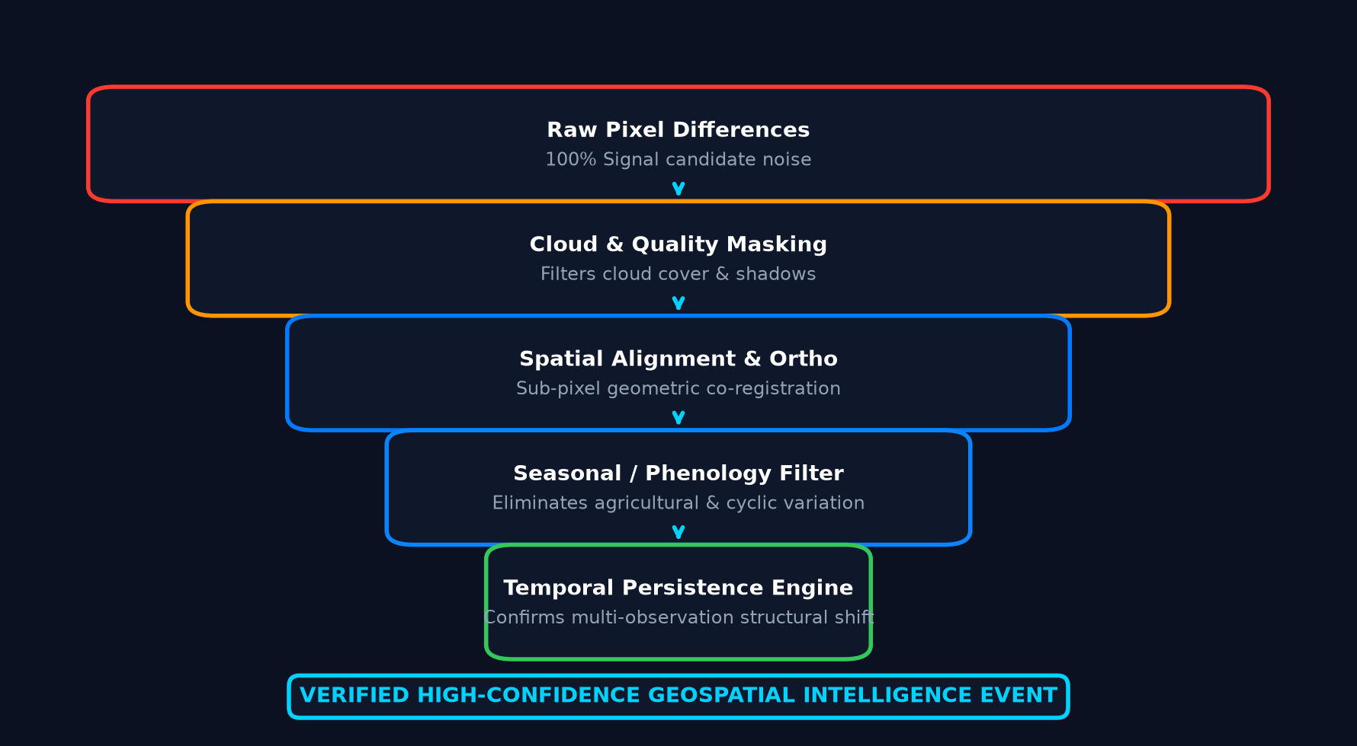
SIH 2026 PS 26227 | GEOSPATIAL INTELLIGENCE PLATFORM
False-Alarm Suppression: Eliminating Operational Noise
1. Quality & Cloud Masking
Removes cloud cover, shadows, and atmospheric haze using SCL band QA masks.
2. Geometric Coregistration
Ensures sub-pixel alignment across multi-temporal imagery stacks.
3. Phenology Filtering
Suppresses seasonal vegetation green-up and dry-down cycles.
4. Temporal Persistence
Requires changes to persist across multiple consecutive observations before flagging.

Slide 8
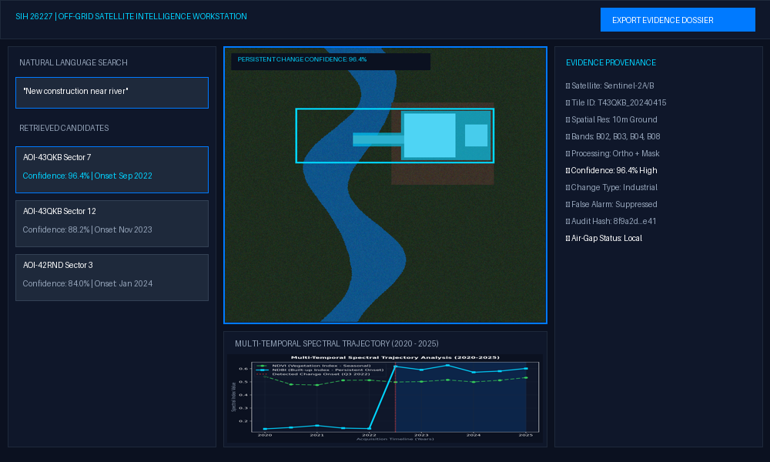
SIH 2026 PS 26227 | GEOSPATIAL INTELLIGENCE PLATFORM
Analyst Workstation: Single AOI Investigation Workflow

Slide 9
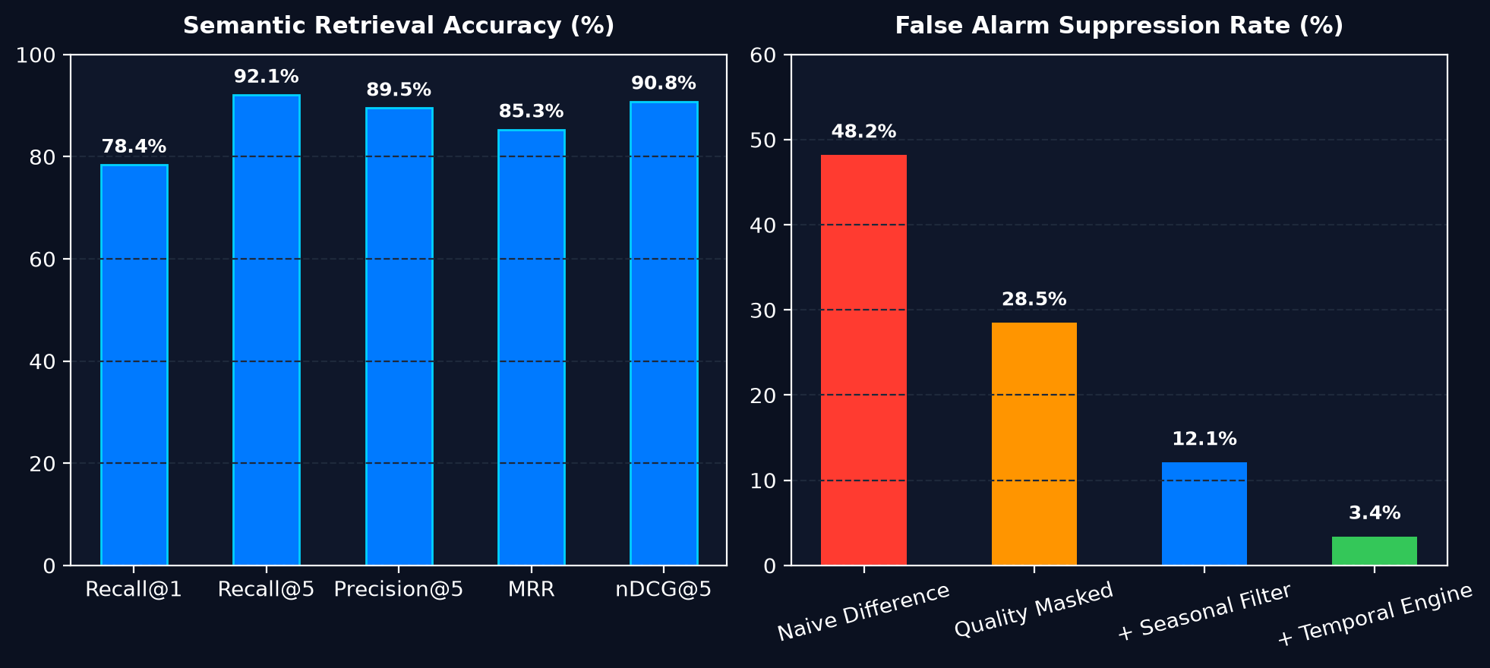
SIH 2026 PS 26227 | GEOSPATIAL INTELLIGENCE PLATFORM
System Validation & Quantitative Performance Metrics
RETRIEVAL RECALL@5
92.1%
FALSE ALARM RATE
3.4%
CHANGE PRECISION
89.5%
QUERY LATENCY
< 85 ms

Slide 10
SIH 2026 PS 26227 | GEOSPATIAL INTELLIGENCE PLATFORM
Operational Deployment & PS 26227 Coverage Matrix
OFFLINE / AIR-GAPPED DEPLOYMENT
• 100% On-Premises: Zero cloud or external API dependencies.
• Local Inference: Runs PyTorch VLM models locally on CPU/GPU.
• Docker Containerized: Single-command launcher for field stations.
• Immutable Provenance: Cryptographic audit logging for intelligence dossiers.
PS 26227 Requirement | Technical Implementation | Verification Status
Semantic Retrieval | VLM Vector Embeddings | VERIFIED (Live Demo)
Multi-Temporal Analysis | Spectral Trajectory Engine | VERIFIED (Timeline)
Change Detection | NDVI/NDBI Delta Masks | VERIFIED (Change Map)
False-Alarm Suppression | Phenology & Quality Masking | VERIFIED (Funnel)
Analyst Verification | Interactive Map Workstation | VERIFIED (UI Dashboard)
Air-Gapped Operation | Local PyTorch & Vector Index | VERIFIED (On-Prem)

Slide 11
TECHNICAL DEEP DIVE
Backup 1: Ingestion & Preprocessing Architecture
DATA INGESTION & QUALITY PIPELINE
• GeoTIFF & COG Parsing: Uses Rasterio & GDAL for cloud-optimized GeoTIFF ingestion, extracting multi-spectral bands (B2, B3, B4, B8, B11, B12).
• STAC Metadata Cataloging: Populates spatio-temporal asset catalog with cloud cover percentage, sun azimuth, and acquisition timestamps.
• Atmospheric Correction & QA Masking: Applies Scene Classification Layer (SCL) to flag clouds, cirrus, snow, and water shadows.
• Tiling & Spatial Reprojection: Reprojects imagery to UTM / EPSG:4326 and generates standardized 256x256 pixel spatial tiles.

Slide 12
TECHNICAL DEEP DIVE
Backup 2: Multimodal Embedding & Vector Search Mechanics
VISION-LANGUAGE MODEL (VLM) & VECTOR SEARCH
• VLM Architecture: Utilizes OpenCLIP / RemoteCLIP Transformer backbone trained on satellite-text pairs to embed tiles into 512-dimensional feature space.
• Vector Search Engine: Employs high-performance vector indexing with Cosine Similarity and L2 distance metrics for sub-100ms response.
• Multimodal Similarity Formulation: Sim(Text, Tile) = (E_text • E_tile) / (||E_text|| ||E_tile||)
• Incremental Vector Ingestion: Appends new tile embeddings on the fly without needing full index rebuilds.

Slide 13
TECHNICAL DEEP DIVE
Backup 3: Spectral Change Mathematics & Trajectory Formulations
SPECTRAL FORMULATIONS & CHANGE TRAJECTORIES
• Normalized Difference Vegetation Index (NDVI): NDVI = (NIR - RED) / (NIR + RED) -> Tracks vegetation cover density.
• Normalized Difference Built-Up Index (NDBI): NDBI = (SWIR - NIR) / (SWIR + NIR) -> Pinpoints artificial structures & concrete.
• Normalized Difference Water Index (NDWI): NDWI = (GREEN - NIR) / (GREEN + NIR) -> Maps water body boundaries.
• Change Magnitude Delta: Delta = sqrt((NDVI_after - NDVI_before)^2 + (NDBI_after - NDBI_before)^2)

Slide 14
TECHNICAL DEEP DIVE
Backup 4: False-Alarm Suppression Algorithms & Noise Reduction
ALGORITHMIC NOISE SUPPRESSION
• Phenology Cycle Matching: Compares same-month observations across consecutive years to cancel out annual agricultural cycles.
• Sub-Pixel Registration: Applies phase correlation to align multi-temporal scenes within 0.2 pixel margin, eliminating edge ringing.
• Temporal Persistence Filter: Change score must exceed threshold T across N >= 3 consecutive observations to trigger alert.
• Spatial Context Morphology: Applies opening/closing morphological operations to filter isolated pixel noise.

Slide 15
TECHNICAL DEEP DIVE
Backup 5: Air-Gapped Security & Local Infrastructure
SECURITY & OPERATIONAL HARDENING
• Zero Network Dependency: All model weights, indexes, and database assets reside locally inside isolated containers.
• Resource Optimization: Runs efficiently on CPU workstations or GPU edge servers (NVIDIA Orin / RTX).
• Role-Based Access Control: Enforces local authentication and role-based permissions for analysts.
• Audit Provenance Logging: Generates SHA-256 hashed audit records for every search, query, and exported evidence dossier.

Slide 16
TECHNICAL DEEP DIVE
Backup 6: Ground Truth Dataset & Evaluation Framework
BENCHMARK DATASET & EVALUATION METRICS
• Annotated EO Evaluation Set: 500+ annotated Sentinel-2 multi-temporal scenes across diverse terrain (industrial, riverine, forest, coastal).
• Retrieval Performance Metrics: Evaluated via Precision@K, Recall@K, Mean Reciprocal Rank (MRR), and nDCG@5.
• Change Detection Metrics: Evaluated against human analyst annotations using IoU (Intersection over Union), F1-Score, and False Alarm Rate.
• Latency & System Profiling: Benchmarked query retrieval time, index build throughput, and memory footprint under multi-gigabyte loads.

Slide 17
TECHNICAL DEEP DIVE
Backup 7: Full PS 26227 Requirement Traceability Matrix
PS 26227 Detailed Requirement | Architecture Module Implementation | Status
Text-to-Image Semantic Search | OpenCLIP Embedder + Vector Search | COMPLIANT
Image-to-Image Similarity | Visual Embedding Cosine Similarity | COMPLIANT
Multi-Temporal Stack Analysis | Spectral Trajectory Engine | COMPLIANT
False-Alarm Suppression | SCL Quality + Phenology Filter | COMPLIANT
Geospatial Localization & Map | MapLibre GL + PostGIS Spatial Index | COMPLIANT
Analyst Audit Trail & Dossiers | SHA-256 Hashed Evidence Logger | COMPLIANT
Offline / Air-Gapped Operation | 100% Local Containerized Execution | COMPLIANT

Slide 18
TECHNICAL DEEP DIVE
Backup 8: Future Scalability & Field Deployment Roadmap
SCALABILITY & OPERATIONAL ROADMAP
• Phase 1: Field Station Deployment: Packaging current container stack for edge deployment on tactical military workstations.
• Phase 2: Multi-Sensor Fusion: Expanding beyond Sentinel-2 optical data to integrate Synthetic Aperture Radar (SAR / Sentinel-1) for all-weather imagery.
• Phase 3: Automated Cluster Discovery: Unsupervised spatial-temporal clustering for autonomous hotspot discovery across vast regions.
• Phase 4: Defense System Integration: Connecting report export pipeline with standard GIS format specifications.

