Slide 1
A CBIR WEBPAGE USING PYTHON

Slide 2
ABSTRACT
A CBIR webpage using Keras , Tensorflow and flask libraries in python . For this CBIR we are using the VGG16(“Very Deep Convolutional Networks for Large-Scale Image Recognition”) architecture to retrieve the features from the images . VGG is a convolution neural network architecture considered to be one of the best computer vision model architecture till date .I have implemented this VGG16 architecture in the project the CBIR system .VGG has 16 separate layers that have weights .
VGG comes with a pretrained model using the weights and does not require training separately and is readily implementable ,which is used in this project

Slide 3


Python libraries used

Slide 4
DIR of project
Feature_extractor.py
offline.py
server.py
CBIR Project
Feature
Img1.npy
Img2.npy
Img
Img1.jpg
Img2.jpg
Uploaded
Query1.jpg
Templates
Index.html

Slide 5
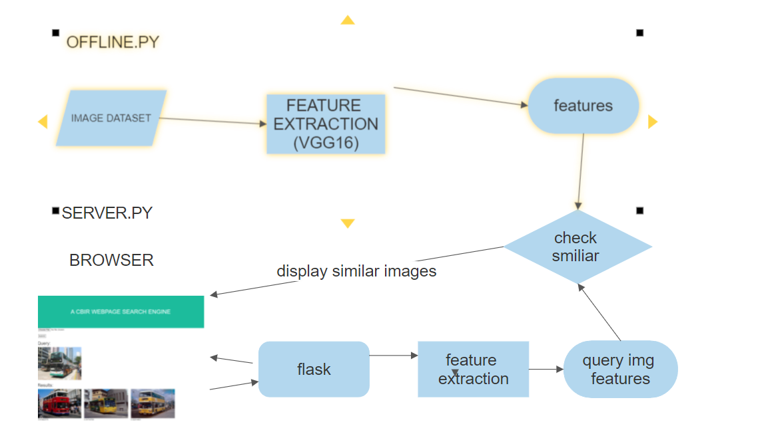
Workflow

Slide 6

Screenshots of project

