Slide 1
Factors of Imperialism
ECONOMIC
POLITICAL
CULTURAL
RELIGIOUS

Slide 2
ECONOMIC motives included the desire to make money, to expand and control foreign trade, to create new markets for products, to acquire raw materials and cheap labor, to compete for investments and resources, and to export industrial technology and transportation methods.
    IMAGE:
POLITICAL motives were based on a nation’s desire to gain power, to compete with other European countries, to expand territory, to exercise military force, to gain prestige by winning colonies, and to boost national pride and security.
    IMAGE:
EXPLORATORY motives were based on the desire to explore “unknown” or uncharted territory to conduct scientific research, to conduct medical searches for the causes and treatment of diseases, to go on an adventure, and to investigate “unknown” lands and cultures.
    IMAGE:
CULTURAL
IDEOLOGICAL motives were based on cultural values such as the belief that the white race was superior, other cultures were “primitive,” Europeans should “civilize” peoples in other parts of the world, great nations should have empires, and only the strongest nations will survive. (Social Darwinism)
    IMAGE:
RELIGIOUS motives included the desire to spread Christianity, to protect European missionaries in other lands, to spread European values and moral beliefs, to educate people s of other cultures.
    IMAGE:

Slide 3
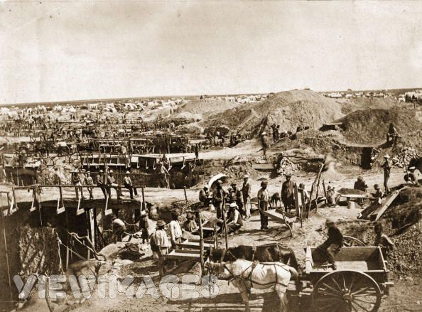
What do you see above the surface?
Symbol of Motive(s)
Why did you chose this Motive(s)?

Slide 4

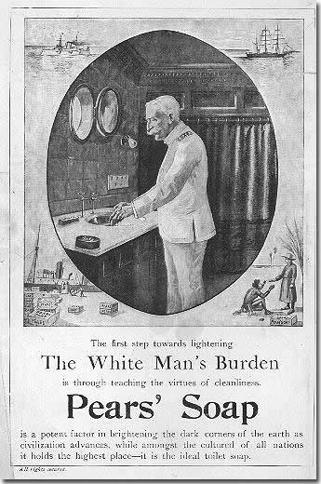
What do you see above the surface?
Symbol of Motive(s)
Why did you chose this Motive(s)?

Slide 5
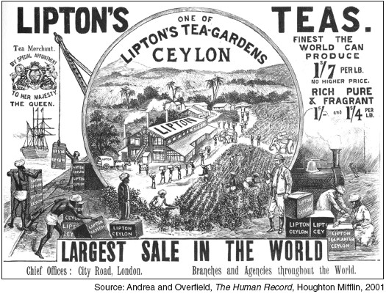
What do you see above the surface?
Symbol of Motive(s)
Why did you chose this Motive(s)?

Slide 6
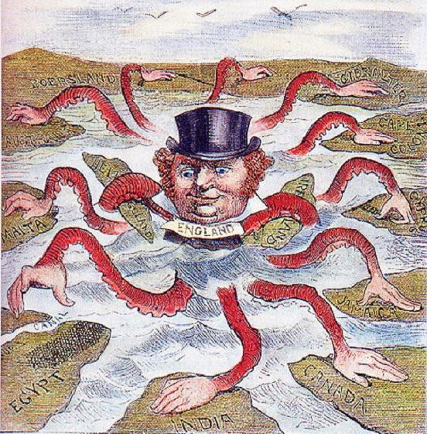
What do you see above the surface?
Symbol of Motive(s)
Why did you chose this Motive(s)?

Slide 7
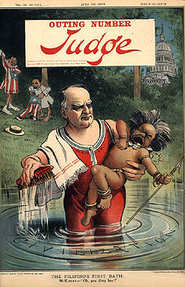
What do you see above the surface?
Symbol of Motive(s)
Why did you chose this Motive(s)?

Slide 8
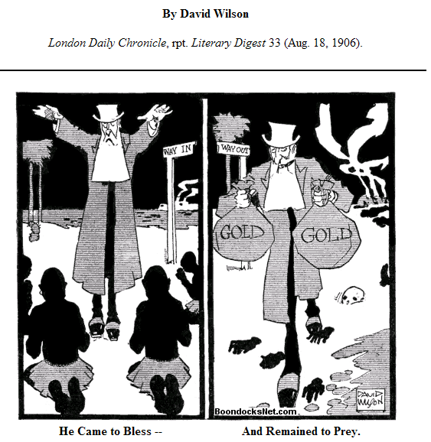
What do you see above the surface?
Symbol of Motive(s)
Why did you chose this Motive(s)?

Slide 9
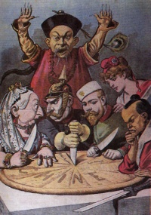
What do you see above the surface?
Symbol of Motive(s)
Why did you chose this Motive(s)?

Slide 10
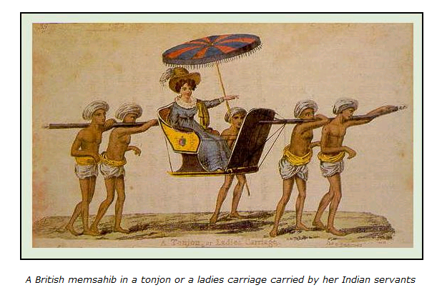
Taken from: www.hinduwisdom.info/European_Imperialism.htm
What do you see above the surface?
Symbol of Motive(s)
Why did you chose this Motive(s)?

Slide 11
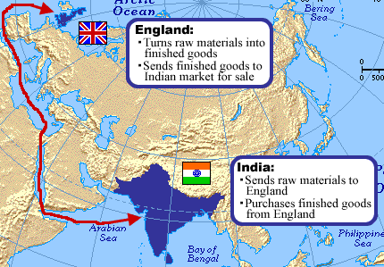
British Imperialism

