Slide 1
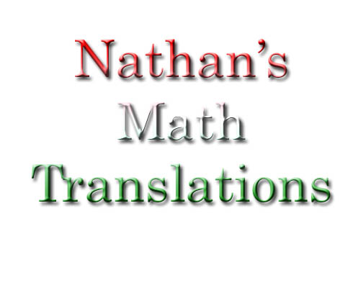
By: Nathan R. Arcuri

Slide 2
?¿?¿?
This will help you get a better understanding for Math problems and what each term means. This will translate Algebraic Expressions into English Expressions. With Nathan’s Math Translations, you just might pass this class after all.

Slide 3

Example 1:
Phrase: 6 less than half the quantity of an unknown plus 5
Algebraic Expression:
Write another phrase:
₍ ₊ ₎
_{x}
₅
₋₆
½
_{The quantity of}
_{A number}
_{Increased by}
₅
_{Minus six.}

Slide 4
Example 2:
Phrase: Seven less than a number increased by five and multiplied by ten.
Algebraic Expression: 10*5+x-7
Write another phrase: Ten multiplied by five increased by a number minus seven.

Slide 5
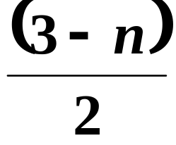
Example 3:
Algebraic Expression:
Phrase:
The quantity
of 3
less than a number
divided by 2.

Slide 6
Example 4:
Algebraic Expression:(10x-8)
5
Phrase:
_{The quantity of}
_{ten}
_{multiplied by a}
_{Number}
_{subtracted by eight}
_{divided by five.}

Slide 7
Commence Ending = Very Yes

