Slide 1
ETL The Look: Analyzing 2025 Sales and Stock
By Narda Noviantoro

Slide 2
Business Problem
Identified Problems:
The company cannot easily see which products sell the fastest. This means that it is difficult to identify which products require priority restocking.
There are some products that stay too long in the warehouse indicating that they have not sold, which means that capital is being held in unsold stock.
Cause: sales and stock data are separate.
Objective: Building a data warehouse that joins sales and stock data to identify slow-moving stock and see which products sell fast.
Who is it for: sales and merchandising team
Time Period:
2025
  2026 data will not be included because the year has not ended, so the data is still incomplete.

Slide 3
Business Process
A product is registered and listed for sale.
Product stock arrives at the distribution center and is prepared to be sold.
A customer orders a product, then one unit from the stock is allocated for that order.
That stock unit is marked as sold.
The product is sent from the distribution center to the customer.
If any problems occur or a customer is dissatisfied, some orders may be cancelled or returned by customers.
Stock that was not sold is kept in the distribution center and is considered slow-moving.

Slide 4
Data Modeling: Fact and Dimension Tables
Fact Tables:
fact_sales (main):
  Grain: one row = one order item
  Measures: sale_price, cost, profit
fact_inventory (supporting):
  Grain: one row = one stock unit
  Measures: cost, is_sold, days_in_stock
Dimension Tables:
dim_product (products being sold)
dim_distribution_center (where products are stored and sent)
dim_user (who buys the products)
dim_date (shows sales and stock dates)

Slide 5
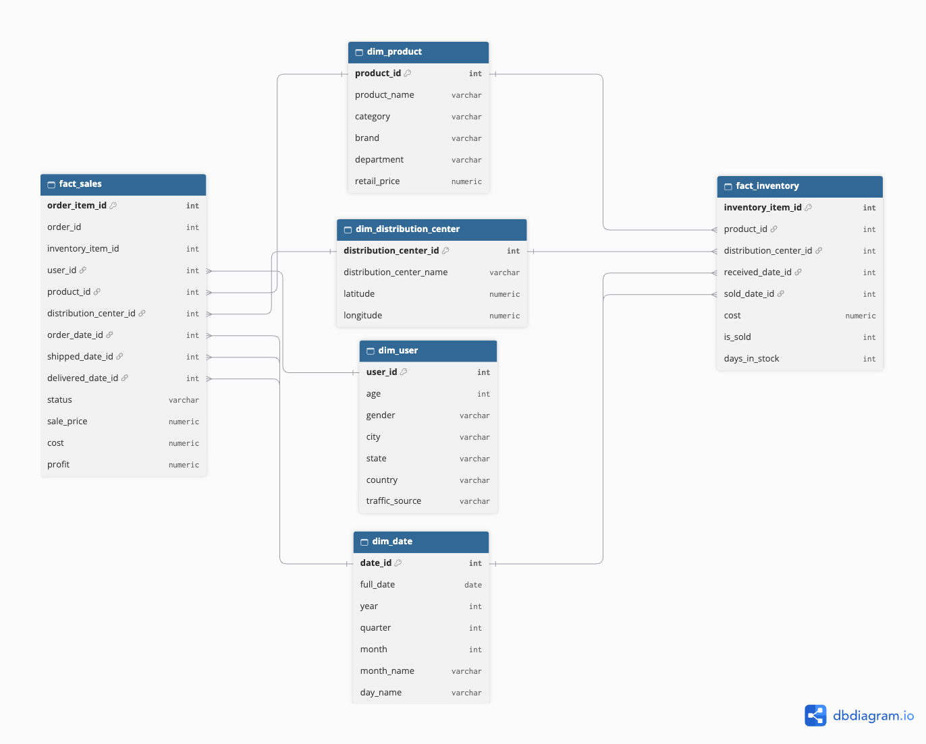
Data Modeling: Galaxy Schema
fact_sales and fact_inventory share dim_product, dim_distribution_center, and dim_date

Slide 6
ETL Process
Extract:
Used 5 queries in BigQuery (thelook_ecommerce) to extract related 2025 data:
  order_items
  inventory_items
  products
  users
  distribution_centers
Saved to 5 CSV files and loaded into PySpark
Transform:
Changed column names and converted text/object data types to date format
Filled in null values with ‘Unknown’ and rounded cost values
Created the dimension and fact tables
Created new columns (profit, is_sold, days_in_stock)
Load:
Created a new database (thelook_dwh) and tables in PostgreSQL
Data is loaded using JDBC into PostgreSQL

Slide 7
Results and Conclusion
Results:
The selling speed between categories is similar (between 28.9 and 32.5 days).
  Dresses are the fastest selling and Jumpsuits & Rompers are the slowest.
More than 50% of stock in each distribution center is not sold, with Mobile AL having the largest unsold percentage (52.46%).
Conclusion:
Dresses can be prioritized for restocking.
The unsold stock across all distribution centers may suggest a widespread problem.
There may be problems with overstocking or weak demand.
Future analysis: planning stock purchasing and analyzing marketing performance using sales data.

Slide 8
Thank You

