Slide 1
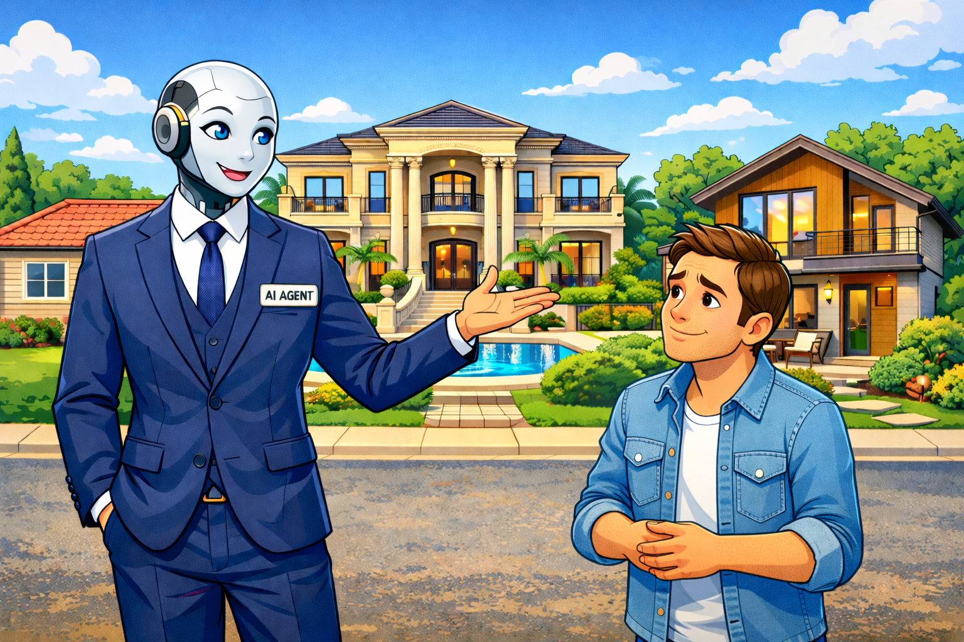
BrokerAI
- Doncho Ivanov, Lora Hristova

Slide 2
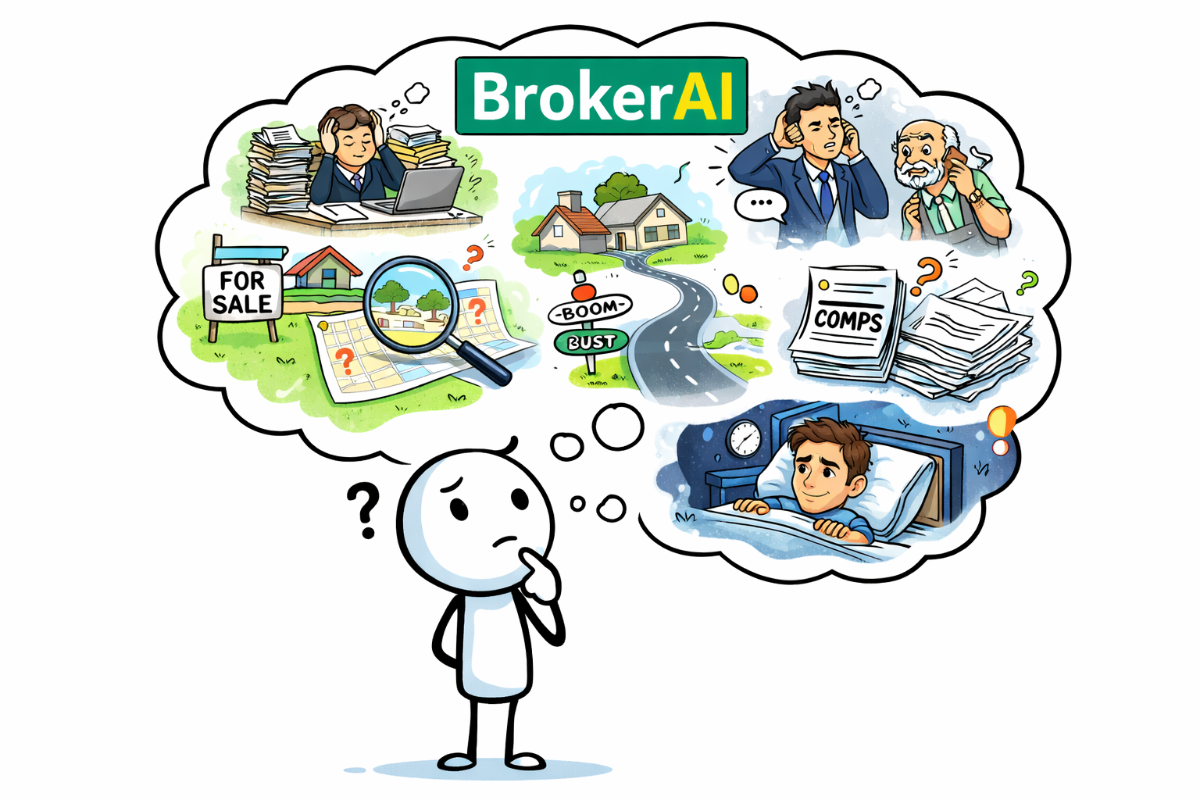
The Idea Behind BrokerAI

Slide 3
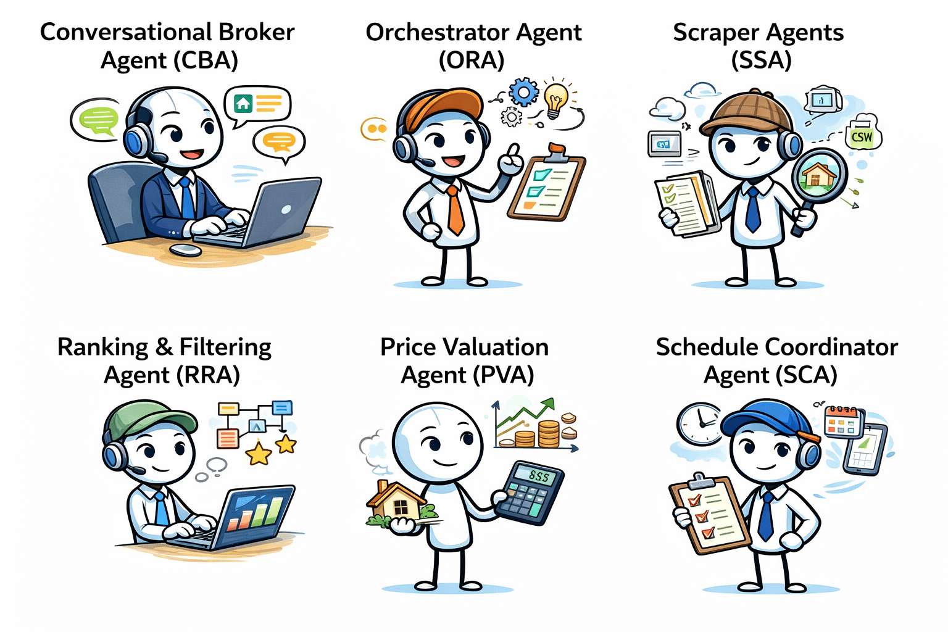
Agents we wanted to include

Slide 4
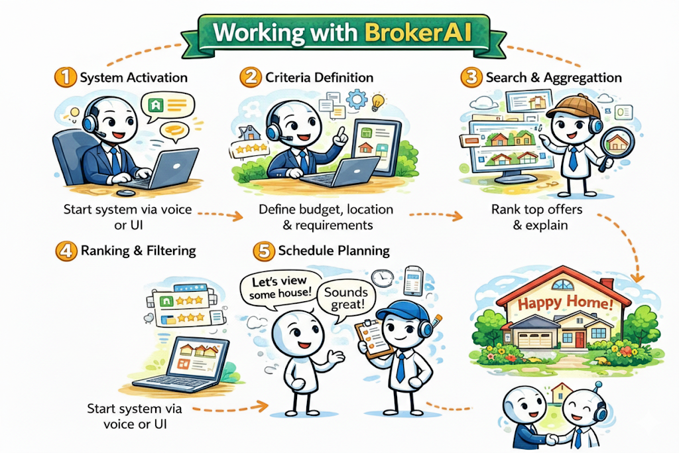
BrokerAI experience

Slide 5
