Slide 1
MoldVision AI: Project Demo
AI + Computer Vision for Mold Detection
Presented on: 2025-08-27

Slide 2
Project Overview
This project combines Large Language Models (LLM) and Vision-Language Models (VLM) using YOLOv8
to detect mold presence on surfaces such as bread and PCB boards.
LLM Part: Predicts mold risk based on temperature, humidity, storage duration, and surface type.
VLM Part: Uses YOLOv8 to detect mold presence in images, including real-time webcam captures.
Results are logged and visualized for analysis.

Slide 3
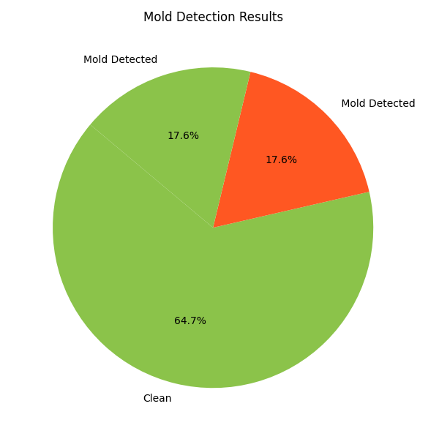
Mold Detection Summary

Slide 4
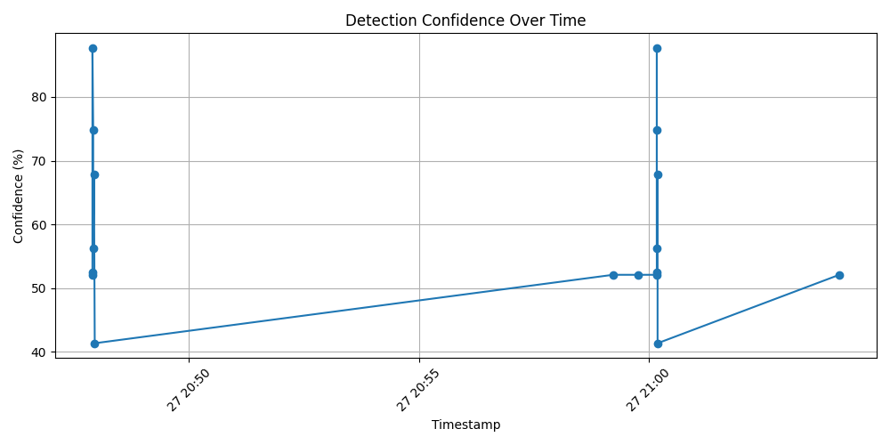
Confidence Over Time

Slide 5
How It Works (YOLOv8)
1. Image is captured from webcam or selected from storage.
2. YOLOv8 model processes the image to detect mold presence.
3. Bounding boxes highlight detected areas (if any).
4. Detection results are logged to CSV and visualized.

Slide 6
Modular Detection Modes
✅ Scan All Images
📅 Scan Today's Captures
📸 Scan Only Latest Image
Each detection mode is accessible via its own Python script.

Slide 7
Final Thoughts
This mini project showcases practical AI application in Computer Vision with flexible scanning options,
easy reporting, and integration potential with IoT for future upgrades.
Built using Python, OpenCV, Pandas, Matplotlib, and Ultralytics YOLOv8.

