Slide 1
Parking Space
Reservation Agent
PROJECT OVERVIEW
P
RAG assistance. Human approval.
Approved-only recording.
ASK
REVIEW
RECORD
Narek Hovhannisyan
Python / LangChain / LangGraph / MCP
Source: PROJECT_REQUIREMENTS.md
Narek Hovhannisyan / Parking Space Reservation Agent
01 / 14
Notes:
Suggested time: 25 seconds
This project connects a parking-information chatbot to a human approval workflow and approved-only file recording. It is a Python learning assignment built around LangChain, LangGraph, RAG and MCP, rather than a production parking business. I will explain the responsibilities of each component, show the Studio workflow, and finish with the measured results and their limits. The central distinction throughout is that an LLM can help with language, but it cannot approve or allocate a reservation. Those transitions are explicit and controlled.
Sources: PROJECT_REQUIREMENTS.md; README.md

Slide 2
Four stages, one complete workflow
ASSIGNMENT COVERAGE
An assignment-scale solution, with a clear responsibility for every stage.
01
02
03
04
RAG chatbot
Human review
MCP recording
LangGraph
Parking answers
Detail collection
Privacy + evaluation
Second LangChain
agent
Studio interrupt
Approve or refuse
Approved-only
writes
Four-field text files
Private + reliable
Integrated state flow
End-to-end tests
Local load validation
Python + LangChain + LangGraph + RAG + a vector database.
Source: PROJECT_REQUIREMENTS.md
Narek Hovhannisyan / Parking Space Reservation Agent
02 / 14
Notes:
Suggested time: 35 seconds
The original assignment has four stages. First, build a RAG chatbot that answers parking questions, collects the required details, filters sensitive data and has an evaluation report. Second, create a separate LangChain agent that communicates with the administrator. Third, record only human-approved reservations using MCP and the specified four-field text format. Fourth, integrate and test the workflow through LangGraph, including dialogue, review and recording load. Chroma, Studio review and a private stdio MCP server are the accepted implementation choices. Examples such as email or FastAPI were not additional mandatory features.
Sources: PROJECT_REQUIREMENTS.md, stages 1–4; AGENTS.md, accepted choices

Slide 3
Two agents. Deterministic coordination.
ARCHITECTURE
Models assist with language; Python enforces the workflow and the human decides.
Parking agent
Administrator agent
Answers parking questions
Collects and clarifies user details
Prepares bounded review wording
Human chooses approve or refuse
Chroma
SQLite
stdio MCP
Public descriptions
Fixed hourly-price metadata
Hours + availability
Private hold ledger
Read-only approval checks
Approved-only text files
Azure/DIAL provides models + embeddings. Python + LangGraph coordinate; no third LLM.
Source: README.md
Narek Hovhannisyan / Parking Space Reservation Agent
03 / 14
Notes:
Suggested time: 50 seconds
There are two language-model agents, not a third orchestrator model. The parking agent handles user interaction and clarification. The administrator agent prepares a bounded review message from the canonical submitted request. Deterministic Python and LangGraph route the conversation, retrieve evidence, validate fields, create holds, apply human decisions and invoke recording. Chroma supplies public descriptions and hourly-price metadata. SQLite holds public dynamic facts and a separate private operational ledger. The recorder independently reads that ledger in read-only mode. Resources belong to the agent instance; conversation and request state belong to individual graph threads.
Sources: README.md, project structure/current workflow; AGENTS.md, agent ownership

Slide 4
RAG uses public facts—not reservation data
STAGE 1 / RETRIEVAL
A practical static/dynamic split keeps public evidence separate from private state.
STATIC / CHROMA
DYNAMIC / SQLITE
20 mock space descriptions
Routes, benefits and trade-offs
USD/hour prices as numeric metadata
No personal reservation details
Public hours and availability
Private pending / approved holds
Private ledger fields never enter RAG
Missing hours remain unknown
Public-topic query
Eligible IDs + filters
Top-3 retrieval
Guarded evidence
Unrelated turns skip retrieval; only bounded public evidence reaches parking answers.
Source: README.md
Narek Hovhannisyan / Parking Space Reservation Agent
04 / 14
Notes:
Suggested time: 40 seconds
The public corpus contains twenty fictional parking spaces with differentiated route descriptions, benefits and trade-offs. Their fixed USD hourly prices are numeric Chroma metadata, not embedded prose. SQLite provides hours and availability; missing hours remain unknown. Its private reservation table is never public RAG evidence. Python derives a bounded public-topic query rather than embedding names, vehicle identifiers or raw chat. It filters eligibility before retrieving up to three similarity-ranked options and guards the evidence. The existing extraction call distinguishes parking from unrelated conversation, so unrelated turns skip retrieval rather than receiving stale parking context.
Sources: README.md, persistent parking information/information retrieval; PARKING_DATA_MODEL.md

Slide 5
Filter first. Rank eligible options second.
STAGE 1 / OPTIONS & BUDGETS
Hard availability and price rules are applied before semantic similarity ranking.
1 / Eligibility
2 / Hourly budget
3 / Semantic ranking
Exclude public blocks
Exclude overlapping holds
Suggestions do not hold
spaces
Validate explicit USD/hour
cues
Filter numeric Chroma prices
Never pad over-budget
results
Rank descriptions of eligible
IDs
Return up to three options
Display every ID and hourly
rate
Optional budget—not a fifth reservation field
under $8/h: < $8 • up to $8/h: ≤ $8 • $5–$10/h: inclusive
Descriptive preferences rank options; they are not hard feature guarantees.
Source: README.md
Narek Hovhannisyan / Parking Space Reservation Agent
05 / 14
Notes:
Suggested time: 40 seconds
Availability and price compliance are code responsibilities. Python excludes publicly blocked spaces and conflicting holds, then combines those eligible IDs with an optional numeric hourly-price filter in Chroma before native top-three ranking. Under eight dollars is strict; up to eight dollars includes eight; supported ranges include both ends. Total-stay costs, ambiguous units and unsupported currency cues require clarification rather than unrestricted offers. The budget is optional search state, not a fifth required reservation field. Descriptive preferences such as carrying bags affect semantic ranking, not guaranteed accessibility or feature suitability. Python displays every selected ID, description and rate.
Sources: README.md, optional hourly price constraints; RAG_EVALUATION.md, budgets/benefits

Slide 6

Collect → validate → ask the user to confirm
STAGE 1 / RESERVATION DETAILS
A checked draft is ready for selection—not submitted and not administrator-approved.
DEMO / USER DETAILS
01
First name
02
Surname
03
Vehicle identifier
04
Duration in hours
No dates or timezone questions.
The server clock starts the period
when submission succeeds.
User review, not human administrator approval
Source: README.md
Narek Hovhannisyan / Parking Space Reservation Agent
06 / 14
Notes:
Suggested time: 45 seconds
The four required fields are first name, surname, a user-provided vehicle identifier and duration in hours. The vehicle does not need a conventional plate format. This implementation deliberately uses immediate duration-only requests: it never asks the user for a date, start time or timezone. Model extraction proposes grounded values; Python validates them and owns the revisioned confirmation summary shown here. Explicit corrections invalidate confirmation, and a vague disagreement blocks submission until clarified. Saying yes confirms only the current details—it is neither a submission nor human administrator approval. Names and vehicle details shown in these user-approved screenshots belong to the demonstration.
Sources: README.md, reservation draft collection; presentation/confirming-user-info-question.png

Slide 7
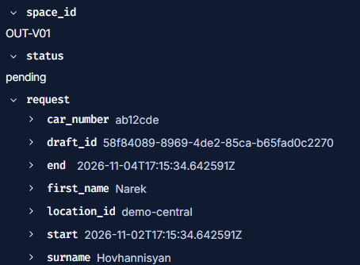
The human administrator owns the decision
STAGE 2 / HUMAN IN THE LOOP
The second LangChain agent prepares the request; a typed Studio interrupt pauses it.
01 /submit SPACE_ID
STUDIO / PRIVATE REVIEW PAYLOAD
Atomic eligibility recheck + pending hold
Server UTC period starts at submission
02 Review canonical facts
Select approve or refuse → Resume
No default decision or request-ID copying
Waiting counts toward the hours. Approval at/after the fixed end becomes elapsed.
Source: README.md
Narek Hovhannisyan / Parking Space Reservation Agent
07 / 14
Notes:
Suggested time: 45 seconds
After confirmation, the user selects a currently offered space with slash-submit and its ID. Python captures the server UTC time inside an atomic SQLite hold transaction and calculates the end from the confirmed duration. The administrator agent then prepares the review wording, while Python supplies the exact canonical facts through a typed LangGraph interrupt. In the same Studio thread, the operator selects approve or refuse and clicks Resume. No request ID needs to be copied and there is no default decision. Waiting for review consumes the requested hours; approval at or after the fixed end becomes elapsed, not approved.
Sources: README.md, Stage 2 submission/review; presentation/interrupting-for-admin-review.png

Slide 8
Only approval opens the recording gate
STAGE 3 / PRIVATE STDIO MCP
One code-selected tool, no arbitrary path or body, and no network listener.
Human-approved row
Private stdio MCP
Approved text file
SQLite is authoritative
Recorder opens existing data
read-only
Verify status and canonical details
Tool:
record_approved_reservation
Atomic no-overwrite publication
Validated success receipt
REQUIRED FOUR-FIELD FORMAT / TEMPLATE
Name
|
Car Number
|
Reservation Period
|
Approval Time
Full name • vehicle identifier • original UTC start/end • original UTC approval instant
Source: README.md
Narek Hovhannisyan / Parking Space Reservation Agent
08 / 14
Notes:
Suggested time: 45 seconds
Python invokes exactly one narrow MCP tool, record_approved_reservation, using internal request and thread identifiers. No language model chooses an arbitrary write tool, filename, body or path. The private stdio server independently reads SQLite in read-only mode and verifies a real human-approved canonical request. It owns the required four-field UTF-8 format: full name, vehicle identifier, original UTC reservation period and original UTC approval instant. The format shown here is a template, not a screenshot of an output file. Publication is atomic and does not overwrite existing files; matching-content replay provides idempotent file effects. Only a validated success receipt permits a recording-success reply.
Sources: README.md, Stage 3 approved recording; PROJECT_REQUIREMENTS.md, file-entry format

Slide 9
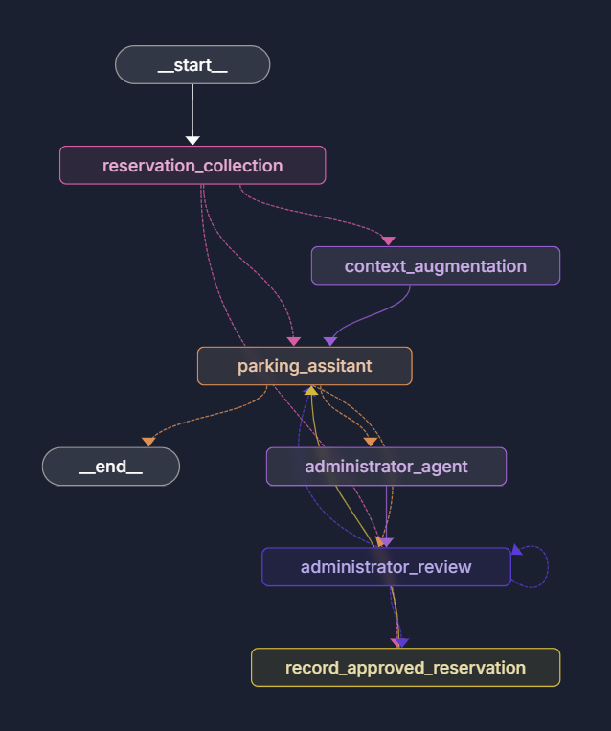
LangGraph makes each transition explicit
STAGE 4 / ORCHESTRATION
Checkpointed review, explicit branches, and code-controlled outcome messages.
COLLECT / ANSWER
Retrieve before information replies;
confirm and recheck current options.
SUBMIT / HOLD
One currently offered ID;
atomic UTC overlap recheck.
PAUSE / REVIEW
Checkpoint the request;
only human resume applies a decision.
RECORD / REPORT
Approve → MCP; refusal bypasses it.
Report approval and recording separately.
Source: README.md
Narek Hovhannisyan / Parking Space Reservation Agent
09 / 14
Notes:
Suggested time: 45 seconds
This is the actual Studio graph, including the intentionally retained spelling parking_assitant in code. Information turns retrieve evidence before answering. Collection, confirmation and submitted outcomes have code-controlled branches. After a successful submission, the graph emits the pending response, prepares administrator communication and pauses for review. Approval routes to recording; refusal or an elapsed request bypasses it. Invalid review values create a fresh interrupt without changing the ledger. Review preparation is checkpointed separately, so resuming does not create another hold or regenerate communication. Slash-new starts a separate one-space request only after a decision, preserving sequential workflow semantics.
Sources: README.md, current graph/hold and decision rules; presentation/agent-diagram.png

Slide 10
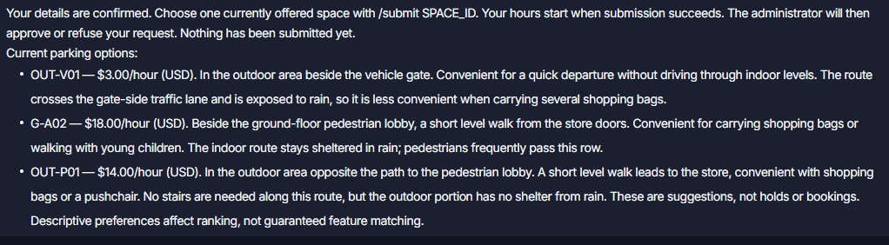
Demo: browse, confirm, keep useful choices
STUDIO WALKTHROUGH / USER
Initial browse choices survive collection and confirmation when they remain eligible.
BROWSE
COLLECT
CONFIRM
SUBMIT
No mandatory second /options search. The user explicitly selects /submit OUT-V01.
Source: README.md
Narek Hovhannisyan / Parking Space Reservation Agent
10 / 14
Notes:
Suggested time: 55 seconds
The user starts by asking for parking and mentioning heavy bags. Early browsing is allowed, and the chatbot displays options while collecting the missing details. The user then provides the names, vehicle identifier and forty-eight-hour duration, and confirms the summary. Python automatically rechecks the earlier choices and keeps eligible IDs in their original order; the user does not need to issue a mandatory second slash-options search. This screenshot preserves OUT-V01, G-A02 and OUT-P01. The user explicitly submits OUT-V01. The heavy-bags example also illustrates a ranking limit: OUT-V01's own description warns that it is less convenient for bags. Retrieval is not perfect feature matching.
Sources: README.md, option continuity; presentation/inital-question.png; presentation/confirming-user-info-answer.png

Slide 11
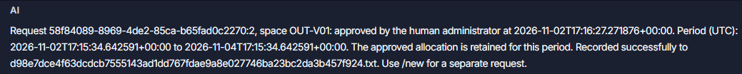
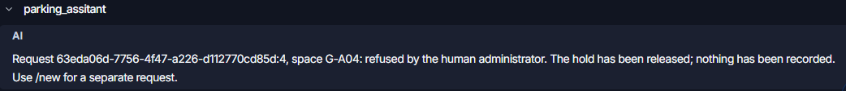
Demo: approval and refusal stay distinct
STUDIO WALKTHROUGH / OUTCOMES
Only the approval branch invokes MCP; refusal releases the pending allocation.
APPROVED + RECORDED
REFUSED / NO RECORDING
Approval ≠ successful file writing. On recording failure, retain approval and report the error.
Source: presentation/admin-approved.png
Narek Hovhannisyan / Parking Space Reservation Agent
11 / 14
Notes:
Suggested time: 45 seconds
These screenshots show the two administrator outcomes. Approval retains the allocation and original UTC period, then the MCP step returns a validated recording receipt and the chatbot reports recorded successfully. The refusal branch releases its pending hold and explicitly says that nothing was recorded. Human approval and file-writing success remain separate results: if recording fails, the approved allocation is retained and the reply must report failure or uncertainty, never pretend success. The selected policy allows one initial attempt and at most one transient retry, then a manual slash-retry-recording for the current approved request. There are no ordinary-chat or background retries.
Sources: presentation/admin-approved.png; presentation/admin-refuse.png; README.md, failures/retries

Slide 12
Practical safeguards, explicit trust limits
DATA PROTECTION & RELIABILITY
Assignment-appropriate protection for a trusted local Studio deployment.
Guard boundaries
Protect recording
State the limits
Presidio + spaCy + rules
Filter sensitive model-copy
history
Guard evidence and model
output
Suppress raw model tokens
Owner-only local files
Read-only approval checks
Atomic no-overwrite writes
One transient retry, then
manual
Necessary details reach
provider
Studio/checkpoints remain
trusted
Detection can miss unknown
PII
No separate admin
authentication
Synthetic privacy: 12/13 positive cases protected; 0/8 benign cases falsely flagged.
Source: GUARDRAIL_EVALUATION.md
Narek Hovhannisyan / Parking Space Reservation Agent
12 / 14
Notes:
Suggested time: 55 seconds
Local Presidio, a pinned spaCy English model and deterministic rules guard public ingestion, selected evidence, model-copy history and generated replies. Necessary reservation fields can still reach the configured provider. Raw model tokens are suppressed from the guarded messages stream, but Studio, checkpoints and debug APIs remain trusted development surfaces. The recording service uses owner-only local permissions, approval checks, atomic publication and bounded subprocess sessions. The small synthetic privacy evaluation fully protected twelve of thirteen positive cases and falsely flagged none of eight benign cases. An unknown unlabeled vehicle identifier was missed. These are practical boundaries—not complete confidentiality, a sandbox or a separate authenticated administrator application.
Sources: GUARDRAIL_EVALUATION.md; README.md, data protection/recording safety

Slide 13
Measured evidence—not production claims
EVALUATION & SYSTEM VALIDATION
Dated, reproducible reports distinguish RAG quality, local load and small live smoke.
RAG / 2026-11-02
LOCAL LOAD / 2026-10-31
REGRESSION / 2026-11-02
0.547
90/90
391
Recall@3 / 20 queries
Full-workflow conversations
Offline tests passed
Precision@3: 0.500
Live answer cases: 12/13
Budget cases: 12/12
Live turn median: 5.574 s
Concurrency: 1 / 5 / 10
45 approved output files
Injected models; scripted review
9 skipped (live opt-in)
13 current HTTP/stdio cases
Real-provider smoke: separate
Small synthetic corpus; mixed results
not production capacity
Small live samples ≠ provider load
Known limits: exact-ID retrieval and two challenge paraphrases still miss.
Source: RAG_EVALUATION.md
Narek Hovhannisyan / Parking Space Reservation Agent
13 / 14
Notes:
Suggested time: 45 seconds
The priced twenty-query retrieval evaluation measured Recall-at-three of 0.547 and Precision-at-three of 0.500. Two live-answer runs passed twelve of thirteen conversations, and all twelve deterministic budget cases passed. The latest live-answer run's whole-turn median was 5.574 seconds (14 turns), not a latency guarantee. Results are mixed: exact-ID lookup and two challenge paraphrases remain weak spots. Separately, the historical full-workflow local load completed ninety conversations across concurrency one, five and ten, producing forty-five approved files. Those load models and review responses were injected or scripted, not provider or human throughput. Current HTTP/stdio regression covers thirteen scenarios; the latest documented offline suite has 391 passes and nine opt-in skips. Real-provider approval/refusal smoke is separate, small-sample evidence.
Sources: RAG_EVALUATION.md, 2026-11-02; STAGE4_VALIDATION.md, historical load/current regression

Slide 14
Four stages. One explicit approval flow.
SUMMARY & PROJECT HANDOFF
RAG assistance → human review → approved-only MCP recording → explicit outcomes.
Language belongs to models.
Decisions belong to the human.
Enforcement belongs to Python.
RUN LOCALLY
uv sync --locked --dev
Configure .env
Connect required VPN
.venv/bin/langgraph dev
Project repository
Setup and usage: README.md
Quality and limits: RAG_EVALUATION.md
Integration/load: STAGE4_VALIDATION.md
Linux / localhost / Studio
SQLite + output reset on startup
Source: README.md
Narek Hovhannisyan / Parking Space Reservation Agent
14 / 14
Notes:
Suggested time: 30 seconds
The delivered assignment slice combines RAG parking assistance, a second LangChain communication agent, human review, approved-only MCP recording and LangGraph orchestration. The takeaway is separation of responsibilities: models assist with language, the human decides, and Python enforces state transitions and writes. The repository contains setup instructions, architecture and evaluation reports. Run the locked environment locally, configure credentials, connect the required VPN and launch LangGraph Studio. Chroma persists, but SQLite and generated recording output deliberately reset on application startup. The repository link comes from project documentation; this presentation does not verify publication of the current local changes. Thank you—questions are welcome.
Sources: README.md, setup/deployment/repository links; PROJECT_REQUIREMENTS.md

