Slide 1

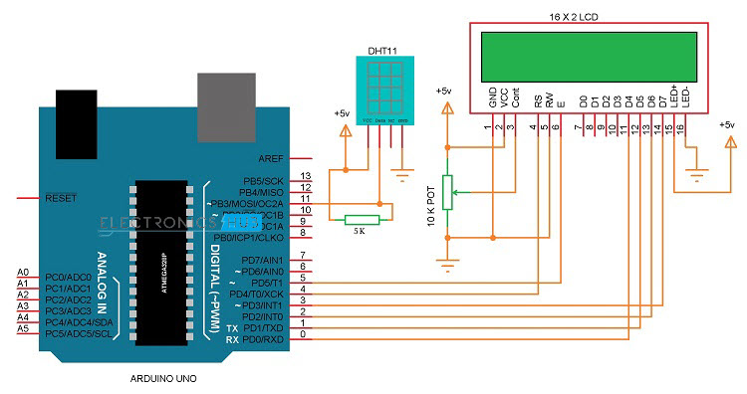
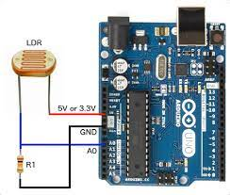
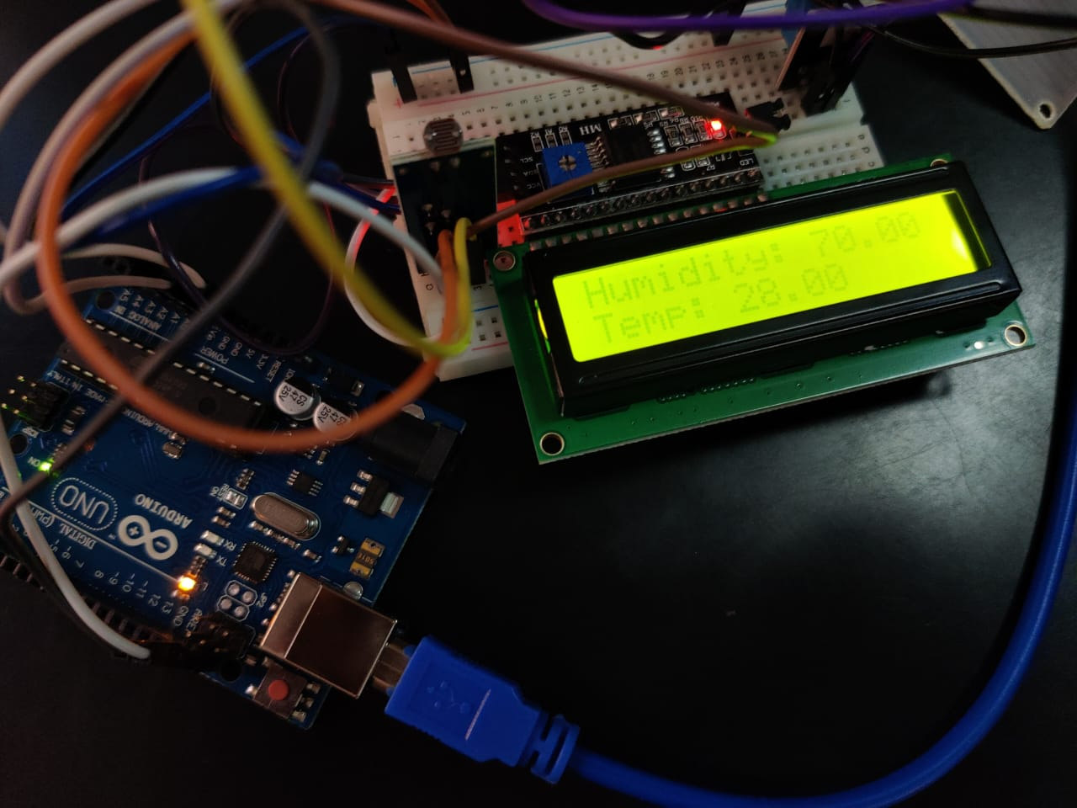
Weather station
A weather station can be described as an instrument or device, which provides us with the information of the weather in our neighbouring environment. Project is implemented using Arduino UNO. Dht 11 sensor used to measure temperature and humidity. An ldr sensor to check whether it is sunny or night. Using the information from the sensors displaying it onto an lcd screen. The lcd screen makes use of an i2c module which makes the connections simpler. All the connections are made on a breadboard using jumper wires.
NAVTEJ REDDY
NAREN C
NITIN J
PES2UG20CS216
PES2UG20CS231
Evlin , mpca teacher
PES2UG20CS218

