Slide 1
CS6030 – NATURAL LANGUAGE PROCESSING MINI PROJECT AMAZON PRODUCT REVIEW ON MOBILE PHONES USING SENTIMENT ANALYSIS
SUBMITTED BY
MITHUN RAAM M – 2018103562
NAREN T P - 2018103568

Slide 2
INTRODUCTION
Mobile phones have revolutionized the way we purchase products online, making all the information available at our fingertips. As the access to information becomes easier, more and more consumers will seek product information from other consumers apart from the information provided by the seller.
Reviews and ratings submitted by consumers are examples of such of type of information and they have already become an integral part of customer’s buying-decision process.
The review and ratings platform provided by eCommerce sites creates transparent system for consumers to take informed decision and feel confident about it.

Slide 3
SENTIMENT ANALYSIS
Sentiment analysis is the process of classifying whether a block of text is positive, negative, or, neutral. Sentiment analysis is contextual mining of words which indicates the social sentiment of a brand and also helps the business to determine whether the product which they are manufacturing is going to make a demand in the market or not. It focuses not only on polarity (positive, negative & neutral) but also on emotions (happy, sad, angry, etc.)
Used Techniques:
Bag of Words
Word2Vec
Long short-term memory (LSTM)
N-gram

Slide 4
OBJECTIVES
Perform exploratory analysis of ratings and reviews
To develop a model to analyze the customer’s reviews and ratings using sentiment analysis.
To classify the positive and negative reviews of the customers over different mobile phone products to help new customers identify the good products.

Slide 5
DATASET - Amazon Reviews: Mobile Phones (2017)
This dataset consists of 400 thousand reviews of mobile phones sold on Amazon.com to find out insights with respect to reviews, ratings, price and their relationships.
This dataset has the following fields:
Product Title
Brand
Price
Rating
Review text
Number of people who found the review helpful

Slide 6
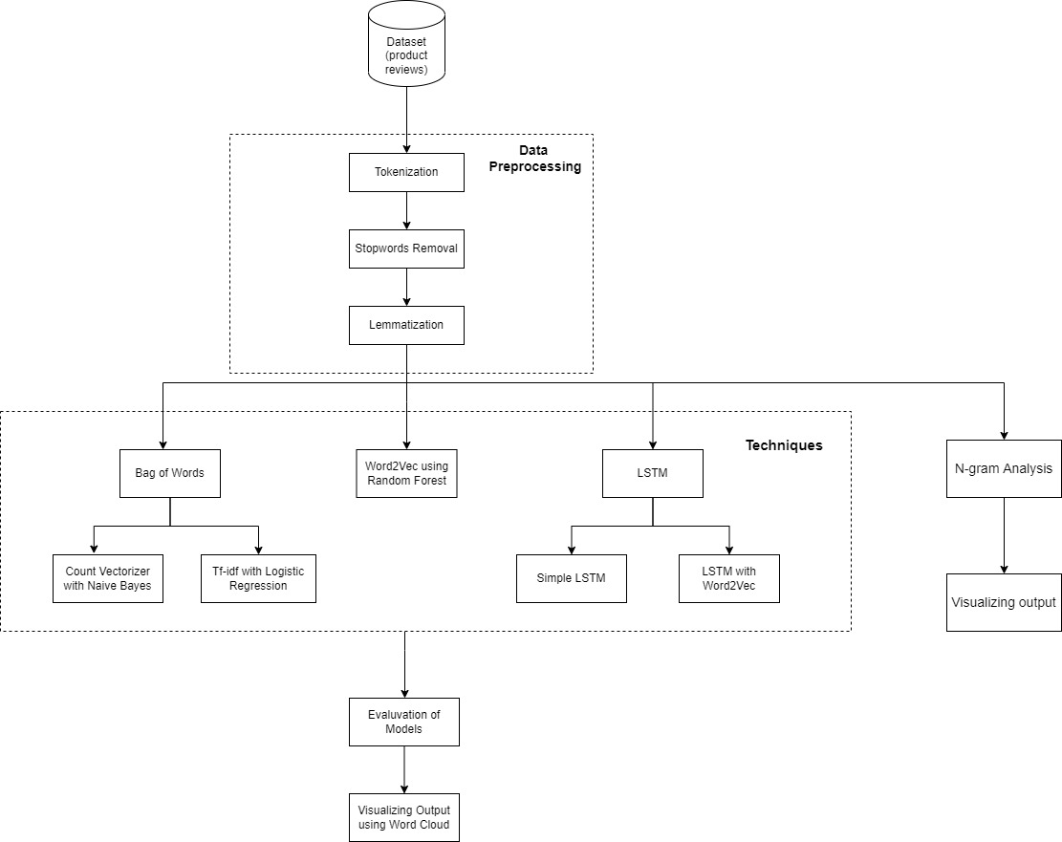
METHODOLOGY DIAGRAM

Slide 7
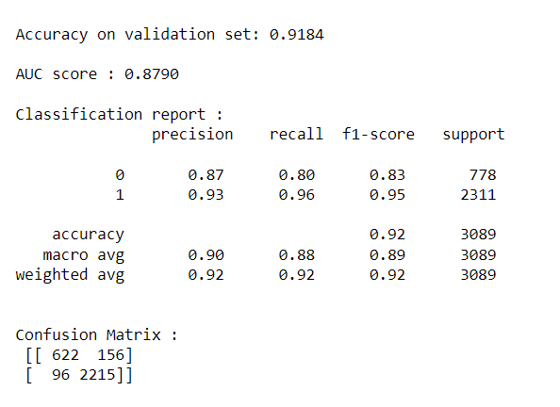
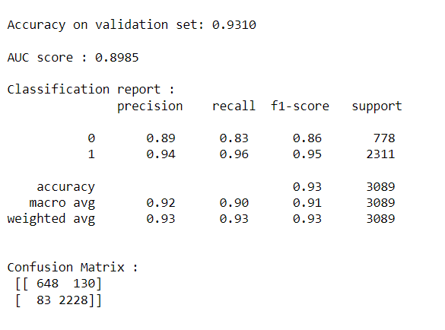
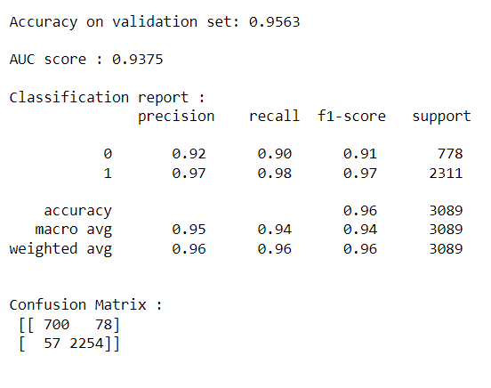
PERFORMANCE
BAG OF WORDS
CountVectorizer with Naive Bayes
TfidfVectorizer with Logistic Regression
After GridSearch

Slide 8
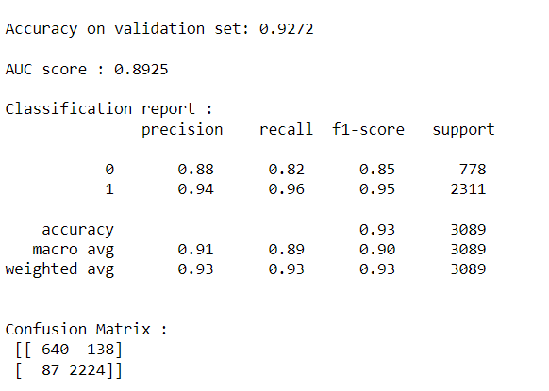
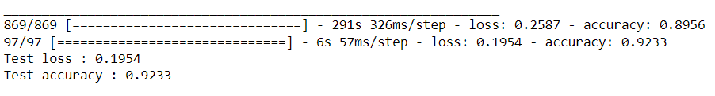
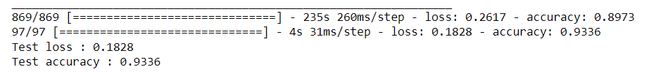
Word2Vec with Random Forest Classifier
LSTM with Word2Vec Embedding
Simple LSTM

