Slide 1
EQUALGAS
Efficient Query Approximation on Large Graphs using Attribute-based Summaries
Narender Gupta, Chinmay Kulkarni, Chaitanya Datye

Slide 2
Agenda
Background
Motivation
Related Work
Proposed Methodology
Dataset
Experimental Evaluations
Results
Conclusion
Strength and Weakness
Future Work

Slide 3

Background
Notes:
Lots of information in large graphs
Each node has multiple attributes having multiple values each
Linearly increasing processing time
Similar queries asked many times
Here we explore graph summarization to get approximate answers to these queries.

Slide 4

Motivation
Efficiency
High-frequency computationally expensive queries.
Accuracy
Tolerance with respect to minor errors.
Notes:
Tradeoff between Efficiency and Accuracy.
Do not need exact results -> approximate is good enough.
More important to give quick results.
Same query type repeated.

Slide 5
Related Work
Graph Summarization [No query-based approach]
Focuses on reducing MDL and graph compression. ^{[1][2]}
Construction of super-nodes using interesting-ness driven techniques. ^{[3]}
Graph Sampling [No attribute-based summaries]
Samples based on edge-connectivity and topology of nodes. ^{[4]}
Query Processing Techniques [Storage usually in order of O(N)]
Indexing and caching based techniques. ^{[5][6]}
No reuse of previously computed metadata in SQL based approaches. ^{[7]}
Bayesian Belief Networks [Computationally expensive]
Needs re-computation of all edge probabilities with each graph update.
[1] Leskovec, J. and Faloutsos, C. 2006. Sampling from large graphs. [2] Paolo Boldi and Sebastiano Vigna. The WebGraph framework I: Compression techniques. [3] Qu, Q., Liu, S., Jensen, C. S., Zhu, F., & Faloutsos, C. (2014). Interestingness-Driven Diffusion Process Summarization in Dynamic Net- works. [4] Ahmed, N. K., Neville, J., and Kompella, R., 2013. Network sampling: from static to streaming graphs. [5] S.Sakr and G. Al-Naymat. Efficient Relational Techniques for Processing Graph Queries
[6] M. Saber, M. Aref, T. Gharib. An Efficient Filtering Technique for Super- Graph Query Processing . [7] P. Zhao and J. Han. On Graph Query Optimization in Large Networks
Notes:
Orange means why we are not doing that

Slide 6

Proposed Methodology
Preprocessing to compute all summary graphs. (ONCE)
For each query, use relevant summary graphs to estimate query result.
Notes:
- Step 1) For all of k attributes, compute pairwise summary graphs - <Explain edge weights>
Step 2) Naïve Bayes for inferred attributes a & b (conditionally independent).
Step 3) Given attributes c & d are independent.

Slide 7

Terminology
Number of nodes in the graph = $N$
Number of attributes = $k$
Maximum number of values per attribute = $V$

Slide 8

Algorithm
Summary Graph Construction
For every pair of attributes - $∁_{2}^{k}$ summary graphs.
Query Resolution using the Naïve Bayes Approximation
Inferred a$ttributes: Pr\left(a,b | c,d\right)=Pr\left(a | c,d\right) × Pr(b|c,d)$
Independence Assumption
Given attributes: $Pr\left(c,d\right)=Pr\left(c\right) × Pr\left(d\right)$
Notes:
- Step 1) For all of k attributes, compute pairwise summary graphs - <Explain edge weights>
Step 2) Naïve Bayes for inferred attributes a & b (conditionally independent).
Step 3) Given attributes c & d are independent.

Slide 9
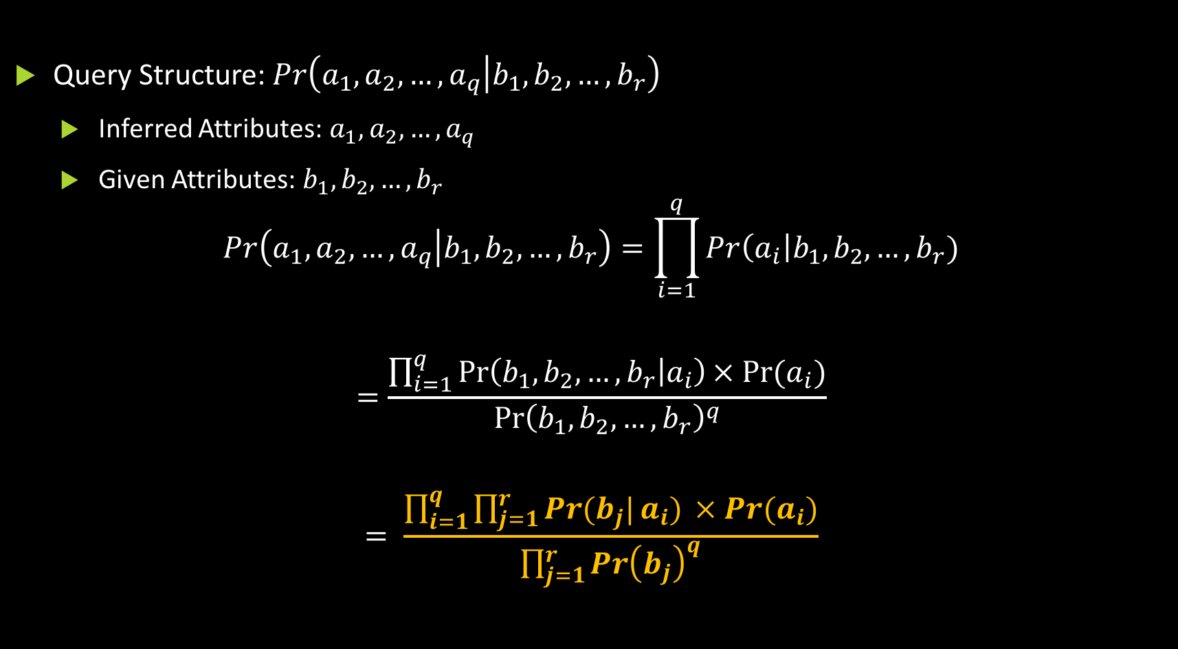
Query Approximation
Query Structure:$Pr\left(a_{1},a_{2},…, a_{q} | b_{1},b_{2},…, b_{r}\right)$
Inferred Attributes: $a_{1},a_{2},…, a_{q}$
Given Attributes: $b_{1},b_{2},…, b_{r}$
$$Pr\left(a_{1},a_{2},…, a_{q} | b_{1},b_{2},…, b_{r}\right)=\prod_{i=1}^{q}{Pr\left(a_{i}\right|b_{1},b_{2},…, b_{r})}$$
$$=\frac{\prod_{i=1}^{q}{\operatorname{Pr}\left(b_{1},b_{2},…, b_{r} | a_{i}\right)× Pr⁡(a_{i})}}{{\operatorname{Pr}\left(b_{1},b_{2}, …, b_{r}\right)}^{q}}$$
$$= \frac{\prod_{i=1}^{q}{\prod_{j=1}^{r}{\operatorname{Pr}{(b_{j}|}a_{i}) }× Pr⁡(a_{i})}}{\prod_{j=1}^{r}{{\operatorname{Pr}\left(b_{j}\right)}^{q}}}$$

Slide 10
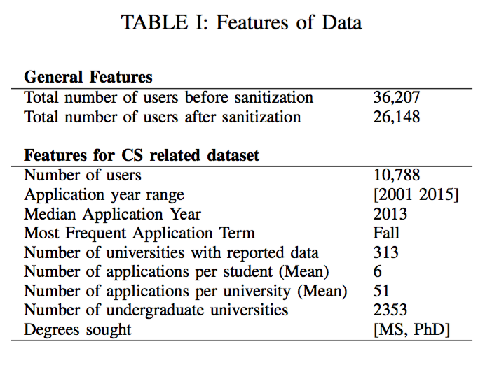
Dataset
University admissions data.
Extracted from Edulix^{[1]} forum for graduate admissions.
Application – University Graph
Each node (application) has many attributes (ex: UG, Term, Major, Program, scores, etc.)
[1]www.edulix.com
Notes:
- Step 1) For all of k attributes, compute pairwise summary graphs - <Explain edge weights>
Step 2) Naïve Bayes for inferred attributes a & b (conditionally independent).
Step 3) Given attributes c & d are independent.

Slide 11
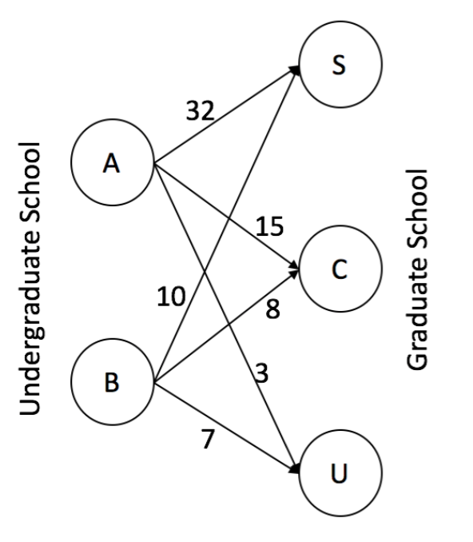
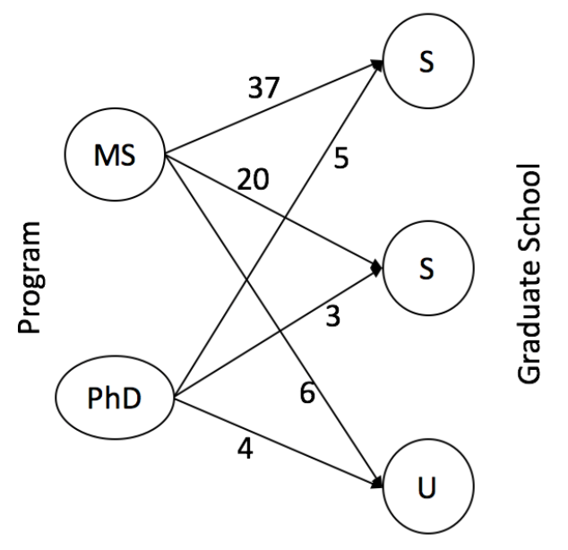
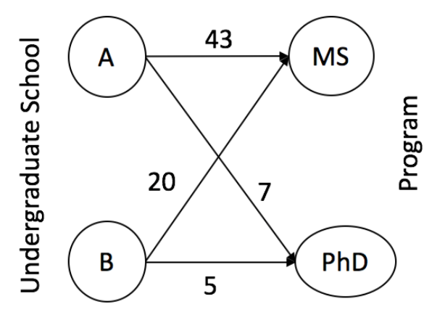


Example Query
Estimate: $\operatorname{Pr}\left(MS, S \right| A)=\operatorname{Pr}\left(S \right|A) × \operatorname{Pr}\left(MS \right|A)=\frac{32}{50} ×\frac{43}{50}=0.55$
Bounds: $[0.54, 0.64]$
Undergrad – Grad
Grad – Program
Program – Undergrad
Notes:
- Probability that a student is from Undergrad university A and applies to Grad school S for MS.

Slide 12

Complexity Analysis
Time Complexity:
Preprocessing:
To construct $∁_{2}^{k}$summary graphs, we need to traverse all $N$ nodes.
Complexity: $O(k^{2}N)$.
Query Approximation:
For each query of the form $Pr\left(a_{1},a_{2},…, a_{q} | b_{1},b_{2},…, b_{r}\right)$, we need to consider a maximum of $∁_{2}^{k}$ ($≈O\left(k^{2}\right)$) summary graphs each with a maximum of $V$values per attribute.
Complexity: $O(k^{2}V)$.
Complexity without summary graphs: $O({Nk}^{2}V)$ since for each query, we need to go over all $N$nodes, all $k$attributes and all possible $V$values per attribute in the worst case.
Space Complexity:
$O(k^{2})$summary graphs each with $O(V^{2})$edges.
Complexity: $O(k^{2}V^{2})$.

Slide 13

Experimental Evaluation
Evaluation Metrics:
Per-query Runtime
Per-query Error
Experiments were run for simple as well as complex queries.
Simple query: $Pr\left(MS, CS | Fall\right)$
Complex query: $Pr\left(MS, CS, NCSU | Fall, BITS Pilani\right)$
Experiments were carried out in varying data sizes and query complexities.

Slide 14
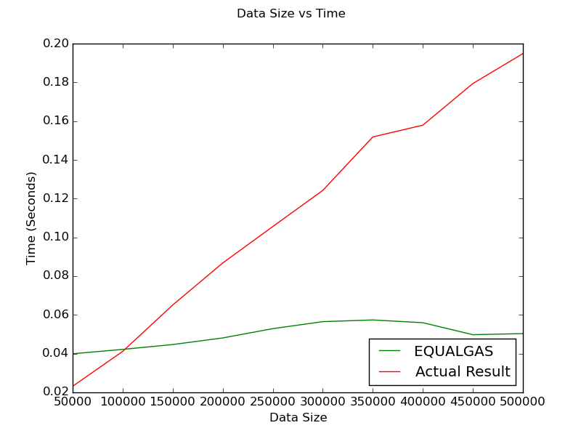
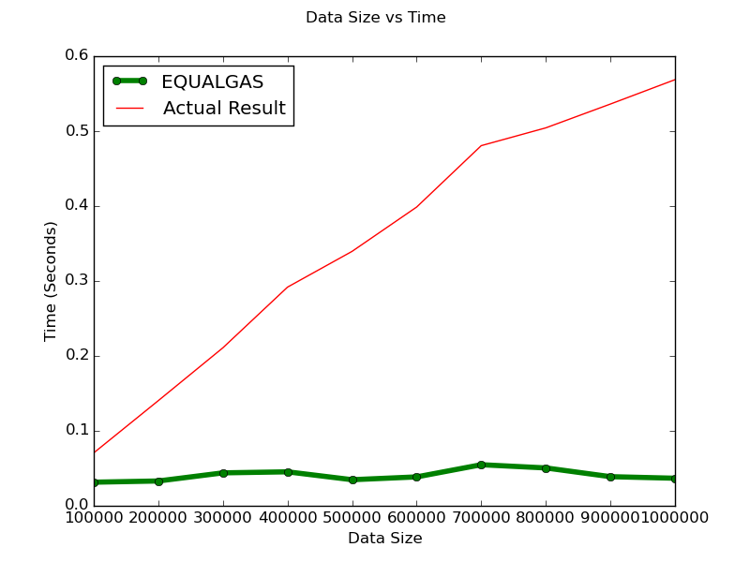
Results – Efficiency
Simple Query
Complex Query
Fig.1 Data Size vs. Runtime for Simple Query
Fig.2 Data Size vs. Runtime for Complex Query
Notes:
- Explain inflection point.

Slide 15
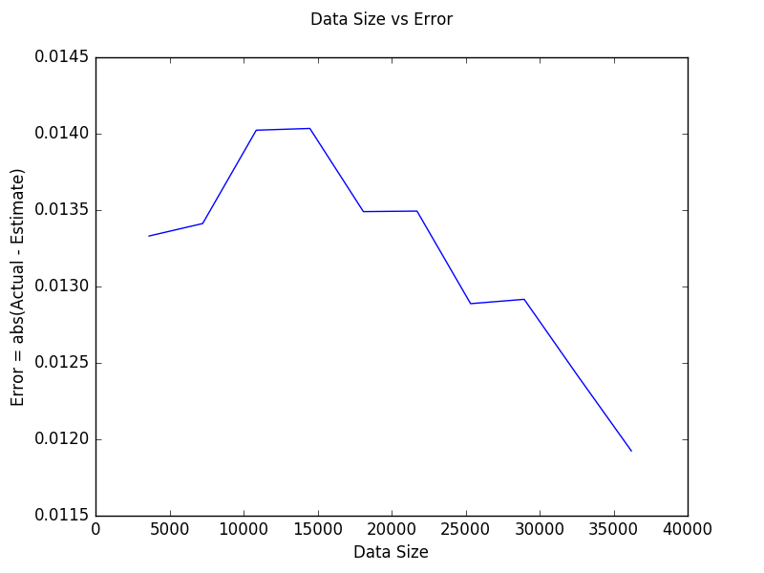
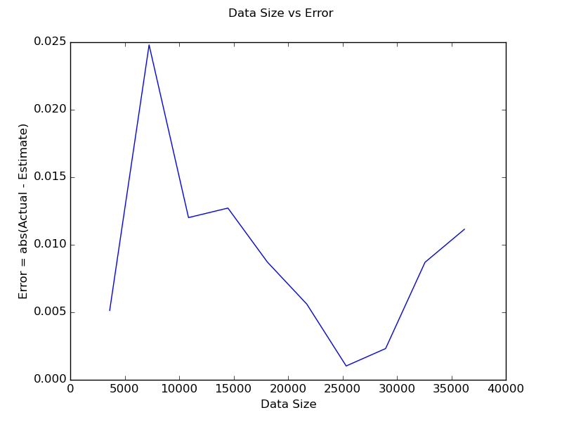
Results – Accuracy
Simple Query
Complex Query
Error reduces with increase in data size
Fig.3 Data Size vs. Error for Simple Query
Fig.4 Data Size vs. Error for Complex Query
Notes:
- Peak in figures – Because in that particular chunk of data, rows with those particular values did not appear (Since data is not uniformly distributed)

Slide 16
Conclusion
With summary graphs, we achieve huge improvements in runtime.
Reduction in query runtime by an order of N (graph size).
As data size increases, the error shows a decreasing trend.
By compromising a little on accuracy, we get significant gains on efficiency.
Significantly less storage required than indexing based solutions, which need O(N) space.

Slide 17
Future Work
Explore modeling this as inference in Markov Networks (undirected Bayesian Belief Networks) [More space intensive though]
Lazy initialization of summary graphs based on popularity of attributes.
Evaluation on very large scale social networks e.g. Twitter, Facebook etc.

Slide 18
Thank You! Questions?

