Slide 1
Sitemap
Presented by Narender

Slide 2

Content:
Sitemap
Sitemap Details
Website Primary Pages
Website Sitemap Structure
Sitemap Tools
Sitemap Tool Example

Slide 3
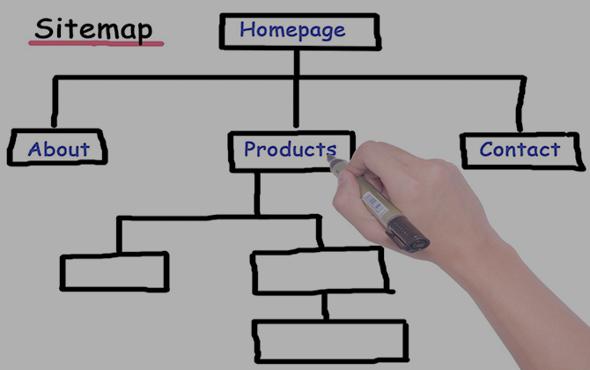
Sitemap
A sitemap lists a website's most important pages, thus, making sure search engines can find and crawl them. Sitemaps also help in understanding our website structure, making it easier to navigate our website

Slide 4
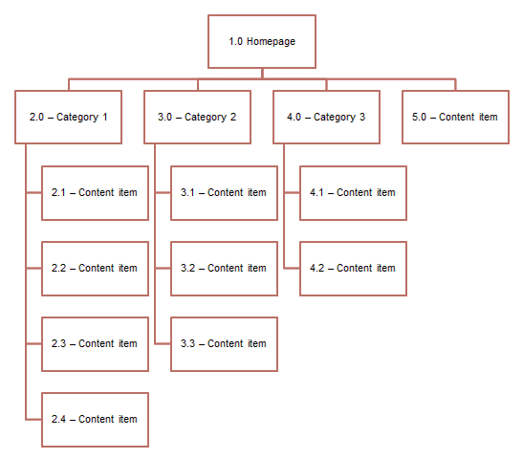
Sitemap Details
A sitemap is a file with a list of all website pages both crawlers and users need to be aware of. It is similar to a book's table of contents

Slide 5
Website Primary Details
Company
Home
Products
Services
Reach Us
Primary navigation – Also referred to as “parent pages,” these make up the main navigation of our website. These pages are at the topmost level of our site

Slide 6
Website Sitemap Structure
Bank
Home
Apply
Payments
Loans
Services
Reach Us
Sub-Pages
Sub-Pages
Sub-Pages
Sub-Pages
Sub-Pages
Sub-Pages

Slide 7
Sitemap Tools
Writemaps.com
Gloomaps.com
GitMind.com
Flowmapp.com
XML-Sitemaps.com
A sitemap tool is used for way of organizing a website, and the data under each section

Slide 8
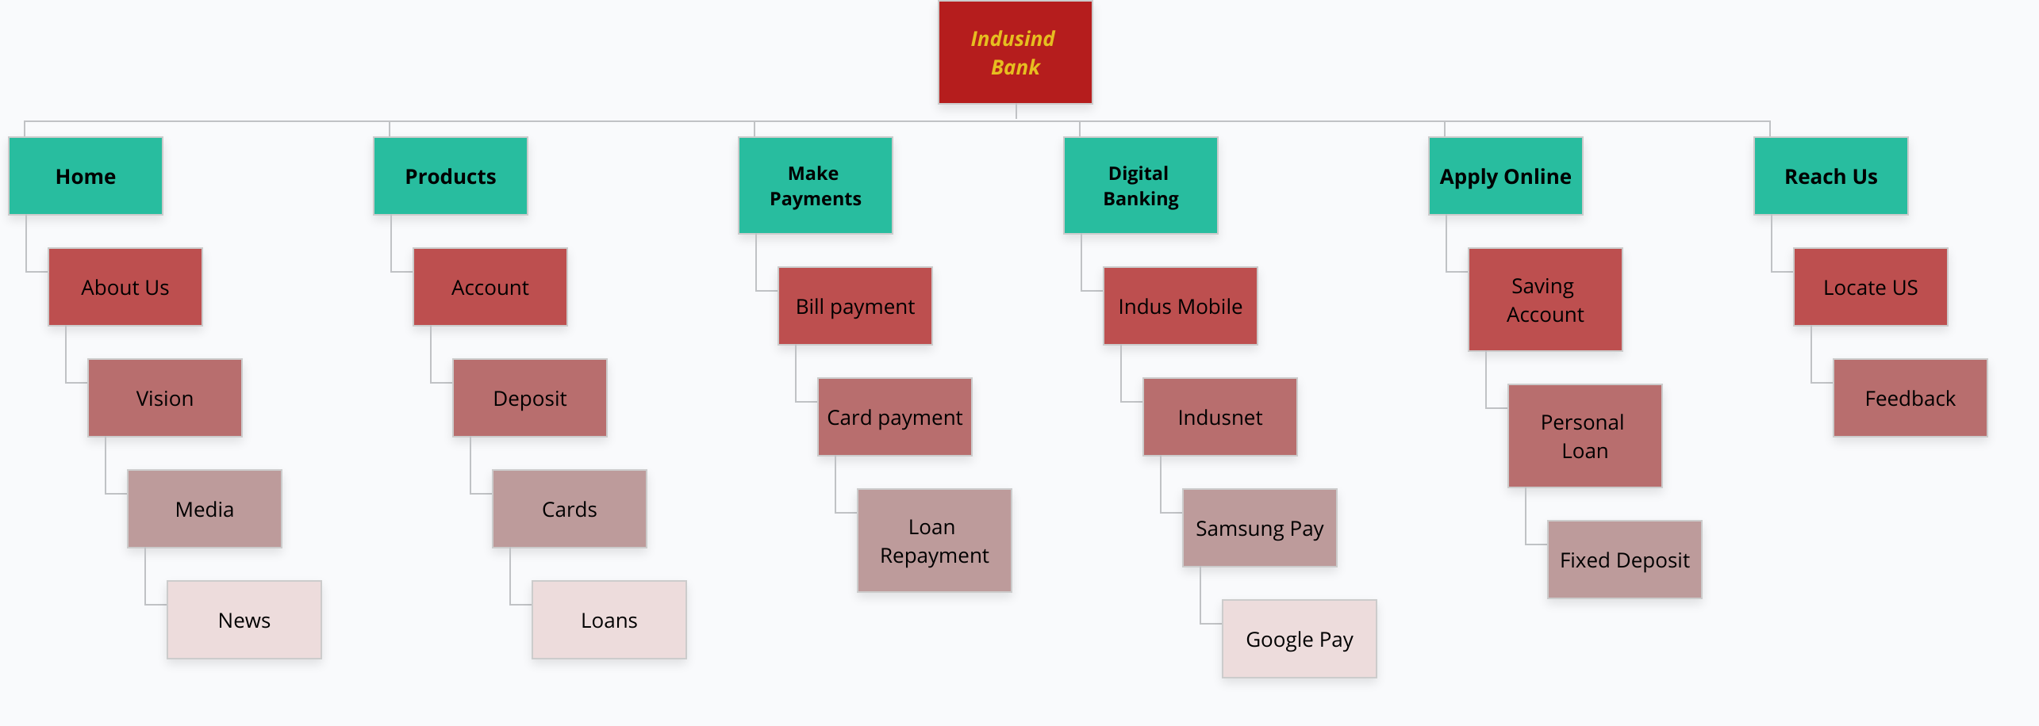
Sitemap Tool Example
Project Link

Slide 9
Conclusion
Typically, Sitemapping is one of the first tasks to be completed in any web design and development project. However, sitemaps can be created and updated at any point of the website process.
Even if your site is already up and running, there may be holes in your navigation or user experience that you don't know about

Slide 10
Thanks
Any Questions
Doubts

