Slide 1

Narendra Parmar

Slide 2
Problem statement
You are hired as a data analyst at Chinook, and your objective is to analyze music record sales data to gain insights and make recommendations for the company's strategy in the physical music market.

Slide 3
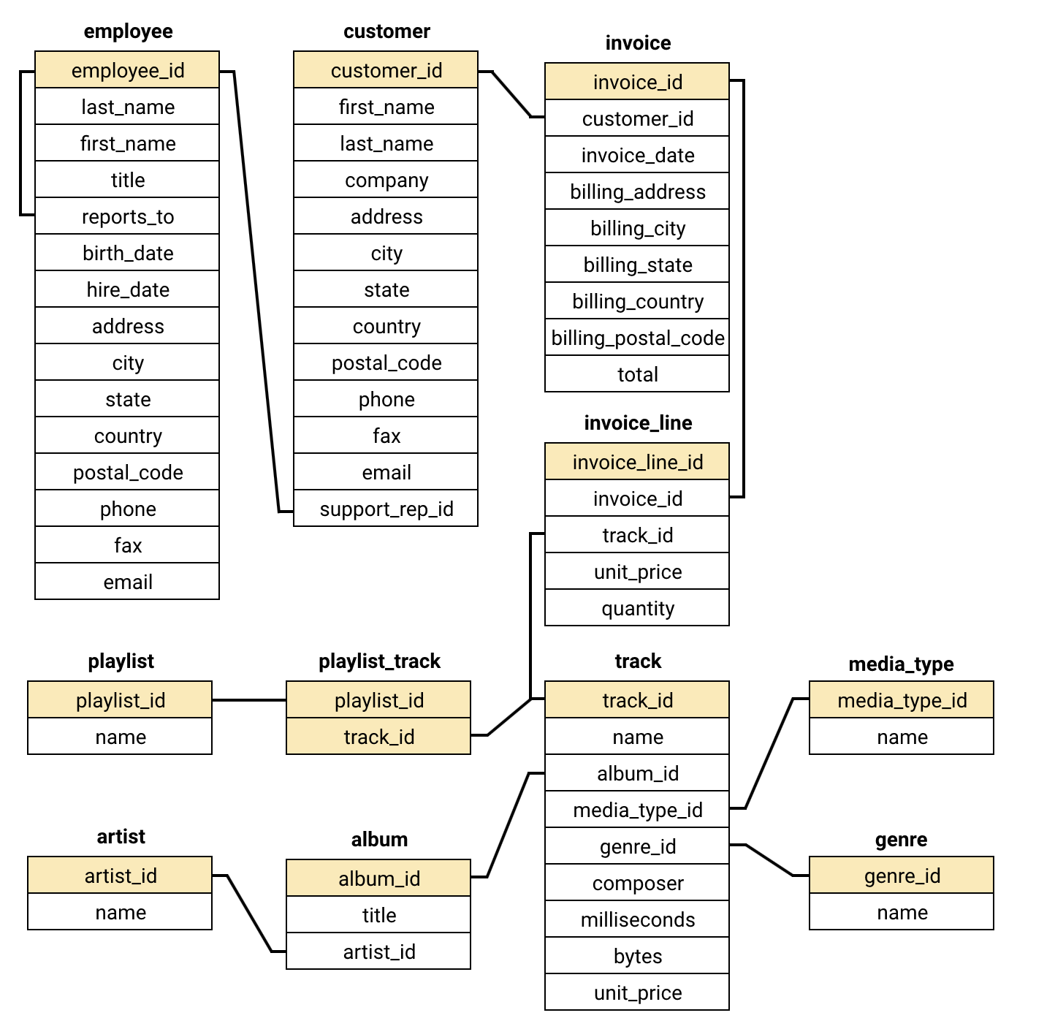
Database schema

Slide 4
Data description
customer:
customer_id: Unique identifier assigned to each customer.
first_name: The given name or first name of a customer.
last_name: The surname or family name of a customer.
company: The name of the company associated with a customer.
address: The street address of a customer's location.
city: The city where a customer is located.
state: The state or province where a customer is located.
country: The country where a customer is located.
postal_code: The postal or zip code of a customer's address.
phone: The phone number of a customer.
fax: The fax number associated with a customer.
email: The email address of a customer.
support_rep_id: The employee ID of the support representative assigned to a customer.
invoice:
invoice_id: Unique identifier assigned to each invoice.
customer_id: The customer ID associated with the invoice.
invoice_date: The date when the invoice was generated or issued.
billing_address: The street address used for billing purposes.
billing_city: The city used for billing purposes.
billing_state: The state or province used for billing purposes.
billing_country: The country used for billing purposes.
billing_postal_code: The postal or zip code used for billing purposes.
total: The total amount due on the invoice.

Slide 5
Data description
invoice:
invoice_id: Unique identifier assigned to each invoice.
customer_id: The customer ID associated with the invoice.
invoice_date: The date when the invoice was generated or issued.
billing_address: The street address used for billing purposes.
billing_city: The city used for billing purposes.
billing_state: The state or province used for billing purposes.
billing_country: The country used for billing purposes.
billing_postal_code: The postal or zip code used for billing purposes.
total: The total amount due on the invoice.
invoice_line:
invoice_line_id: Unique identifier assigned to each line item on an invoice.
invoice_id: The invoice ID to which the line item belongs.
track_id: The ID of the track or product included in the line item.
unit_price: The price per unit for the line item.
quantity: The quantity of units for the line item.
playlist:
playlist_id: Unique identifier assigned to each playlist.
name: The name or title of the playlist.
playlist_track:
playlist_id: The ID of the playlist to which the track belongs.
track_id: The ID of the track included in the playlist.
track:
track_id: Unique identifier assigned to each track or song.
name: The title or name of the track.
album_id: The ID of the album to which the track belongs.
media_type_id: The ID of the media type associated with the track.
genre_id: The ID of the genre associated with the track.
composer: The name of the composer or artist who composed the track.
milliseconds: The duration of the track in milliseconds.
bytes: The file size of the track in bytes.
unit_price: The price per unit for the track.

Slide 6
Data description
album:
album_id: Unique identifier assigned to each album.
title: The title or name of the album.
artist_id: The ID of the artist associated with the album.
artist:
artist_id: Unique identifier assigned to each artist.
name: The name of the artist.
media_type:
media_type_id: Unique identifier assigned to each media type.
name: The name or description of the media type (e.g., MPEG audio file, AAC audio file).
genre:
genre_id: Unique identifier assigned to each genre.
name: The name or description of the genre (e.g., rock, pop, classical).
Data Link: Link

Slide 7
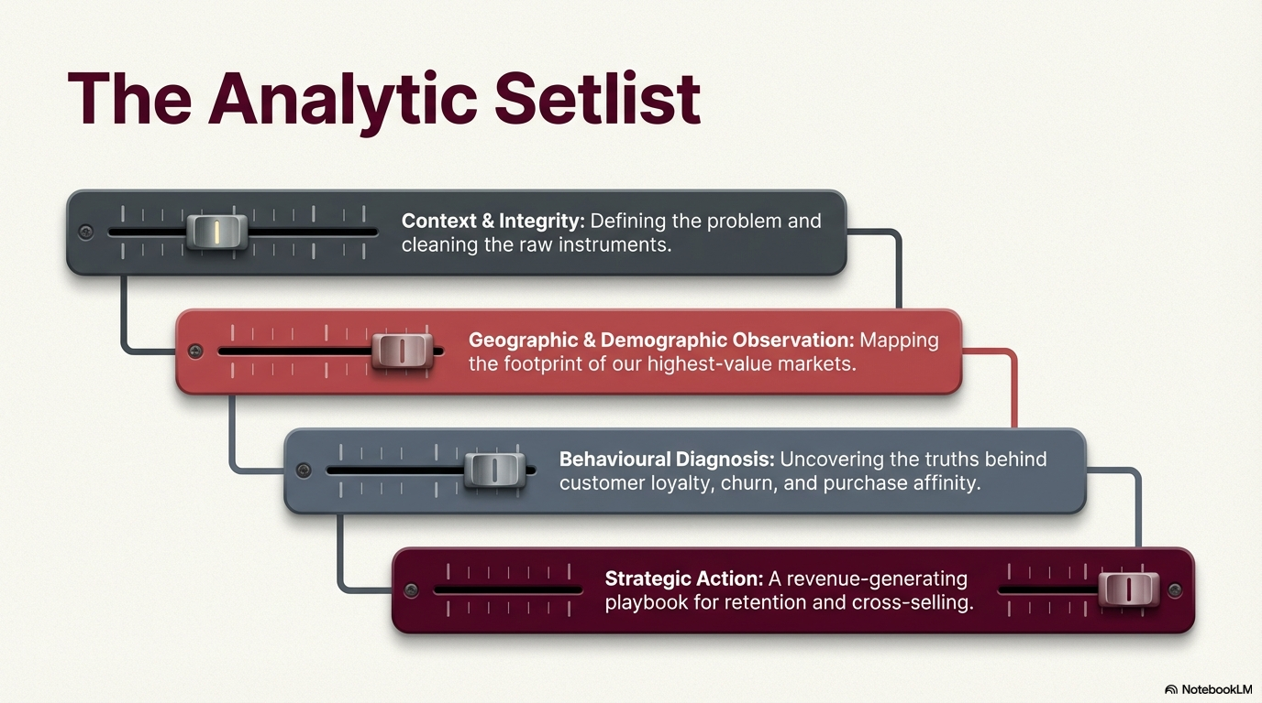

Slide 8
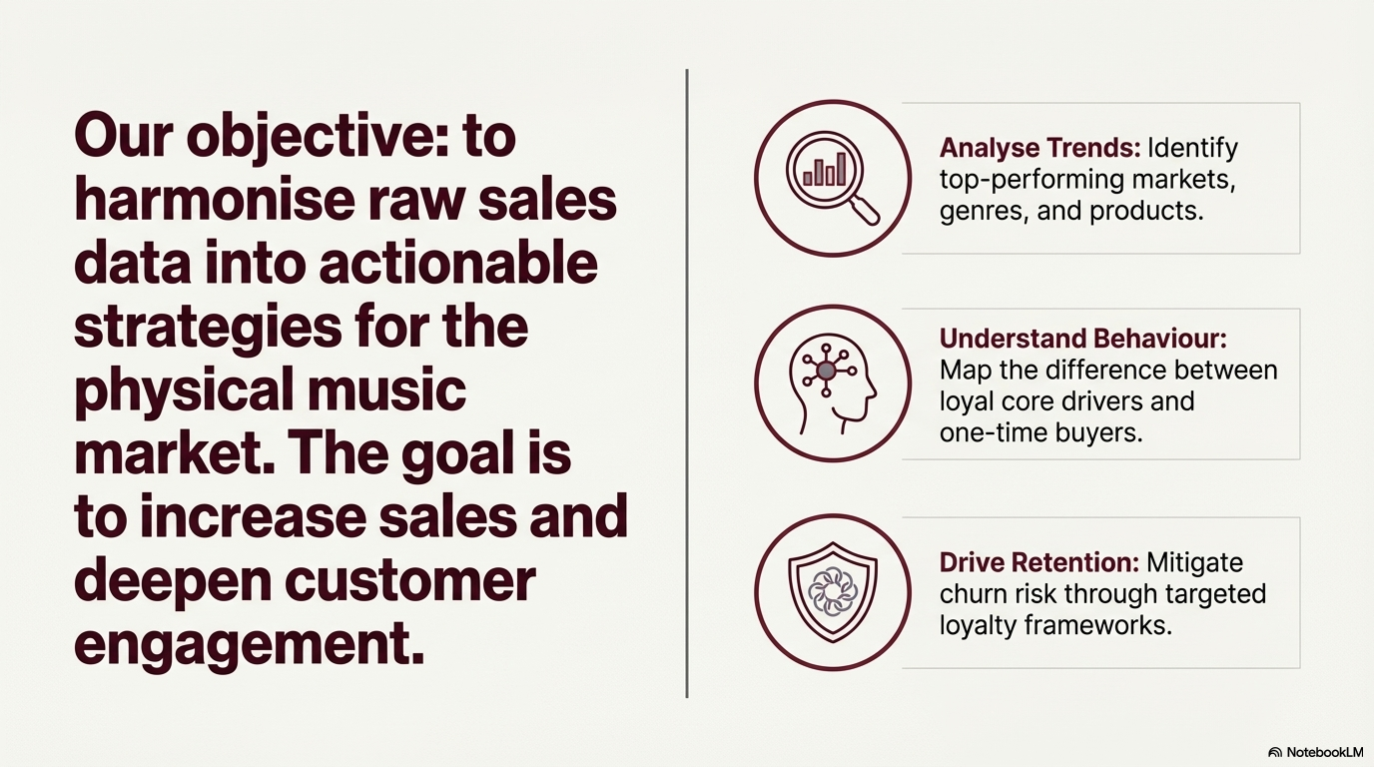

Slide 9
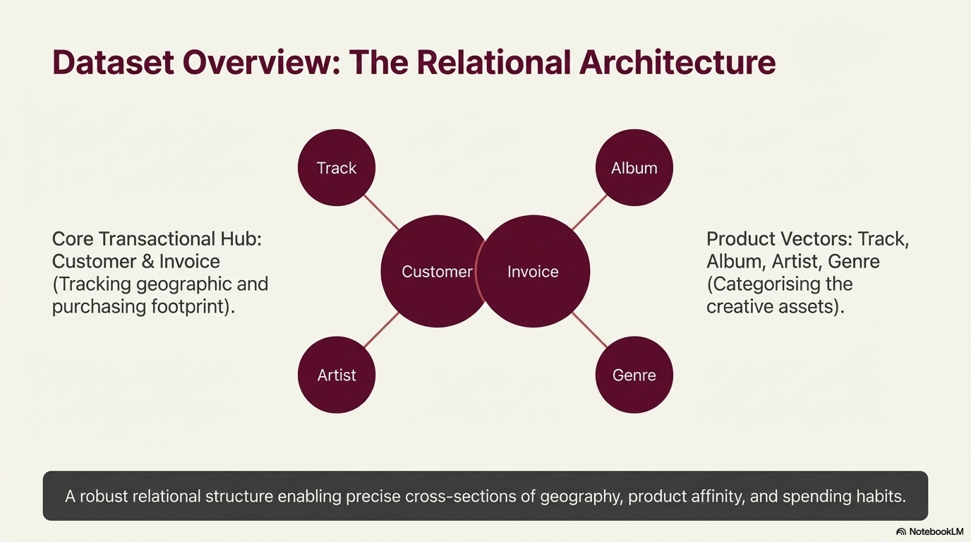

Slide 10
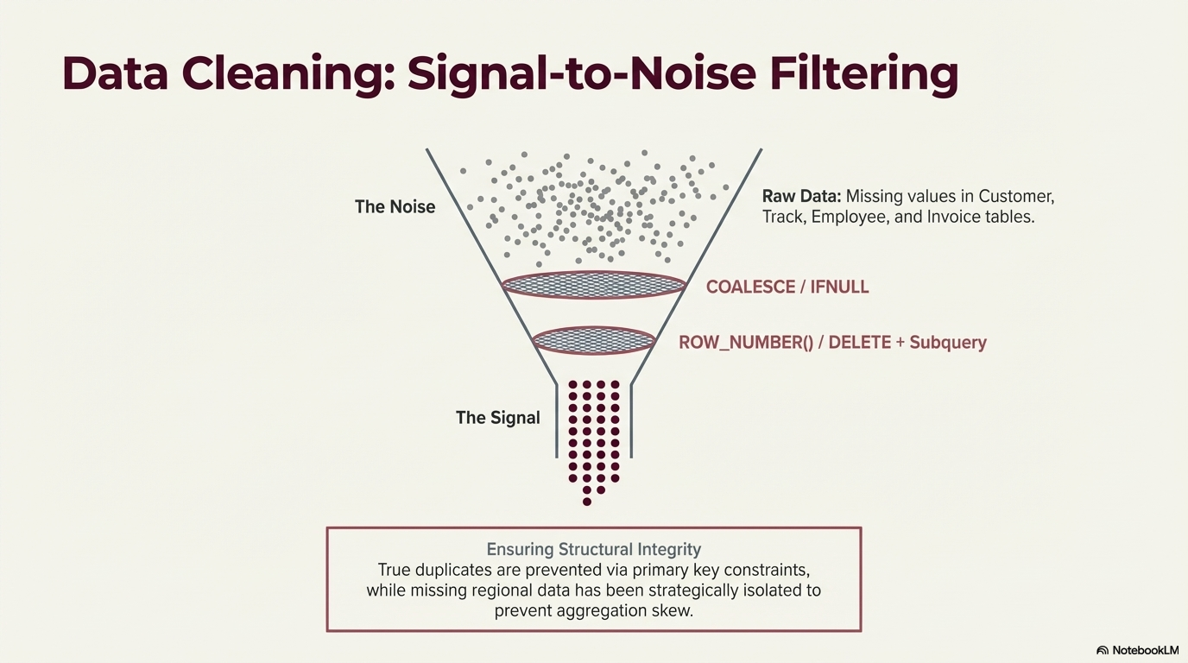

Slide 11
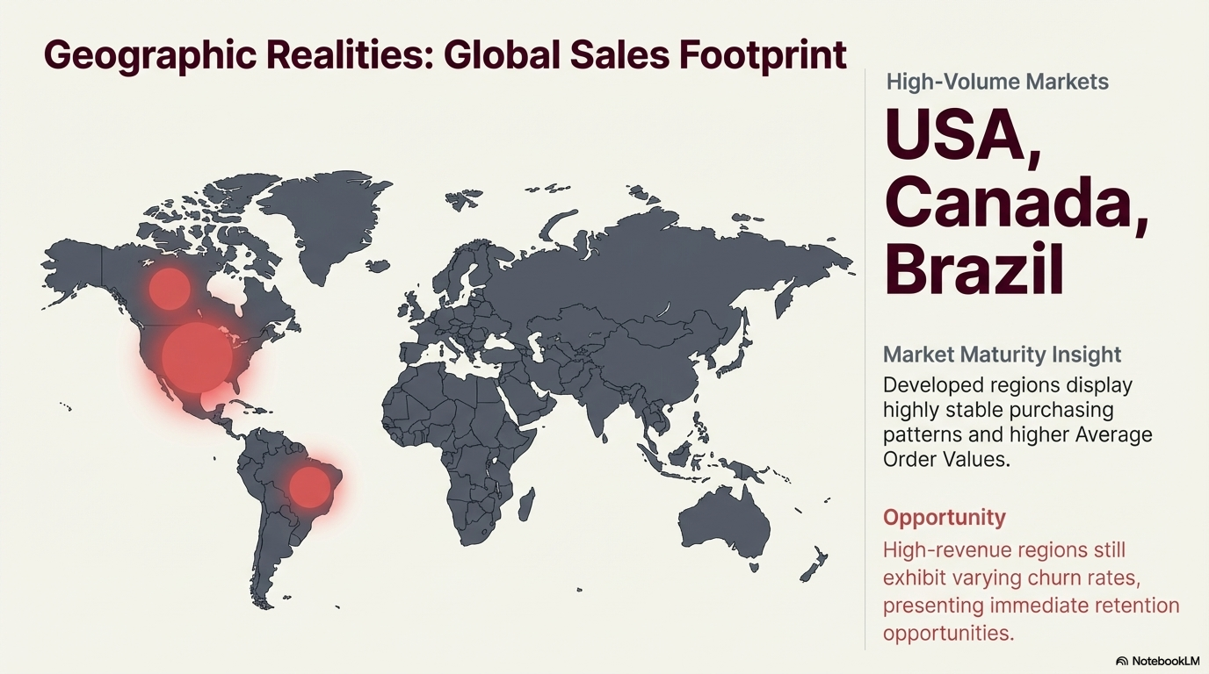

Slide 12
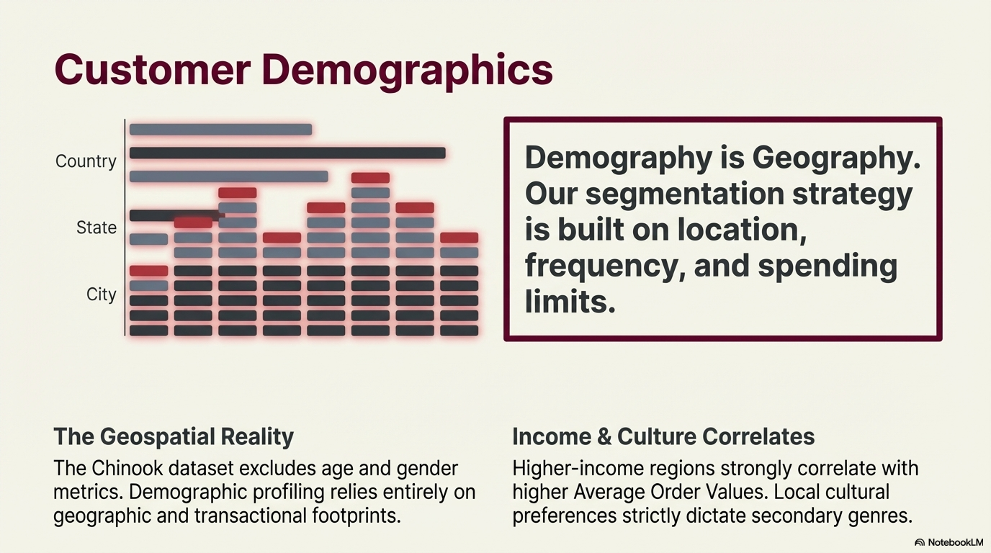

Slide 13
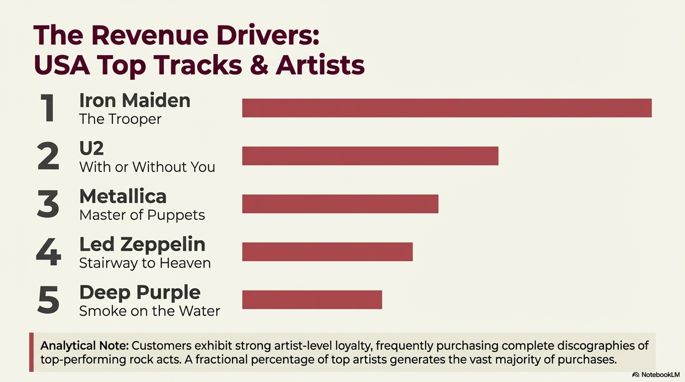

Slide 14
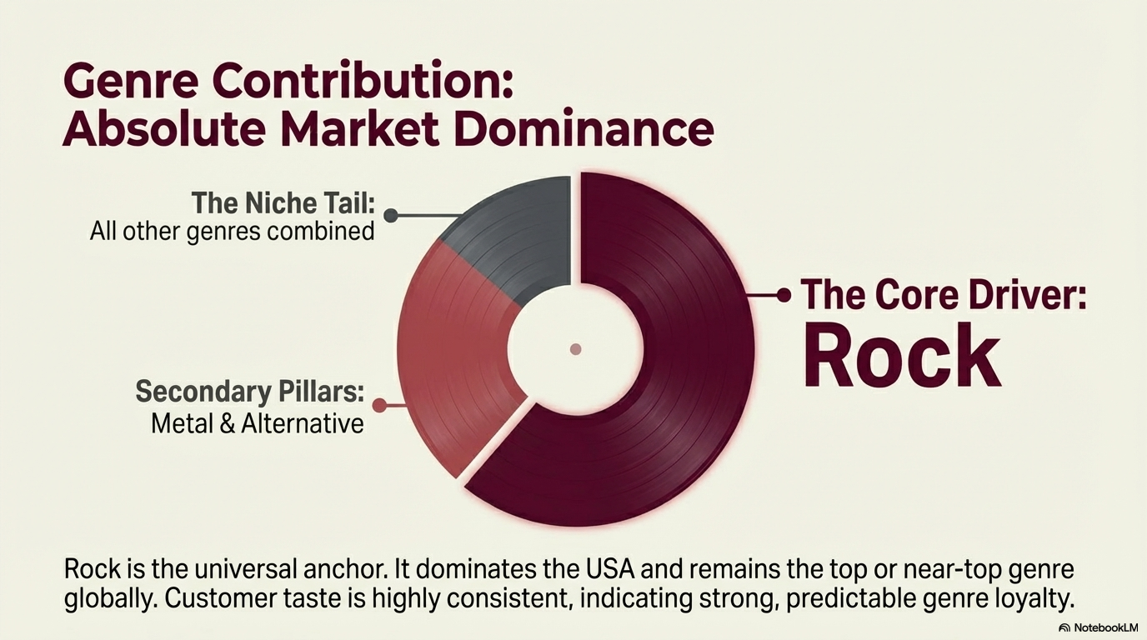

Slide 15
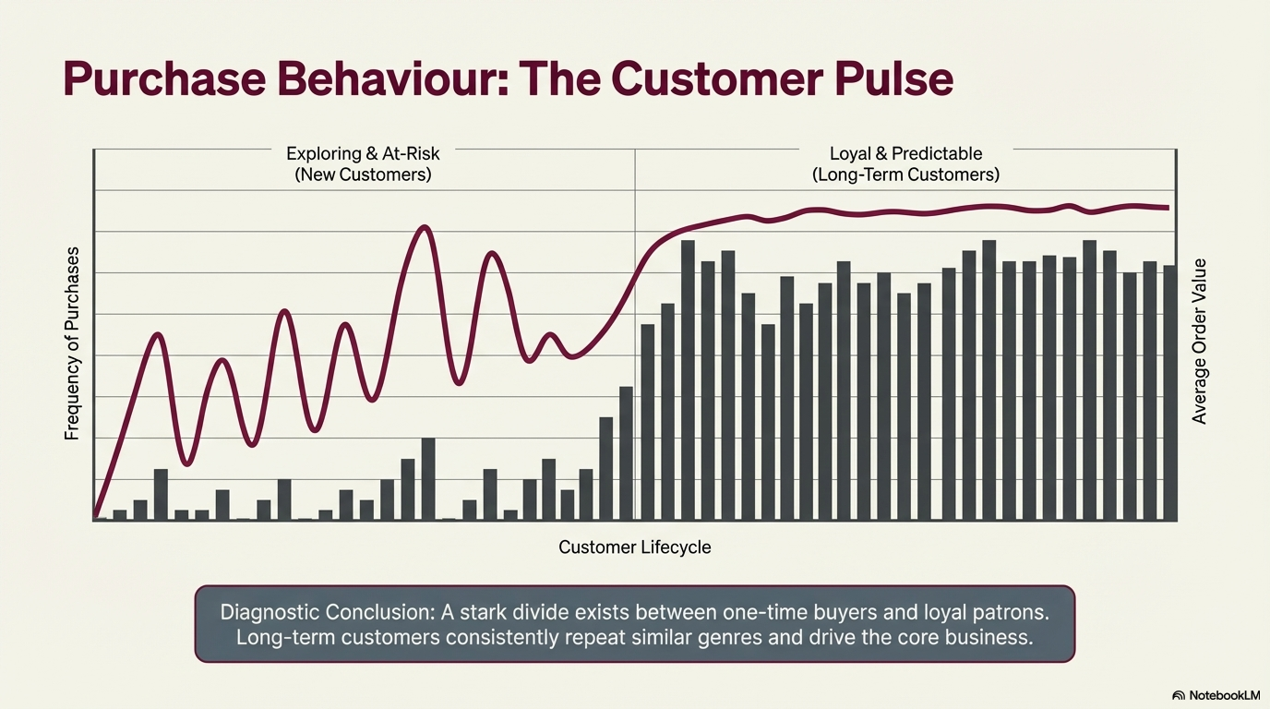

Slide 16
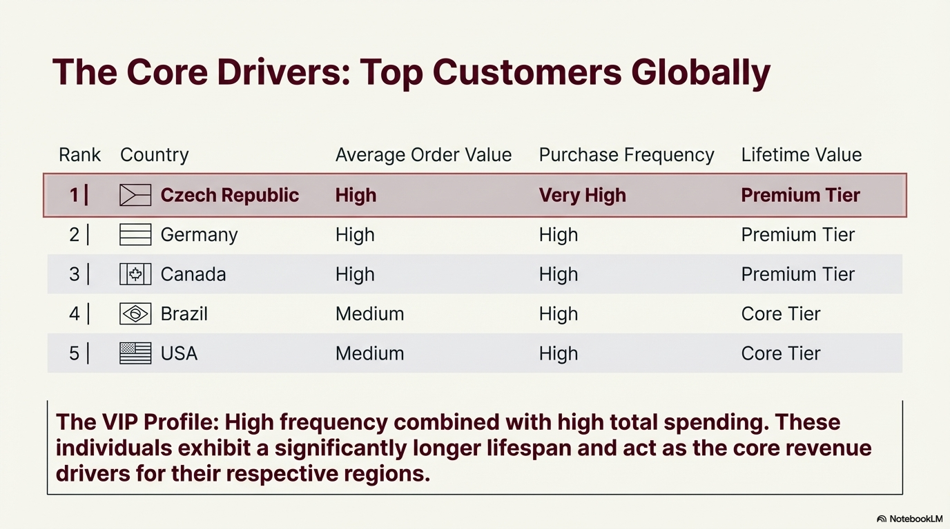

Slide 17
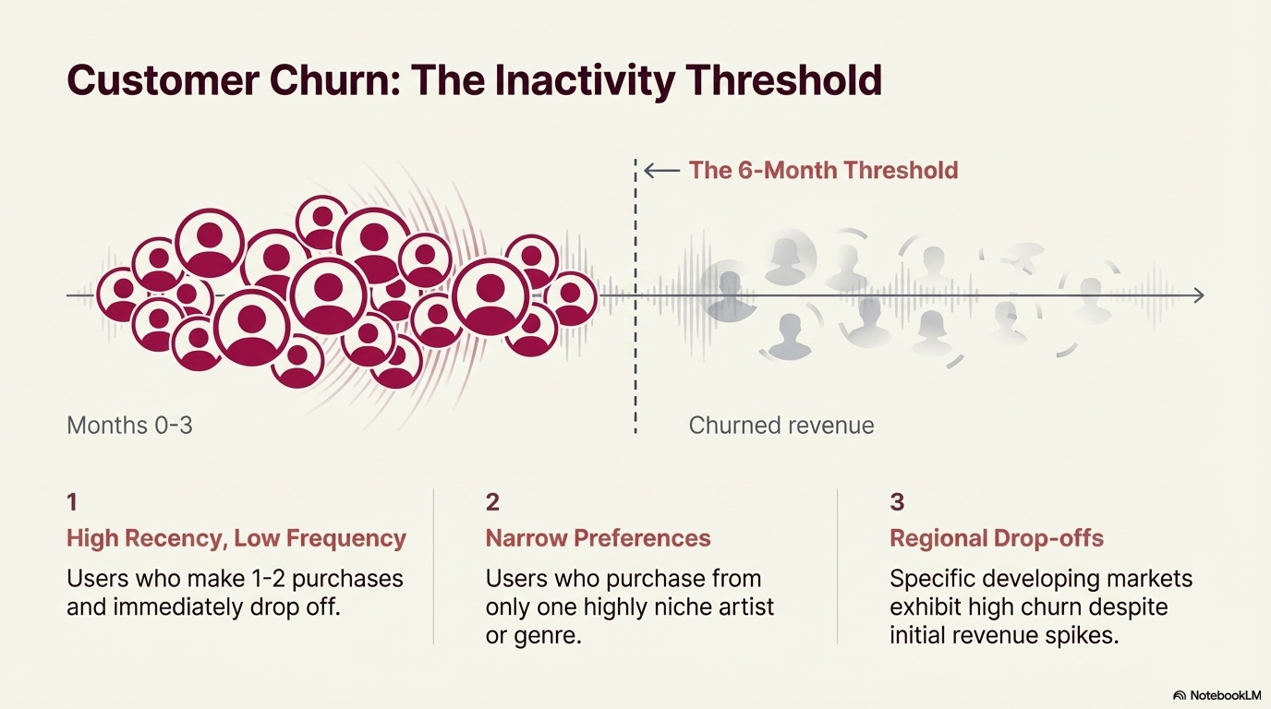

Slide 18
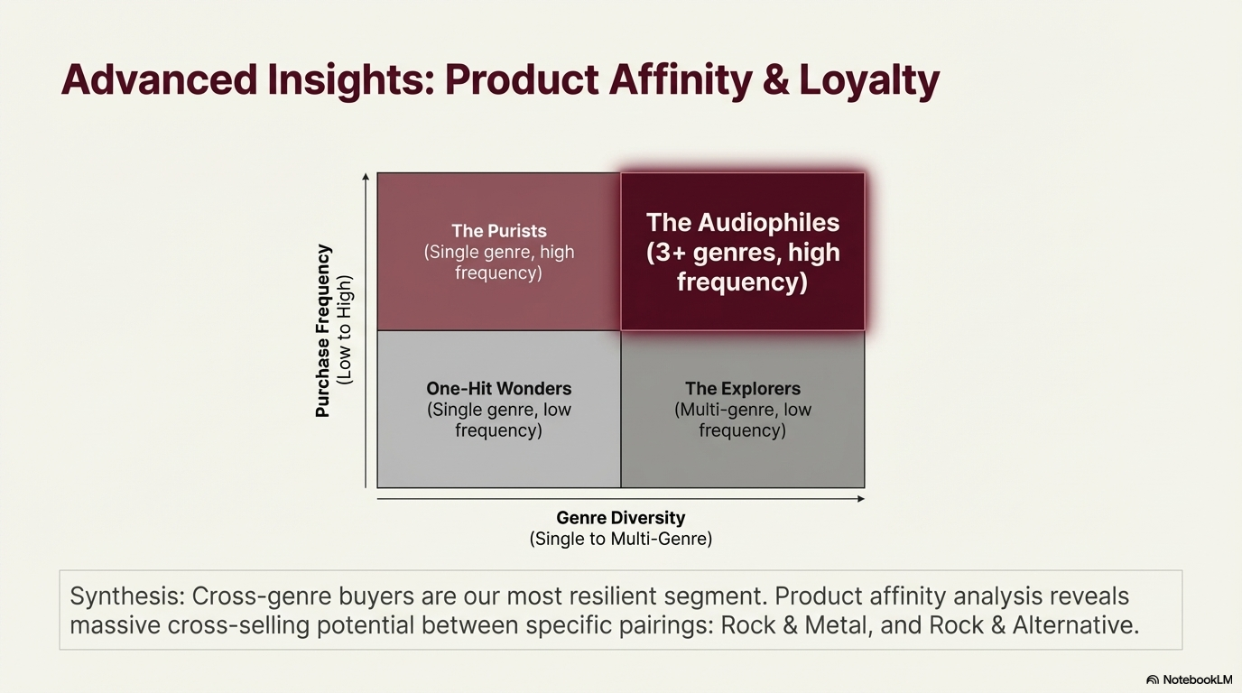

Slide 19


Slide 20
