Slide 1





Analytics -4
Narendra Medisetti
11012094

Slide 2
Residual Neural Network for Image Recognition

Slide 3
Introduction
ResNet, named for Residual Networks, is a traditional neural network used as a backbone for multiple computer vision tasks. This model won the ImageNet Competition in 2015. The fundamental breakthrough with ResNet has allowed us to successfully train extremely deep neural networks with 150 + layers. Deep learning is hierarchical set of representation such as learning low, mid, high level features.
I have used Resnet for flower recognition.

Slide 4
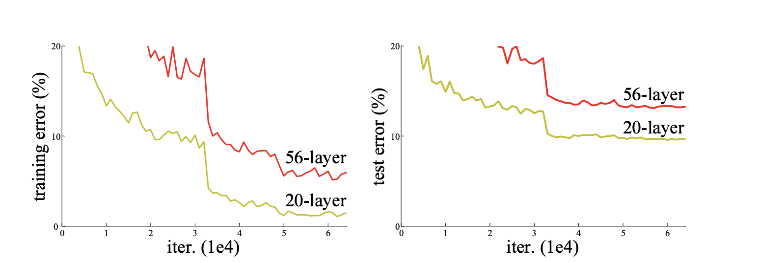
Adding layers to deep convolutional neural nets
Figure 1: Adding layers to CNN (Kaiming he, Xiangyu Zhand, Shaoqing Ren, Jian Sun, 2015)
It trained on CIFAR-10
Higher training error and test error
Vanishing gradient problem

Slide 5
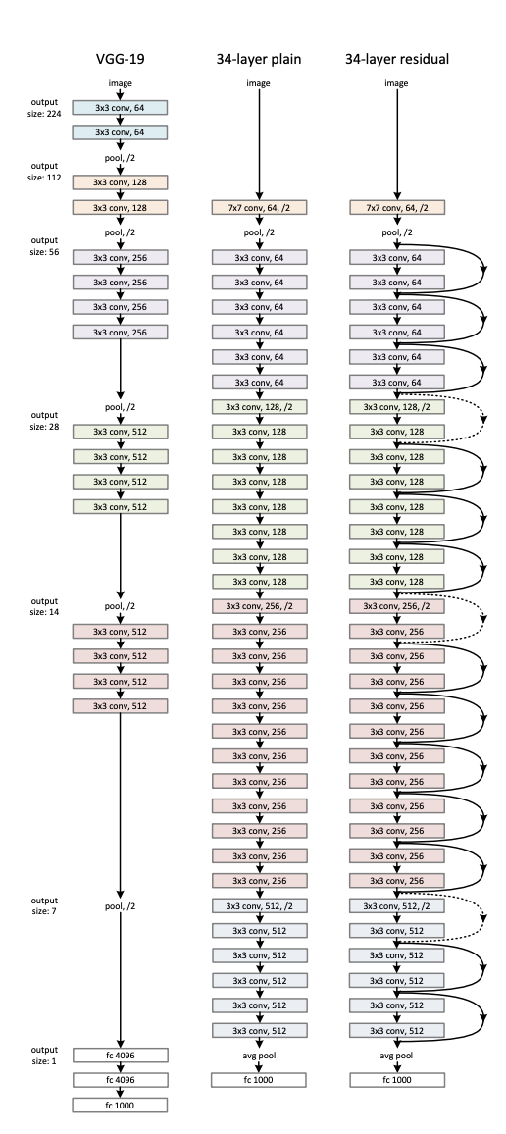
Resnet Architectures for image net
Figure 2: ResNet Architectures for image net (Kaiming he, Xiangyu Zhand, Shaoqing Ren, Jian Sun, 2015)

Slide 6
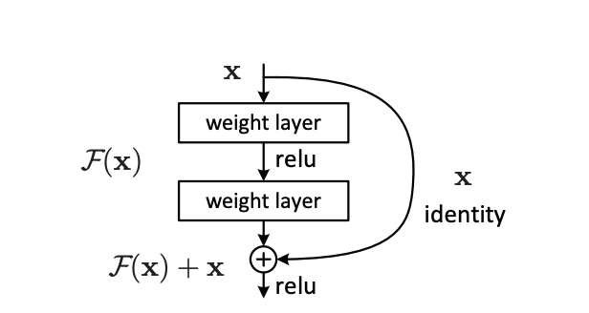
Identity Mapping
Figure 3: Identity mapping (Kaiming he, Xiangyu Zhand, Shaoqing Ren, Jian Sun, 2015)
1. Skip conncetion between input layer added to the output from previous layer to the output stacked layer

Slide 7
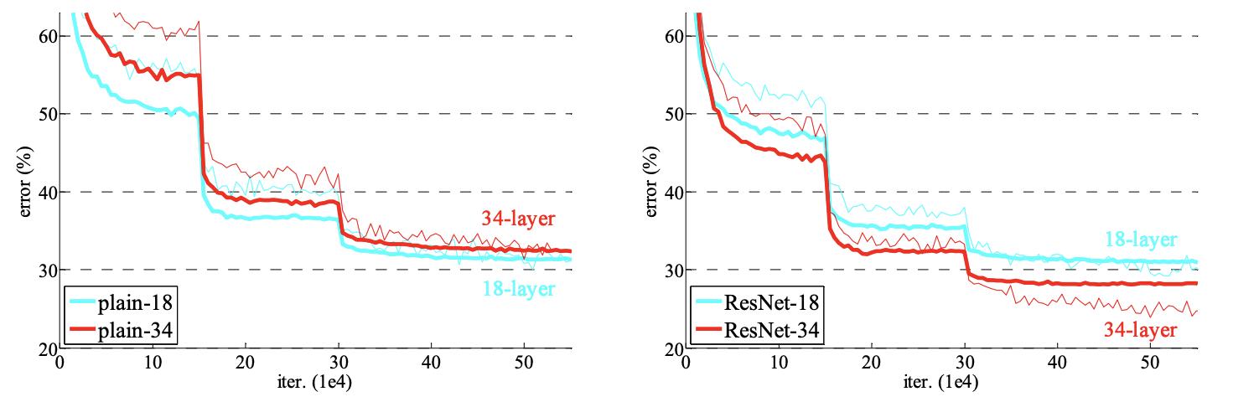
Plain network vs resnet
Figure 4: plain network vs ResNet (Kaiming he, Xiangyu Zhand, Shaoqing Ren, Jian Sun, 2015)
ResNet train on imagenet classification dataset
It consists of 1000 classes
Trained on 1.28 million training image and evaluated 50K validation images

Slide 8
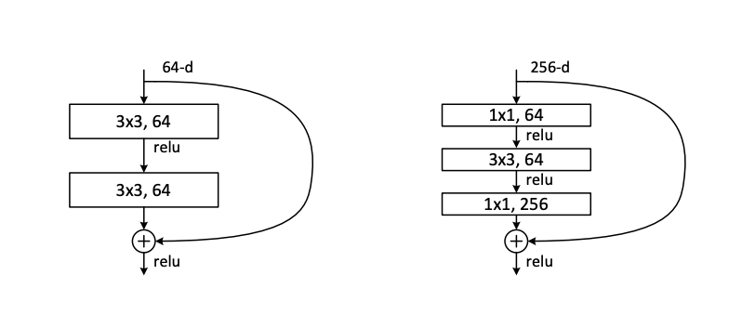
Deeper botleneck architecture
Figure 5: A depper residual (Kaiming he, Xiangyu Zhand, Shaoqing Ren, Jian Sun, 2015)
They extend skip connection By skiping two layers
This is done to save training time

Slide 9
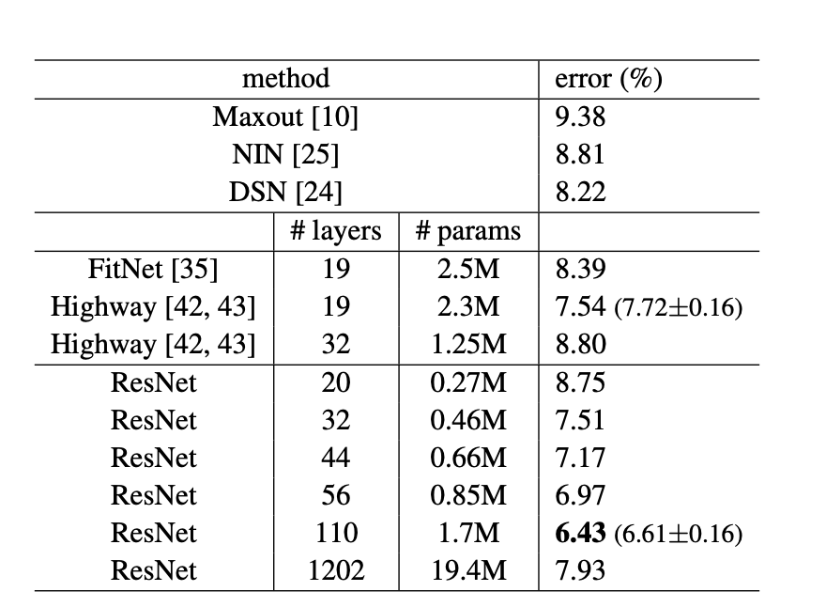
Restnet trained with Cifar-10
Figure 6: Classication on CIFAR-10 (Kaiming he, Xiangyu Zhand, Shaoqing Ren, Jian Sun, 2015)
CIFAR-10 dataset consists of 50 K training image and 10 k test image in 10 classes
They extremly focus on deep network but on pushing state of art result

Slide 10
over 1000 layers
Resnet trained on 1202 layer.
Testing error worse than ResNet-110.
Authors suggest this due to overfitting.

Slide 11
REferences
Kaiming He, Xiangyu Zhang, Shaoqing Ren, Jian Sun. 2015. “Deep residual learning for image recognition”.
Kaggle. “Flowers recognition”. https://www.kaggle.com/alxmamaev/flowers-recognition. Last access on September, 2020.
Connor Shorten. “Introduction to Resnet”. https://towardsdatascience.com/introduction-to-resnets-c0a830a288a4 . Last access on September, 2020.

Slide 12
List of figures
Figure 1: Adding layers to CNN (Kaiming he, Xiangyu Zhand, Shaoqing Ren, Jian Sun, 2015)
Figure 2: Resnet Architectures for image net (Kaiming he, Xiangyu Zhand, Shaoqing Ren, Jian Sun, 2015)
Figure 3: Identity mapping (Kaiming he, Xiangyu Zhand, Shaoqing Ren, Jian Sun, 2015)
Figure 4: plain network vs resnet (Kaiming he, Xiangyu Zhand, Shaoqing Ren, Jian Sun, 2015)
Figure 5: A depper residual (Kaiming he, Xiangyu Zhand, Shaoqing Ren, Jian Sun, 2015)
Figure 6: Classication on CIFAR-10 (Kaiming he, Xiangyu Zhand, Shaoqing Ren, Jian Sun, 2015)

Slide 13
Thanking you

