Slide 1





Data Storytelling and Communication Medisetti narendra

Slide 2
House prices in The United State of America

Slide 3
Introduction
Aim of this project is to analyse House Prices data and predict the better explainability methods and visualization. The real estate market is rapidly evolving. The housing market in the United of America has always been a topic of national attention, with news sites dedicating sections that report on key news that can potentially affect housing prices and the trends in recent months. For many people, buying a property is one of the most important decision and purchase in life. This project justifies the value of houses to the customer who want buy and sell their houses in the United States of America.

Slide 4

Software REquirement
Python Programming language
MS Excel: To Import, Export and Analyse
Tableau: It’s a visualization tool, to present the insights pictorially
Packages: Pandas, Numpy, Seaborn, Matplotlib, Sklearn.

Slide 5
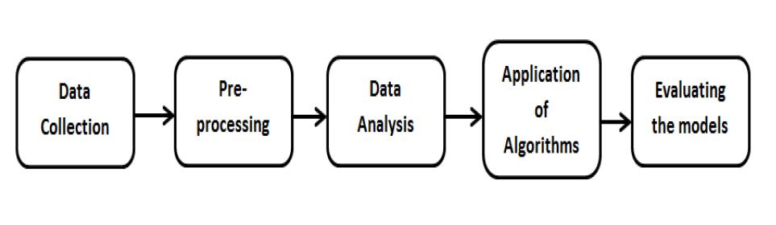
Methodology

Slide 6
Data Collection
The dataset used in this project was an open source dataset from Kaggle website.
It consists of 21613 rows and 21 features.
It contains 19 numeric and categorical variables.

Slide 7
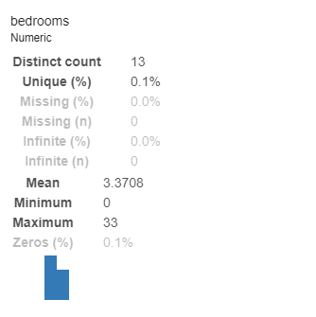
Pre-processing
I have compared my dataset with the actual ground truth (http/info.kingcounty.govs:/) in order to come to a conclusion that I am working on the correct data set.

Slide 8
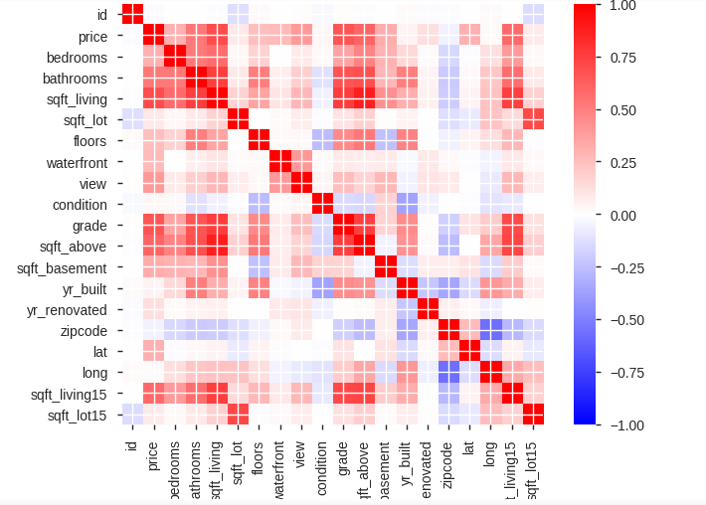
Data Analysis
Correlation Matrix:

Slide 9
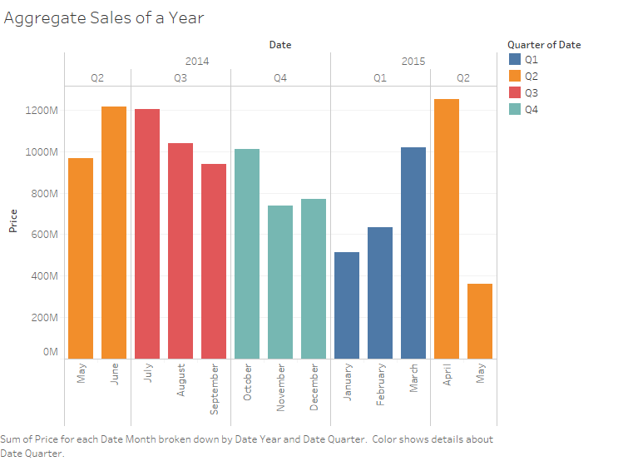
Sales of a Year

Slide 10
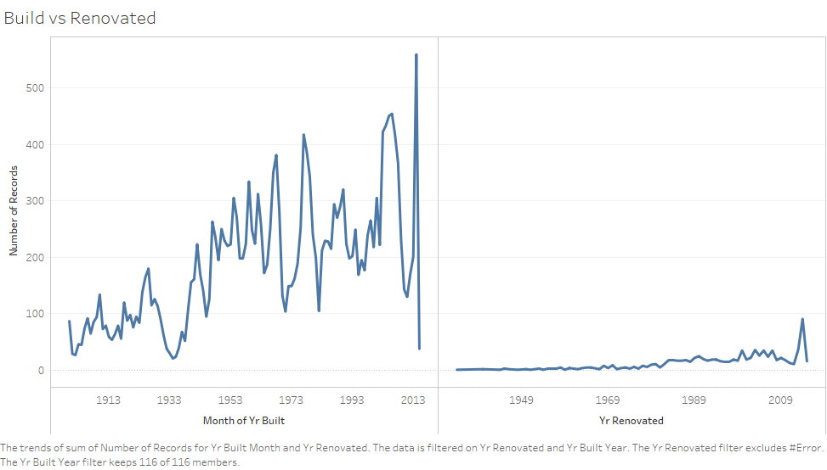
Build vs Renovation

Slide 11
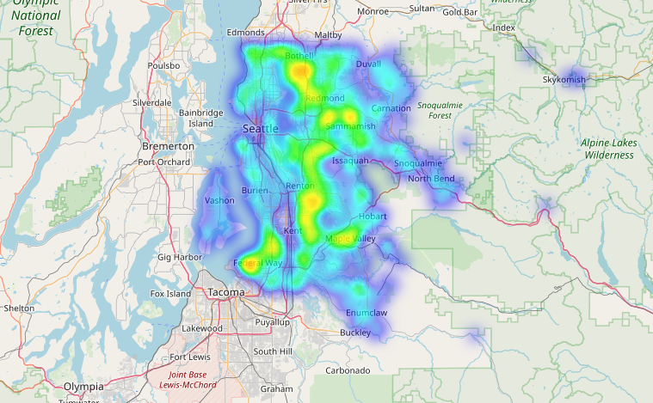
1940-1960

Slide 12
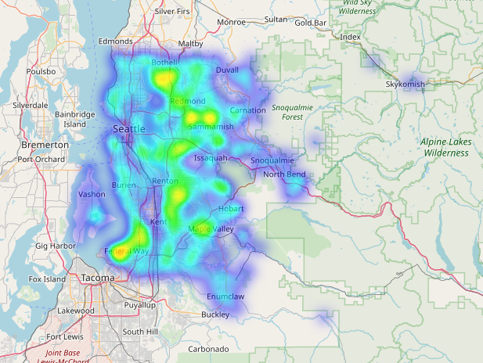
1960-1990

Slide 13
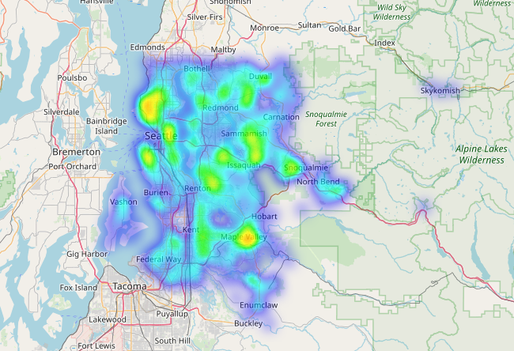
1990-2015

Slide 14
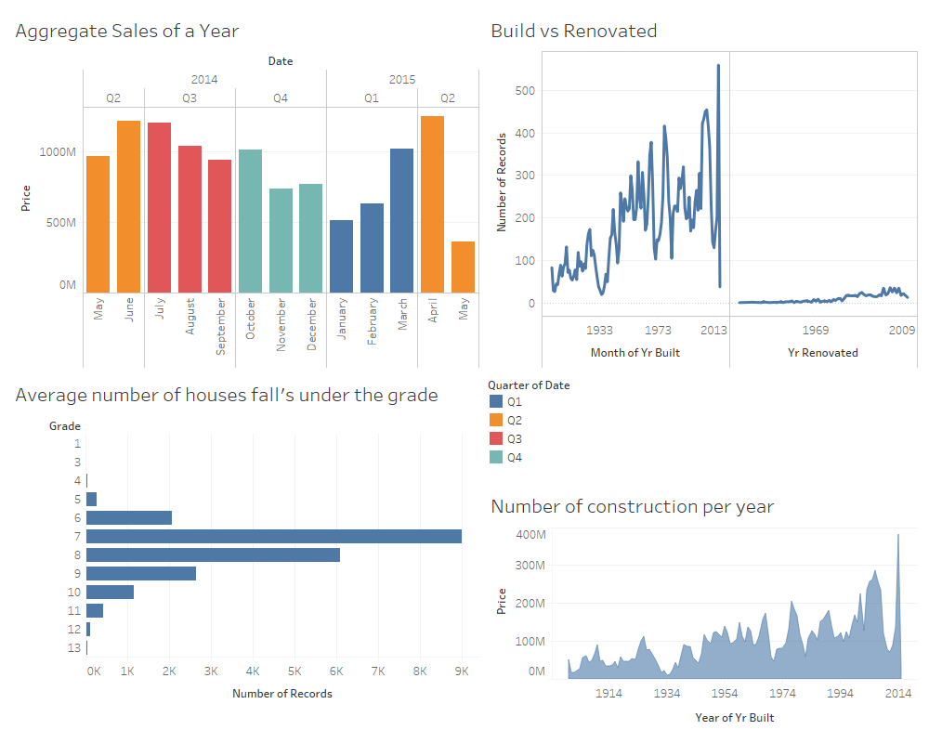
dashboard

Slide 15
Model algorithm
Linear regression
Random Forest
XGboost
Catboost

Slide 16

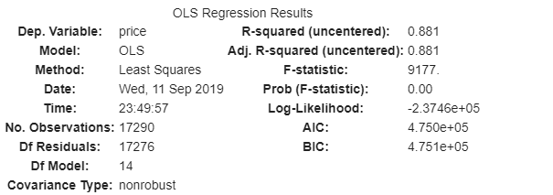
Linear regression
RMSE:

Slide 17
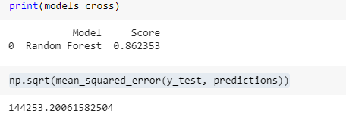
Random forest

Slide 18

XGBOOST
RMSE

Slide 19

catboost

Slide 20
Innovation:
The actual observation from the data set which I found has major impact are Square foot , location and the year of construction respectively. However the overall accuracy which I have tried to improve is limited to the data which I have took to analyse.
My Idea of innovation is to predict the price by automatically considering the factors influencing the price which are mention below. Its has a broad scope and difficult to integrated are the dimensions together as many factors cannot be fit under one platform. To build a prediction model we have to focus on integrating the social and economical factors .

Slide 21
Factors Influencing the outcome
Depreciation Rate of the Building.
Expenditure rate of the particular geographical location .
Increase in the population which creates the necessity of accommodation.
Raise/ Fall in the Real-estate marks which has several influencing factors.
Slightly a marginal effect on the emotional factors of the people.

Slide 22
Thinking you

