Slide 1




j unyuo@gmail.com

Slide 2


What is Java Persistence API
Primary Features
Five Steps to Implement JPA
◦ Download Hibernate Components
◦ Prepare Database, and Download JDBC Driver
◦ Implemented POJO entities and add annotations
◦ Persistence.xml
◦ Implemented client side code via EntityManager

Slide 3



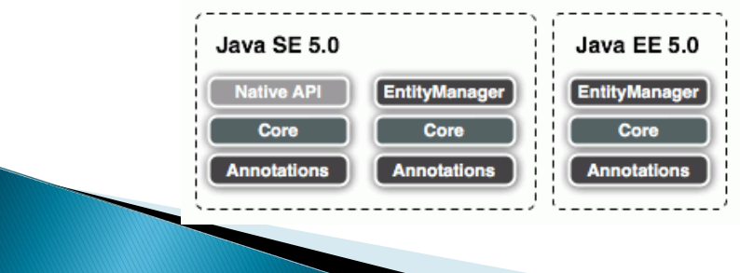
The Java Persistence API is the standard object/relational mapping and persistence management interface of the platform. As part of the specification effort, it is supported by all major vendors of the Java industry.

Slide 4

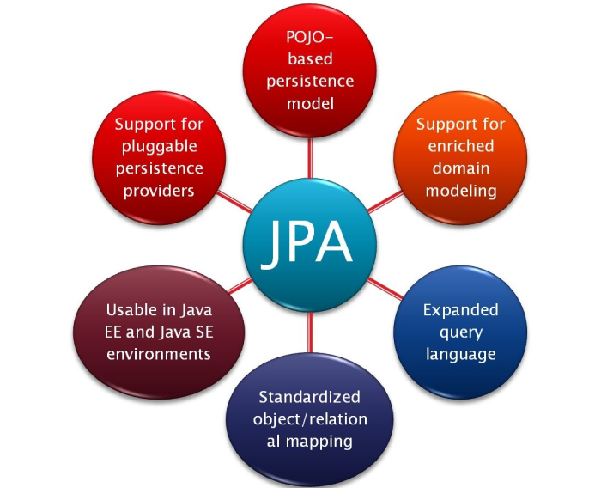



Inheritance, polymorphism, etc.
Using annotations and/or XML

Slide 5







Java Application
Java Persistence API
Hibernate
TopLink
Kodo (OpenJPA)
Everyone can use their own favorite persistence technology

Slide 6










Java Persistence API
 | Hibernate API
Hibernate Annotation (JPA) Hibernate EntityManager
Hibernate Annotation (Hibernate) Hibernate XML Mapping File
Hibernate Core

Slide 7

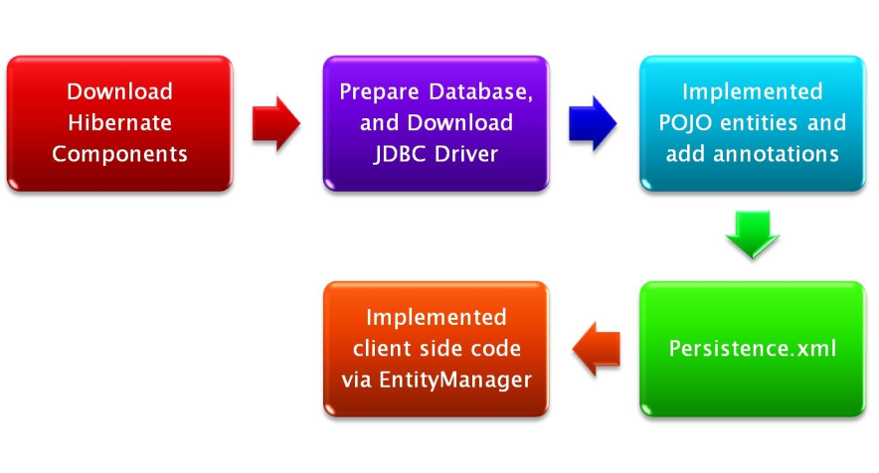


1. Hibernate Core
2. Hibernate EntityManager
3. Hibernate Annotations
MySQL JDBC Driver

Slide 8








1. Hibernate Core
2. Hibernate EntityManager
3. Hibernate Annotations
http://www.hibernate.org/
 | MySQL JDBC Driver

Slide 9

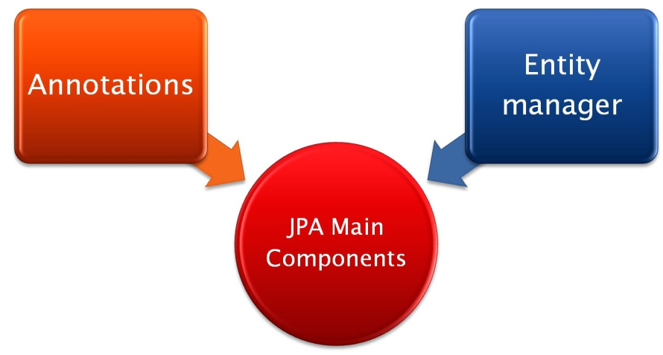
 | To label artifacts (classes, methods etc.) for persistence or persistence related operations
A “gateway” to the persistence classes
Allow access to persistent objects, transaction context, query language etc.

Slide 10

Hibernate Annotations includes
◦ Standardized Java Persistence and EJB 3.0 (JSR 220) object/relational mapping annotations
◦ Hibernate-specific extension annotations for performance optimization and special mappings
Hibernate EntityManager includes
◦ The standard Java Persistence management API
◦ The standard Java Persistence Query Language
◦ The standard Java Persistence object lifecycle rules
◦ The standard Java Persistence configuration and packaging

Slide 11


1. Hibernate Core
2. Hibernate EntityManager
3. Hibernate Annotations
 | MySQL JDBC Driver

Slide 12
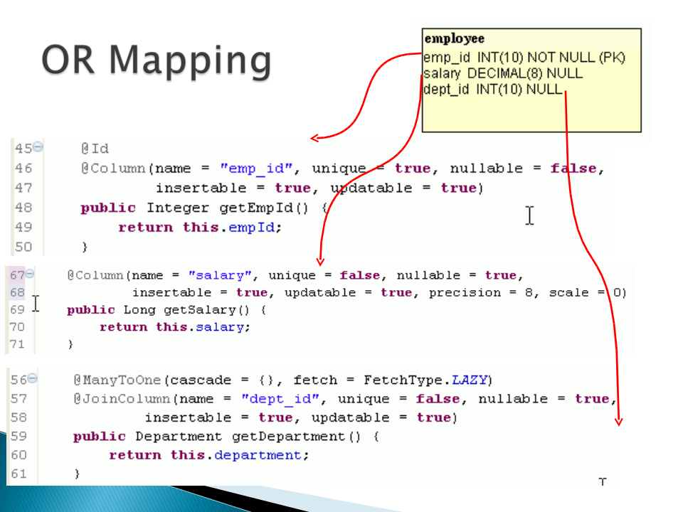

Slide 13
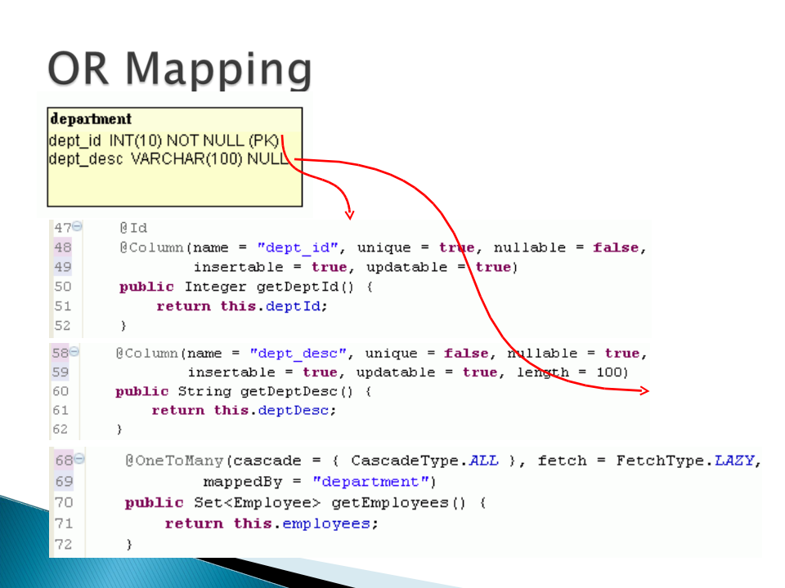

Slide 14



Attached to a class
Signify that a class is persistent
Example:
An entity must follow the Java Bean convention for its attributes to be persistent
◦ Having getters and setters

Slide 15

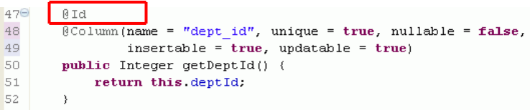
Each entity must have an identity
An identity of an entity could simply be a class variable annotated with @Id
Example

Slide 16
Id can be auto generated
There are other strategies such as
◦ GeneratorType.SEQUENCE
◦ GeneratorType.IDENTITY
AUTO is best for portability between database vendors

Slide 17

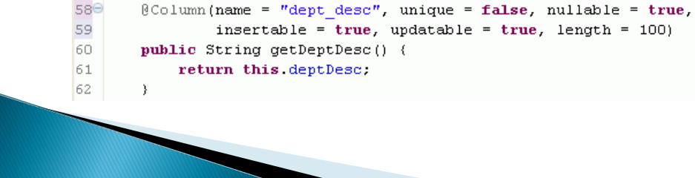
@Column, is put on getter of a class variable
Has several functionalities
◦ Updatable (boolean)
◦ Nullable (updatable)
◦ Length (int)
◦ Example:

Slide 18

There are 4 types of links
◦ @OneToOne
◦ @OneToMany
◦ @ManyToOne
◦ @ManyToMany
In most cases, putting the annotation on a getter of a class variable would be enough
In some cases, we need to identify a few parameters to the annotations

Slide 19

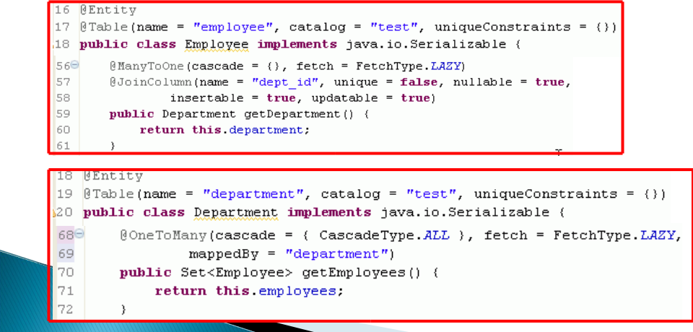
Two cases
◦ Two entities share the same primary key value

Slide 20

Entity objects have two distinct modes
◦ Attached
The object is in the database
◦ Detached
The object is in memory acting as a DTO
Modification on detached object would not be persisted automatically
Developers need to persist detached objects using a primitive

Slide 21

Entity manager:
◦ Gateway to persistent classes
◦ Enable queries
◦ Outside of session beans, provides transaction facility

Slide 22


1. Hibernate Core
2. Hibernate EntityManager
3. Hibernate Annotations
 | MySQL JDBC Driver

Slide 23

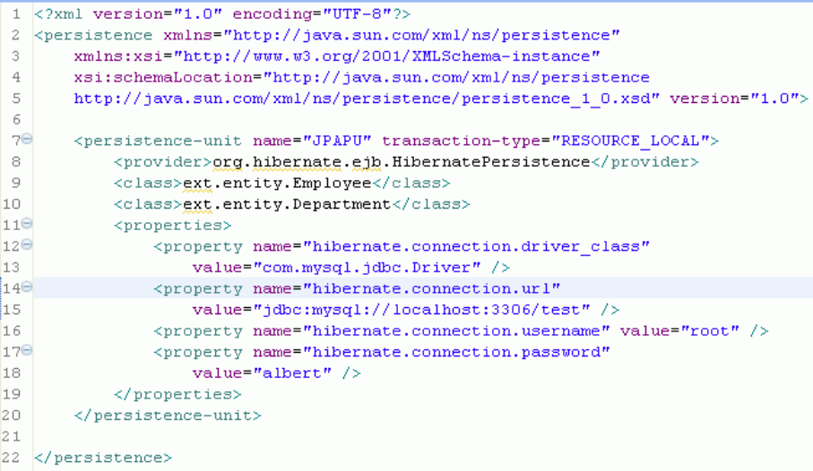




EntityManagerFactory
Name
Entity classes
Driver
JDBC URL
User name
password

Slide 24

1. Hibernate Core
2. Hibernate EntityManager
3. Hibernate Annotations
 | MySQL JDBC Driver

Slide 25

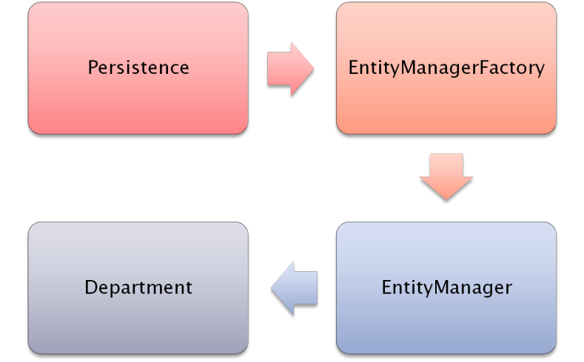



Create
Create
Persistence.xml
Operates

Slide 26
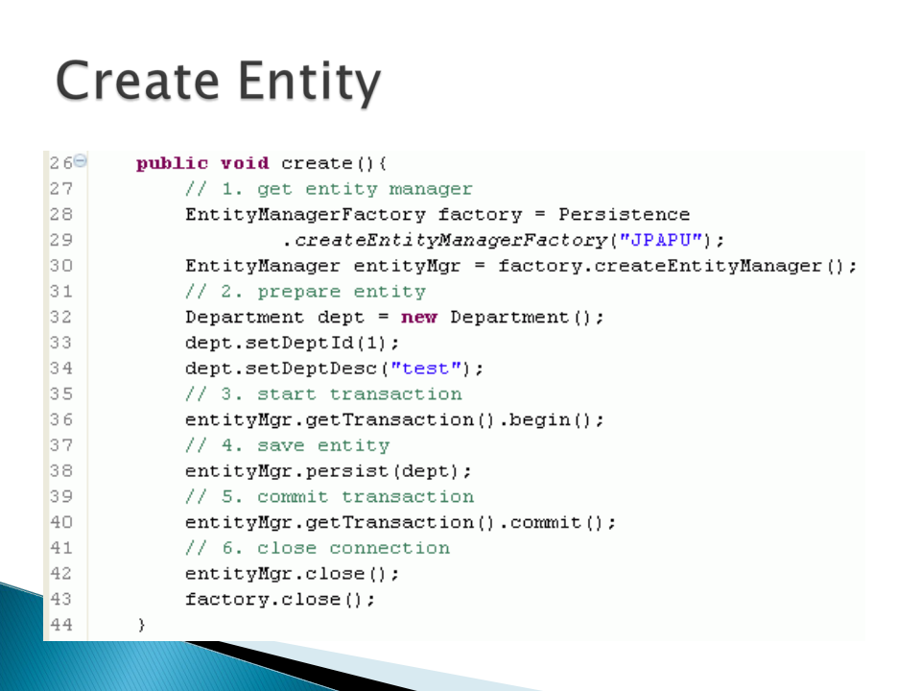

Slide 27
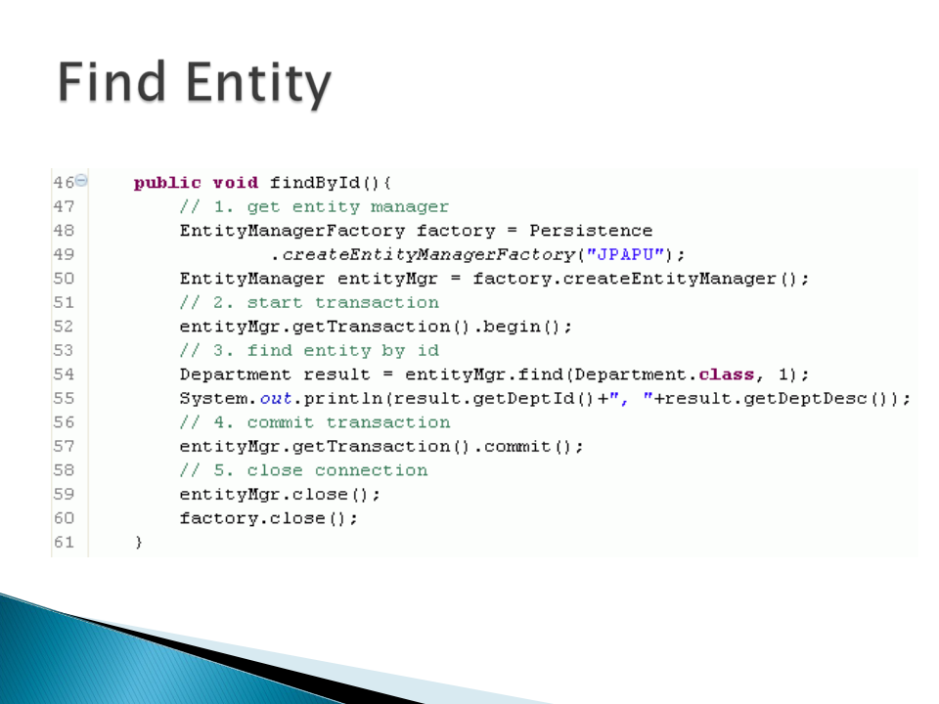

Slide 28
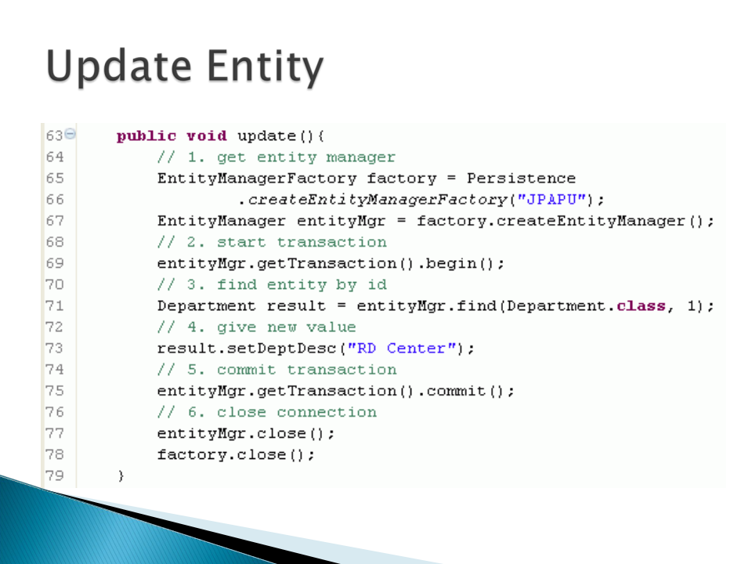

Slide 29


