Slide 1
NARENDRA LAKKOJU
Final project
<number>

Slide 2
KEY LOGGER AND SECURITY
<number>

Slide 3


AGENDA
Problem Statement
Project Overview
End Users
Solution and Value Proposition
The "Wow" Factor in Our Solution
Modelling
Results
3/21/2024 Annual Review
<number>

Slide 4

PROBLEM STATEMENT
Problem:
Keyloggers are a significant threat to cyber security,
leading to unauthorized access to sensitive information,
identity theft, and financial fraud.
Impact:
Affects individuals, businesses, and organizations by
compromising data privacy and security.
<number>

Slide 5

PROJECT OVERVIEW
Objective:
Develop a comprehensive understanding of keyloggers,
their types, how they work, and effective security measures
to prevent keylogging attacks.
Scope:
Includes an analysis of hardware and software keyloggers,
legal and ethical implications, security measures, and
best practices.
<number>

Slide 6

WHO ARE THE END USERS?
Individuals: Concerned about personal data security and privacy.
Businesses: Need to protect corporate data and ensure compliance with security standards.
Organizations: Require robust security measures to
safeguard sensitive information.
Security Professionals: Aim to understand and mitigate keylogging threats.
<number>

Slide 7

YOUR SOLUTION AND ITS VALUE PROPOSITION
To avoid keyloggers
Use anti virus program
Use password manager
Use multi factor authentication
Use a firewall
Avoid suspicious links and downloads
Change password periodically
Update your system
Use Virtual Keyboard to type passwords
and sensitive information
<number>

Slide 8
Solution:
Implement a multi-layered security strategy that
includes anti-keylogging software, regular system
scans,software updates,and user education.
Value Proposition:
Enhanced Security: Reduces the risk of data
breaches and identity theft.
User Awareness: Educates users about keylogging
threats and protection methods.
Compliance: Helps businesses and organizations
comply with data protection regulations.
<number>

Slide 9

THE WOW IN YOUR SOLUTION
Innovative Approach: Combining technical
measures with user education for comprehensive
protection.
Demonstration:Real-time demonstration of a simple
keylogger to illustrate the threat and the effectiveness
of security measures.
Impact: Significant reduction in the likelihood of
keylogging attacks through proactive measures.
3/21/2024 Annual Review
<number>

Slide 10
MODELLING
Architecture Overview:
Modular Design: The keylogger code is structured into modular functions for better readability and maintenance.
Event Handling: Utilizes the pynput library to capture and handle keyboard events.
Data Logging: Implements functions to log captured data into text and JSON files.
<number>

Slide 11
MODELLING
Components:
Key Press Handling: Function: on_press(key)
Description: Captures and logs the pressed keys.
Details: Appends key press events to a list and updates the JSON log file.
Key Release Handling: Function: on_release(key)
Description: Captures and logs the released keys.
Details: Appends key release events to a list, updates the JSON log file, and accumulates keys for the text log.
Logging Functions:
Text Logging: generate_text_log(key)
Description: Writes the recorded keys to key_log.txt.
JSON Logging: generate_json_file(keys_used)
Description: Dumps the list of key events to key_log.json.
<number>

Slide 12
MODELLING
GUI Integration:
Tkinter Framework: Utilizes tkinter for creating a graphical user interface.
User Interaction:
Start Button: Initiates the keylogger.
Stop Button: Stops the keylogger.
Status Updates: Provides real-time feedback on the status
of the keylogger (running/stopped).
<number>

Slide 13
MODELLING
Flow Diagram:
Initialization:Set up the main GUI window.Initialize global variables for key logging.
Event Capture:
Start capturing key events when the "Start" button is pressed.Log key press and release events.
Data Logging:
Continuously update text and JSON log files with captured key events.
Stop Logging:
Stop capturing key events when the "Stop" button is pressed.
Update the GUI status to indicate the keylogger is stopped.
<number>

Slide 14
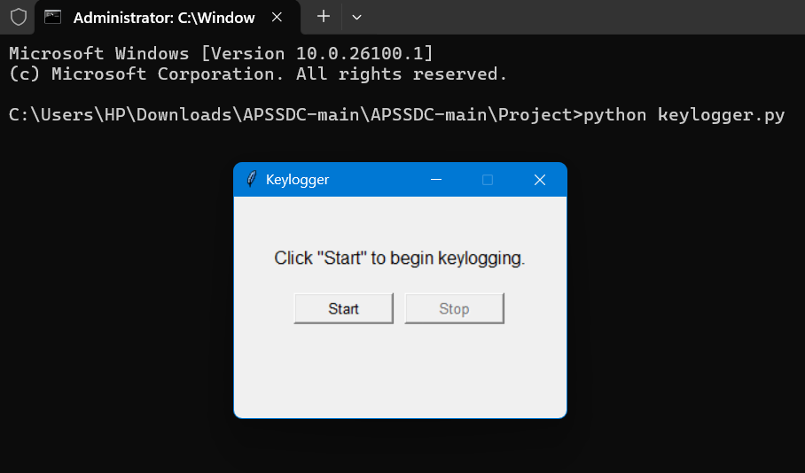
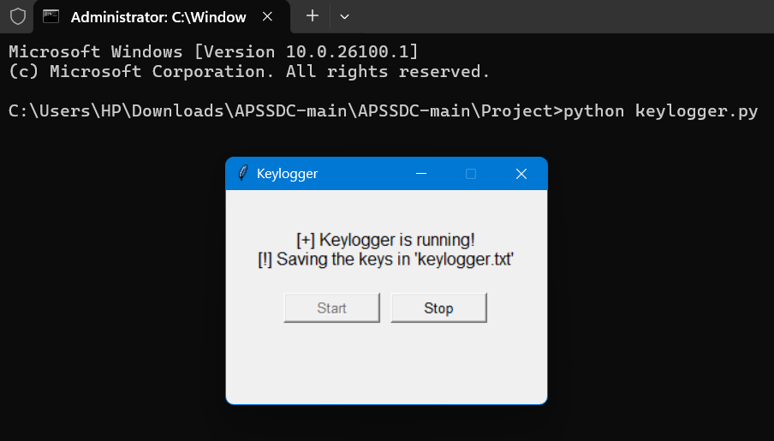
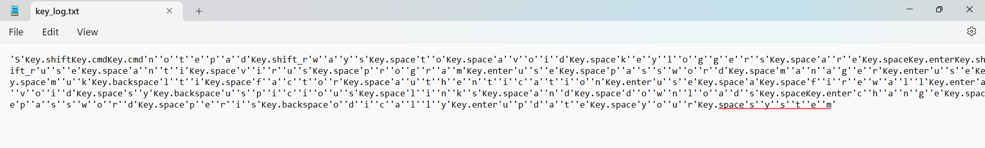
RESULTS
Screenshots of the GUI: Display the user interface, including the start and stop buttons,
and the status label.
Sample Logs: Show examples of the key_log.txt and key_log.json files to illustrate
how the keystrokes are recorded.
<number>

Slide 15
RESULTS
1.Successfully implemented a keylogger that captures keystrokes
and records them into both text and JSON files.
2.Real-time keylogging with start and stop functionality
controlled via a simple GUI.
3.The GUI provided a user-friendly way to control the keylogger, making it accessible and easy to use.
4.The keylogger project demonstrated the capability to effectively capture and log keystrokes in real-time.
5.Emphasized the ethical use of keyloggers and the importance of implementing security measures to protect against malicious use.
<number>

Slide 16
https://github.com/narendralakkoju/NARENDRA_LAKKOJU.git

