Slide 1
Term Project Group 18-Recurrent Neural Network
Anvesh Radharapu
Sairam Mandarapu
Reddy Narendranath Reddy
Jahnav Jayanth Reddy Kukkala
Sai lohith konakanchi
INFO 5505 Fall 2022

Slide 2
Facial Expression Recognition using Recurrent
Neural Network

Slide 3
Agenda
Title
Motivation and Background
Abstract
Literature Survey
Objectives of the Study
Data Set and Data Processing
Research Design and Model Description
Data Analysis and Data Visualization
Results and Conclusion
References

Slide 4
Motivation and Background
Facial expressions are a form of nonverbal communication that help individuals understand the basic emotions of sadness, happiness, fear, disgust, anger, and tiredness, etc. Facial expressions are often misunderstood. Facial expressions of an emotion are the patterned facial muscle movements that reflects the associated emotional states experienced internally.
The process of learning about facial expressions allows one to develop a detailed understanding of how an emotion is expressed on the face. It involves different ways of comprehending elements like age, gender, culture, and fundamental emotions, as well as the development of a role in how an emotion is expressed through the face. Or to put it another way, certain facial expressions can be used to understand and assess emotions.
In order to automatically understand and recognize human emotions like happiness, sadness, anger, fear, surprise, disgust, and so on, an automatic facial expression recognition system is being developed. This research area is currently very active in the fields of signal processing, pattern recognition, and artificial neural networks.

Slide 5
Abstract
The goal of emotion recognition technology is to determine a person’s emotions from their facial expressions. Facial expression recognition research and public interest have a long history. The Three major steps are face detection, facial feature extraction, expression classification are applied on CK+48 (Extended Cohn-Kanade dataset). For Face detection and extract high-level information from the image we use Candide-3 face model with a learned objective function, and Recurrent Neural Network in combination with convolution Network, support vector machines (SVM) are utilized in recognize and classifying facial expressions. The benefit of utilizing a recurrent network is that the classification process can taken into account the temporal relationships contained in the image sequences. The method would be great for real-time recognition because everything is automatic and recurrent networks may be utilized to create predictions online. Different businesses already utilize emotion recognition extensively to determine how customers feel about their goods, brands, marketing initiatives, employees, or on-site interactions, this technology offers options that go beyond market research and digital advertising. Our Experimental results are promising and reached an accuracy of 85% which is 5% more compared to traditional Neural Nets.
Index Terms—CK+, SVM, Candide-3, Reccurent Neural Network, Facial expression recognition

Slide 6
Literature Survey
Facial Expression Recognition(FER) has a substantial amount of research that has been carried out over the last two decades. Most of the related research on FER is usually divided into three modules, namely feature extraction, model training, feature detection. Feature Extraction module usually comes under data preprocessing phase, where numerous feature extraction techniques has been used in multiple researches to get a comparative performance of the various efficient extraction techniques.
Previous works have used a range of these feature extraction techniques but the most used ones among them are Facial Acting Coding System(FACS), Principal Component Analysis(PCA), Linear Discriminant Analysis(LDA), Local Binary Pattern(LBP), Local Gradient Code(LGC), and so on. As feature extraction plays a vital role in FER, it is recommended to use the appropriate technique for the process and if in doubt, a comparative analysis based on the performance of these techniques is always helpful in making the right decision.
Coming to model fitting module, this phase is generally responsible for training a selected model with the extracted features from the images. Though numerous models are available to process this extracted features, neural network approach is the most used way in majority of relevant research for their efficient mechanism and the Convolutional Neural Networks(CNN) as well as the Recurrent Neural Networks(RNN) are the most used models for processing and training the features that are extracted in the previous module.
Finally, the feature detection and classification module usually involves classification models to classify and predict the facial expression. There are only three classification models that are being used extensively for the detection, classification and prediction of the featured facial expressions in the previous research, which are Support Vector Machine(SVM), k-Nearest Neighbor(KNN), and Long Short-Term Memory(LSTM).

Slide 7
Objectives of the Study
The main objective of this study would be to implement an emotion recognition system, that would analyze and predict the human emotions with the help of their facial expressions using Recurrent Neural Networks.
The Extended Cohn-Kanade (CK+) dataset consists of 593 video clips from 123 distinct people who range in age from 18 to 50 and are of various genders and ethnic backgrounds. Each video depicts a change in face expression from neutral to a specified peak expression. It was shot at 30 frames per second (FPS) at either 640x490 or 640x480 resolution.
One of the seven expression classes - anger, contempt, disgust, fear, pleasure, sorrow, and surprise are assigned to 327 of these video clips. Most facial expression classification algorithms employ the CK+ database, which is widely recognized as the most frequently used laboratory-controlled facial expression classification database currently available.
By using the above dataset, we try to train the model and determine emotions in the test dataset.

Slide 8
Data Set and Data Processing
The dataset that is being used in this analysis The Extended Cohn-Kanade (CK+) dataset, which consists of 593 video clips from 123 distinct people who range in age from 18 to 50 and are of various genders and ethnic backgrounds.
Each video depicts a change in face expression from neutral to a specified peak expression. It was shot at 30 frames per second (FPS) at either 640x490 or 640x480 resolution. One of the seven expression classes—anger, contempt, disgust, fear, pleasure, sorrow, and surprise—is assigned to 327 of these movies.
A significant proportion of facial expression classification algorithms employ the CK+ database, which is widely recognized as the most frequently used laboratory-controlled facial expression classification database currently available.
The given data is divided into training and test datasets using the K-fold approach. The input dataset is divided several times in this procedure decrease the possibility of over-fitting. The model will be assessed using a different test set in every cross-validation step because every time a different split is generated. We want to utilize the test set to predict the model’s performance in a real-life scenario, so we won’t be using it for K-fold validation.

Slide 9
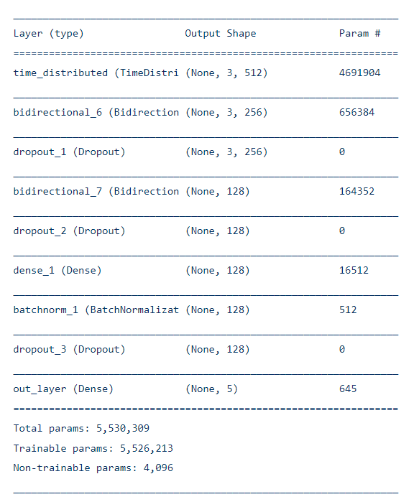
Research Design and Model Description
A bidirectional LSTM network with 128 layers and 64-layer Bidirectional LSTM layer in both the forward and backward hidden layers was utilized, as was a unidirectional LSTM within the hidden layer.
Each network contained 35 input units and six output units, one for each target class. All hidden layers were completely connected to each other, as well as to the input and output layers.
The output layer had a SoftMax activation function and was trained for classification using the cross-entropy objective function.
Dropouts are employed at regular intervals for generalization and ELU is selected as the activation function since it not only avoided the dying relu problem, but it also outperformed LeakyRelu.
he_normal is chosen as the kernel initializer because it is compatible with ELU. For improved results, batch normalization is also performed.
For a time-distributed CNN model we stacked few Bidirectional LSTMs over a unidirectional LSTM and finally a few dense layers.
To the dense layer we added a SVM classifier for more accuracy with the help of kernel regularizer=tf.keras.regularizers.l2(0.01) and squared hinge in the loss factor of model compiler.
The epoch’s history reveals that accuracy gradually improves and reaches +85% on both the training and validation sets. ReduceLROnPlateau is also termed anytime the accuracy reaches a plateau.

Slide 10
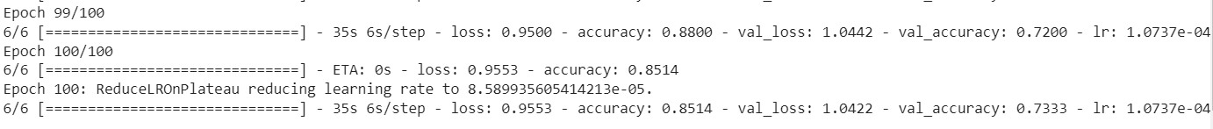
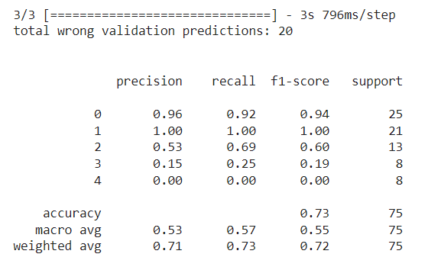
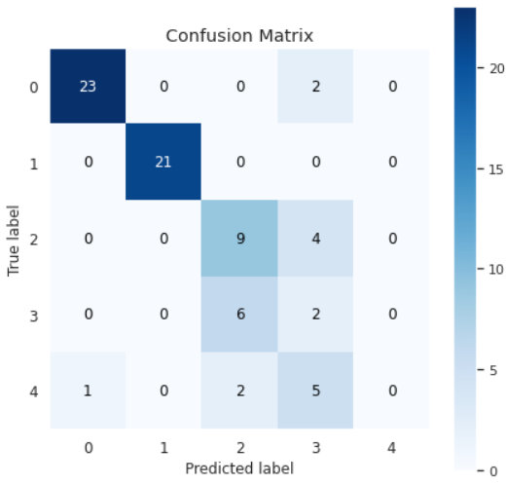
Data Analysis and Data Visualization

Slide 11
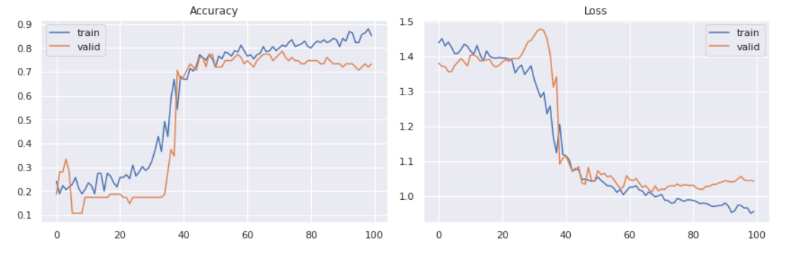
Data Analysis and Data Visualization

Slide 12
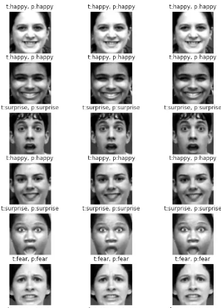
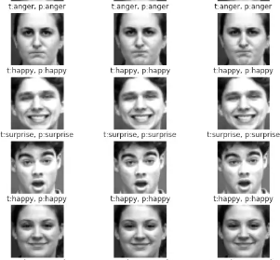
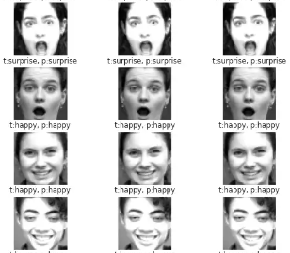
Results and Conclusion
We conclude this work presenting an approach for facial expression estimation that combines a convolution-Recurrent Neural Net model which predicts 5 Facial Expressions with SVM as a classifier included.

Slide 13
References
Jorgen Ahlberg. Candide-3 - an updated parameterised face. 2001. ¨
Mei Bie, Huan Xu, Yan Gao, and Xiangjiu Che. Facial expression recognition from a single face image based on deep learning and broad learning. Wireless Communications and Mobile Computing, 2022, 2022.
Tanoy Debnath, Md Mahfuz Reza, Anichur Rahman, Amin Beheshti, Shahab S Band, and Hamid Alinejad-Rokny. Four-layer convnet to facial emotion recognition with minimal epochs and the significance of data diversity. Scientific Reports, 12:2045–2322, 2022.
Parnal Dudul, Shital Tayade, and Ajay K. Talele. Facial image based emotion recognition system using neural network. International Journal of Advanced Research in Computer and Communication Engineering, 6:52–66, 2017.
Alex Graves, Christoph Mayer, Matthias Wimmer, Jurgen Schmidhuber, ¨ and Bernd Radig. Facial expression recognition with recurrent neural networks. In Proceedings of the International Workshop on Cognition for Technical Systems, 2008.
Sepp Hochreiter and Jurgen Schmidhuber. Long short-term memory. ¨ Neural computation, 9(8):1735–1780, 1997.
KS Jaswanth and D Stalin David. A novel based 3d facial expression detection using recurrent neural network. In 2020 International Conference on System, Computation, Automation and Networking (ICSCAN), pages 1–6. IEEE, 2020.
Ji-Hae Kim, Byung-Gyu Kim, Partha Pratim Roy, and Da-Mi Jeong. Efficient facial expression recognition algorithm based on hierarchical deep neural network structure. IEEE access, 7:41273–41285, 2019.
Jyoti Kumari, Reghunadhan Rajesh, and KM Pooja. Facial expression recognition: A survey. Procedia computer science, 58:486–491, 2015.
Ninad Mehendale. Facial emotion recognition using convolutional neural networks (ferc). SN Applied Sciences, 2(3):1–8, 2020.

Slide 14
References
Amr Mostafa, Mahmoud I. Khalil, and Hazem Abbas. Emotion recognition by facial features using recurrent neural networks. In 2018 13th International Conference on Computer Engineering and Systems (ICCES), pages 417–422, 2018.
Maja Pantic and Leon J. M. Rothkrantz. Automatic analysis of facial expressions: The state of the art. IEEE Transactions on pattern analysis and machine intelligence, 22(12):1424–1445, 2000.
R Reji and P Sojan Lal. A compact deep learning model for robust facial expression recognition. International Journal of Engineering and Advanced Technology, 8(6):2956–2960, 2019.
Roland Schweiger, Pierre Bayerl, and Heiko Neumann. Neural architecture for temporal emotion classification. In Tutorial and Research Workshop on Affective Dialogue Systems, pages 49–52. Springer, 2004.
Jie Shao and Yongsheng Qian. Three convolutional neural network models for facial expression recognition in the wild. Neurocomputing, 355:82–92, 2019.
Yan Tang, Xingming Zhang, Xiping Hu, Siqi Wang, and Haoxiang Wang. Facial expression recognition using frequency neural network. IEEE Transactions on Image Processing, 30:444–457, 2021.
PC Vasanth and KR Nataraj. Facial expression recognition using svm classifier. Indonesian Journal of Electrical Engineering and Informatics (IJEEI), 3(1):16–20, 2015.
Matthias Wimmer, Freek Stulp, Sylvia Pietzsch, and Bernd Radig. Learning local objective functions for robust face model fitting. IEEE Transactions on Pattern Analysis and Machine Intelligence, 30(8):1357– 1370, 2008.
Tong Zhang, Wenming Zheng, Zhen Cui, Yuan Zong, and Yang Li. Spatial–temporal recurrent neural network for emotion recognition. IEEE transactions on cybernetics, 49(3):839–847, 2018.
Xiaoming Zhao, Xugan Shi, and Shiqing Zhang. Facial expression recognition via deep learning. IETE technical review, 32(5):347–355, 2015

Slide 15
Thank You

