Slide 1

AU-Conditioned MAE + Pose-Normalized FER

Slide 2
MSML 640 – Computer Vision
Robust Facial Expression Recognition with AU-MAE and Pose Normalization
Team Members
Key Roles
Prakhar P. Tiwari| 121323248 | ptiwari1@umd.edu
Narendra R. Rane | 121300713 | nrane@umd.edu
Pretraining (AU-MAE, backbone models, GitHub pipeline)
Pose normalization, datasets & evaluation, ablation studies

Slide 3
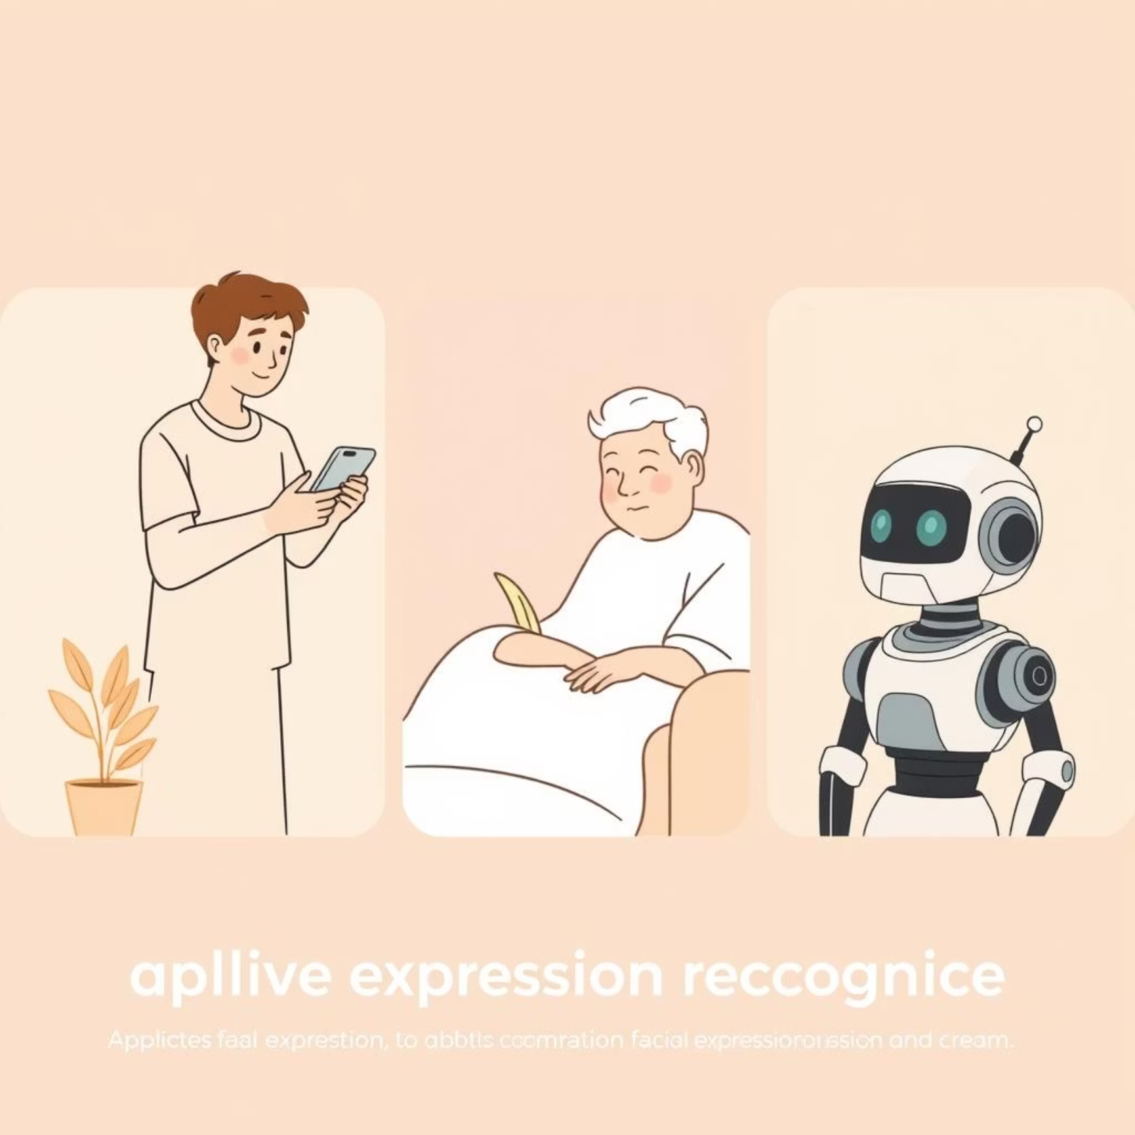
The Challenge: Robust FER In-the-Wild
Facial Expression Recognition (FER) is a cornerstone technology, driving innovation across Human-Computer Interaction (HCI), healthcare, and robotics. Its broad applicability underscores the critical need for systems that can accurately interpret human emotion.
Current Limitations in FER
Large Pose Variations: Significant
performance drop between frontal and
profile views.
Occlusions: Masks, sunglasses, or hands
obscuring facial features.
Limited Labeled Data: Scarcity of high-quality,
comprehensively annotated datasets.
Subtle Expressions & Imbalance: Difficulty in
discerning nuanced emotions and handling
skewed class distributions.
Our goal is to develop a robust,
interpretable FER system capable of
accurately recognizing expressions from
"in-the-wild" images and videos.

Slide 4
Related Work & The Gap
Datasets
1
Architectures
2
Major benchmarks like AffectNet, RAF-DB, and FER-2013 provide foundational data, but often struggle with the diversity of real-world conditions.
CNNs with attention excel at local feature extraction
(eyes, mouth).
Vision Transformers (ViT, VTFF) capture global contextual
information.
Pretraining
3
Multi-task Learning
4
Self-supervised MAE pretraining has shown promise for general face tasks, learning robust representations from unlabeled data.
Some models integrate Action Unit (AU) detection with
FER, but deep integration within self-supervised pretraining
remains underexplored.
The Unaddressed Need
Few existing works effectively combine AU-guided self-supervised pretraining with explicit pose normalization for enhanced FER
robustness in unconstrained environments.

Slide 5
Our Novel Contributions
AU-Conditioned MAE Pretraining
Lightweight Pose Normalization
We propose learning rich facial priors by reconstructing masked patches, explicitly conditioned on Action Unit (AU) predictions. This fosters inherent robustness to occlusions and sensitivity to subtle expressions.
An integrated 3D frontalization module (spatial transformer) will standardize facial poses, significantly increasing consistency and reducing variation in feature extraction, regardless of input angle.
Our work introduces a novel framing: leveraging multi-task AU supervision directly within the self-supervised
pretraining phase to guide feature learning.

Slide 6

System Overview: AU-MAE + Pose-Normalized FER
Encoder Backbone
AU Auxiliary Head
CNN or ViT extracts features
Predicts action units (aux loss)
Pose Normalizer
MAE Pretraining
FER Fine-tune
Aligns and frontalizes input face
Masked recon with AU conditioning
7-class softmax with cross-entropy
Our system processes an input face image through a Pose Normalizer, feeding into an Encoder (CNN/ViT backbone). During pretraining, a Masked Autoencoder reconstructs occluded
patches, crucially conditioned on AU predictions. In fine-tuning, a dedicated FER head (7-class softmax) and an AU auxiliary head collaborate. Optimization involves MAE loss, AU
binary cross-entropy, and FER cross-entropy, ensuring robust and interpretable learning.

Slide 7
Scope, Use Cases & Novelty Validation
1) Scope of the System
• Focus: FER in unconstrained, real-world conditions (pose variation, occlusions, limited labels).
• Goal: Robust, interpretable FER pipeline using AU-guided pretraining + pose normalization.
2) Target Use Cases
• Healthcare: Monitor patient emotions in telemedicine sessions.
• HCI: Adaptive interfaces responding to user emotions.
• Robotics: Social robots interpreting facial cues in dynamic environments.
3) Novelty Check
• Searched arXiv, Google Scholar, GitHub with keywords: AU-guided FER, pose-normalized FER, AU-MAE.
• Related work: AU-conditioned learning and pose normalization studied separately.
• Gap: No integrated system combining AU-conditioned self-supervised pretraining with pose frontalization.

Slide 8
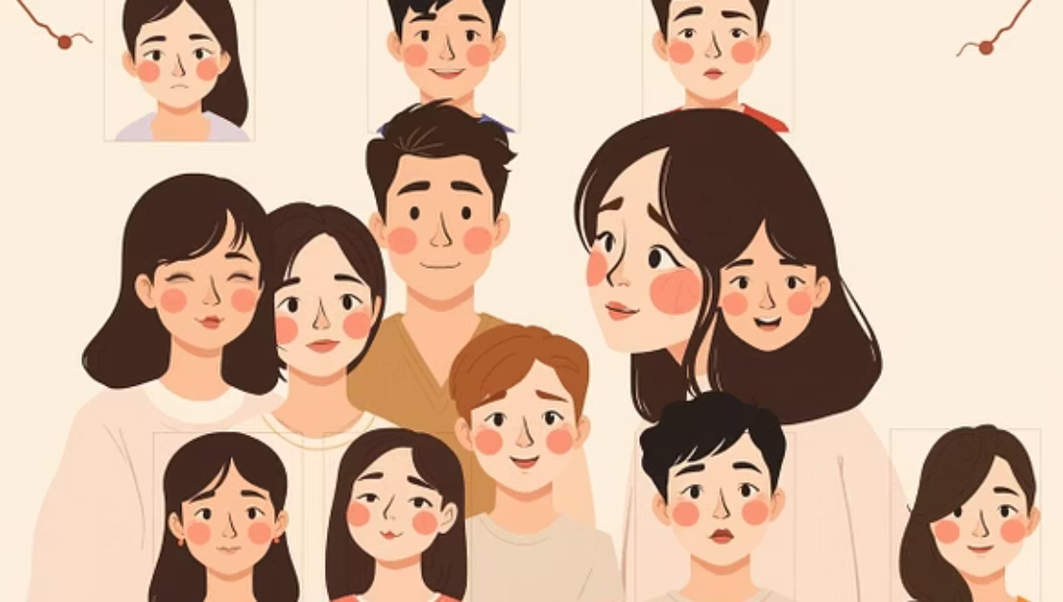
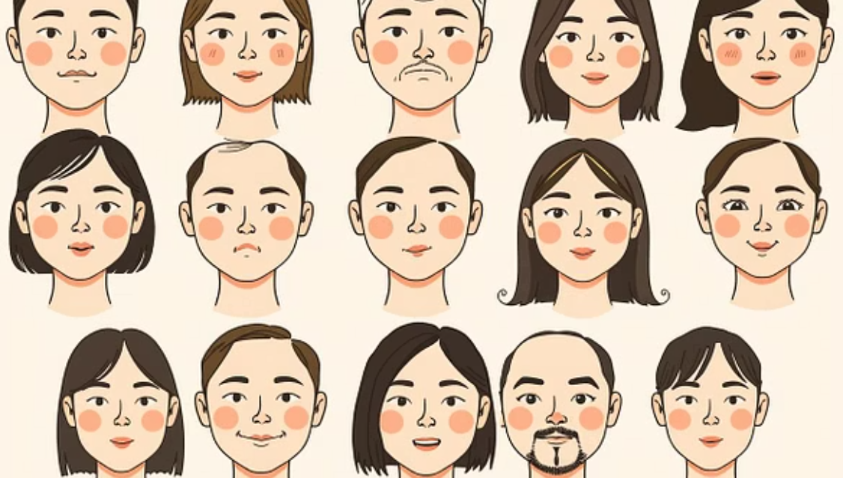
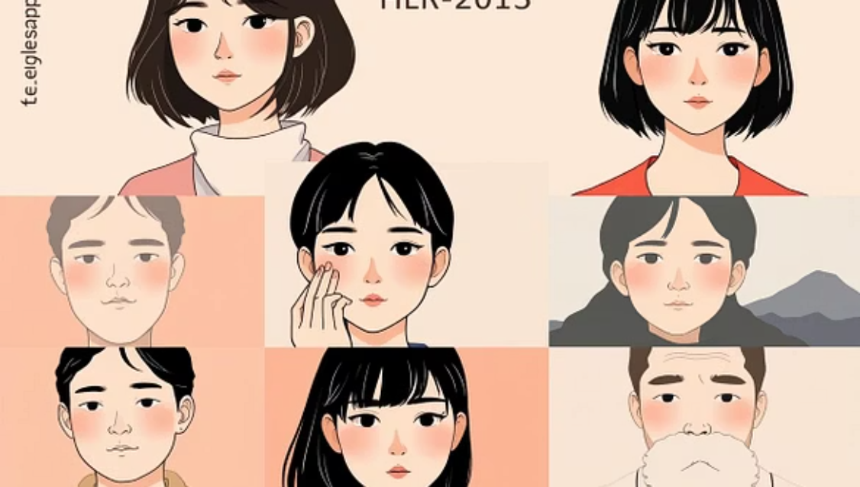
Dataset Strategy
Training & Pretraining: AffectNet
Validation & Benchmark: RAF-DB, FER-2013
Bonus: "Data-in-the-Wild" Collection
Leveraging the extensive AffectNet dataset, including both its labeled and vast unlabeled portions. This provides the necessary scale for effective self-supervised pretraining with AU conditioning.
These established datasets will serve as our primary benchmarks for validating the model's generalization capabilities and comparing performance against state-of-the-art methods.
To further assess real-world robustness, we plan to curate a small, challenging dataset from smartphone images, specifically targeting various occlusion types and extreme pose variations.

Slide 9
Rigorous Evaluation Plan
Performance Metrics
Comparative Baselines
Accuracy & Balanced Accuracy: To assess overall performance and handle class imbalance effectively.
ResNet50 FER Classifier: Standard
ImageNet-pretrained model.
Macro-F1 Score: Providing a robust measure across all expression classes.
Attention-CNN: Representative of
feature-focused CNN architectures.
Confusion Matrices: For detailed insight into per-class prediction strengths and weaknesses.
ViT-based FER Model: State-of-the-art
global feature extractor.
Robustness Analysis: Quantifying performance degradation across varying pose angles and specific occlusion types.
Crucial Ablation Studies
Impact of AU conditioning (with vs. without).
Contribution of pose normalization (with vs.
without).
Effectiveness of AU-MAE vs. traditional
ImageNet pretraining for encoder initialization.

Slide 10
Expected Challenges & Strategic Mitigation
Compute Cost
AU Label Scarcity
Challenge: High computational demands for ViT-based MAE pretraining. Mitigation: Explore smaller ViT variants or leverage ResNet-based MAE architectures for efficiency.
Challenge: Limited availability of dense, accurate AU labels. Mitigation: Employ pseudo-labeling techniques or explore weak supervision methods to augment AU annotations.
Class Imbalance
Ethical Considerations
Challenge: Skewed distribution of expression classes in datasets. Mitigation: Implement focal loss during training or apply sample reweighting strategies to balance contributions.
Challenge: Potential for dataset bias and misuse of FER technology. Mitigation: Thoroughly document dataset biases, transparently discuss limitations, and prevent overclaiming capabilities (e.g., distinguishing FER from personality inference).

Slide 11
Project Timeline
Our project is structured to align with the course schedule, ensuring focused progress and timely delivery of each component.
Weeks 0–2
Proposal & Setup: Finalize approach, dataset selection, and GitHub repository configuration.
Weeks 3–6
AU-MAE Pretraining: Execute AU-Conditioned MAE pretraining
on the AffectNet dataset.
Weeks 7–9
Fine-tuning & Baselines: Conduct FER training and establish performance baselines.
Weeks 10–11
Ablations & Robustness: Perform cross-dataset evaluation, robustness analysis, and test "data-in-the-wild."
Weeks 12–13
Finalization: Prepare comprehensive report, demo video, presentation slides, and reflective analysis.

Slide 12
Key Deliverables
GitHub Repository
Full code implementation with detailed commits and a comprehensive README for easy setup and reproduction.
Demo Video
A practical demonstration showcasing real-time FER capabilities on diverse sample images and video streams.
Final Report
In-depth documentation covering related work, system design, novelty, experiments, limitations, and future research.
Presentation & Q&A
This presentation, along with an interactive Q&A session for deeper discussion.

Slide 13
Thank You

