Slide 1



Project Review on “Design modification and analysis of Heat Exchanger”
Presented By
Project Guide
1) Mr. Nikhil Jitendra Patil
2) Mr. Rushikesh Sahadev Phanase
3) Mr. Akshay Ashok Patil
4) Mr. Narendra Nandkumar Saralkar
Prof. Sachin Borade
Zeal College of Engineering & Research, Pune
College Code: 4053

Slide 2

Sponsorship Details
Company Name – Mechatol Engineering
Solutions.
Address – Ketan Park, Shantiban Chowk, Kothrud, Pune – 411038.
Name of Industrial Guide – Mr. Anand Bhise

Slide 3
Content
Introduction
Problem statement
Abstract
Objective
Literature survey
Methodology
Technical specification
Design outcomes
Design calculations as per TEMA std
Material selection
3D modelling and Analysis
Engineering costing
Scope of project
Reference

Slide 4
Introduction
A heat exchanger is a system used to transfer heat between two or more fluids. Heat exchangers are used in both cooling and heating processes. The fluids may be separated by a solid wall to prevent mixing or they may be in direct contact
They are widely used in space heating, refrigeration, air conditioning, power stations, chemical plants, petrochemical plants, petroleum refineries, natural-gas processing, and sewage treatment. The classic example of a heat exchanger is found in an internal combustion engine in which a circulating fluid known as engine coolant flows through radiator coils and air flows past the coils, which cools the coolant and heats the incoming air.

Slide 5
Problem Statement
Design a double stack heat exchanger for industrial purpose(paper pulp industry application) to increase heat transfer rate and reduce pressure drop across existing baffles and tubes using TEMA standard.

Slide 6
Abstract
Thermal performance and Pressure drop are the major parameters for an evaluation of shell and tube type of Heat Exchanger. The path followed by the stream fluid and orientation of Baffle are the properties on which thermal performance and pressure drop are depend respectively. In shell and Tube type of Heat Exchange Optimization is carried out to reduce weight of saddle support and subsequent corresponding result and also manufacturing cost of Heat Exchanger. Design of Heat Exchange is done by the reference of TEMA (Tubular Exchangers Manufacturer Association) standards and using solid Works software and SFD analysis using solid works simulation as well Material selection by Ashby chart. All the parameters have been taken from the relevant industry code and standards.

Slide 7
Objective
To increase the heat transfer rate(Tube side).
To reduce the (Tube side) Pressure drop .
To reduce the weight of saddle.

Slide 8
Literature survey
The purpose of this chapter is to provide a literature review of past research effort journals or articles related to shell and tube heat exchanger and Finite element analysis whether on two dimension and three dimension modelling.
Moreover, review of other relevant research studies are made to provide more information in order to understand more on this research

Slide 9
Methodology
Problem statement
Literature review
Process identification
Design
Analysis
Result and discussion
Conclusion

Slide 10
Scope of the Project
Project flow chart

Slide 11
Technical Specification :
These are the input data for Hot stream:
These are the input data for Cold stream:
Flow |  |  |  | Kg/h | 120000
Inlet Temperature |  |  |  | °C | 80
Outlet Temperature |  |  |  | °C | 50.00
Density |  |  |  | Kg/m³ | 971.79
Viscosity |  |  |  | cP | 0.354
Specific Heat |  |  |  | Kcal/Kg.°C | 0.92
Thermal Conductivity |  |  |  | Kcal/m.h.°C | 332
Viscosity at Wall temperature |  |  |  | cP | 0.16
Allowable Pressure Drop |  |  |  | bar | 0.5
Fouling Factor |  |  |  | m².h.°C/Kcal | 0.0004
Flow |  |  |  | Kg/h | 9000
Inlet Temperature |  |  |  | °C | 20
Outlet Temperature |  |  |  | °C | 57.17
Density |  |  |  | Kg/m³ | 998.21
Viscosity |  |  |  | cP | 1
Specific Heat |  |  |  | Kcal/Kg.°C | 0.99
Thermal Conductivity |  |  |  | Kcal/m.h.°C | 12
Viscosity at Wall temperature |  |  |  | cP | 0.59
Allowable Pressure Drop |  |  |  | bar | 0.5
Fouling Factor |  |  |  | m².h.°C/Kcal | 0.0004

Slide 12
Design Outcomes
Initial design
Pressure drop 0.248
Heat transfer rate 212.16
Saddle weight 49kg per set
Expected design
Pressure drop 0.1340-0.1360
Heat transfer rate 340-350
Saddle weight 30kg-35kg per set

Slide 13
Part List
Bottom support rear assembly
Front channel cover Assembly
Front support assembly without part
Shell side pipe spool assembly
Part list

Slide 14
Design calculations as per TEMA std
Calculations to reduce tube side pressure drop .
heat exchanger sheet link
TEMA STANDARD

Slide 15
Material selection with the help of ASHBY property charts. (24 Aug-30 Aug 2020)
Material selection is based on :
ASHBY charts
ASME(American society of mechanical engineering)
ASM(American society for metals)
Step wise process for material selection by ASHBY charts:
Screening
Selecting property chart
Selecting guidelines
Potential candidate material
Gather material cost
Calculate relative cost
Calculate scale value
Calculate weighing factor
Performance index calculation

Slide 16
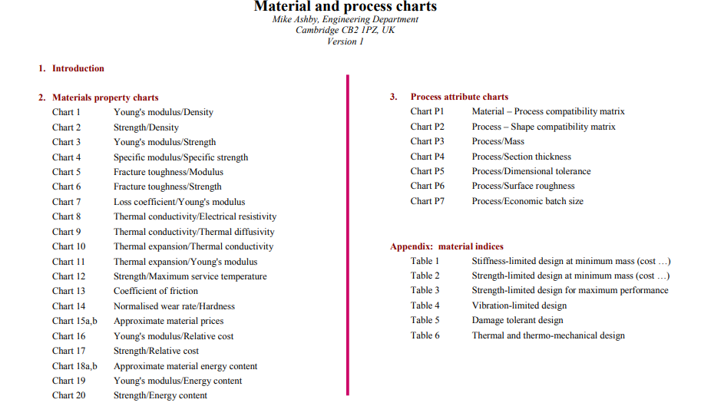
ASHBY Charts

Slide 17
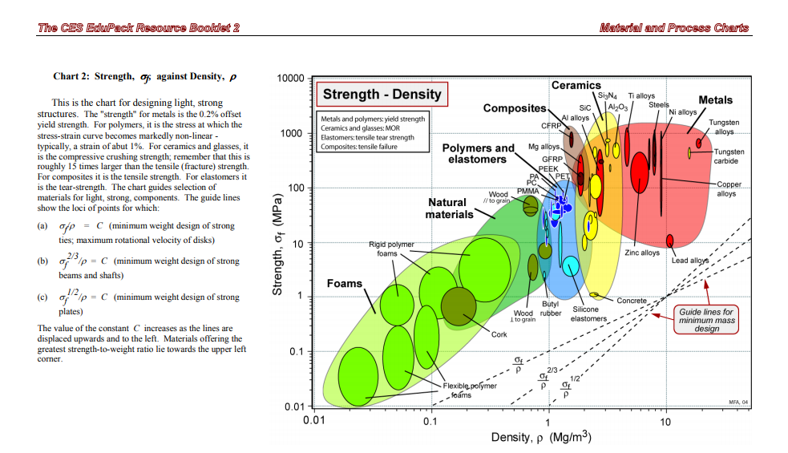

Slide 18
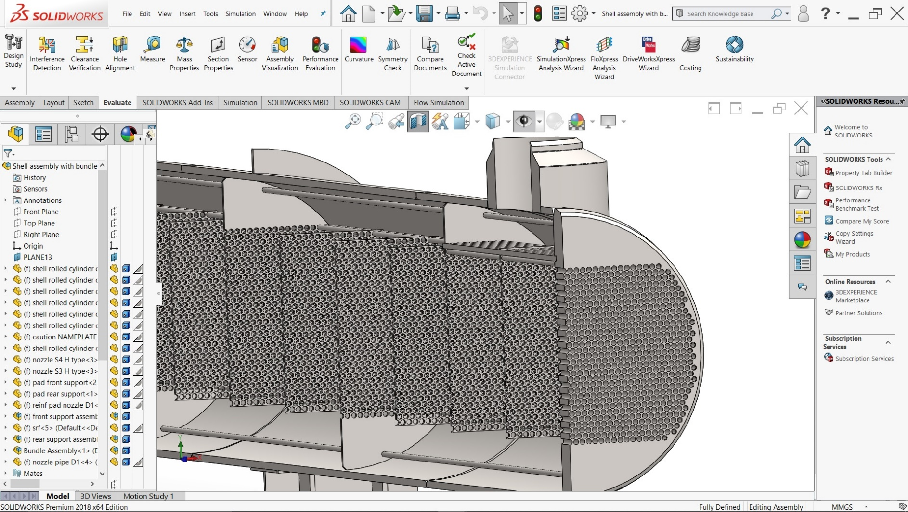
Design of Heat Exchanger Parts
3D Modelling:
We have completed the design of all parts on solid works.

Slide 19
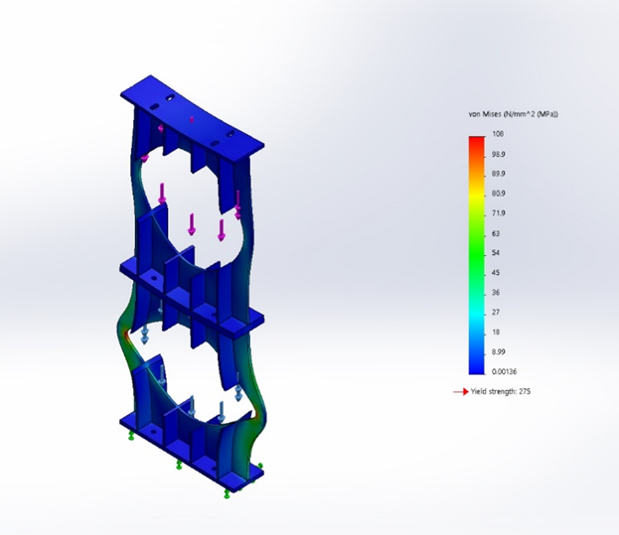
Saddle support FEA Analysis
Boundary Condition :
Analysis type – Structural analysis
Force = 39.413 KN on upper
bundle in downward direction
Force = 78.826 KN on lower
bundle in downward direction
Minimum requirement in design
FOS of design = 2. 5 to 3
Material | Results
 | Equivalent Stress (MPa) | Displacement (mm) | Factor of Safety (FOS)
ASTM 516 GR 70 | 108 | 0.339 | 2.4
IS 2002 GR 1 | 108 | 0.33 | 2
IS 2062 GR A | 108 | 0.338 | 2.3
IS 2475 GR 5 | 108 | 0.377 | 2.5
IS 2062 GR B | 108 | 0.356 | 1.8

Slide 20
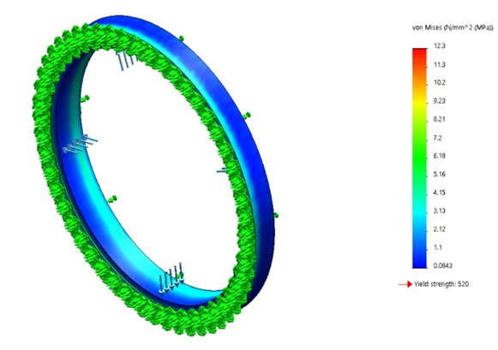
Girth Flange
Boundary Condition :
Analysis type – Structural analysis
Material Pressure = 0.7 bar
Material | Results
 | Equivalent Stress (MPa) | Displacement (mm) | Factor of Safety (FOS)
A105 | 12.3 | 1.67E-03 | 20
A181 GR-60 | 12.2 | 1.66E-03 | 17
A181 GR-70 | 12.3 | 1.63E-03 | 20
A182 F1 | 12.3 | 1.63E-03 | 22
A182 F5 | 12.3 | 1.67E-03 | 22
A182 F5-a | 12.3 | 1.84E-03 | 42
A182 F11-1 | 12.3 | 1.75E-03 | 25
A182 F11-2 | 12.3 | 1.94E-03 | 22
A182 F11-3 | 12.3 | 1.84E-03 | 25
A182 F12-1 | 12.3 | 1.63E-03 | 18
A182 F12-2 | 12.3 | 1.84E-03 | 22
A182 F304 | 12.2 | 1.79E-03 | 17
A182 F304-L | 12.2 | 1.79E-03 | 14
A182 F316 | 12.2 | 1.79E-03 | 17
A182 F316-L | 12.2 | 1.75E-03 | 14
A182 F321 | 12.2 | 1.79E-03 | 17
A182 F347 | 12.2 | 1.75E-03 | 17
A350 LF-1 | 12.3 | 1.63E-03 | 17
A350 LF-2 | 12.3 | 1.63E-03 | 20
A350 LF-3 | 12.3 | 1.63E-03 | 21
A105 | 12.3 | 1.67E-03 | 20

Slide 21
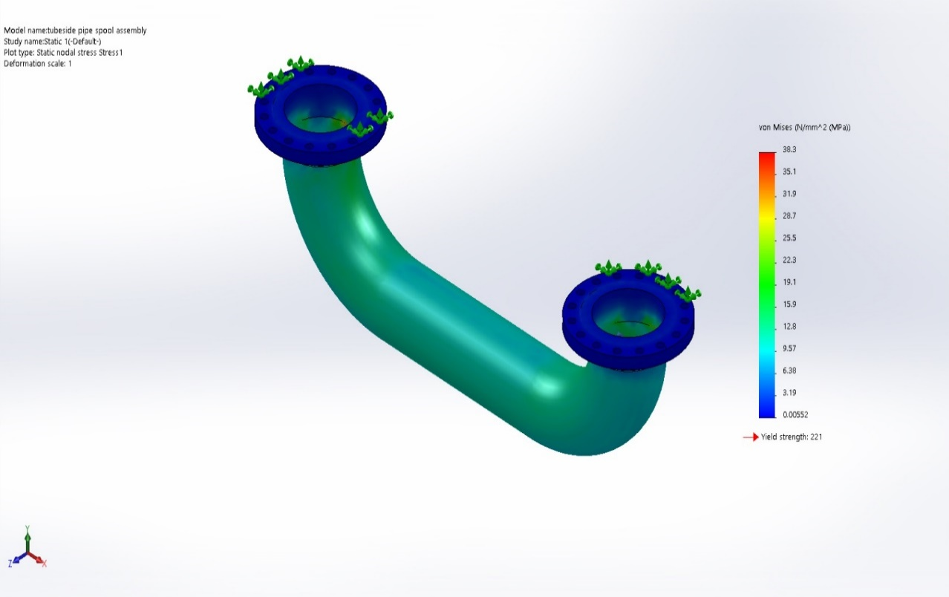
Fitting Pipe
Boundary Condition :
Analysis type – Structural analysis
Material Pressure = 0.7 bar
Minimum requirement in
design
FOS = 2.5 to 3
Material = Plain Carbon Steel

Slide 22
Optimization | Wall thickness | Nozzle resting thickness | Results
 |  |  | Equivalent Stress (MPa) | Displacement (mm) | Factor of Safety (FOS)
Original | 12.7 | 1.47 | 397 | 0.0383 | 4.2
Optimization 1 | 9 | 2 | 42.3 | 0.022 | 2.9
Optimization 2 | 8 | 2 | 55 | 0.0244 | 3
Optimization 3 | 7 | 2 | 38.3 | 0.0294 | 3
Optimization 4 | 6 | 2 | 36.3 | 0.0336 | 3.2
Optimization 5 | 5 | 2 | 39 | 0.0397 | 4.2
Optimization 6 | 12.7 | 2 | 34.5 | 0.0165 | 3.5
Optimization 7 | 12.7 | 1.5 | 32.6 | 0.0379 | 4.3
Optimization 8 | 12.7 | 1.4 | 36.6 | 0.0383 | 3.8
Optimization 9 | 12.7 | 1.3 | 34 | 0.038 | 3.9
Optimization 10 | 12.7 | 1.2 | 35.4 | 0.0384 | 3.9
Optimization 11 | 12.7 | 1.1 | 83.4 | 0.108 | 2
Optimization 12 | 5 | 1.9 | 157 | 0.341 | 1.4
Optimization 13 | 7 | 1.9 | 126 | 0.264 | 1.7

Slide 23
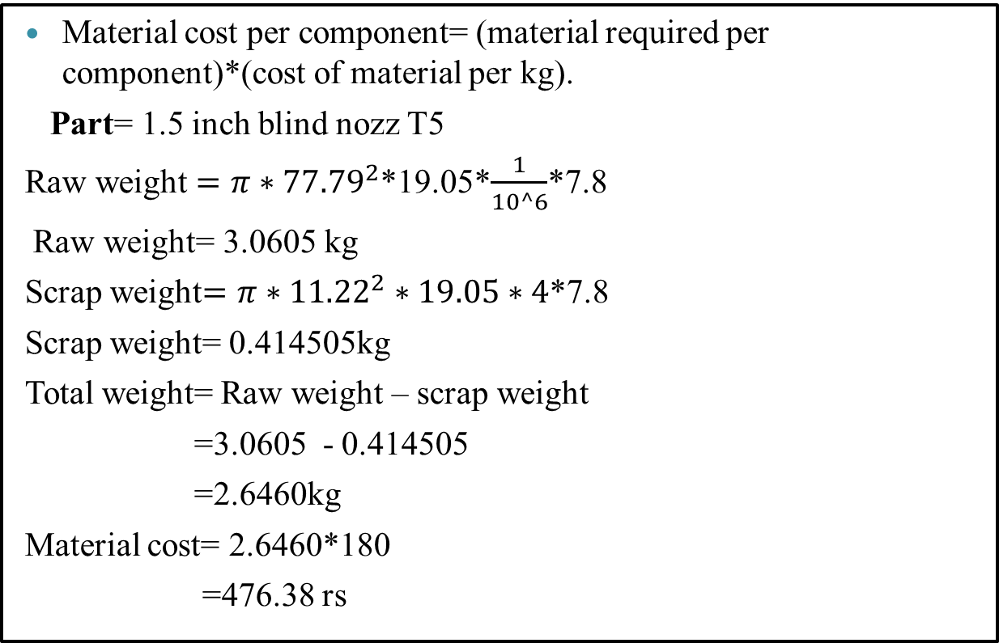
Engineering Costing of all components. (3 Aug-8 Aug 2020)
Material cost per component= (material required per component)*(cost of material per kg).
Part= 1.5 inch blind nozz T5
Raw weight $=π{∗77.79}^{2}$*19.05*$\frac{1}{10^6}$*7.8
Raw weight= 3.0605 kg
Scrap weight$=π∗{11.22}^{2}∗19.05∗4$*7.8
Scrap weight= 0.414505kg
Total weight= Raw weight – scrap weight
=3.0605 - 0.414505
=2.6460kg
Material cost= 2.6460*180
=476.38 rs

Slide 24
Costing of all components of Heat Exchanger.
link for sheet

Slide 25
Reference
Sadik Kakaç & Hongtan Liu (2002). Heat Exchangers: Selection, Rating and Thermal Design (2nd ed.). CRC Press. ISBN 0-8493-0902-6.
Perry, Robert H. & Green, Don W. (1984). Perry's Chemical Engineers' Handbook (6th ed.). McGraw-Hill. ISBN 0-07-049479-7.
"Shell and Tube Exchangers". Retrieved 2009-05-08.
] B.B. Gulyani, Estimating number of shells in shell and tube heat exchangers: a new approach based on temperature cross, Trans. ASME J. Heat Transfer 122 (3) (2000) 566–571.
Grzegorz Golanski, Institute of Materials Engineering, Czestochowa University of Technology, Poland. Performance of Shell and Tube Heat Exchangers with Varying Tube Layouts.

Slide 26

This Photo by Unknown Author is licensed under CC BY-NC-ND

