Slide 1
SIMULTANEOUS PERTUBATION STOCHASTIC
APPROXIMATION (SPSA)

Slide 2
OVERVIEW
BACKPROPAGATION
BACKPROPAGATION BASED NEURAL NETWORK
SPSA
GRADIENT DESCENT vs SPSA
SPSA BASED NEURAL NETWORK

Slide 3
BACK PROPAGATION
The normal backpropagation is a gradient descent method
which converges to a local minima or local maxima.
Simple algorithm that is easy to implement and each iteration is cheap; just need to compute a gradient
Can be very fast for smooth objective functions, i.e. well-conditioned and strongly convex
However, it’s often slow because many interesting problems are not strongly convex
Cannot handle non-differentiable functions (biggest downside)

Slide 4
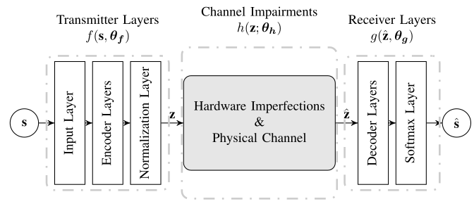
GENERAL NN FRAMEWORK

Slide 5
Neural Network with BackPropagation
The configurations of the Neural Net are mentioned below:
encoder layers = 2 normalization layer = 1
hidden encoder layer dimensions = {16,7}
decoder layers = 2 activation function = RELU
hidden decoder layer dimensions = {7, 16} batch size = 16
Noise channel = AWGN with varying noise varience
Output layer = LogSoftmax
Loss function = NLLLoss
Optimizer = Adam Optimizer

Slide 6
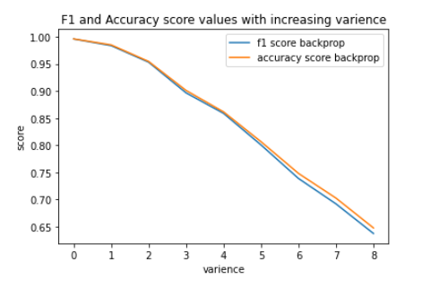
Neural Network with BackPropagation

Slide 7
BACK PROPAGATION
As we can see back propagation is doing well for different
range of noise varience. The model accuracy is decreasing as
the varience in the noise is increasing and this is clearly
evident from the model because it becomes hard to learn if
the noise since varience is high.
Since backpropagation can’t be used over non-differentiable
noise channels, we planned to use SPSA in the place of
back propagation.

Slide 8
SPSA
As we can see back propagation is doing well for different
range of noise varience. The model accuracy is decreasing as
the varience in the noise is increasing and this is clearly
evident from the model because it becomes hard to learn if
the noise since varience is high.
Since backpropagation can’t be used over non-differentiable
noise channels, we planned to use SPSA in the place of
back propagation.

Slide 9
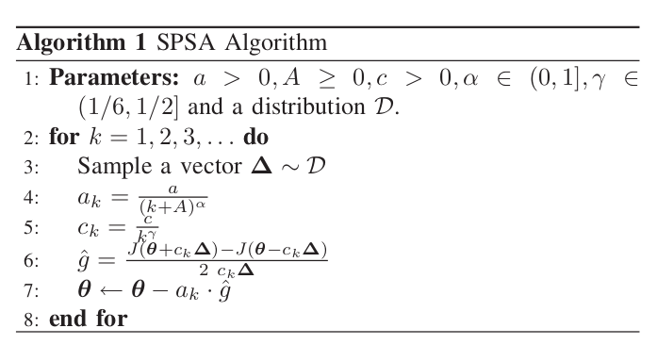
SPSA

Slide 10
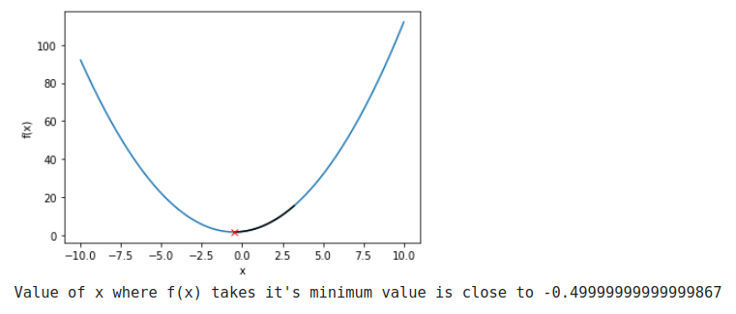
SPSA vs GRADIENT DESCENT
Gradient Descent for y = x2 + x + 2

Slide 11
SPSA vs GRADIENT DESCENT
For Different Convex and Concave Functions we implemented
SPSA and checked the convergence. For Convex
functions we compared SPSA with BackPropagation. We did it
for the following functions:
y = x2 + x + 2
y = xsinx
y = |x|
y = |x-2| + |x+2|
y = x2 + y2 + 2x + 2y

Slide 12
SPSA vs GRADIENT DESCENT
Gradient Descent for y = x2 + x + 2

Slide 13
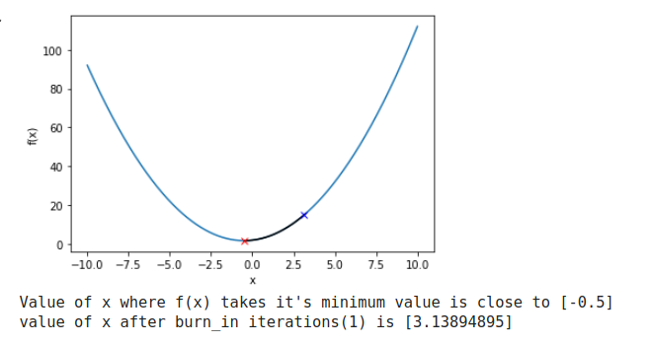
SPSA vs GRADIENT DESCENT
SPSA for y = x2 + x + 2

Slide 14
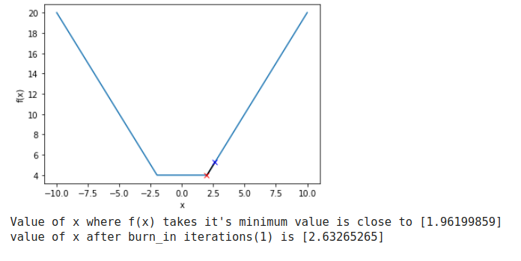
SPSA FOR NON-DIFFERENTIABLE FUNCTIONS
SPSA for y = |x-2| + |x+2|

Slide 15
Neural Network with SPSA
The configurations of the Neural Net are mentioned below:
encoder layers = 2 normalization layer = 1
hidden encoder layer dimensions = {16,7}
decoder layers = 2 activation function = RELU
hidden decoder layer dimensions = {7, 16} batch size = 16
Noise channel = AWGN with varying noise varience
Output layer = LogSoftmax
Loss function = NLLLoss
Optimizer = Adam Optimizer

Slide 16
Neural Network with SPSA
The SPSA Parameters are mentioned below:
a = 0.05
A = 25
c = 0.1
alpha = 0.9
beta = 0.3

Slide 17
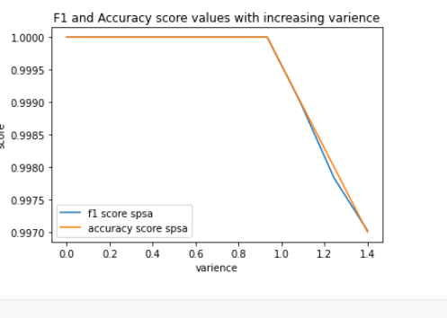
SPSA based Neural Network

Slide 18
FUTURE SCOPE
Since the current SPSA model is not working for high noise varience,
we need to change the model to learn high noise varience atleast on
par with Back Propagation model. Then we can think of performing
SPSA only for noise channel layers as they are only
non-differentiable and we can apply SPSA for those layers and
perform backpropagation for the remaining layers in the encoder
and decoder since backpropagation is a faster method.

Slide 19
THANK YOU

