Slide 1
GIBBS SAMPLING

Slide 2
GIBBS SAMPLING
My Project consists of two parts. In the first part, I used Gibbs
Sampling to get samples from a Normal Distribution. In the second
part of the project I explored the applications of Gibbs Sampling in
Topic Modelling specifically Latent Dirichilet Allocation (LDA) where
we used Gibbs Sampling for generating samples from complex
distributions. I explored a computionally optimized way of Gibbs
Sampling technique also known as Collapsed Gibbs Sampler.

Slide 3
GIBBS SAMPLING
OVERVIEW
GIBBS SAMPLING
USING GIBBS SAMPLING TO FIND SOLUTION TO LINEAR SYSTEM OF EQUATIONS (GIBBS SAMPLING FOR GUASSIAN DISTRIBUTION)
USING GIBBS SAMPLING IN TOPIC MODELLING AND LATENT DIRICHLET ALLOCATION (GIBBS SAMPLING FOR DIRICHLET AND OTHER DISTRIBUTIONS)
DERIVING GIBBS SAMPLER FOR LDA
COLLAPSED GIBBS SAMPLER

Slide 4
GIBBS SAMPLING
We used Gibbs Sampling to sample from a Multivariate
Normal distribution iteratively and checked whether the
samples are converging to the expected distribution and the
samples were converging to expected distribution.
The following are the plots of the convergence metrics for a
1225 x 1225 sparse matrix with both L2 Norm and Max Norm.
We can clearly observe that the norm difference is very less.

Slide 5
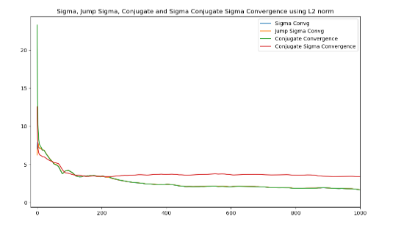
GIBBS SAMPLING

Slide 6
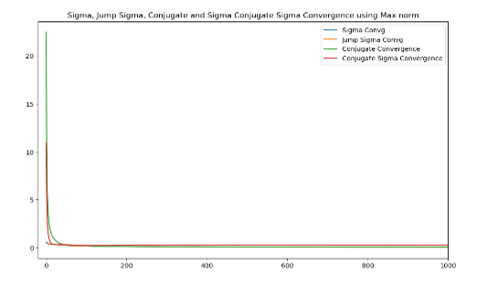
GIBBS SAMPLING

Slide 7
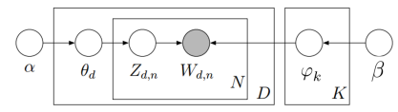
TOPIC MODELLING
Latent Dirichlet Allocation is one of Topic Modelling techniques where we classify a document into a particular topic.
Graphical Representation of LDA Model:

Slide 8
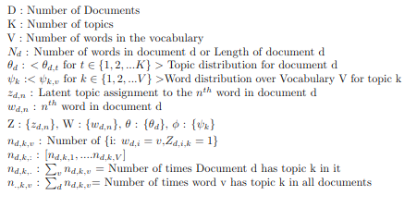
GIBBS SAMPLING
Notations:

Slide 9
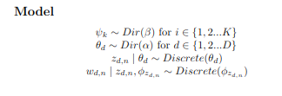
GIBBS SAMPLING
LDA Model can be described in the following way where Dir is
nothing but dirichilet distribution.

Slide 10

TOPIC MODELLING
Our Primary Task in LDA is to find the following posterior
Our Primary Task in LDA is to find the following posterior
From the above model detals joint can be further simplified
as the following

Slide 11
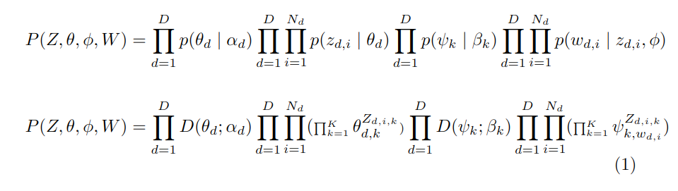
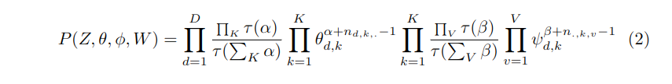
TOPIC MODELLING
Joint Probability:

Slide 12
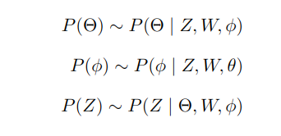
TOPIC MODELLING
Marginalizing above intergral with respect to Z is difficult. So
we calculate the posterior by using Gibbs Sampling. Where
we conditionally update each variable iteratively.

Slide 13
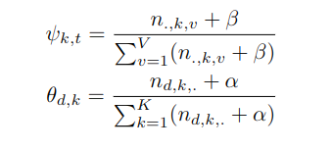
TOPIC MODELLING
We can integrate out the remaining parameters and update
the hidden variable Z.This is called Collapsed Gibbs Sampling

Slide 14
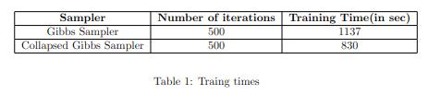
TOPIC MODELLING
Collapsed Gibbs Sampler is faster than Normal Gibbs Sampler
as we need not take all parameters into consideration

Slide 15
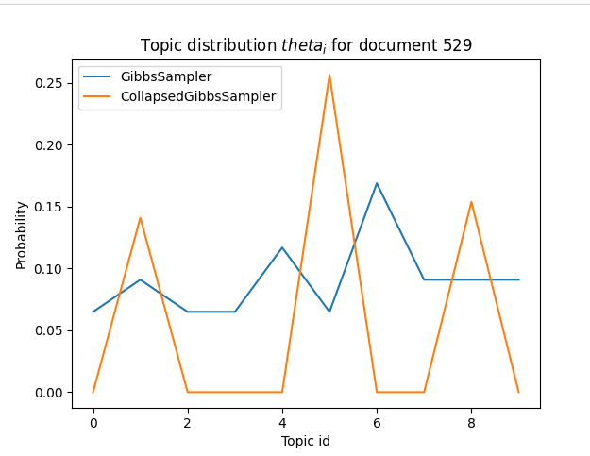
TOPIC MODELLING
Gibbs Sampler Vs Collapsed Gibbs Sampler

Slide 16
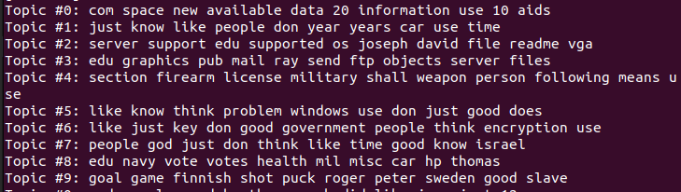
TOPIC MODELLING
Topics classified by Gibbs Sampler

Slide 17
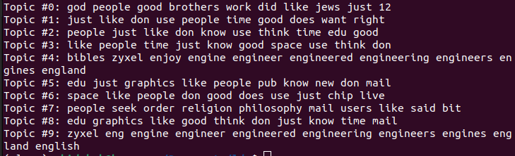
TOPIC MODELLING
Topics classified by Collapsed Gibbs Sampler

Slide 18
TOPIC MODELLING
Querying:
Estimating topic proportions of unseen or a new
document. We do this by updating Z using Gibbs Sampling
and then update the topic proportions of the new document
according to our new sampled Z vector.

Slide 19
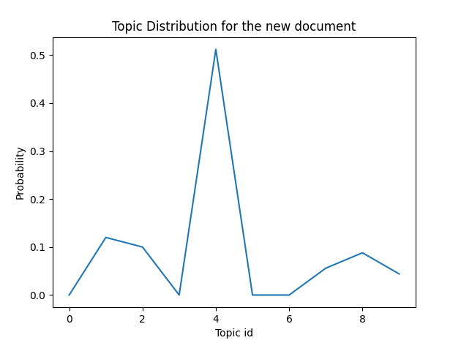
TOPIC MODELLING
Topic proportions of a new set of words classified by Collapsed Gibbs Sampler.

Slide 20
FURTHER SCOPE
Implementing Topic Modelling using mixture models and
doing inference using Gibbs Sampling. Comparing the
inference results over Mixture Models and LDA.
Analysis of our topic model for similarity checking.

Slide 21
WHAT DID I LEARN
Methods like Steepest Descent, Conjugate Gradient
Multivariate Normal Distributions, Sampling stratagies from a
Multivariate Normal.
Gibbs Sampling
MLE, MAP and Bayesian Estimators
Conjugate Priors and Exponential Family Distributions mainly
Dirichilet distribution
Topic Modelling specifically LDA

Slide 22
THANK YOU

