Slide 1
Inventory Optimization & Supply Chain Insights
Capstone Project
Tools: Excel | Python | MySQL | Power BI
Prepared by: Narendra Verma
This project demonstrates an end-to-end analytics workflow including data preparation, transformation, SQL-based insights, and interactive dashboard visualization.

Slide 2
Acknowledgment
I would like to express my sincere gratitude to everyone who supported me during the completion of this capstone project.
I would especially like to thank:
My instructors and mentors for their valuable guidance
My institution for providing learning resources
The online analytics community and documentation platforms for technical support
My peers for their encouragement and feedback
Their support played a crucial role in the successful completion of this project.

Slide 3
Project Objective
The objective of this project is to analyze inventory operations, supplier performance, and sales trends using structured datasets and interactive dashboards.
Key goals:
Monitor stock availability across warehouses
Identify low-stock and out-of-stock products
Evaluate supplier delivery performance
Measure fulfillment efficiency
Analyze sales trends across categories
Support data-driven inventory decisions

Slide 4
Tools & Technologies Used
This project was developed using multiple analytics tools across different stages:
Tool | Purpose
Excel | Initial data validation & structure review
Python | Data Cleaning and missing value treatment
MySQL | Data transformation and business analytics queries
Power BI | Dashboard development and Visualization
Tool | Purpose
Excel | Initial data validation & structure review
Python | Data cleaning and missing value treatment
MySQL | analysis queries
Power BI

Slide 5
Dataset Overview
The project uses a relational dataset consisting of multiple connected tables:
Products
Inventory
Suppliers
Warehouses
Purchase Orders
Sales Transactions
Categories
These tables together represent an inventory and supply-chain analytics system.

Slide 6
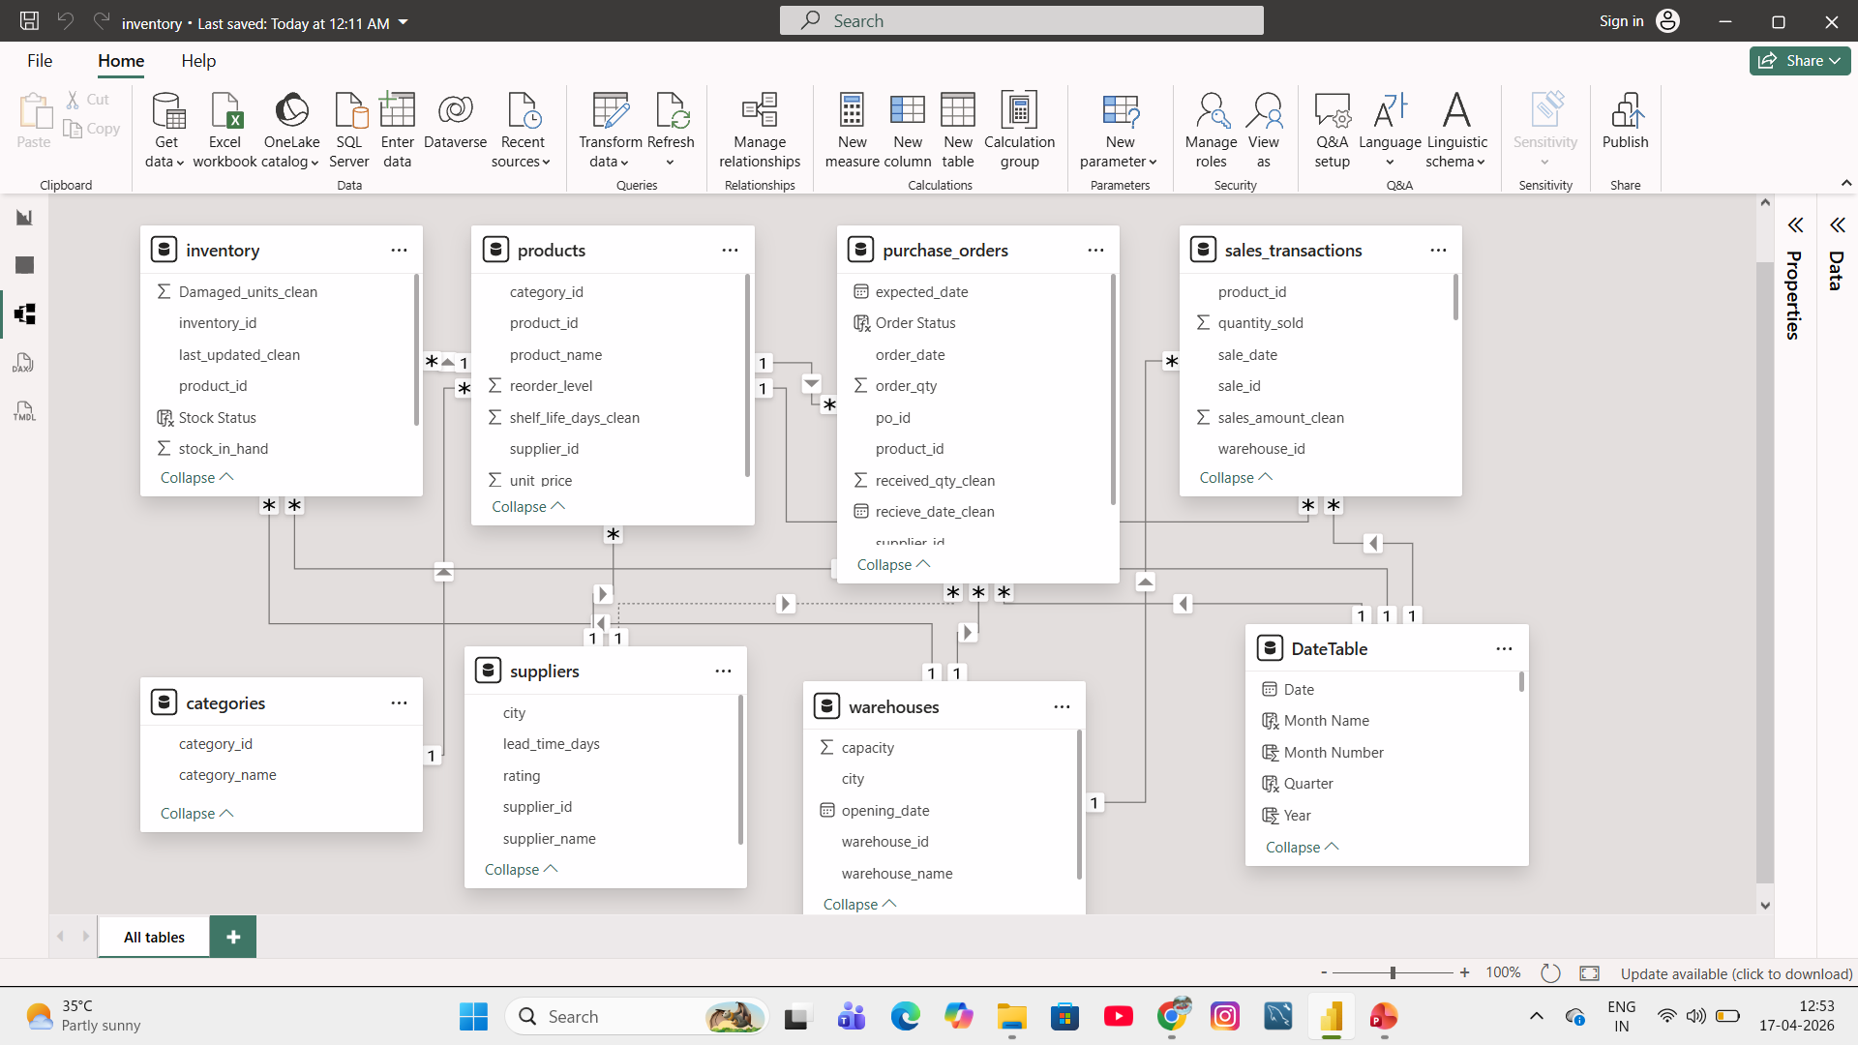
Model view relationships

Slide 7
Project Workflow Architecture
The workflow followed a structured analytics pipeline:
CSV Dataset ⬇ Excel Validation ⬇ Python Data Cleaning ⬇ MySQL Data Transformation ⬇ Power BI Dashboard Development ⬇ Business Insights Generation
This workflow ensures data accuracy and reliable reporting.

Slide 8
Data Validation Using Excel
Before analysis, dataset quality was verified using Excel.
Performed tasks:
Checked missing values
Reviewed column structure
Verified datatype consistency
Identified duplicate records
Validated relationships between tables
Excel helped ensure the dataset structure was suitable for further processing.

Slide 9
Data Cleaning Using Python
Python was used to clean and prepare the dataset before loading into SQL.
Key cleaning steps:
Replaced missing shelf_life values category-wise
Updated received_date using expected_date
Updated inventory last_updated using purchase_orders table
Calculated missing sales_amount using quantity × unit_price
Converted incorrect datatypes
Handled null values across multiple tables
These steps improved dataset accuracy and consistency.

Slide 10
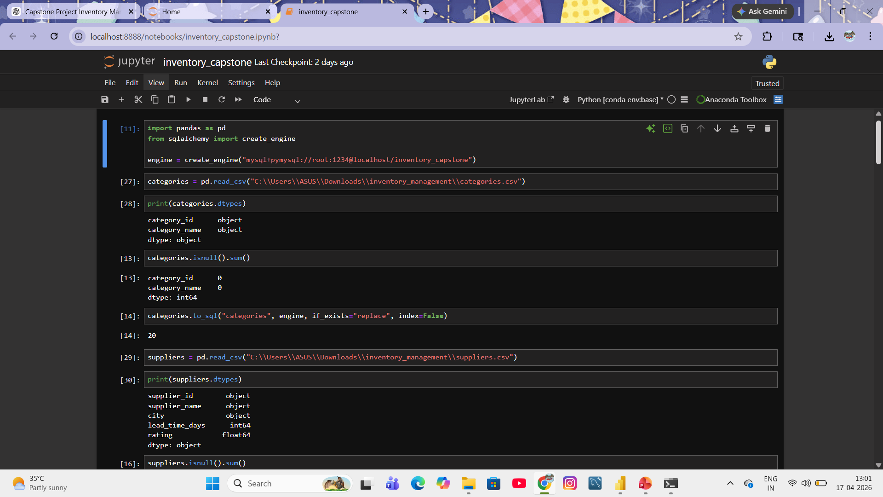
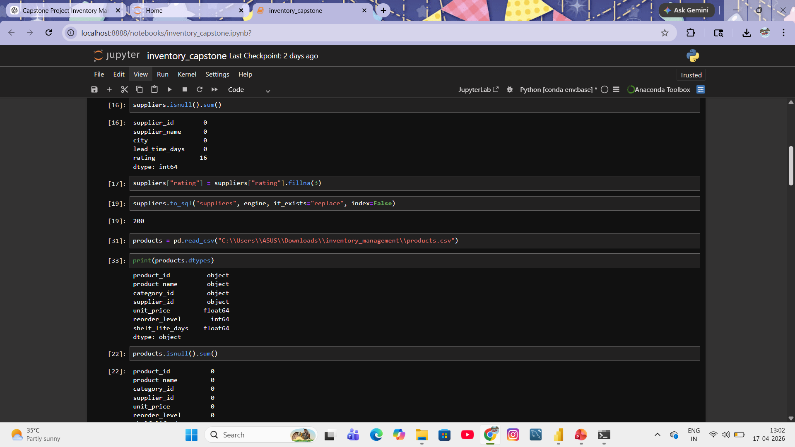
Python notebook

Slide 11
Data Loading into MySQL
After cleaning the dataset:
CSV files were imported into MySQL
Tables were structured relationally
Primary and foreign key relationships were validated
Row counts were verified
This ensured reliable SQL-based analytics.

Slide 12
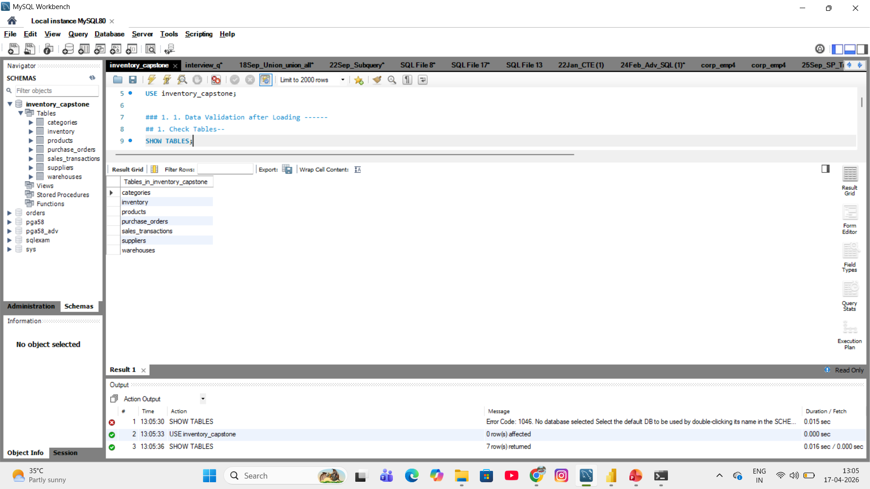
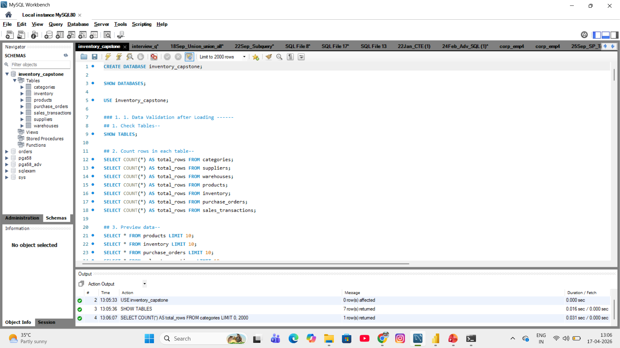
Tables In MySQL

Slide 13
SQL Data Transformation
SQL queries were used to generate business-ready analytics columns.
Examples:
Created stock status classification
Identified delayed supplier deliveries
Calculated fulfillment percentages
Generated inventory value metrics
Created category-level performance indicators
SQL transformation improved interpretability of raw data.

Slide 14
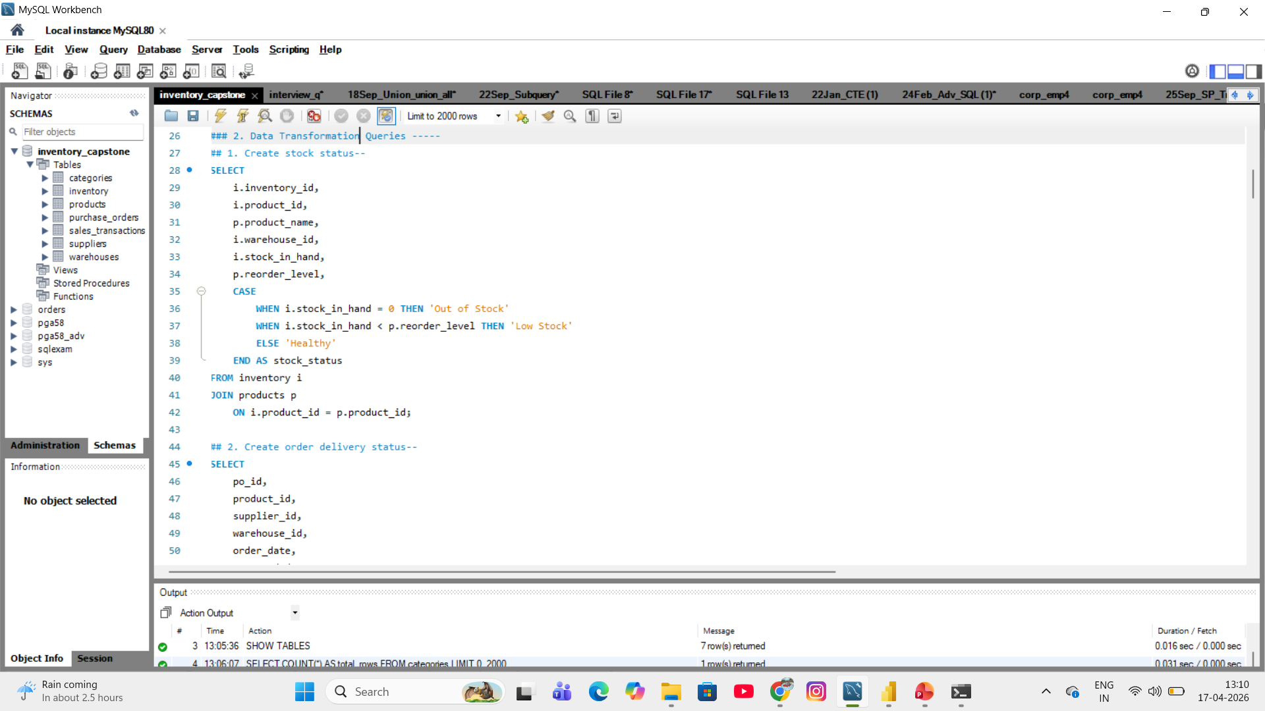
CASE WHEN query

Slide 15
SQL Business Analysis Queries
SQL queries helped generate operational insights:
Examples:
Top selling products identification
Low stock product detection
Supplier delay tracking
Warehouse inventory valuation
Category-wise revenue comparison
Monthly revenue trend analysis
These insights supported dashboard visualization.

Slide 16
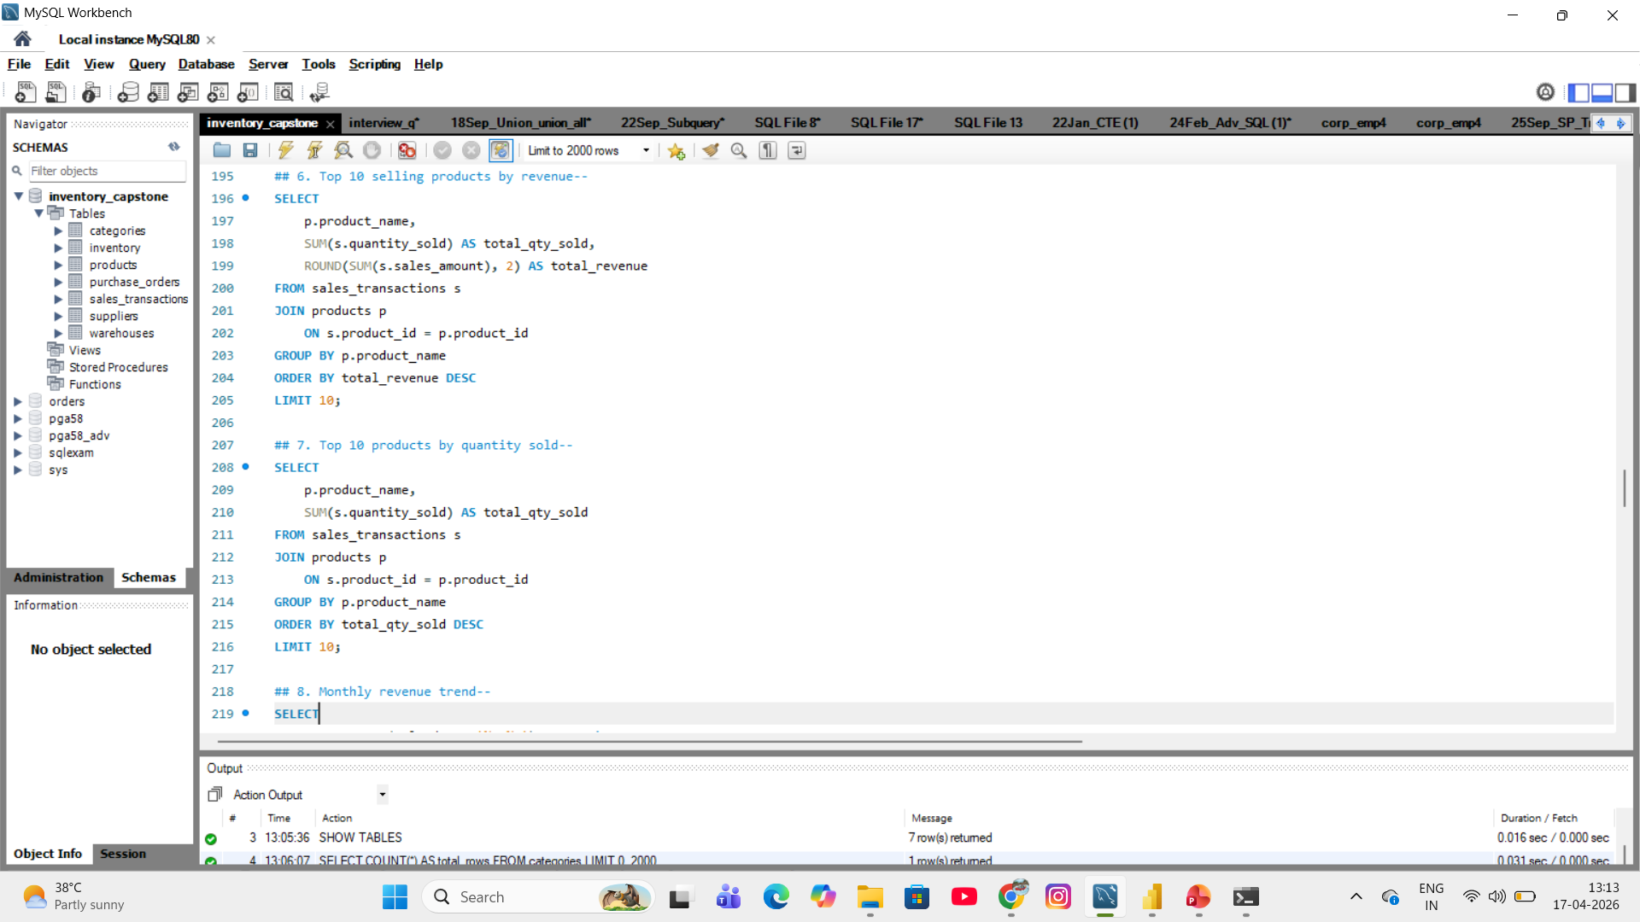
Query results table

Slide 17
Power BI Data Model
A star-schema style relational model was built in Power BI.
Steps performed:
Connected dimension tables with fact tables
Created DateTable for time intelligence
Enabled filtering across dashboards
Ensured optimized relationships for reporting
This structure supports scalable analytics reporting.

Slide 18
Dashboard 1: Inventory Overview
This dashboard focuses on stock monitoring and warehouse visibility.
Key features:
Total inventory value tracking
Low-stock and out-of-stock identification
Damaged inventory monitoring
Category-wise inventory comparison
Warehouse-wise stock distribution
Supports inventory control decisions.

Slide 19
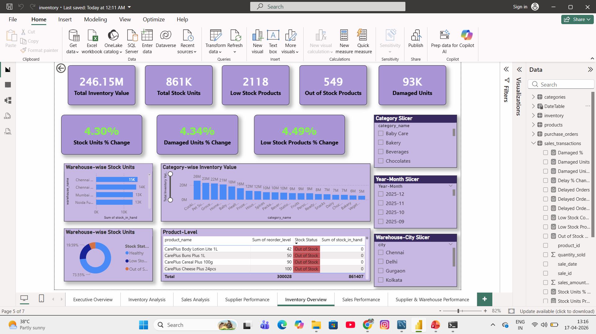
Inventory dashboard

Slide 20
Dashboard 2: Sales Performance
This dashboard analyzes product demand and revenue trends.
Key features:
Monthly revenue trend analysis
Category-wise revenue comparison
Top-selling product identification
Quantity growth tracking
Sales performance KPIs with percentage change indicators
Supports sales strategy decisions.

Slide 21
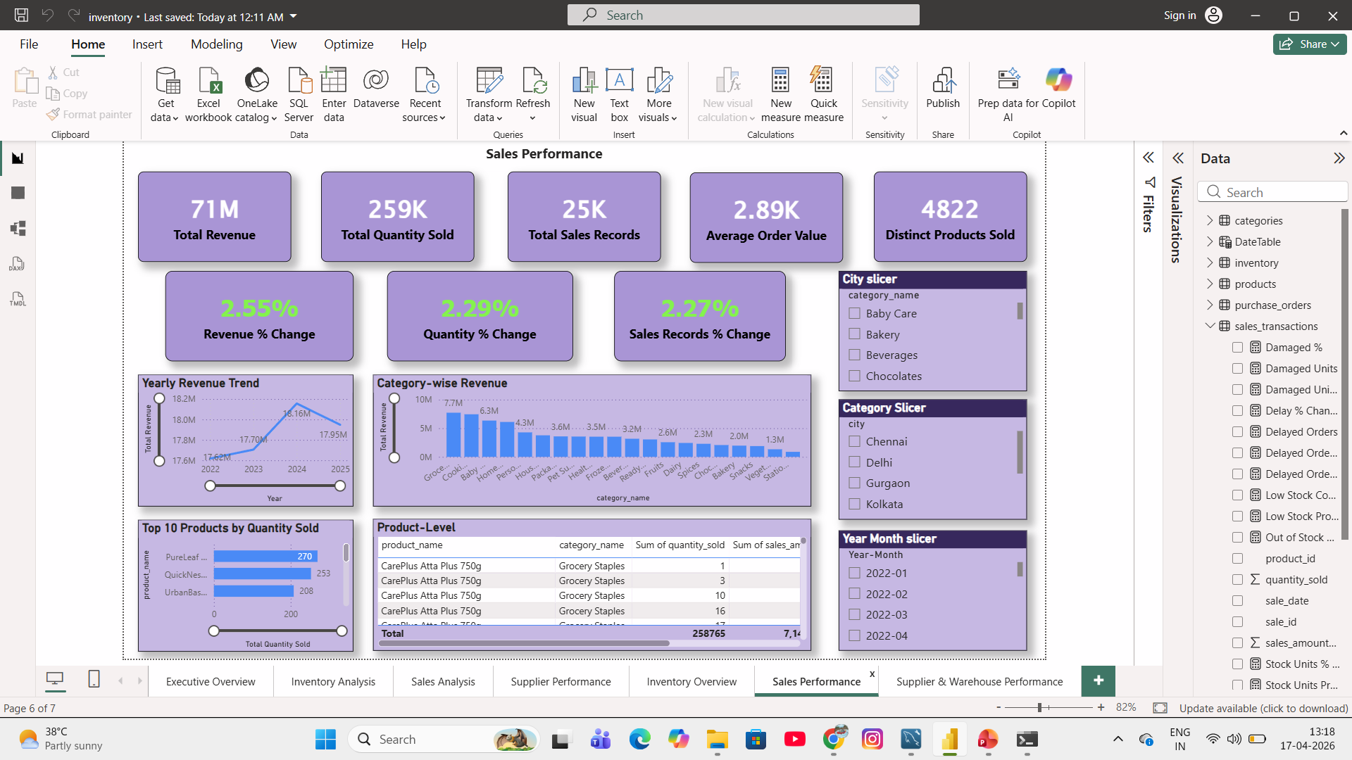
Sales dashboard

Slide 22
Dashboard 3: Supplier & Warehouse Performance
This dashboard evaluates supply-chain efficiency.
Key features:
Supplier delay tracking
Fulfillment rate measurement
Warehouse damage comparison
Warehouse inventory value analysis
Supplier performance scorecard
Supports supplier evaluation decisions.

Slide 23
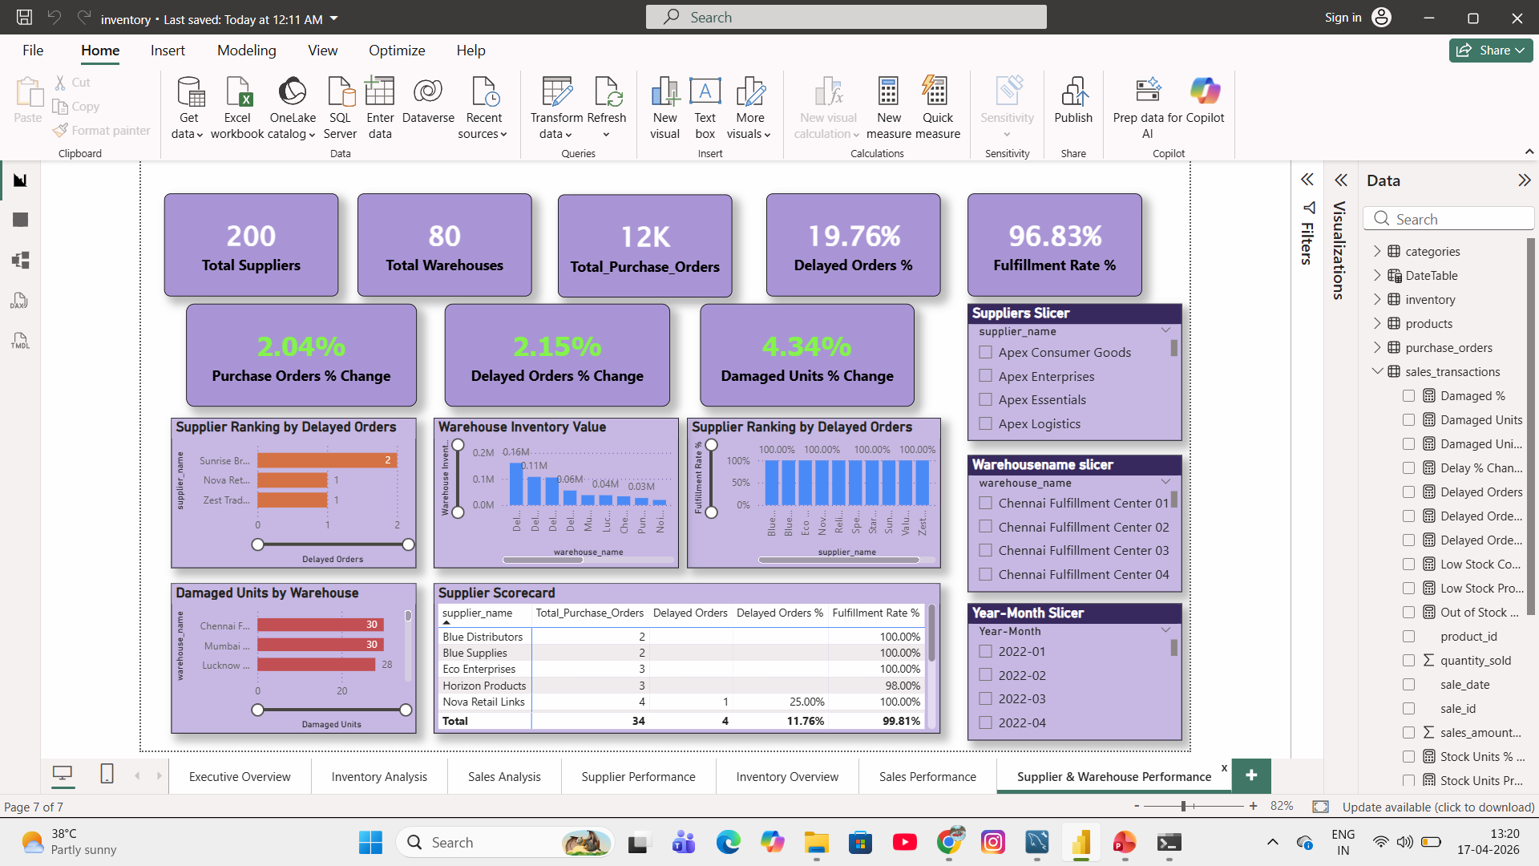
Supplier& Warehouse dashboard

Slide 24
Key Insights Generated
The analysis produced several operational insights:
Identified suppliers with frequent delivery delays
Detected warehouses with high damaged inventory
Highlighted low-stock risk categories
Found top-performing product segments
Tracked monthly revenue growth trends
These insights help improve supply-chain efficiency.

Slide 25
Business Impact
The developed dashboard helps organizations:
Improve inventory visibility
Monitor supplier performance
Reduce stock-out risks
Support faster replenishment decisions
Track operational efficiency
Enable data-driven management decisions

Slide 26
Future Improvements
This system can be further enhanced by:
Adding demand forecasting models
Automating data refresh pipelines
Deploying dashboards on Power BI Service
Creating alert systems for low stock
Integrating machine learning predictions

Slide 27
Thank You
Questions & Discussion Welcome
Your Name – Narendra Verma Email – narendrav674@gmail.com

