Slide 1
SPEC CPU v8 Development
Understanding SPEC CPUv8, its development processing, and integrating new benchmarks into the harness

Slide 2
Overview
SPEC CPU benchmarks have arguably been the most important server and workstation benchmarks since SPEC CPU92 from last century.
CPUv8 is the next generation benchmark suite scheduled to be released in January 2024.
All of AMD’s Search Program benchmarks must be through Step 2 by April 29.
The four new benchmarks must be integrated into the framework and satisfy the Step 2 requirements on the next slide.
This training session is intended to show the process of integrating a new benchmark into the CPUv8 framework.

Slide 3
Prerequisites and recommended Tools
Ubuntu 22.04 or newer, root user is recommended
python3, python3-pip, numactl, cpupower, lstopo, killall, neofetch, tmux, vim, mc, spacevim
gcc, g++, gfortran, gcc-multilib, g++-multilib, gfortran-multilib
AOCC4 (http://aocc.amd.com/releases/AOCC-4.0/GA/aocc-compiler-4.0.0.tar). Copy into /opt/AMD/aocc and extract. Run install.sh
AOCL (http://aocl.amd.com/). Install into /opt/AMD/aocl/<version#>.
Local tools
Windows: MobaXterm, WinSCP, Visual Studio Code, Tabby, WinMerge, Firefox, Notepad++
Mac: iTerm2, Forklift, Visual Studio Code, Meld, Firefox
Linux: Dolphin, Tabby, Visual Studio Code, Kate, Meld, Firefox

Slide 4
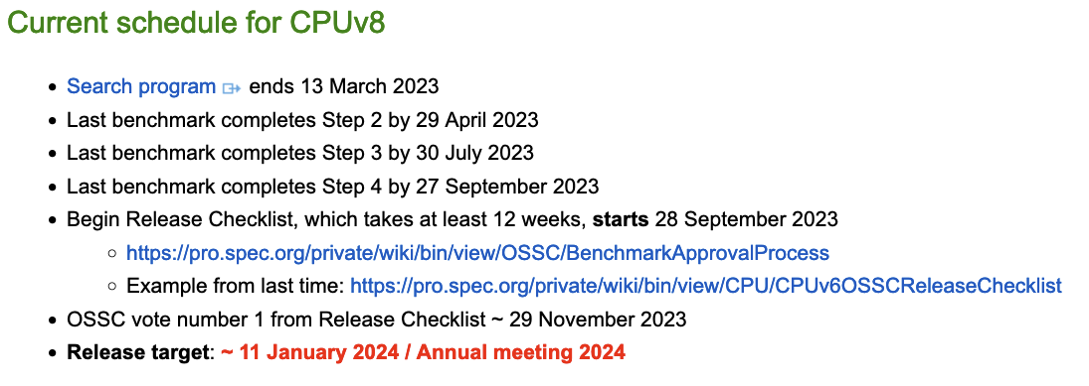
CPUv8 Search Program Next Steps
Give the authors access to the CPUv8 framework https://www.spec.org/cpu/authors/framework.html
New AMD CPUv8 search program candidates
Name | CPUv8 # | Entry # | Application URL
graph500 | 754 | 51 | https://www.graph500.org/
gpaw | 755 | 59 | https://wiki.fysik.dtu.dk/gpaw/
scikit | 756 | 60 | https://scikit-learn.org/stable/
namd | 757 | 62 | http://www.ks.uiuc.edu/Research/namd/

Slide 5
Step 2
Step 2 Initial porting and workload ($1500 upon successful completion)
2a Work within SPEC's environment
2b Compute for at least one minute
2c Define valid answers
2d Generate valid answers on both Windows® and Unix® operating systems
2e Include documentation
2f Verify and fully describe the licensing
2g Step 2 Award
2h Movement to the next step

Slide 6
Obtaining and Installing CPUv8
Download the CPUv8 framework kit from the SPEC CPU website: https://www.spec.org/cpu/authors/framework.html
Copy the tarball into your CPUv8 directory and extract it.
Install CPUv8: ./install.sh Answer yes to the prompt. The installation process takes few minutes.
Source the shell so that the CPUv8 utilities will run: . ./shrc

Slide 7
Example: Prime Numbers (1/3)
cd to benchspec/CPU
Extract the 788.prime_r archive here.
Add the new benchmark, 788.prime_r, to the following bsets: CPU.bset, specrate.bset. You can also add the benchmark to any_cpp.bset, specrate_any_cpp.bset, pure_cpp.bset, etc., but this is not necessary.
cd to 788.prime_r/src. Keeping Makefile, delete the specrand source code and copy prime.cpp here. Don’t touch Makefile.
There are three workload directories in 788.prime_r/data/. Modify the control file to contain the required prime number limit. For test, enter 100, train: 100000, refrate: 1000000.
Run the benchmark in isolation to generate reference output data and copy it to the test, train, and refrate output folders. Delete the specrand files.
Modify object.pm as shown on the next slide.

Slide 8
Example: Prime Numbers (2/3)
With the file 788.prime_r/Spec/object.pm:
Modify the benchmark information in the header. $benchlang will be CXX.
Delete $floatcompare since we will not be doing floating point comparisons.
Delete $bench_flags since we have no include files.
Modify sources: @sources = (qw(prime.cpp));
There are no common sources, so delete that block.
Modify the invoke routine to handle the single command line argument: for (@temp) {
my ($limit) = split;
next if m/^\s*#/ || m/^\s*$/;
push @rc, {
'command' => $exe,
'args' => [ $limit ],
'output' => "prime_numbers.out",
'error' => "prime_numbers.err",
};
}

Slide 9
Example: Prime Numbers (3/3)
In the 788.prime_r/Spec folder:
modify flags.xml by changing the benchmark name.
Delete the F-Ispecrand-common block.
Delete the DTRY_REENTRANT_VERSIONS block.
Delete the remaining two C++ related blocks.
Appropriately modify the files in 788.prime_r/Docs
Note that there are reference time and power files under each workload. Don’t worry about modifying them, since Cloyce will do it based upon reference system data.

Slide 10
Building and Running Your Benchmark
Decide upon a compiler. It is usually best to use the operating system’s GCC/G++/Gfortran and forego extra libraries for the initial build.
Reference data needs to be produced at –O0. Often miscompares occur under –Ofast due to fast math shortcuts.
Create a config file. I have provided a GCC-based config file with the flags broken out into their own include files to make maintenance easier. It might be necessary to modify allow_build and build_path macros.
The gcc13-flags.xml file must be copied to the CPUv8 root directory.
Build the benchmark. I have provided a simple build script that can be modified for more complicated build conditions.
Run the benchmark: runcpu --config amd_rate_gcc13_znver4_A1.cfg --iterations 1 --noreportable --size all --tune all --ignoreerror 788

Slide 11
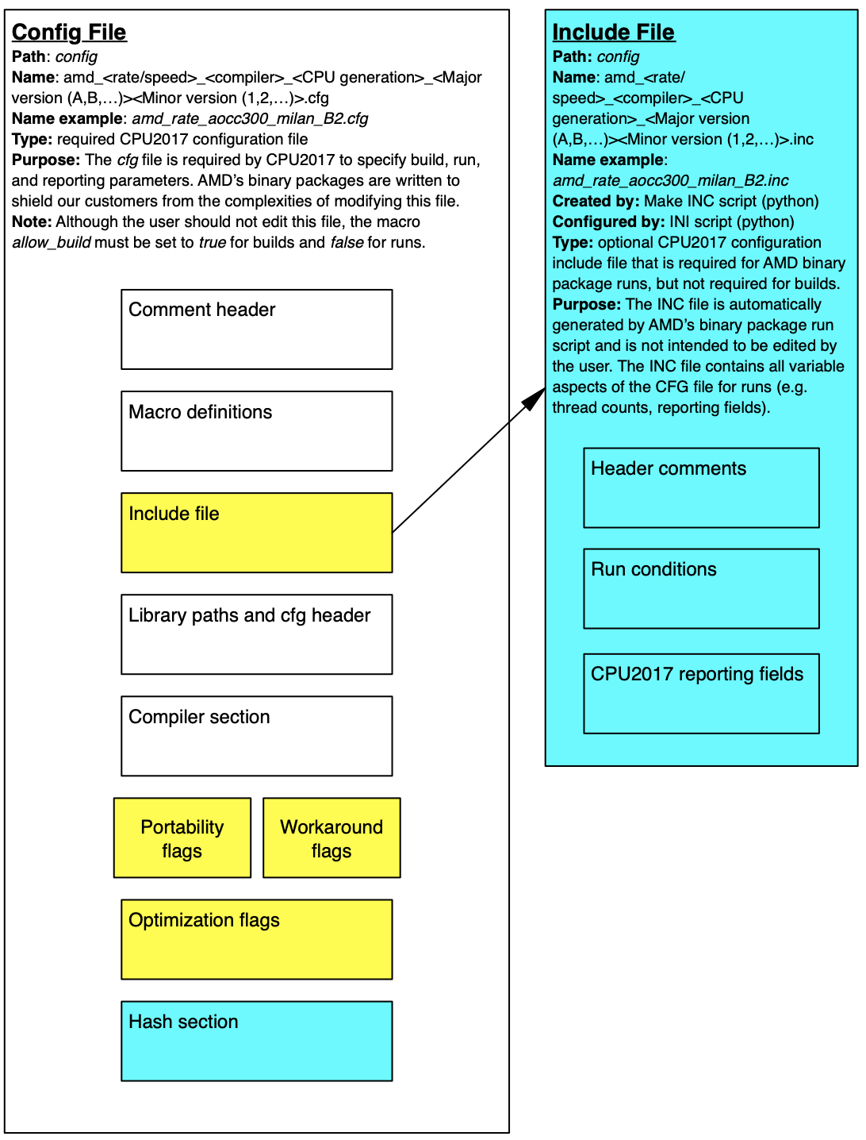
Config File
The SPEC CPUv8 config file follows identical features with the CPU 2017 config file.
Config files are located in the config directory and the file suffix is cfg.
The config file is used to specify which compilers to use, build flags, run conditions, and reporting fields.
After successful builds, hashes of the executables are stored at the bottom of the config file.
There are three categories of flags: portability, workaround, and optimization. Portability + workaround are the minimum flags needed to build a benchmark.
Yellow blocks are now include files.

Slide 12
CPUv8 Porter’s Progress Reports
From the CPUv8 root directory source the shell: . ./shrc
Enter the results directory
Run the porter’s progress utility:
port_progress –times CPU*.log > pp-times.txt
Builds successfully (no CE’s)
Runs successfully (no RE’s)
Results validate (no VE’s)

