Slide 1



Raising Student Achievement By Promoting a Growth Mindset
Notes:
I want to take a few minutes to introduce you to some exciting research I’ve been learning about on how students’ beliefs about intelligence can have a big impact on their engagement and achievement. This presentation is from the PERTS center in the Department of Psychology at Stanford University. PERTS stands for The Project for Education Research That Scales, and they are dedicated to providing educators with free, evidence based tools and resources to promote student resilience and achievement.

Slide 2
Overview
Fixed versus Growth mindset
Research on how beliefs shape learning
How to change mindsets
– 5-session PD invitation
Notes:
Here’s a quick overview of what we’re going to cover in this presentation:
What these two mindsets - Fixed versus growth mindset - are.
Why they matter - so we’ll look at some of the research evidence on how and why they can impact students’ achievement.
And finally, I’ll talk about a professional development series we’ll be holding soon to explore how we can help our students develop a growth mindset.

Slide 3
Quick Survey
How many of you have …
no previous exposure to mindset research?
some familiarity with this topic?
a great deal of familiar with it?
Notes:
A quick show of hands - how many of you have...
no previous exposure to mindset research?
some familiarity with it?
a great deal of familiarity with it?
[YOU MAY ALSO WANT TO GIVE A FEW MINUTES TO GET THEIR INITIAL REACTIONS BECAUSE SOME MAY HAVE HEARD OF IT AND THINK IT’S JUST A FAD OR DON’T BELIEVE IN IT]

Slide 4
What Motivates Students
to Try Hard in School?
Some students are highly motivated and others are not.
Why?
Notes:
Some students are highly motivated and others are not.
Why?

Slide 5
Growth Mindset and Achievement
Decades of research show a powerful relationship between
mindset and achievement.
Students’ beliefs about intelligence and learning impact:
Motivation
Academic behaviors (e.g., studying and seeking help)
Responses to challenges and setbacks
Academic achievement
Notes:
There are, of course, a lot of reasons kids don’t try hard. Over the last few decades, a lot of research has shown that there is a powerful relationship between students’ mindsets and their achievement.
These beliefs have a big impact on students’
Motivation
Academic behaviors (for example, studying and seeking help)
Responses to challenges and setbacks
Academic achievement

Slide 6

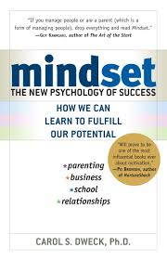
Growth Mindset vs. Fixed Mindset
Fixed mindset
Intelligence is a fixed trait. You can’t change it.
Growth mindset
You can grow your intelligence through effort.
Notes:
Carol Dweck, who pioneered this research, began studying students’ beliefs about intelligence because she was interested in the question of why some students are so resilient in the face of challenges while others are not.
What she found was that students generally hold one of two very different beliefs about intelligence. Some students have what she calls a “fixed mindset” - the belief that intelligence is a fixed trait that doesn’t change much. So, like eye color - these students believe you’re born with a certain amount of it and there’s not much you can do to change it. Other students have a very different belief about intelligence - a growth mindset. They see it more like a muscle that grows with effort.

Slide 7

Mindsets
These two beliefs lead students to very different conclusions about the meaning of events
Notes:
And it turns out these beliefs act like lenses through which students interpret their day-to-day experiences in school, particularly experiences of adversity. Students can draw very different conclusions about the meaning of the same events.

Slide 8

Mindsets
And the meaning they make – the narrative they construct – determines the behaviors in which they choose to engage
Photo by Gregory Ewanowich
Notes:
And these interpretations – these lenses – are what shape the narrative students use to make sense of their world. And the meaning we all make of events is what determines the behaviors we choose to engage in. If a student believes there isn’t a point in trying, then even the best teacher may not be able to reach them. It’s like the old saying goes… you can lead a horse to water, but you can’t make them drink.

Slide 9
Consequences of Beliefs
 | Fixed Mindset | Growth Mindset
Goal in School?
Values effort?
Reaction to Failure?
Blackwell, Trzesniewski, & Dweck 2007
Notes:
So what are the consequences? They affect the goals students have, how they view effort, and how they respond to failure and setbacks.

Slide 10
Consequences of Beliefs
 | Fixed Mindset | Growth Mindset
Goal in School? | Look Smart
Values effort?
Reaction to Failure?
Blackwell, Trzesniewski, & Dweck 2007
Notes:
For students with a fixed mindset, their goal in school is to show how smart they are, or hide how dumb they think they are. This makes sense right? If you think you’re just born smart or dumb, you want to make sure you show you’re smart. So this makes them much less likely to ask questions in class, or seek out help from peers or teachers because that would involve showing they don’t know something.

Slide 11
Consequences of Beliefs
 | Fixed Mindset | Growth Mindset
Goal in School? | Look Smart | Learn
Values effort?
Reaction to Failure?
Blackwell, Trzesniewski, & Dweck 2007
Notes:
Students with a growth mindset on the other hand have the goal to learn, so they’re more likely to ask a question if they don’t understand, or to seek out help or try a new strategy if they are struggling.

Slide 12
Goals
Looking smart is most important:
“The main thing I want when I do my school work is to show how good I am at it."
Learning is most important:
“It’s much more important for me to learn things in my classes than it is to get the best grades.”
 | Fixed mindset | Growth mindset
Goals? | Look Smart | Learn
Values effort?
Reaction to Failure?
Blackwell, Trzesniewski, & Dweck 2007
Notes:
Students with a fixed mindset are more likely to agree with...
“The main thing I want when I do my school work is to show how good I am at it.
Whereas students with a growth mindset are more likely to agree with…
“It’s much more important for me to learn things in my classes than it is to get the best grades.”

Slide 13
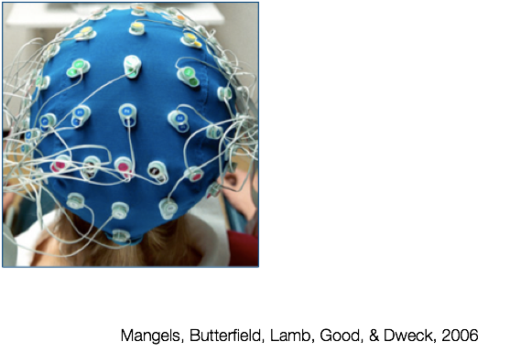
ERP Evidence for How Mindsets
Control Attention
Notes:
(optional slide)
There’s even evidence to support that mindsets play a role in where you focus your attention.

Slide 14
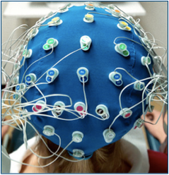
Procedure
Participants asked a question.
Participants type their answer.
Participants are told whether they are right or wrong.
Brain activation is recorded.
Participants are told the correct answer.
Brain activation is recorded.
WRONG!
And the answer is...
Notes:
(optional slide)
In a study from 2006, researchers measured students’ brain activity during a trivia quiz:
First, they asked students (participants = Ps) trivia questions.
Ps typed their answers and then were told whether they got it wrong or right.
They measured brain activity to determine how much the participants were paying attention.
Turns out, not surprisingly, all students showed high levels of attention when being told if they got the answer wrong or right. Both growth mindset and fixed mindset participants cared about knowing if they got the answer right or wrong.
NEXT, and this is where it gets interesting, they told participants the correct answer and measured their brain activation. What do you think happened?
That’s right, students with a growth mindset showed significantly more activation. The students with a fixed mindset were only interested in their performance, not learning from their mistake. They tuned out when they had an opportunity to learn what the correct answer was.
THEN, a little while later, they gave a pop quiz with the same trivia questions and, guess what? The growth mindset group did significantly better.

Slide 15
Consequences of Beliefs
 | Fixed Mindset | Growth Mindset
Goal in School? | Look Smart | Learn
Values effort?
Reaction to Failure?
Blackwell, Trzesniewski, & Dweck 2007
Notes:
What about effort? Students with a fixed mindset actually see effort as proof of low ability. They think that if you have to try hard that means you aren’t very smart.

Slide 16
Consequences of Beliefs
 | Fixed Mindset | Growth Mindset
Goal in School? | Look Smart | Learn
Values effort? | No
Reaction to Failure?
Blackwell, Trzesniewski, & Dweck 2007
Notes:
Whereas students with a growth mindset see effort as how you grow your abilities.

Slide 17
Consequences of Beliefs
 | Fixed Mindset | Growth Mindset
Goal in School? | Look Smart | Learn
Values effort? | No | Yes
Reaction to Failure?
Blackwell, Trzesniewski, & Dweck 2007
Notes:
Students with a fixed mindset are more likely to agree with…
“To tell the truth, when I work hard at my school work it makes me feel like I’m not very smart.”

Slide 18
Value of Effort
Effort is negative:
“To tell the truth, when I work hard at my school work it makes me feel like I’m not very smart."
Effort is positive:
“The harder you work at something, the better you’ll be at it.”
 | Fixed mindset | Growth mindset
Goals? | Look Smart | Learn
Values effort? | No | Yes
Reaction to Failure?
Notes:
Whereas students with a growth mindset are more likely to agree with...
“The harder you work at something, the better you’ll be at it.”

Slide 19
Consequences of Beliefs
 | Fixed Mindset | Growth Mindset
Goal in School? | Look Smart | Learn
Values effort? | No | Yes
Reaction to Failure?
Blackwell, Trzesniewski, & Dweck 2007
Notes:
Responses to failure - Fixed mindset students tend to have a helpless response to failure or struggling with something they don’t immediately get. They give up because they see setbacks as evidence they ‘don’t have what it takes.’

Slide 20
Consequences of Beliefs
 | Fixed Mindset | Growth Mindset
Goal in School? | Look Smart | Learn
Values effort? | No | Yes
Reaction to Failure? | Give Up
Blackwell, Trzesniewski, & Dweck 2007
Notes:
Students with a growth mindset are more likely to work harder in response to a failure.

Slide 21
Consequences of Beliefs
 | Fixed Mindset | Growth Mindset
Goal in School? | Look Smart | Learn
Values effort? | No | Yes
Reaction to Failure? | Give Up | Work Harder
Blackwell, Trzesniewski, & Dweck 2007
Notes:
When students were asked how they would respond to failing a test, students with a fixed mindset are more likely to agree with these statements...
“I would spend less time on this subject from now on.”
“I would try not to take this subject ever again.”
“I would try to cheat on the next test.”

Slide 22
Response to Failure
Helpless
“I would spend less time on this subject from now on.”
“I would try not to take this subject ever again.”
“I would try to cheat on the next test.”
Resilient
“I would work harder in this class from now on.”
“I would spend more time studying for the tests.”
 | Fixed mindset | Growth mindset
Goals? | Look Smart | Learn
Values effort? | No | Yes
Reaction to Failure? | Give up | Work Harder
Notes:
Whereas students with a growth mindset are more likely to agree with…
“I would work harder in this class from now on.”
“I would spend more time studying for the tests.”

Slide 23
Consequences of Mindsets
 | Fixed Mindset | Growth Mindset
Goal in School? | Look Smart | Learn
Values effort? | No | Yes
Reaction to Failure? | Give Up | Work Harder
Achievement | Lower | Higher
Notes:
Students with a fixed mindset tend to show declines in their performance over time, particularly when they transition to a new environment such as from elementary to middle school or middle school to high school.
Students with a growth mindset typically show increases over time.

Slide 24


Does Growth Mindset Correlate with Achievement? Evidence From A Nationwide Sample In Chile
Chilean National Achievement Test
10th grade test incorporated Growth Mindset Assessment
n=147,000
Susana
Claro
Dave
Paunesku
Claro, Paunesku, & Dweck (under review)
Notes:
Numerous studies have shown that students with a growth mindset do better academically. In a recent, large-scale study, researchers had an opportunity to look at the relationship between mindsets and achievement in an entire nation. All of the 10th graders in Chile that took the national standardized test - so over 140,000 students - were also asked questions to assess their mindsets.

Slide 25
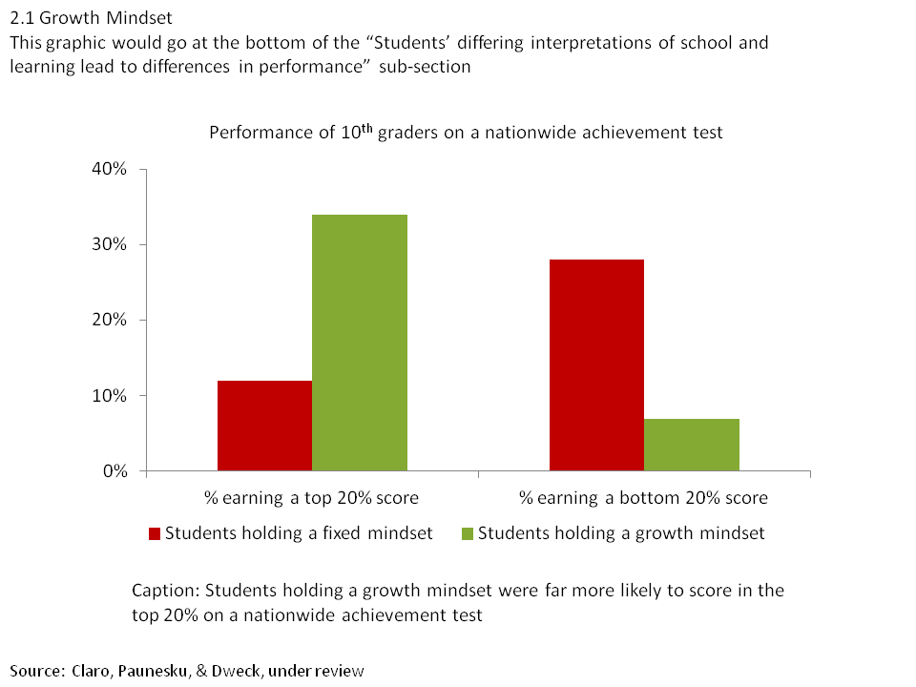
Does Growth Mindset Correlate with Achievement? Evidence from a Nationwide Sample in Chile
Notes:
SLIDE 25And they found that students with a growth mindset (those who disagreed with statements like, “You can learn new things, but you can’t really change your basic intelligence”) were 3x as likely to score in the top 20%, whereas students with a fixed mindset were 4x more likely to score in the bottom 20%. GET PERMISSION TO USE

Slide 26
Recursive Processes
Higher Achievement
Increased Effort
Growth Mindset
Challenge or Failure
Fixed
Mindset
Reduced Effort
Lower Achievement
Notes:
NOTE: THIS SLIDE IS ANIMATED. [ADVANCE] INDICATES WHEN YOU SHOULD CLICK ADVANCE TO BRING UP THE NEXT PART OF THE SLIDE.
The reason these mindsets can have such an impact on achievement has to do with the recursive process that takes place when students experience a challenge or setback.
[ADVANCE] When a student w/ a GMS experiences a setback
[ADVANCE] they increase their effort
[ADVANCE] which leads to better results
[ADVANCE], which then reinforces their belief that they can improve – it reinforces their growth mindset.
[ADVANCE] Students with a fixed mindset have the opposite recursive process taking place. [ADVANCE] They experience a failure,
[ADVANCE], they reduce their effort,
[ADVANCE], which leads to lower achievement over time,
[ADVANCE] which then reinforces their belief that they don’t ‘have what it takes.’

Slide 27
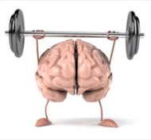
Mindsets Can Change!
Rigorous research also shows that mindsets can change
When they are changed to have a Growth Mindset, students do better
Notes:
What’s exciting though is that there’s also research showing that students’ beliefs can be changed, and that when they are, students do better.

Slide 28
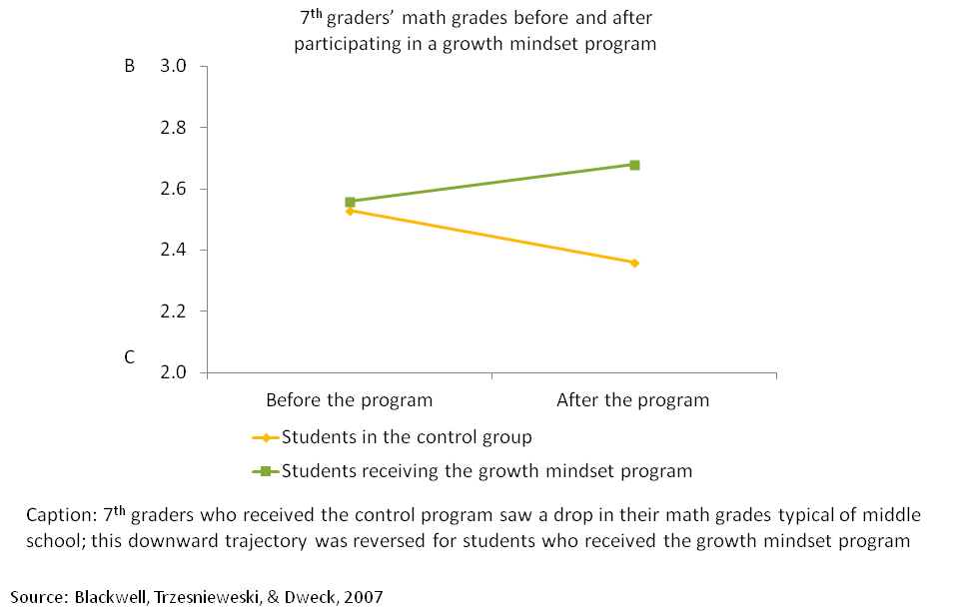
Mindset Interventions
Notes:
In one study, 7th grade students were taught about neuroplasticity - how the brain changes when you learn new things. They were shown the evidence that you really can change your intelligence by challenging yourself and learning new strategies. Students in the treatment group who got this message did significantly better after the intervention than students in the control group.
Students in the treatment group showed an increase in their math grades

Slide 29
Online Growth Mindset Intervention
Study Design:
1584 students, SES from 1% to 90% reduced lunch
13 high schools (8 public, 4 charter, 1 private); SES from 1% to 90% reduced lunch
33% Latino, 17% Asian, 23% White, 11% Black, and 16% other/mixed ethnicity
Intervention:
Two 45-minute sessions
Taught about the brain and neural plasticity
Discussed implications for effort, help seeking, and intelligence
Paunesku, Walton, Romero, Smith, Yeager, & Dweck (2015)
Notes:
In another study with over 1500 high school students, students were randomly assigned to participate in a 2-session online intervention that taught about neuroplasticity and helped participants to understand the implications of this for effort, help seeking, and intelligence...

Slide 30
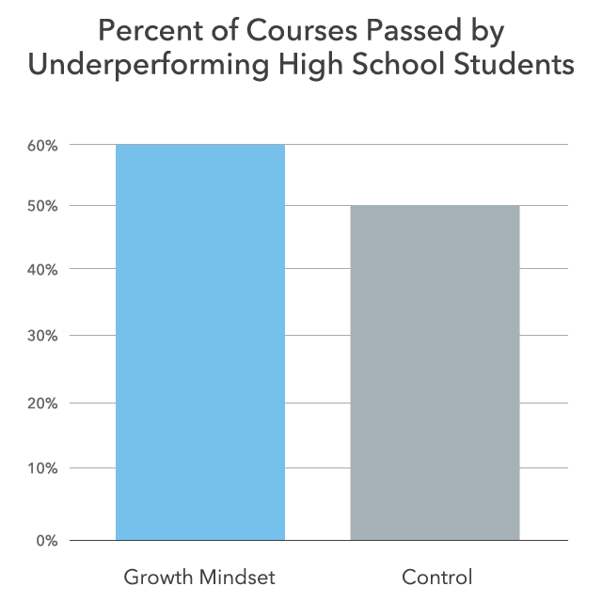
Paunesku, Walton, Romero, Smith, Yeager, & Dweck (2015)
Notes:
It helped struggling students – students who were at risk for dropping out of high school in the semester prior to the intervention – improve their grades. These students became more likely to earn As, Bs, and Cs in all 4 core classes.
(*Underperforming, or “at-risk” for drop-out criteria was developed by Consortium for Chicago School Research (CCSR). Students who earn GPAs < 2 or fail a core academic class are considered “at-risk”)
It makes sense that it helped underperforming students because a growth mindset matters most when things are hard.

Slide 31
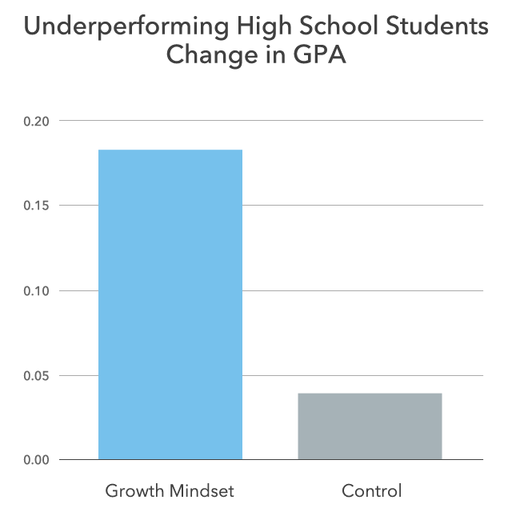
Paunesku, Walton, Romero, Smith, Yeager, & Dweck (2015)
Notes:
These students also showed a significant increase in their GPAs

Slide 32
How Do Everyday Interactions Shape Mindsets?
The language we use tells others what we believe and what we value
Feedback tells us what is expected of us and what goals we should have
Notes:
In addition to directly changing students mindsets by teaching them about the brain, how can our everyday interactions shape students’ mindsets?
Part of the answer is that our language signals to others what we believe and what we value.
- What beliefs are being reinforced?
- What goals are being promoted?
- Are mistakes valued?

Slide 33

Self-esteem Movement
Notes:
The self-esteem movement got under way in the early 70’s and had all the best intentions. The belief at the time was that praising kids’ abilities would help them feel secure about those abilities and thus to develop into healthy adults. So every kid on the team was given a trophy whether they won or lost, (still goes on today, right?) and parents regularly praised their kids for being talented at this or that.

Slide 34

Praise
Research Question:
Do different kinds of praise influence students’ response to failure?
Claudia Mueller
Notes:
Researchers Claudia Mueller and Professor Dweck were worried that this type of praise might actually have unintended negative consequences--leading kids to develop more of a fixed mindset and to respond with less resilience when faced with setbacks.

Slide 35
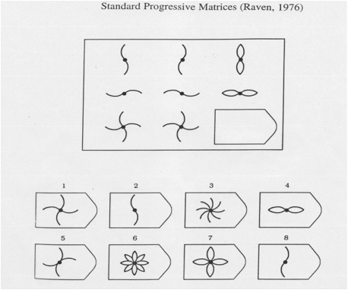
Praise Effects on IQ Test Performance:
N = 128 5th grade students
Standard progressive matrices (Ravens)
Mueller & Dweck, 1998
Notes:
In a study to test this, 5th grade students were given a set of moderately difficult problems to solve
They were given a set of Standard Progressive Matrices (Raven) questions, which is supposed to be a culture free IQ test - the goal here is to find the missing piece. What do you think the answer is? (it’s #7)
All students were told that they got a good score

Slide 36
Praise Effects on IQ Test Performance:
Control Group: “Wow, that’s a really good score.”
Intelligence Praise: “Wow, that’s a really good score. You must be smart at this.”
Effort (Process) Praise: “Wow, that’s a really good score. You must have tried really hard.”
Mueller & Dweck, 1998
Notes:
All students were told they did well, but the praise they received differed in subtle but important ways.
Students were randomized to get one of 3 different kinds of praise.
Control praise - “Wow, that’s a really good score.” There is no attribution for why they did well.
Intelligence praise - “Wow, that’s a really good score. You must be smart at this.” They are told their good score means they are smart - that their ‘smartness’ is the reason they did well.
Effort (Process) praise - “Wow, that’s a really good score. You must have tried really hard.” Here the explanation for their good performance is that they tried hard.

Slide 37
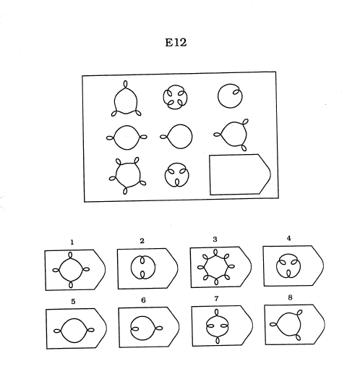
Part 3: IQ Test: Very Difficult
Mueller & Dweck, 1998
Notes:
Then they were given a set of very difficult problems
This is an example of a hard problem, though the ones the 5th graders were given weren’t actually this hard. Just for fun, any guesses on what the answer is? [PAUSE TO GIVE THEM A CHANCE TO FIGURE IT OUT]
It’s an arithmetic question - the outward nubs are positive, and inward are negative so the answer is #5.

Slide 38

After Setback
“That’s a lot
worse”
Mueller & Dweck, 1998
Notes:
After this set of questions, all participants were given the same feedback… “That’s a lot worse”

Slide 39
Praise Effects on IQ Test Performance:
Completed moderately difficult IQ problems
Received positive feedback (intelligence praise, effort praise, or control)
Completed very difficult IQ problems
Received negative feedback that they did a lot worse
Completed moderately difficult IQ problems
Mueller & Dweck, 1998
Notes:
NOTE: THIS SLIDE IS ANIMATED. [ADVANCE] INDICATES WHEN YOU SHOULD CLICK ADVANCE TO BRING UP THE NEXT PART OF THE SLIDE.
Then they went back to working on moderately difficult problems.
To review:
All were given moderately difficult IQ test questions
Each group gets positive feedback - intelligence, effort, or neutral praise
Then complete hard questions
All get same negative feedback
Then, all given another set of moderately difficult IQ questions similar to the first set
[ADVANCE] So the first and last [ADVANCE] set of problems were of the same level of difficulty. The researchers were interested in how the different groups would perform on the last set of moderately difficult problems after they experienced a failure.

Slide 40
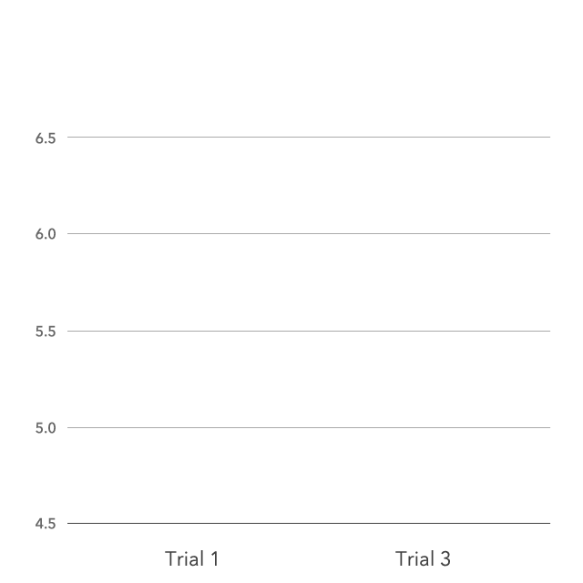
Number of Problems Solved Before and After Setback
Control praise
Intelligence praise
Effort praise
Notes:
What they found was really interesting. Students who got neutral praise did about the same. They did slightly better, which you’d expect because they’d had more practice. The students who were given effort praise though did better. What’s most interesting though is that students who were praised for their intelligence were demoralized by that setback and actually did worse. Hearing that the reason they did well was because they were smart lead them to interpret the failure as evidence that they might not be so smart after all.
Keep in mind, these are tests that have been touted as measuring a supposedly fixed ability: IQ. Yet, just one slight modification to the praise students received had a significant impact on their performance.

Slide 41
Growth Mindset Praise
Don’t Focus On:
Qualities commonly interpreted as stable, like talent or intelligence
Do Focus On:
Effort and strategies used
“I like how you tried a new way to solve that.”
Abilities improving over time with practice
“You’ve been practicing and I can see it’s paying off.”
Mistakes and being challenged as necessary part of learning
“I love mistakes because they’re an opportunity to learn – being challenged is when the brain grows most.”
Notes:
So, here’s a few do’s and don’ts of praise:
Don’t Focus On:
Qualities commonly interpreted as stable, like talent or intelligence
Instead
Do Focus On:
Effort and strategies used
“I like how you tried a new way to solve that.”
That abilities improving over time with practice
“You’ve been practicing and I can see it’s paying off.”
Mistakes and being challenged as necessary part of learning
“I love mistakes because they’re an opportunity to learn – being challenged is when the brain grows most when it’s being challenged.”
This last one is so important, because students are often really scared of making mistakes, but mistakes are an essential part of the learning process. Learning how to create opportunities and activities to help students become more comfortable making mistakes is something we’ll focus on in the professional development sessions.

Slide 42
What Can We Do For Our Students?
Notes:
WHAT CAN WE DO FOR OUR STUDENTS?

Slide 43
Let’s Learn Together!
You are invited to participate in an upcoming professional learning cycle
Learn simple ways to cultivate a Growth Mindset in your students
We will use resources developed by Stanford University’s PERTS Laboratory (the Project for Education Research That Scales)
Notes:
MODIFY CONTENT OF THIS SLIDE TO FIT YOUR CONTEXT

Slide 44
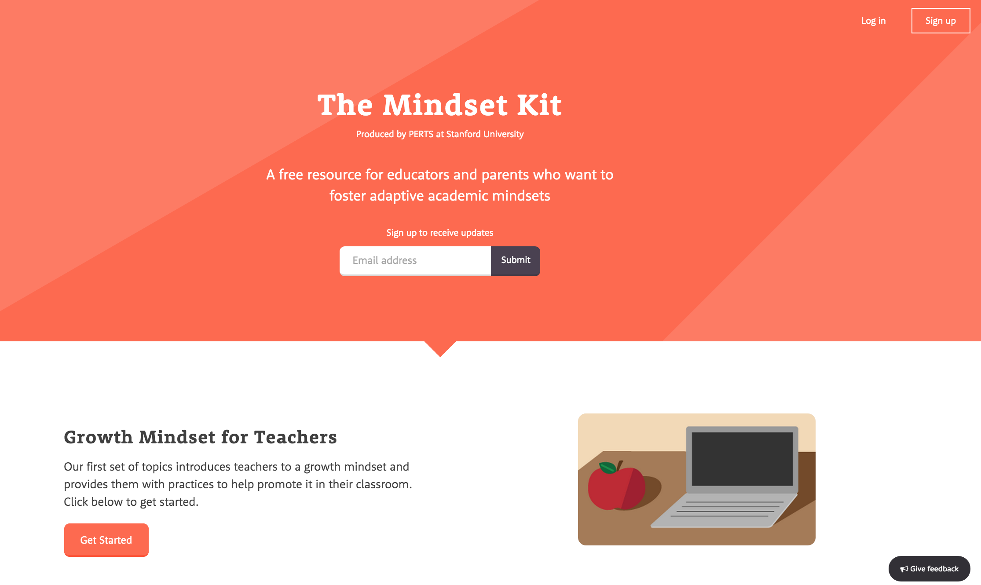
Mindset Kit – mindsetkit.org
Notes:
The PERTS research center at Stanford University has recently developed a set of free, evidence-based courses to help educators learn about this research and how to integrate it into their classroom practices. We’ll be using their resources to explore this work and learn together what we can do to help our students AND ourselves develop a growth mindset.

Slide 45

Questions? Comments? How do mindsets show up in your classrooms?
Notes:
FAQ’s
Below are answers to a few questions that often come up. If you are asked a question you don’t know the answer to, let them know you’ll look into it. If you email us, we’ll get back to you with how we would address the question. If it’s a question we get repeatedly, we’ll add it to this FAQ list.
Are you saying all students have equal ability?
No. Having a growth mindset doesn’t mean you believe everyone has equal ability in every domain. It means you believe that no matter where a person is now, they can always improve with effort, good strategies, and help.
All too often, we attribute good performance to ‘talent’ and ‘smartness’ when it is much more likely that those students who are earning higher grades have had a lot more opportunities for learning and practice. And attributing students’ success to innate abilities can have a negative impact on their resilience when they hit a challenge. By using praise that focuses on effort, strategies, and seeking help as the mechanism for improving, students retain a sense of control for their own success. They can make choices to improve if they want to. If a student is given messages that suggest success is dependent on ‘natural ability’ then it robs them of control over improving - it robs them of agency.
Do learning mindsets matter more or less for high-achieving or low-achieving students?
Having a growth mindset is advantageous for anyone facing challenges, so high and low-achieving students can benefit as long as they’re being challenged by what they’re working on. If either high or low achieving students are not being challenged and having to confront inevitable setbacks involved in learning new things, then they may not benefit as much.
Will this work for students with disabilities?
Though there hasn’t been research specifically looking at this, it seems like it could be very helpful for these students because they are so often given messages that they are lacking in ‘talent’ and ‘intelligence’.
Can students have a fixed mindset in one topic and a growth mindset in another?
Great question! Yes, absolutely. We all have a combination of fixed and growth mindsets in different domains of our life. A person might have a growth mindset about their ability to improve at a sport, for example, but believe they are ‘not good at math’. And people can also have intermediate mindsets - not fully fixed or growth.
I have a classroom that has a wide range of abilities, and kids are always comparing themselves. How do I deal with the low performing kid comparing themselves to the high performing kid? Or worse, the high performing kids who brag about how ‘easy’ everything is for them?
Another great question! This is just the kind of specific challenges we want to explore further during the PD session because that’s a tricky situation that requires creating a new classroom norm to address - and that takes time. Kids need to first understand how the brain and learning work (learning how to do this is part of the PD). Once they understand this, you help them see that someone who is more advanced has just had more time to practice and get better.

