Slide 1
Kumon Award Ceremony
2018 Excellence Awards

Slide 2
Important Announcements
Parents are requested to please remain seated and attend the complete ceremony. We have important announcements for the upcoming year at the end of the ceremony.
If you have NOT been receiving emails from us, then please fill out the email address in the feedback form and submit the form outside before leaving.

Slide 3
Student Motivation
Building a Community of Self Motivated Learners

Slide 4

There are three things to remember about education. The first is motivation. The second one is motivation. The third one is motivation. (former U.S. Secretary of Education Terrel Bell)
Student Motivation

Slide 5

Why Motivation?
When Students feel more motivated to learn, they perform better academically, improve classroom behavior, and gain a higher sense of self-esteem.

Slide 6
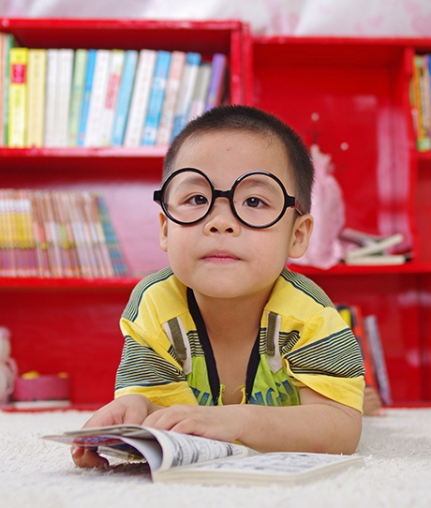
What is Motivation?
Motivation is a drive that encourages an action or a feeling. To motivate means to encourage and inspire. In other words, motivation can be defined as motive for action.

Slide 7
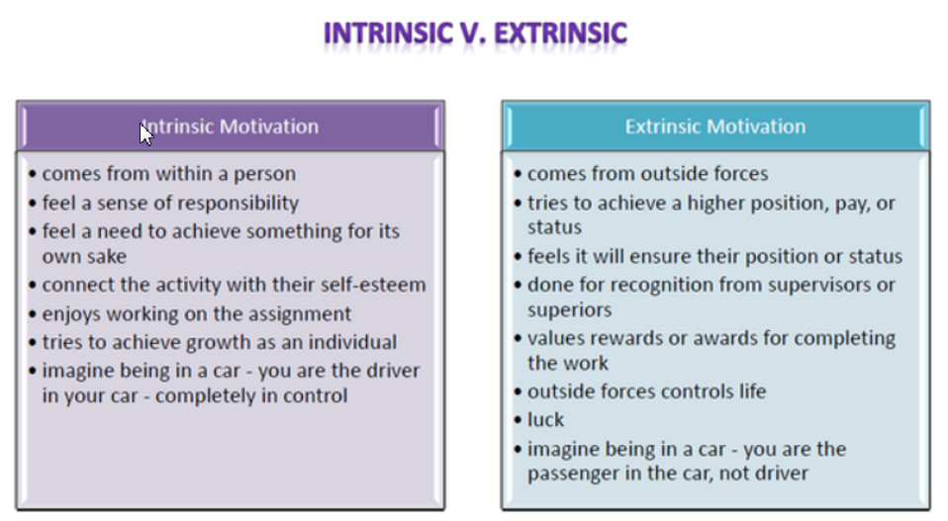
Types of Motivation

Slide 8
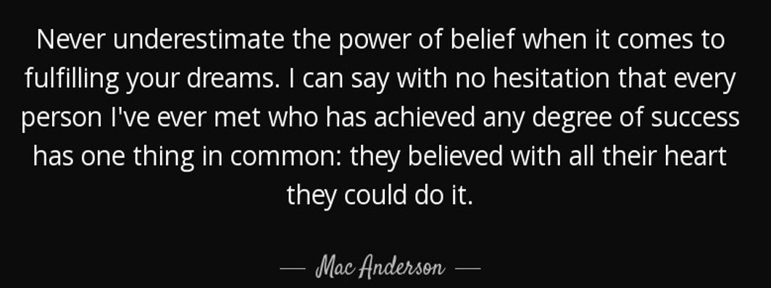
Power of Belief

Slide 9
Creating the Conditions for Student Motivation
To inspire intrinsic motivation as a daily part of education, we must nurture the conditions for student growth through:
Feeling of Accomplishment: Students feel motivated when they feel they have accomplished something on their own. What we need to cultivate is the culture of Finishing what you start and how to accomplish the goal.
Competence: Feeling that one has the ability to be successful in doing it.
Recognition: Feeling cared about by people whom they respect.

Slide 10

Kumon GRADUATES!!
Graduation Diploma are presented to these GRADUATES who have COMPLETED the Kumon Program!!.
Saloni Parikh (Reading Graduate)
Ananya Handa (Math Graduate)
Sheel Parikh (Reading Graduate)
Ipsa Bijumalla (Reading Graduate)
Ankita Majumdar (Math Graduate)
Shreeya Rajesh (Reading Graduate)
Ayush Khot (Math Graduate)
Anish Khot (Math Graduate)
Bhavyaa Chauhan (Math & Reading Graduate)
Deeraj Pothapragada (Math & Reading Graduate)
Krishna Pothapragada (Math & Reading Graduate)

Slide 11
Achievement Awards
Students who are working hard towards achieving Honor Roll are presented with Achievement Medals.
Barrick , Ye
David , Rodrigues Steigleder
Dhruva , Shah
Samaira , Bongale
Sara , Palle
Suprita , Matcha
Aastha , Choudhary
Ishan Mohamed , Imran
Rayan , Razi
Rishank , Kanagala
Sri Charvi , Penmatsa
Thomas , Hardy
Arav , Pathi
Deborah , Abimbola-akinola
Dhaliwal , Sukhtejveer
Jasan , Premkumar
Jori , Hardy
Max , Hwang
Siva , Padman
Vishnu Tejaswin , Bheemisetty
Aarya , Bhadane
Kaur , Samreen
Shourya , Sachin

Slide 12
Achievement Awards
Students who are working hard towards achieving Honor Roll are presented with Achievement Medals.
Sreekar , Nakireddi
Talha Khan , Khan
Azeem , Syed
Diogo , Rodrigues Steigleder
Ali , Syed
Divya , Reddy

Slide 13
Kumon J by 6 & J Completion
Students studying level J by 6th grade are presented with a Globe Trophy and Students completing J Level will be presented a J Completion Plaque.
Ariha , Ajmera
Nishka , Bijumalla
Kavya , Reddy
Mesoma , Akpuokwe
Kali , Patel
Rachel , Coutinho
Dhairya , Trivedi
Ami , Dholakia
Sarayu , Suresh

Slide 14
Kumon G By 4 Awards
Students studying level G by or before 4th grade are recognized with a Gold Star Award.
Pranshu , Nautiyal
Atharva , Vaze
Daiwik , Muralidharan
Nathan , Mburu
Sahana , Suresh
Sanjay , Manikandan
Shivani , Mani
Sristi , Barnwal
Aditya , Byju
Eshanvi , Sharma
Nandika , Rajesh
Rithisha , Chunduri
Ryan , Golzarsaravi
Samil , Sharma
Sneha , Ganesan
Srihan , Pasupula

Slide 15
Platinum Awards
Students Studying 3 Years above their Grade Level are presented with Platinum Awards!
Naihara Rout
Christian , Hwang
Emily , Gutierrez
Krish , Biswas
Abhinav , Byju
Akshay , Manikandan
Bharath , Santhosh
Diya , Patel
Nelson , Mburu
Nimit , Trivedi
Shreyash , Vanapalli
Sri Yuktha , Matcha
Debanshi, Dey
Anusha , Konjeti
Laaibah , Zaman
Nelith , Ranaweera
Pranavi , Shrestha
Simer , Patel
Vidhya , Kumar
Pillalamari , Akhil
Suhas , Muddala
Vani , Ramesh
Ansh , Tomar
Arshia , Ajmera
Deepesh , Balwani
Sanjana , Sivakumar
satkeerth , boyapalli
Snigdha , Akula
Srisha Manoj

Slide 16
Kumon Gold Awards
Students Studying 2 Years above their Grade Level are presented with Gold Awards!
Aditya , Jayanthi
Aaryan , Bedi
Shiv , Sahani
Shubhanshi, Dey
Destiny , Abimbola-akinola
ISHAN , MAJUMDAR
Julia , Stephen
Adah , Singh
Kannan , Anisha
Maanya , Srivastava
Shiven , Patel
Vibha , Athreye
Kavith , Ranaweera
Priscilla , Abimbola-akinola
Shreyaa , Mani
Valeria , Ramirez
Yajna , Sivakumar
Vishnu , Dhamodharan
Noor , Singh
Shabab , Ahmed

Slide 17
Kumon Bronze Awards
Students Studying at Kumon International Standards (KIS) are presented with Bronze Awards!
Ahluwalia , Balraj
ELISHA , ALMEIDA
Farhan , Ahmed
Vyan , Dadsena
Aryan , Gupta
Shah , Ruhi
Tala , Amiry
Alisha , Dhingra
Anoushka , Chaudhary
Trisha , Suresh
Colin , Juhn
Dhivija Sai , Challa
Archi , Damle
Fatheen , Ahmed
Shreevallabh , Damle

Slide 18
Kumon Silver Awards
Students Studying One Year above their Grade Level are presented with Silver Awards!
Aishani , Malhotra
Divena , Sivakumar
Max , Rozdolsky
Medhansh , Nautiyal
Ronit , Vig
Srisha , Bhowmik
Tejas , Challa
Vishnu , Ramesh
Aditi , Palakodeti
Aditi , Vaze
Deevyaa , Chauhan
Jaivik , Trivedi
Jesunifemi , Aluko-Olokun
Jianna , Patel
JORDAN , ALMEIDA
Lana , Amiry
Liezl , Casenas
Sahana , Dinesh
siddharth , guttikonda
Vihaan , Sharma
Akshay , Mullick
Julia , Rozdolsky
Kaushal , Pratury
KAVISH , BAROT
Krish , Iyer
Kundan , Velpula
Parvana , Sreejith
Saatvik , Ranjan
Sahana , Sriram
Veda , Ramesh
Vikash , Kumar
Abhiram , Yenugula

Slide 19
Kumon Silver Awards
Students Studying One Year above their Grade Level are presented with Silver Awards!
Kaima , Akpuokwe
Neto , Akpuokwe
Prisha , Mittal
Rayyan , Malik
Sara , Naqvi
sarthak , boyapalli
Tameem , Ahmed
Zoe , Leveston
Abhishek , Rasalkar
Morgan , Leveston
Tiana , Prakash
Ynfinity , Sy
Aarush , Yada
Andrea , Ramirez
Krithi , Ashok
Shuruah , Ahmed
Amogh , Garde
Aashi , Singh
AKSHAR , BAROT
Kush , Shah
Meghana , Chillakuru
Pradyun , Shrestha
Shuruah , Ahmed
Amogh , Garde
Aashi , Singh
AKSHAR , BAROT
Kush , Shah
Meghana , Chillakuru
Pradyun , Shrestha

Slide 20
Do you have a child 3+ year old who could benefit from kumon?
Would you want to add another subject for your child to see if he/she can handle another subject?

Slide 21

No Risk or obligation to try kumon for 2 weeks.
Trial runs Nov 1 – 15th. Register before Oct 31st for Trial.

Slide 23
9999

