Slide 1
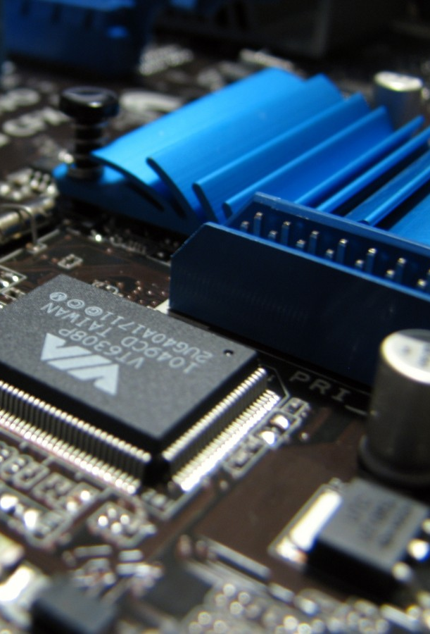
Dragon Board™
410c
- Presented by,
Narendran & Pooja Pawade

Slide 2
Introduction
The Dragon-Board 410c, a product of Arrow Electronics based upon 96-Boards, is the development board based on the mid-tier Qualcomm® APQ8016E processor.
96Boards is a 32-bit and 64-bit ARM® Open Platform hosted by Linaro™ with the intension to serve the software/ maker and embedded OEM communities
Dragon-Board 410c is designed to support rapid software development, education and prototyping

Slide 3

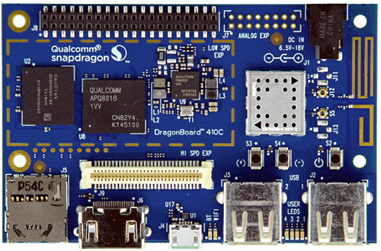

FRont view

Slide 4
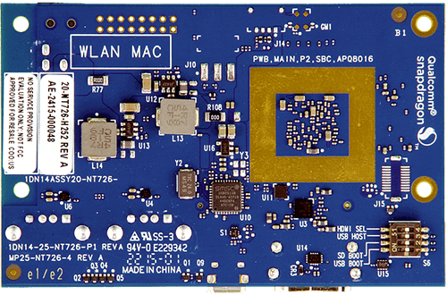
Back view

Slide 5
SPECIFICAION Features
OS Support:
Android 5.1 (Lollipop) on Linux Kernel 3.10
Linux based on Debian 8.0
Open Embedded
Ubuntu Core
Windows 10 IoT Core
CPU:
Quad-core ARM® Cortex® A53 at up to 1.2 GHz per core with both 32-bit and 64-bit support.
Qualcomm Adreno 306 400MHz GPU for PC-class graphics with support for advanced APIs, including OpenGL ES.
Memory/storages:
1GB LPDDR3 533MHz / 8GB eMMC 4.5 / SD 3.0 (UHS-I)

Slide 6
Continue..
Graphics:
Qualcomm Adreno 306 GPU with support for advanced APIs, including OpenGL ES 3.0, OpenCL, DirectX, and content security.
Video:
1080p@30fps HD video playback and capture with H.264 (AVC), and 720p playback with H.265 (HEVC)
Camera Support:
Integrated ISP with support for image sensors up to 13MP
Audio:
PCM/AAC+/MP3/WMA, ECNS, Audio+ post-processing (optional)

Slide 7
CONTINUE..
Connectivity:
WLAN 802.11 b/g/n 2.4GHz
Bluetooth 4.1
GPS
On-board GPS antenna
On-Board Bt and WLAN antenna
User Interface:
Power/Reset
Volume Up/Down
6 LED Indicators:
4 user controllable
2 for radios (BT and WLAN activity)

Slide 8
Continue..
I/O Interface:
One USB 2.0 micro B (device mode only)
Two USB 2.0 (host mode only)
One 40-pin Low Speed (LS) expansion connector UART, SPI, I2S, I2C x2, GPIO x12, DC power
One 60-pin High Speed (HS) expansion connector 4L-MIPI DSI, USB, I2C x2, 2L+4LMIPI CSI
Footprint for one optional 16-pin analog expansion connector for stereo headset/ line-out, speaker and analog line-in
The board can be made compatible with Arduino using an add-on mezzanine board

Slide 9
Continue..
Power, Mechanical and Environment:
Power: +6.5V to +18V
Dimensions: 54mm by 85mm meeting 96Boards™ Consumer Edition standard dimensions specifications
Operating Temp: 0°C to +70°C
RoHS and Reach compliant
External Storage:
Micro SD card slot

Slide 10
ApplicaTions
Robotics
Cameras
Medical Devices
Vending machine
Smart Building
Digital Signage
Casino Gaming console

Slide 11
Conclusion
Processor, WLAN, Bluetooth, and GPS all packed into a board the size of a credit card.
All this makes it ideal for enabling embedded computing and Internet of Things (IoT) products
It is designed to support feature-rich functionality, including multimedia, Game development etc.,

Slide 12
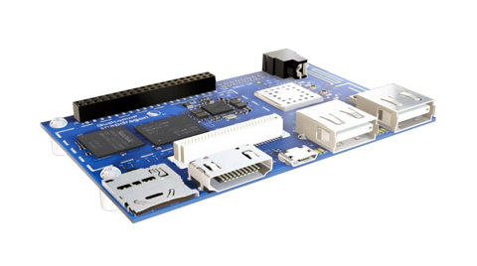
Thank you...!

