Slide 1
Exposure-based Models

Slide 2
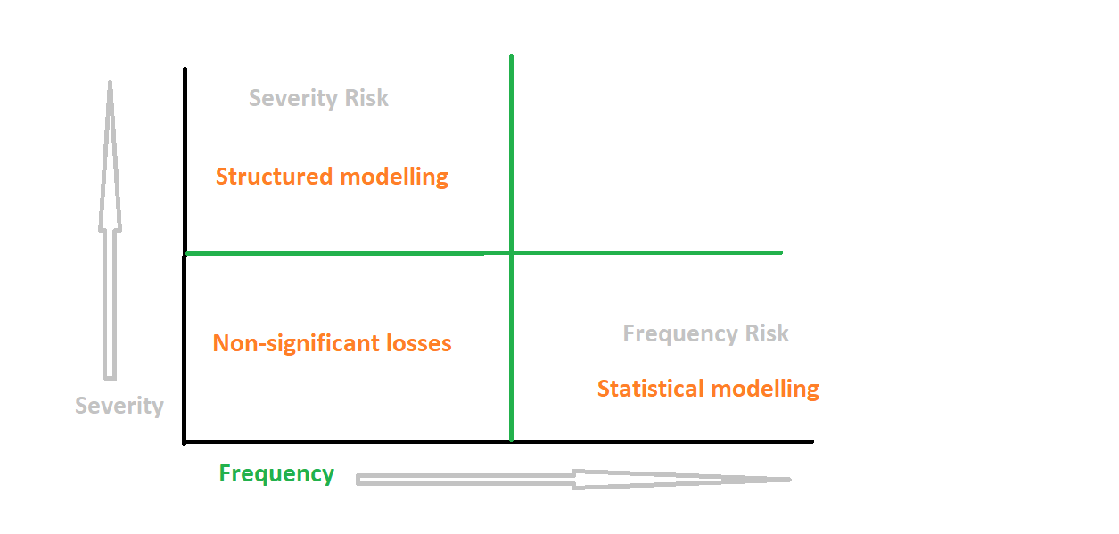
Exposure-Based Models (XOI)

Slide 3
Exposure-Based Models (XOI)
Exposure-based models look at the underlying drivers and causes of operational loss events, rather than just statistically describing their impacts
It is based on Bayesian Networks
Each Building blocks is identified with business factors that influences its value
The XOI Model is defied by simple equation with building blocks
Risk = eXposure x Occurance x Impact
X = eXposure represents a number of units (people, processes, systems, products etc.) that are at risk of loss
O = Occurrence is the likelihood that exposure will result in a loss event
I = Impact is the financial amount can be lost in an event
Risk Drivers
External Factors
Control Quality
Business Metrics

Slide 4
Bayesian Networks (BN)
Class of Probabilistic graphical models:
based on concept of conditional dependence.
A BN is :
- a set of nodes each containing a probability distribution that describes and quantifies (the uncertainty in) a process, an event, a group of people
Specific features:
Conditional dependence between nodes is explicitly represented through directed edges.
- Directed edge: a node can only be a ‘child’ of a parent node or can be a top parent node;
- two way (cyclical) edges are not allowed.
Directed edges between the nodes:
- aim to represent causal processes (an event influencing another event).
Points of Strength of BN:
Offer a graphical description of the problem:
- What is the chain of events and processes leading to a specific class of operational losses
Allows to seamlessly incorporate qualitative judgements from:
- Subject matter experts, Risk managers within a quantitative framework.
The experts collaboratively design the model structure representing the chain(s) of events for the specific, idiosyncratic risk at hand.
- It transform intuition and qualitative expertise to quantitative model inputs and outputs.
- Help in identifying assumptions and incorporate decision nodes
Each Building blocks is identified with business factors that influences its value

Slide 5
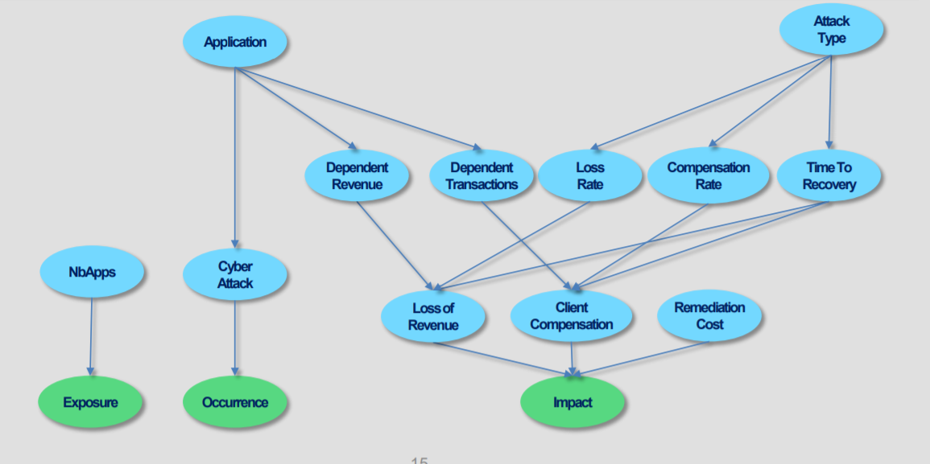
Illustrative Model Structure:
Cyber Attack Critical Application

Slide 6
Model Quantification
Risk Driver | Assessment
Number of critical applications | 5 applications: Internet banking, Cards, Transfers, Trade, Loans. Each application having equal share.
Type of attack | Duration: 80% Magnitude: 20%
Probability of cyber attack | Internet banking: 10% Loans: 5% Trade: 10% Transfers: 15% Cards: 10%
Dependent Revenue | Internet banking: 60% with 5mn$, 40% with 10mn$ Loans: 60% with 10mn$, 40% with 20mn$ Trade: 95% with 0.001mn$, 5% with 5mn$ Transfers: 95% with 0.001mn$, 5% with 5mn$ Cards: 60% with 10mn$, 40% with 20mn$
Dependent Transaction | Internet banking: 0.001mn$ Loans: 0.001mn$ Trade: 5bn$ Transfers: 75bn$ Cards: 0.001mn$
Compensation rate | Transfers/others: 10$ per $1mm trans. Trades: 150$ per $1mm trans. for a duration attack, 300$ per $1mm trans. for a magnitude attack
Loss of revenue rate | Duration Attack: 20% Magnitude Attack: 100%
Time to recovery | Duration Attack: 7 days Magnitude Attack: 1 day
Remediation cost | 5mn$

