Slide 1
MICRO CREDIT LOAN – DEFAULTER MODEL

Slide 2
PROBLEM DEFENITION
The aim of the client is to provide wireless telecommunication and its emergency services available to the poor and low income group
Wireless mobile network communication has become an essential component of human life.
Many users have telecom connections but are unable to make effective use of it since they do not have balance in their accounts when in need
The Client is aimed at providing this to the end user in the terms of credit loan which is to be repaid within 5 days with a minimal interest

Slide 3
DATA CLEANING AND PREPROCESSING
Age on network, Last recharge date had unrealistic values of about 2700 years and those have been removed.
Unrealsitic data in columns were checked for and removed
Outliers were checked for using box plots and removed using zscore
The data was scaled using standard scaler prior to feeding it to the model

Slide 4
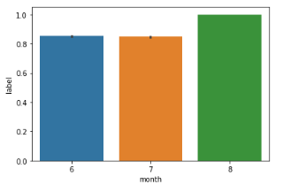
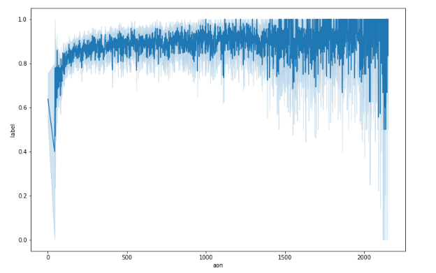
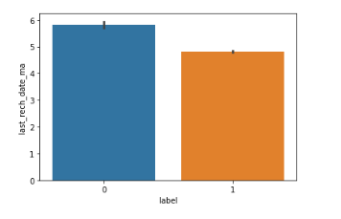
Visualizations
Plots with label and other attributes were plotted to find trends in the data.
Box plots were also generated to test for outliers, and they were detected.

Slide 5
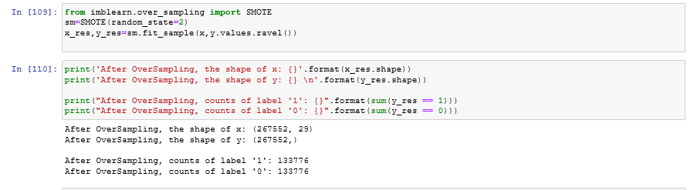
Data Manipulations
Data set is imbalanced with 87.5% non defaulters and the rest defaulters.
This is a risk factor as the model could be biased.
Balancing techniques needs to be implemented to get our model to perform well – Synthetic Minority Over Sampling Technique(SMOTE )

Slide 6
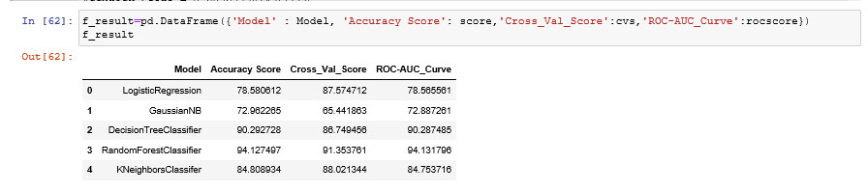
Modelling
A Typical classification problem where the output is 0 or 1,defaulter or non-defaulter.
Several Classification models were tried and the results are as per the table below:

Slide 7
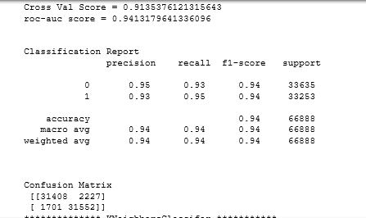
Modelling and Metrics
Out of the results, Random Classifier is estimated to be the best performing model and hence we proceed further evaluating other metrics

Slide 8

Hyperparameter Tuning
Checking if Random Forest model can be further enhanced using GridSearchCV.

Slide 9
Model Selection and Conclusion
Random Forest has all the metric scores > 90% and is considered a very good model.
The model can be deployed for future use and prediction
The model can distinguish between defaulters and non-defaulters with ease and hence can help the client in the decision making to see if the requestor would be a defaulter.
The benefit of the project would ultimately go to a good customer where the company will sanction his request for a loan
The client is also at benefit since the loans will be given to the absolute needy and they can be certain about the repayment by the user.

