Slide 1
TRAFFIC SIGNS CLASSIFICATION

Slide 2
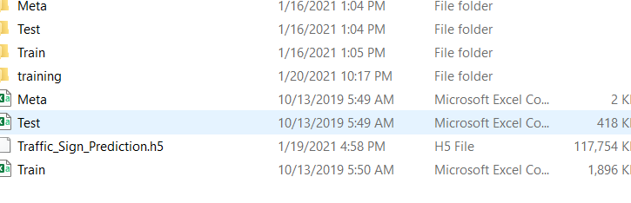
PROBLEM DEFENITION
Develop a CNN model to be trained on 43 classes of road signs
Test the model for accuracy
The intend for the model to perform well on test data, that is to be able to predict the road signs in the test folder

Slide 3
DATA CLEANING AND PREPROCESSING
Images were imported to Jupyter Notebook and the images were converted to numpy arrays
CNN Deep learning technique was used to classify between the objects
The CNN model performed well with an accuracy of 95%

Slide 4
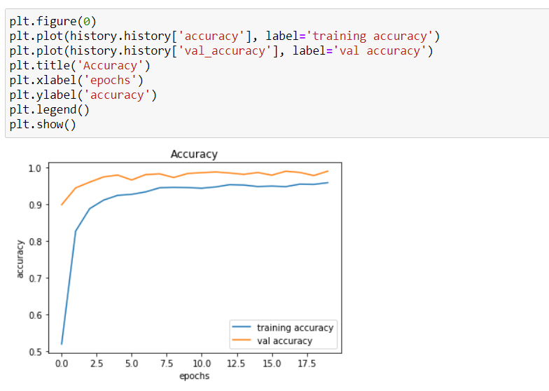
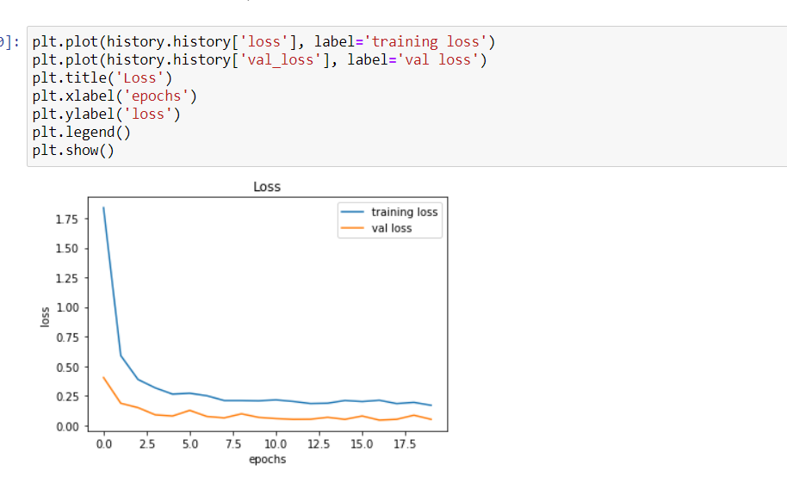
Visualizations
The accuracy was found to improve and the loss was found to be drastically dropping

Slide 5
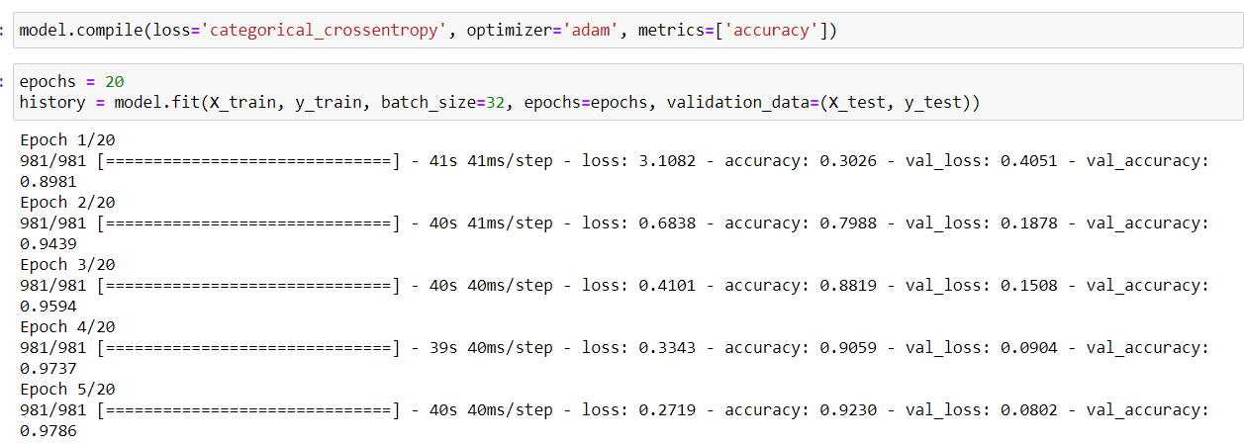
Modelling and Metrics
CNN performed very well with optimizer “Adam” .
Accuracy was chosen as the metric and the loss function was set to binary cross entropy.

