Slide 1

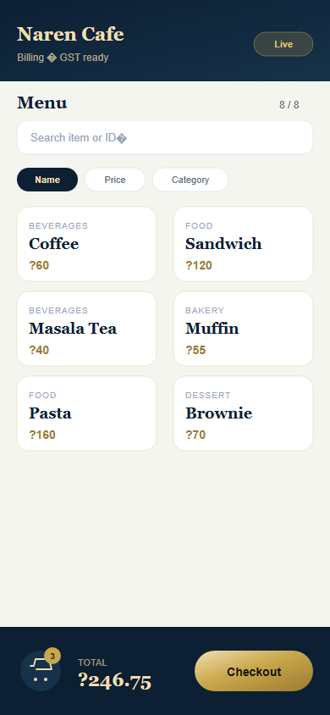
PRODUCT DEMO
NAM bill
Fast POS billing for shops & cafés
Inventory · Billing · GST · WhatsApp PDF invoices
Order history · Sales reports · Android · Web · Windows
Demo shop: Naren Cafe
Walkthrough: Inventory → Billing → Invoice → History → Export
Live billing UI

Slide 2
Agenda
NAM bill
01 Problem
02 Product
03 UI tour
Why paper billing fails at the counter
What NAM bill does in one suite
Inventory, Billing, History screens
04 Live flow
05 Reports
06 Go-live
5–7 minute demo checklist
Exports owners & accountants use
Platforms, license, next steps

Slide 3
Why this product
NAM bill
Common pain points
What shops need instead
• Manual totals slow checkout during rush
• Variants & add-ons get missed on paper
• Customers ask for WhatsApp bills — staff retype
• No clean order history or Order ID
• Owner has no daily/weekly sales view
• Heavy POS hardware is expensive & slow to set up
• Tap-to-bill on phone or counter PC
• GST, FSSAI, GSTIN on professional invoices
• WhatsApp PDF in seconds
• Menu with variants, add-ons, bulk import
• History + Excel/HTML exports
• Works offline after install

Slide 4
Solution overview — NAM bill
NAM bill
One licensed suite for the counter
Simple POS for cafés, stalls, and retail counters.
• Inventory with variants, add-ons, categories, and CSV bulk import
• Fast cart billing with GST toggle, paid status, and Order IDs
• WhatsApp PDF invoices + Order Ready messages
• History, sales stats, backup/restore, themes, and multi-language
Android
Web
Windows
• Installable APK
• Cashier / waiter phone
• No Expo Go in shops
• Browser counter
• Laptop / tablet demos
• Same feature set
• Electron desktop
• NSIS installer
• Fixed shop PC

Slide 5
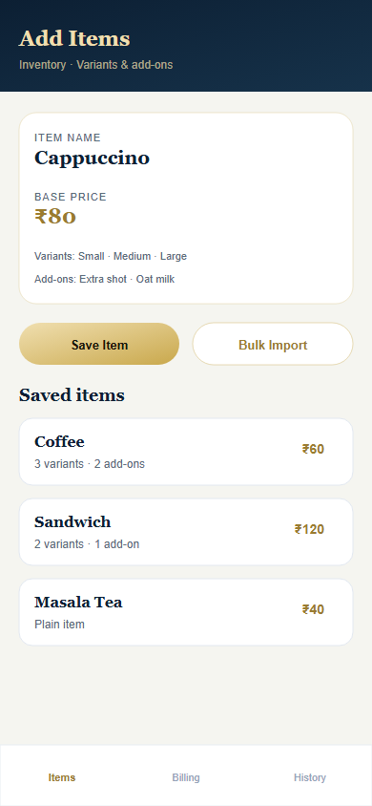
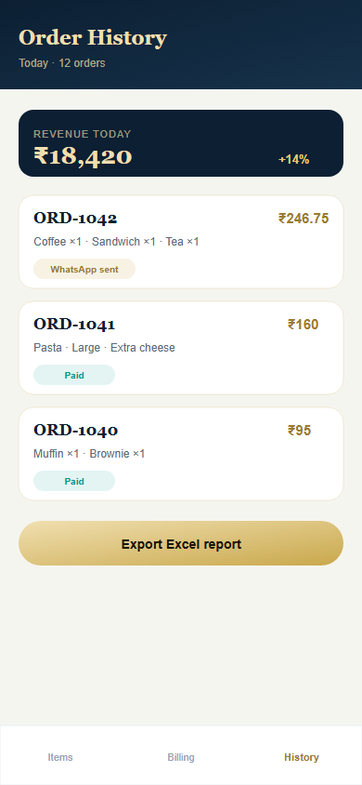
Product UI — three core screens
NAM bill
Show these live during the demo (phone or browser)
1 · Inventory
2 · Billing
3 · Order History

Slide 6
Key features
NAM bill
Billing
Inventory
Invoices
Search & sort menu
Cart qty control
GST 5% toggle
Mark paid + Order ID
Variants & add-ons
Categories
Bulk CSV import
Edit / delete items
WhatsApp PDF
FSSAI & GSTIN
Resend from history
Order Ready message
History
Reports
Shop ops
Order ID lookup
Paid / unpaid
Sales stats
Date filters
Today / 7 / 30 / custom
HTML table export
CSV for Excel
License login
Themes & branding
i18n languages
Backup / restore

Slide 7
Demo data (sample menu)
NAM bill
Use this menu while presenting
• Coffee — Base ₹60 | S ₹50 · M ₹60 · L ₹80 | Extra shot ₹20
• Masala Tea — Base ₹40 | Regular ₹40 · Strong ₹45 | Lemon ₹5
• Sandwich — Base ₹120 | Veg ₹120 · Chicken ₹160 | Cheese ₹15
• Muffin — Base ₹55 / ₹70 | Chocolate add-on ₹10
• Pasta — Base ₹160 | plain or with add-ons
• Brownie — Base ₹70
Tip: bulk-import the full menu from CSV for a faster setup demo.
Inventory screen

Slide 8
Live demo flow (5–7 minutes)
NAM bill
Suggested walkthrough
• 1. Login with license key → show shop name on header
• 2. Settings: shop name, FSSAI, GSTIN, theme colors
• 3. Inventory: add Coffee with S/M/L + Extra shot (or bulk import)
• 4. Billing: add Coffee (Large) + Extra shot, Sandwich (Veg) + Cheese
• 5. Toggle GST 5% · enter WhatsApp number · Mark Paid → Checkout
• 6. Show Order ID (e.g. ORD-000042) → send WhatsApp PDF invoice
• 7. History: open order, resend invoice / Order Ready
• 8. Export Today report as HTML + CSV · open sales stats
• 9. Optional: export backup JSON → explain restore on new phone

Slide 9
Example order
NAM bill
Sample bill
What the customer gets
Order ID: ORD-000042
Shop: Naren Cafe
• Coffee (Large) + Extra shot × 2 — ₹200
• Sandwich (Veg) + Cheese × 1 — ₹135
• Mineral Water × 1 — ₹25
Subtotal: ₹360
GST 5%: ₹18
Grand Total: ₹378
• Professional PDF tax invoice
• Shop name, FSSAI, GSTIN (if set)
• Item lines with variants & add-ons
• Order ID for easy reference
• Optional “Order Ready” WhatsApp later

Slide 10
Reports, stats & backup
NAM bill
Exports
Sales stats
Backup
• Today / 7 / 30 / All / custom dates
• HTML table — share instantly
• CSV — opens in Excel / Sheets
• Line items, variants, totals
• Revenue for selected range
• Orders & items sold
• Top-selling items
• Owner-friendly snapshot
• Export menu + orders + settings
• Import on a new device
• Safe shop migrations

Slide 11
Deployment & license
NAM bill
How shops run it
License model
• Android APK for floor staff phones
• Web browser for laptop / tablet counters
• Windows Electron installer for fixed PCs
• One codebase — same UX everywhere
• Offline-capable billing after install
• Shop name + 10-character license key
• Time-bound validity with renewal code
• Optional API credentials for integrations
• Simple for pilots and partner distribution

Slide 12
Next steps after the demo
NAM bill
Recommended path
• Pilot at 1 shop for 3–7 days with real menu
• Collect feedback from cashier + owner
• Finalize branding (logo, theme, invoice fields)
• Train staff → go live → renewals
What to prepare
Success signals
• Shop name + license key
• Menu CSV (or 8–12 items ready)
• FSSAI / GSTIN if needed on bills
• Android phone or laptop for demo
• First bill under 30 seconds
• WhatsApp invoice sent successfully
• Owner exports today’s sales
• Staff can bill without help

Slide 13
Ready for a live walkthrough?
NAM bill — Simple · Fast · Professional
Open the app → login → bill a sample order → send WhatsApp invoice.
Contact: Bluvent · WhatsApp: 93805 47492· Email: [Your email]

