Slide 1
Sales Analysis Dashboard
Overview and Insights
Presented by: Ventrapragada. Naren

Slide 2
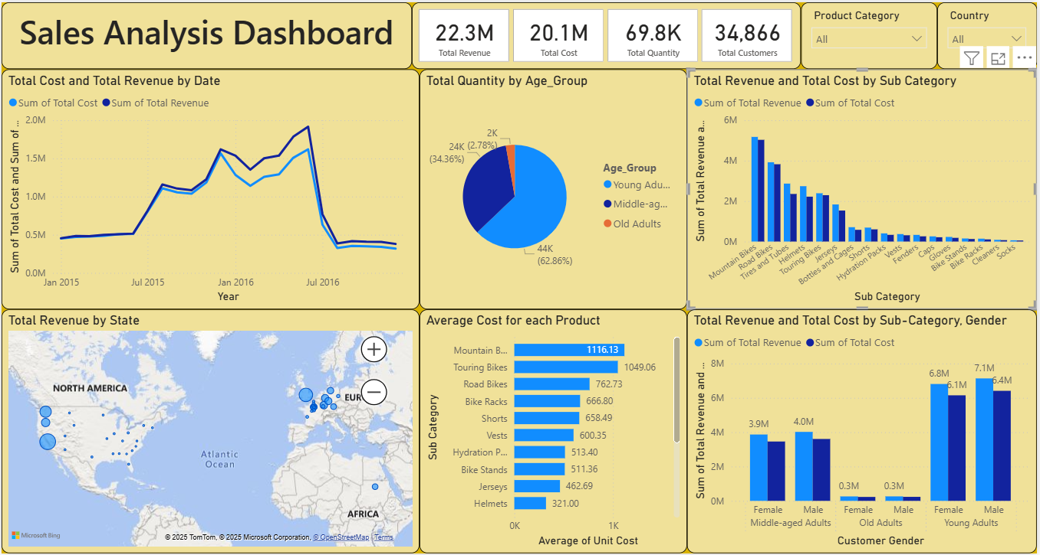

Slide 3
Executive Summary
- Total Revenue: 22.3M
- Total Cost: 20.1M
- Total Quantity Sold: 69.8K
- Total Customers: 34,866
- Main Focus: Understand revenue, cost trends, customer segmentation, and product performance.

Slide 4
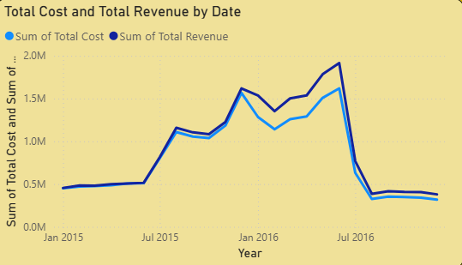
Revenue and Cost Trends by Date
- Revenue and cost steadily increased from Jan 2015 to mid-2016.
- Noticeable drop after July 2016—seasonal dip or market shift?
- Peak around early 2016.

Slide 5
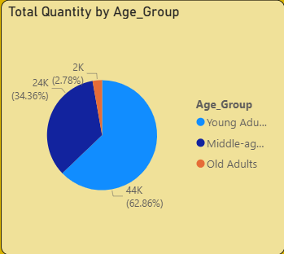
Quantity Distribution by Age Group
- Young Adults (63%) dominate purchases.
- Middle-aged Adults (34%) follow next.
- Minimal purchases from Old Adults.

Slide 6
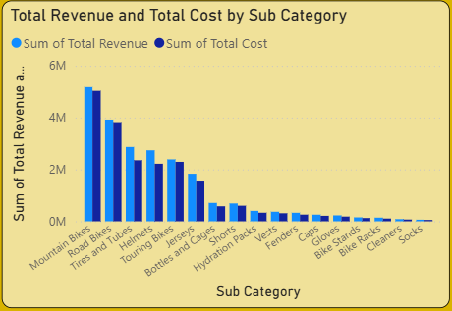
Revenue vs Cost by Product Sub-Category
- Top Performers: Mountain Bikes, Road Bikes, Tires and Tubes.
- These generate the highest revenue.
- Margins vary significantly.

Slide 7
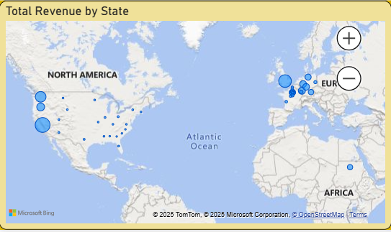
Revenue by State
- High revenue in North America and Europe.
- Market expansion potential in low-revenue regions.

Slide 8
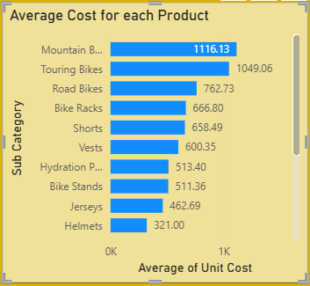
Average Unit Cost by Product
- Mountain and Touring Bikes are most expensive.
- Helmets and Jerseys are most affordable.
- Profitability analysis needed.

Slide 9
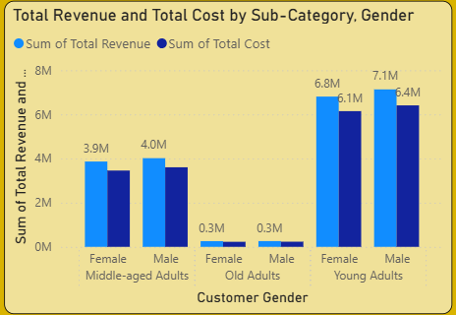
Revenue & Cost by Gender and Age Group
- Young Adults (both genders) drive most revenue.
- Gender split is nearly equal.
- Negligible sales from Older Adults.

Slide 10
Key Takeaways
- Young Adults are the main customer base.
- Mountain and Road Bikes are revenue leaders.
- Revenue is geographically concentrated.
- Opportunity to expand across age groups and regions.

Slide 11
Recommendations
- Target Young Adults in marketing strategies.
- Explore campaigns for Middle-aged and Old Adults.
- Bundle accessories with high-ticket items.
- Analyze post-July 2016 revenue dip.
- Expand in untapped geographic markets.

