Slide 1
Predicting Diabetes
Exposys Project

Slide 2
Team
Arjun p
Harish Raj Y
Naresh S
Sushmeetha C.K

Slide 3
Index
Introduction
Past Papers
Proposed Method
Algorithm Used
Conclusion

Slide 4
Introduction
Diabetes is toxic infections on the planet. Diabetes caused in view of stoutness or high blood glucose level, etc.
AI Is a technique that is utilized to prepare PCs or machines unequivocally. Different Machine Learning Techniques give proficient outcome to gather Knowledge by building different characterization and outfit models from gathered dataset.
We utilize the Pima Indian Diabetes Dataset, we apply different Machine Learning order and group Techniques to foresee diabetes..
We apply famous grouping and troupe techniques on dataset for forecast.
Diabetes happens when body doesn't make sufficient insulin.

Slide 5
Past Papers
THE Mosaic project
The MOSAIC (Models and simulation techniques for discovering diabetes influence factors) project, funded by the European Union in the years 2012 to 2016, has involved the application of modern data mining strategies to gain better insights on the T2DM management of a specific clinical center based on its EHR data. We applied a data mining pipeline on the data of nearly 1,000 T2DM patients, collected by the IRCCS (Istituto di Ricovero e Cura a Carattere Scientifico, which means a research hospital), Istituto Clinico Scientifico Maugeri (ICSM), Hospital of Pavia, Italy for more than 10 years to derive hospital-based T2DM complications risk prediction models.on page 02
06 November 2021
20:25
Notes:
Assets:
https://www.freepik.com/free-vector/third-party-logistics-3pl-transport-cargo-export-import_4997379.htm
https://www.freepik.com/free-vector/isometric-line-font-halftone-alphabet-letters_3685415.htm
https://www.freepik.com/free-vector/marketing-e-commerce-data-analysis-tool-isometric-web-banner_4997371.htm
https://www.freepik.com/free-vector/future-smart-technology-smartphone-with-application-self-driving-auto-screen_4997377.htm
https://www.freepik.com/free-vector/finances-isometric-horizontal-web-banner_3824488.htm
https://www.freepik.com/free-vector/fueling-gasoline-diesel-isometric-web-banner-fuel-nozzle-hose-droplet-gas_3586082.htm
https://www.freepik.com/free-vector/fueling-gas-gasoline-diesel-station-isometric-web-banner_4997387.htm
https://www.freepik.com/free-vector/business-partnership-line-art-isometric-banner-corporate-principles-business-team_3685465.htm

Slide 6
Proposed Method
The information dataset to perform logistic regression is collected from Kaggle Pima Indian’s diabetes dataset, which contains data which amounts nearly 768 entries about women who has/does not have diabetes.
We then use random under sampler to balance the amount of “0” and “1” in our output in effort to stop our model from biasing against one particular type of outcome
The column entries include 'Pregnancies', 'Glucose', 'BloodPressure', 'SkinThickness', 'Insulin','BMI', 'DiabetesPedigreeFunction', 'Age' and Outcome (has diabetes or not)
.
We then split the train data and test data in ratio of 8:2
Firstly, the data is visualized to find the correlation between the entries, then all the missing values (0 in our case) is replaced with mean value for all non-zero terms.
We then train our data using logistic regression

Slide 7
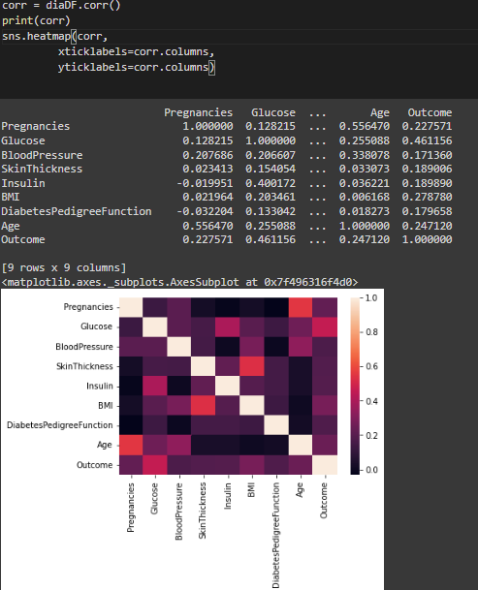
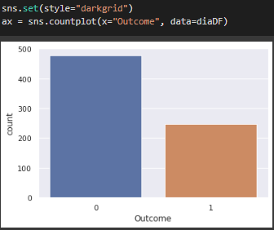
Visualize the correlation between each entries:
Visualize total number of diabetes cases among the entries:

Slide 8
Algorithm Used : Logistic
regression Xgboost
XGboost model:
XGBoost is a decision-tree-based ensemble Machine Learning algorithm that uses a gradient boosting framework. In prediction problems involving unstructured data (images, text, etc.) artificial neural networks tend to outperform all other algorithms or frameworks.
Logistic regression uses an equation as the representation, very much like linear regression. Input values (x) are combined linearly using weights or coefficient values (referred to as the Greek capital letter Beta) to predict an output value (y).

Slide 9
Conclusion
75%
The main aim of our project was to design and implement Diabetes Prediction Using Machine Learning Methods and Performance Analysis of that methods and it has been achieved successfully.
Our proposed approach uses both Logistic regression and XGboost to predict diabetes with 75% accuracy. This model when deployed along with health data from doctors can save a lot of human lives

Slide 10
THANK YOU

