Slide 1
Dynamic Web Pages
(Flash, JavaScript)
Zhi Liu
Nov.15th. 2005
Information Architecture and Design

Slide 2
Overview
Definition—dynamic web pages
Server-Side & Client-Side technologies
Flash (Background, Application, Strength, IA Considerations, Resources)
JavaScript (Background, Application, Strength, IA Considerations, Resources)
Conclusion

Slide 3
Dynamic Web pages
First introduced in 1995 with the creation of JavaScript
Multiple technologies of delivering interactive content used
Two major categories of technologies:
a) Server-side technology
b) Client-side technology

Slide 4
Server-Side
Web pages are produced on-the-fly by server-side programs, frequently based on parameters in the URL or from an HTML form.
1)The browser sends an HTTP request. 2)The server retrieves the requested file with the script. 3)The server executes the script or program which typically outputs an HTML web page. 4)The server sends the HTML output to the client's browser. 5)Example: www.google.com
Scripting Languages (PHP, Perl, Coldfusion, etc.) in combination with database.

Slide 5
Client-Side
Web pages containing content that can change without the actual HTML code being changed. Client-side dynamic content is generated on the client's computer.
JavaScript: client-side scripting language.
Flash: an alternative approach to scripting language, prepackages the scripted actions into a new file format.

Slide 6
Flash
First developed in 1995, currently Flash 8.0 version
Combine graphics, animation, sound and scripting
Use vector graphics
.swf and .fla formats
Software: MX Flash /SWiSH/Mix FX/Others

Slide 7
Flash Applications
Navigation menus
Headers
Website intros
Website advertisements
Flash sites
Flash games

Slide 8
Flash—Strength
Catchy, high level of visual impact
Work well with HTML (<object> and <embed> tags)
Good for interactive games, educational sites

Slide 9
Flash—IA Considerations
Bandwidth and load time constrains: take a long time to download and consume vast amounts of bandwidth.
Usability constrains: break the back button, no control over text size, standard colors for visited and unvisited links not work
Search engine constrains: The Google index does include pages that use Flash. However, this is a new feature, so the crawlers may still experience problems indexing Flash pages.)

Slide 10
Flash—Examples
Educational: http://www.edb.utexas.edu/japanese/index.php
Entertainment:
http://www.mattworld.2ya.com/
Information
http://www.seaworld.com/seaworld/tx/attractions_home.aspx

Slide 11
JavaScript
First rollout in 1995, named Livescript, developed by Netscape
Most important JavaScript event: early marriage with HTML
JavaScript and Java (similar syntax)
Created for non-programmers (loosely typed scripting language)

Slide 12
JavaScript Application
Form input value validation
Image rollover
Calculation
Pop-up windows
……

Slide 13
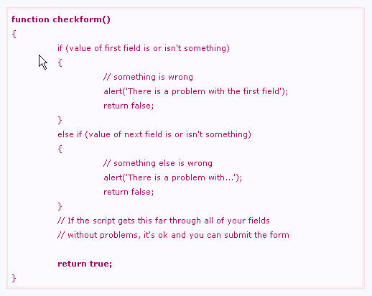
Sample Script—Form Validation

Slide 14
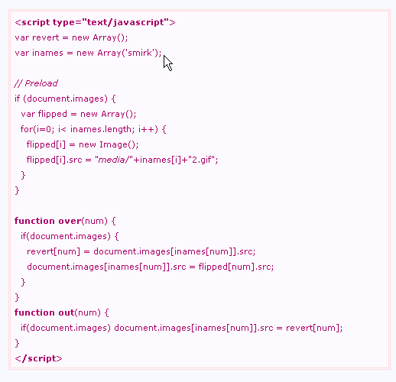
Sample Script—Image Rollover

Slide 15
JavaScript — Strength
Speed: fast, code functions run immediately on the user’s computer
Simplicity: relatively simple to learn and implement
Versatility: plays nicely with other languages, can be inserted into any web page regardless of the file extension.
Server load: reduces the demand on the site server.

Slide 16
JavaScript — IA considerations
Security: the code executes on the user’s computer, it can be exploited for malicious purposes
Cross-platform issues: Some browsers don't support the language or they don't support all aspects of the language.

Slide 17
JavaScript — Resources
http://www.dynamicdrive.com/
http://javascript.internet.com/
http://www.javascript.com/
http://www.w3schools.com/js/default.asp
……

Slide 18
Conclusion
Need for interaction on web pages is diverse.
No single technology is dominant for a specific dynamic feature.
Based on users, content and context, information architects can consider different technologies.
Just because it can be done, doesn't mean you have to do it.

Slide 19
Reference
JavaScript Overview. Enterprise Edition Server-Side JavaScript Guide. Retrieved on Nov.6, 2005, from http://docs.sun.com/source/816-5930-10/intro.htm#13092
JavaScript Tutorial Retrieved on Nov.6, 2005, from http://www.w3schools.com/js/default.asp
Macromedia Flash, Retrieved on Nov.6, 2005, from http://en.wikipedia.org/wiki/Macromedia_Flash
Nielsen, Jakob. (2000). Flash: 99% Bad. Retrieved on Nov.6, 2005, from http://www.useit.com/alertbox/20001029.html

Slide 20
Question?

Slide 21
Thank You!

