Slide 1
Model building and evaluation Phase
Milestone 4

Slide 2
Model evaluation parameters: R2 score, MSE, MAE
 | Model Name | R2 Score | RMSE | MAE
6 | XG Boost | 0.994051 | 895.386308 | 653.243182
5 | G boost | 0.994006 | 898.755828 | 671.454890
4 | Random Forest | 0.993847 | 910.620482 | 666.573389
3 | DTR | 0.988521 | 1243.737717 | 828.833559
1 | Lasso Regression | 0.984573 | 1441.874909 | 1110.824552
0 | Linear Regression | 0.984572 | 1441.889516 | 1111.099246
2 | Ridge Regression | 0.984571 | 1441.933511 | 1111.053399
7 | AdaBoost | 0.976459 | 1781.120538 | 1431.655609

Slide 3
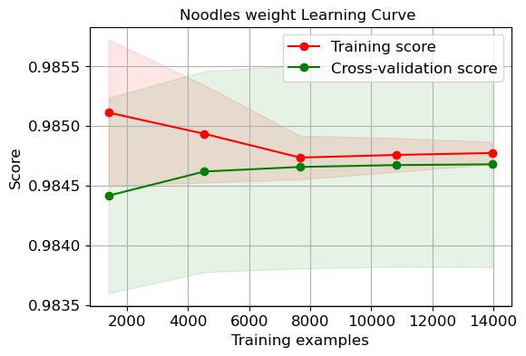
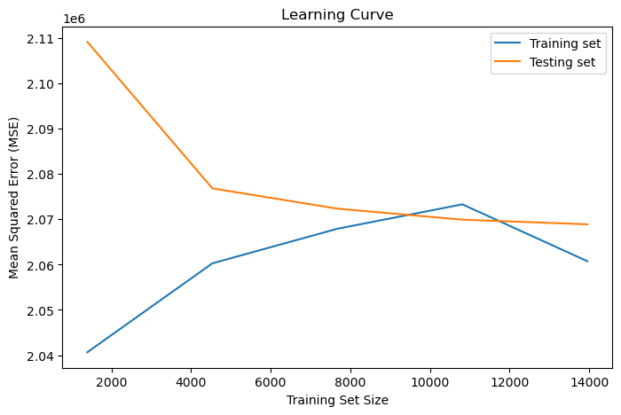
Learning curve for linear regression (R2score)
R2 Score : Training and testing curve converge quickly but the testing error doesn’t decrease much.
MSE : Training and testing curve converge at 11000 samples and error decreases thereafter.

Slide 4
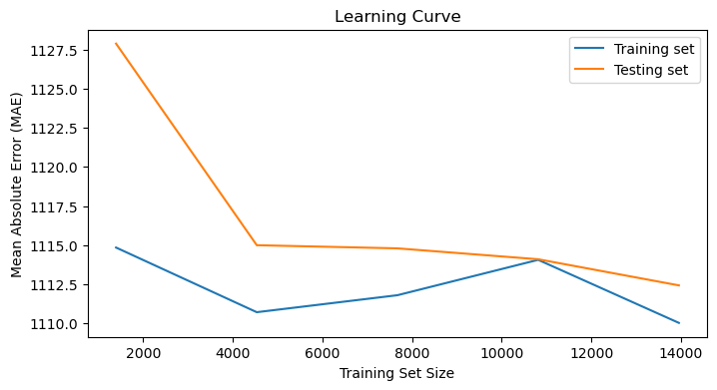
Learning curve with MAE
Training curve error trend is not consistent but testing curve error decreases gradually.

Slide 5
Post hyperparameter tuning with CV
 | Model Name | CV Accuracy | CV STD
6 | XG Boost | 0.994557 | 0.000357
5 | G Boost | 0.994200 | 0.000326
4 | Random Forest | 0.993890 | 0.000292
3 | DTR | 0.991505 | 0.000550
1 | Lasso | 0.984678 | 0.000861
0 | Linear Regression | 0.984677 | 0.000861
2 | Ridge | 0.984675 | 0.000863
7 | AdaBoost | 0.977985 | 0.001328
XG Boost regressor is the best model with 99.4 accuracy

Slide 6
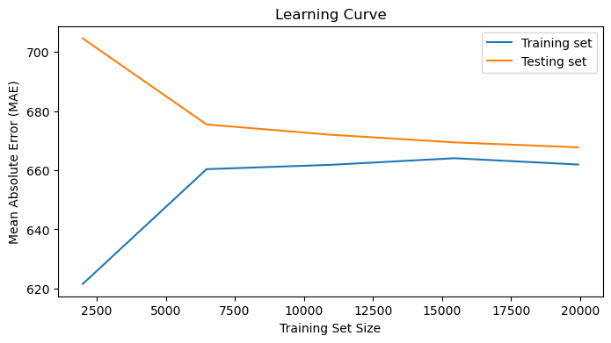
MAE(G Boost)
Gradient Boost is the best performing model with all the error curves performing in a similar trend.
The training error increases and testing error decreases till both converge and gradually the error decreases.

Slide 7
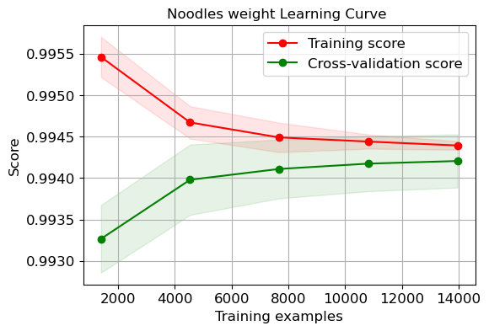
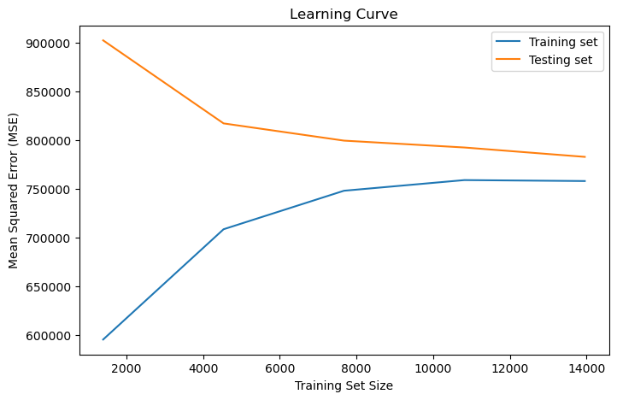
Gradient Boosting Regressor is the best model learning curve
Training error increases but testing error decreases and both converge .

Slide 8
Model Summary
- Linear Regression, Lasso, Ridge perform in the manner of learning curve for all the three losses(R2 Score, MSE, MAE).
- Decision tree and Random Forest Regressor are the models with low bias and high variance hence overfitting.
- Gradient Boost is the best algorithm where R2score, MSE , MAE are performing in similar trend.
- XG Boost is showing high variance which indicates overfitting.
- AdaBoost show high bias and high variance and the worst performing model.

Slide 9
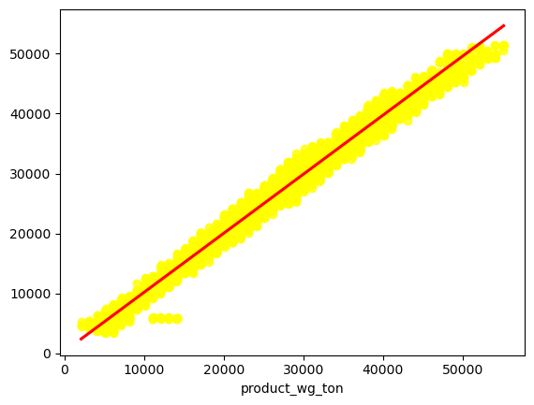
Linear Regression(best fit line)
Best fit line of all predictor variables against target variable.

Slide 10
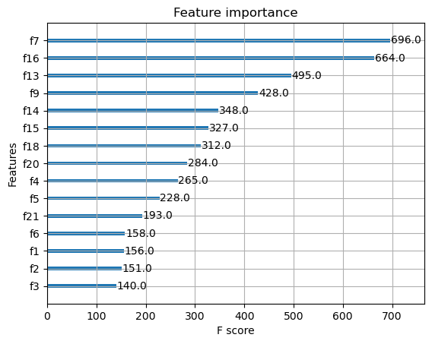
Feature importance(with XG Boost Regressor(top 15)
F7 : Retail shop numbers
F16: Storage issues in l3m
F13 : distance from hub
F9: num of distributors
F14:num of workers
F15: wh year established
F18: approved govt certificate
F20: govt check l3m
F4: num of refills in l3m
F5 : transport issues in l3m

Slide 11
Recommendations(top features)
Higher the number of retail shops, more noodles can be supplied to different parts of region and segments of market. Level of service of noodles to clients and customers is also important.
Storage issues affect the delivery time of noodles to customers causing delay and may also affect the quality and safety of noodles.Hence special attention is needed to in managing high quantity.
Distance of warehouse affects the delivery time to shops sometimes due to weather and traffic.It should be decreased if possible.
Higher the number of distributors more choices to supply the product in time , hence able to meet the demand.
Higher the number of workers better management of storing, receiving, shipping of noodles .
Recently(2020) established warehouse only can store high quantity of product. Hence old warehouses need to be renovated.

Slide 12
Continued.....
7.Approved warehouse certificate has good facilities to store high quantity of noodles.
8.Transport issues are seen only in warehouses having less weight may be due to lack of management.
9.Competitors impact on weight is seen only in medium product weight range. Need to focus on those locations of warehouses.
10.Temperature regulation machines are needed more in locations of product weight less than 20000 tons.
11.More refills are happening with presence of temperature reg mach
Hence it is recommended to use in all warehouses.
12.Warehouse breakdown is more in 20000tons this needs to accessed with respect to weight.

Slide 13
Continue......
Storage issues increase with breakdown, hence it is necessary to keep in check.
Storage issues are also more in old warehouses(before 2008)
This needs to be assessed.

Slide 14
Conclusion
By addressing all the issued above the gap between demand and supply can be reduced . Hence it is possible to reduce the uncertanities, challenges and identify potential opportunites in supply chain of noodles.

