Slide 1


Workflow
an opinionated discussion
Shreyas
Grad Student, MIMS’14
seekshreyas
some slides adopted from and inspired by Scott Schacon’s https://github.com/schacon/git-presentations

Slide 2
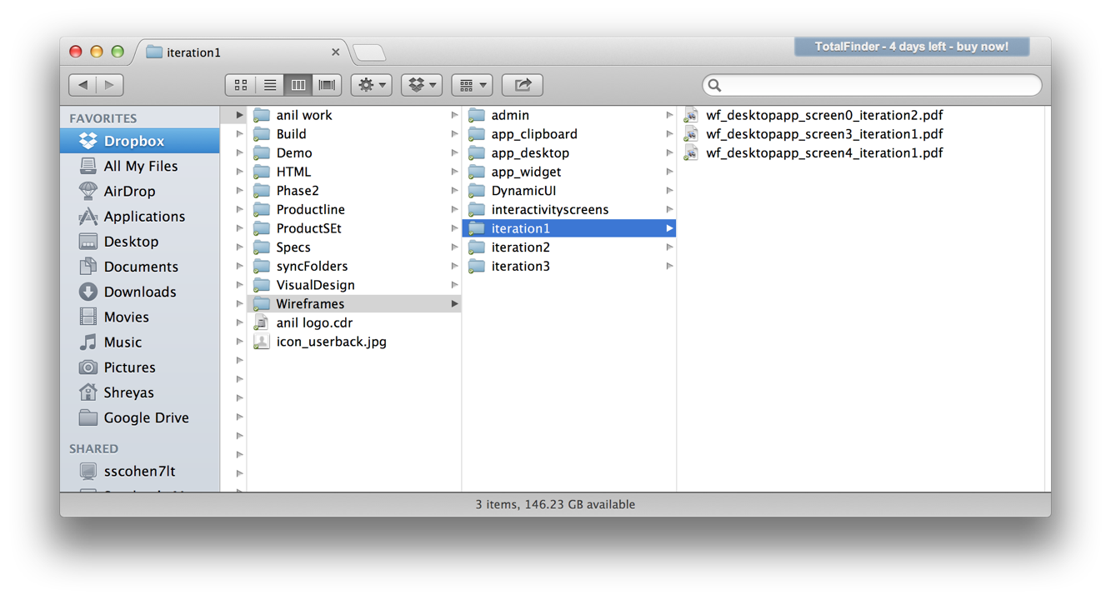
We’ve all been here ...
Notes:
we start off a project having a fair idea of what we are going to do ...

Slide 3
We’ve all been here ...
Notes:
soon we have multiple iterations, multiple versions...

Slide 4

We’ve all been here ...
Notes:
and then we have to collaborate, share...

Slide 5
Problems
multiple versions
many contributors
...
conflicts

Slide 6
Attempted Solutions

Slide 7


git + Github
a better workflow

Slide 8
git
git is an open source, distributed version control system designed for speed and efficiency

Slide 9
git
git is an open source, distributed version control system designed for speed and efficiency

Slide 10
git
git is an open source, distributed version control system designed for speed and efficiency

Slide 11
git
git is an open source, distributed version control system designed for speed and efficiency
(almost) everything is local
Notes:
(almost) everything is local... branching, merging etc

Slide 12
No Network needed for
Performing a diff
Viewing file history
Committing changes
Merging branches
Obtaining any other revision of a file
Switching branches
(almost) everything is local
Notes:
(almost) everything is local... branching, merging etc

Slide 13

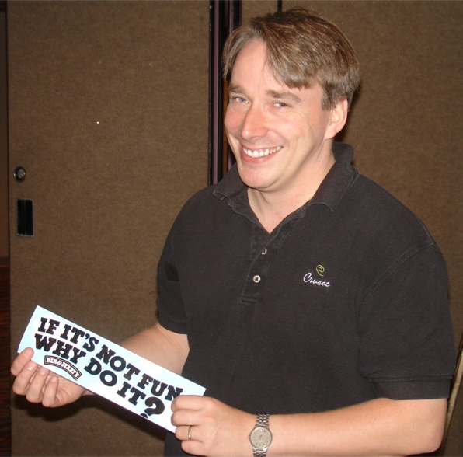
git
git is an open source, distributed version control system designed for speed and efficiency
More Advantages
http://bit.ly/git-advantages
http://bit.ly/git-linus-intro
Notes:
initially created by Linus Torvalds, now supported by a huge open source community ... field tested with Linux Kernel

Slide 14
.. and
No .svn directories
Independence
Notes:
You don’t have to go ask someone to create a branch for you, or create a repo for you or request a branch merge.. you do as you please with YOUR copy.

Slide 15
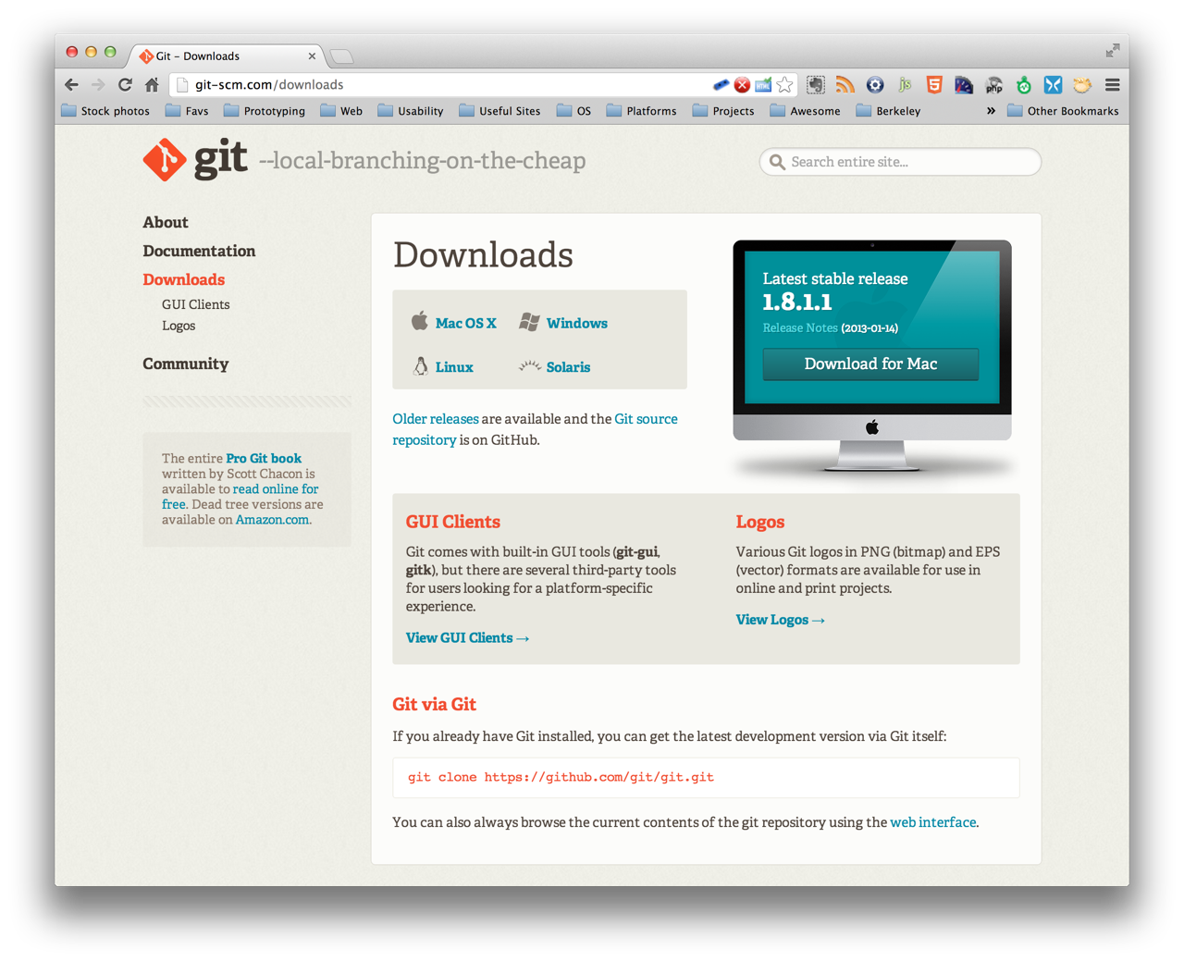
installing git
http://git-scm.com/downloads
Notes:
We’ll be using the git command line interface, but feel free to choose your preferred solution GUIs, Editor Extension etc

Slide 16
getting setup ...
$ git config --global user.name “<YOUR_NAME>”
$ git config --global user.email “<YOUR_EMAIL>”
or edit them in ~/.gitconfig

Slide 17
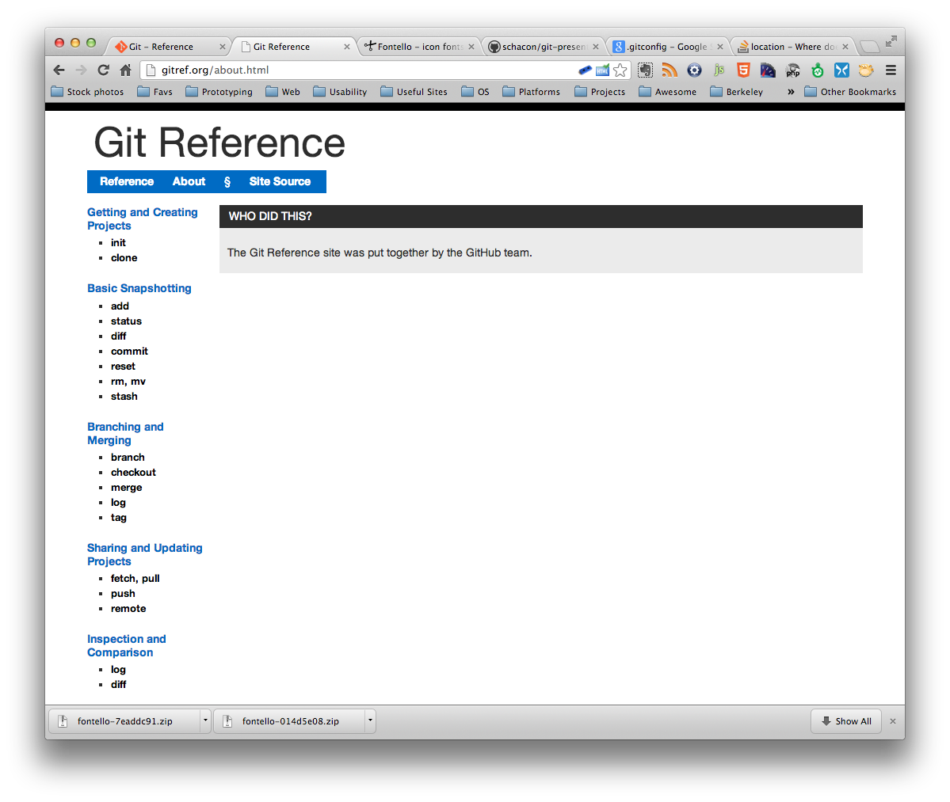
lets dive in..
gitref.org/
Creating New Repo
Committing
Branching/Merging
InspectionCloning a RepoUpdating

Slide 18
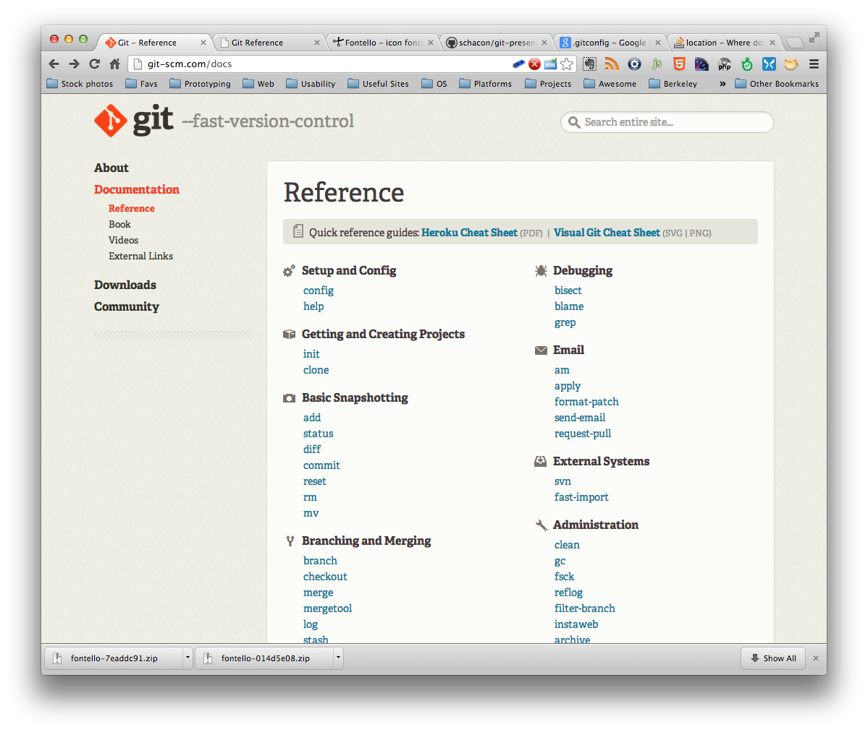
lets dive in..
http://git-scm.com/docs
Creating New Repo
Committing
Branching/Merging
Inspection
Cloning a Repo
Updating

Slide 19
Git Commands
$ git init
Creating New Repo
Committing
Branching/Merging
Inspection
Cloning a Repo
Updating
$ mkdir workspace
$ cd workspace
$ ls -al
$ git init
Initialized empty Git repository in ../workspace/.git/
$ ls -al
drwxr-xr-x 10 Shreyas staff 340 Jan 15 17:22 .git

Slide 20
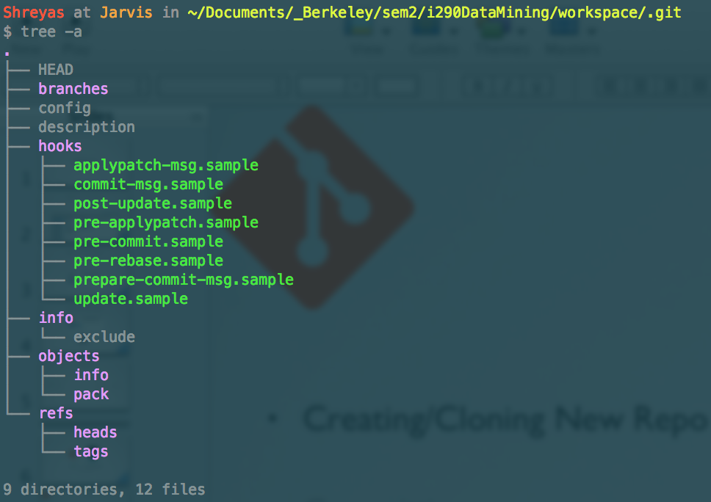
Git Commands
$ cd .git
Creating New Repo
Committing
Branching/Merging
Inspection
Cloning a Repo
Updating
$ tree -a

Slide 21
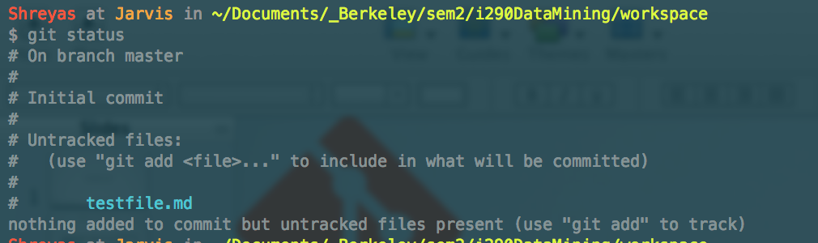
Git Commands
$ cd ..
$ touch testfile.md
Creating New Repo
Committing
Branching/Merging
Inspection
Cloning a Repo
Updating
$ git status
branch name
staging area

Slide 22
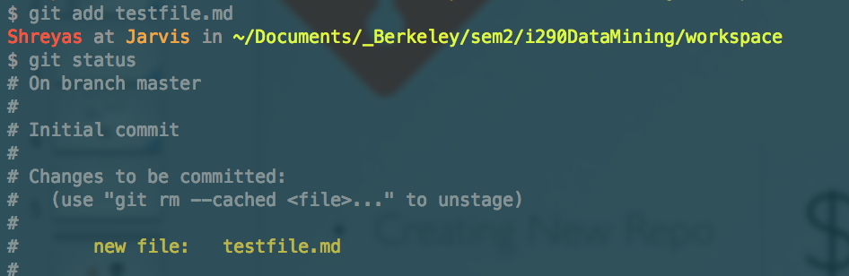
Git Commands
$ git add <filename>
Creating New Repo
Committing
Branching/Merging
Inspection
Cloning a Repo
Updating
$ git status
staging area

Slide 23
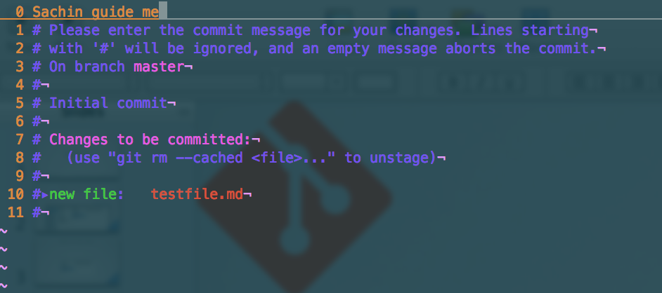
Git Commands
$ git commit
Creating New Repo
Committing
Branching/Merging
Inspection
Cloning a Repo
Updating
$ git status
your commit msg
Notes:
Although, I like working in small steps, here are some shortcuts
git commit -m “<your msg>” [doesn’t open up the editor for msg]
git commit -am “<your msg>” [adds the files tracked and uses msg on command-line]

Slide 24
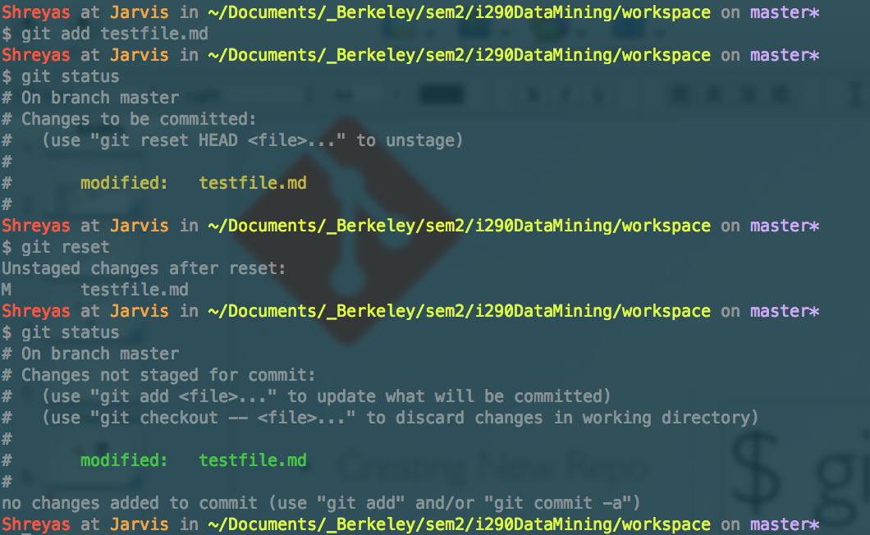
Git Commands
$ git reset
Creating New Repo
Committing
Branching/Merging
Inspection
Cloning a Repo
Updating
(undo add)
changes staged
changes unstaged

Slide 25
Git Commands
$ git reset --soft HEAD^
Creating New Repo
Committing
Branching/Merging
Updating
Inspection
Cloning A Repo
(undo a commit and redo)
$ git reset --hard HEAD~3
Rewind the branch to get rid of last three commits
learn more here :
http://git-scm.com/docs/git-reset
also refer
git revert :
http://git-scm.com/docs/git-revert.html
git stash :
http://git-scm.com/docs/git-stash

Slide 26
Git Commands
$ git rm <filename>
Creating New Repo
Committing
Branching/Merging
Inspection
Cloning a Repo
Updating
remove a file from the repo
as expected, you will need to commit the change
$ git mv <filename>
move/rename a file from the repo
as expected, you will need to commit the change

Slide 27
Git Commands
$ git branch
Creating New Repo
Committing
Branching/Merging
Inspection
Cloning a Repo
Updating
list of branches
$ git branch <branchname>
new branch
$ git checkout <branchname>
switch

Slide 28
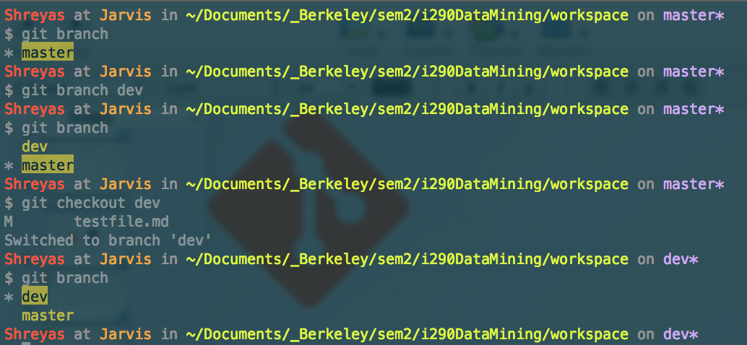
Git Commands
Creating New Repo
Committing
Branching/Merging
Inspection
Cloning a Repo
Updating
branch list
new branch dev
switch branch

Slide 29
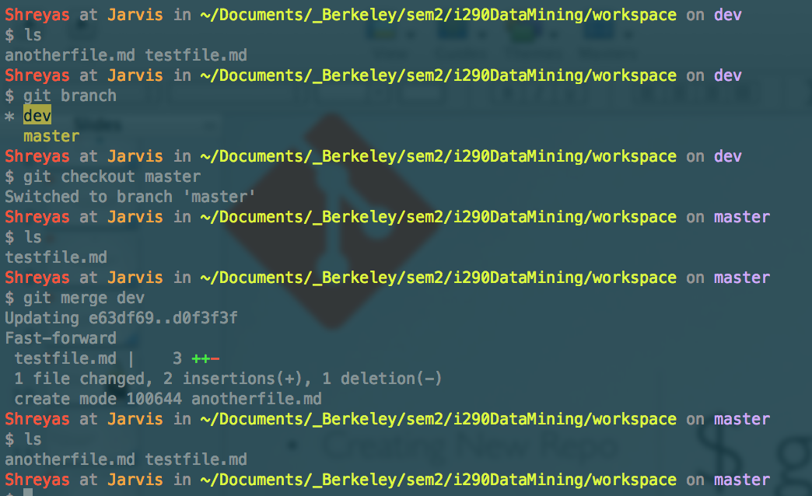
Git Commands
$ git merge <branchname>
Creating New Repo
Committing
Branching/Merging
Inspection
Cloning a Repo
Updating
merge branches
branch merge

Slide 30
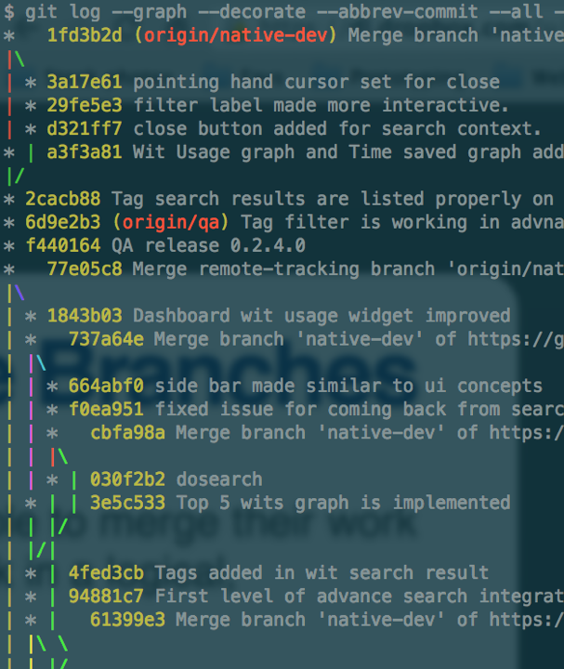
Git Commands
$ git log
  --graph
  --decorate
  --abbrev-commit
  --all
  --pretty=oneline
Creating New Repo
Committing
Branching/Merging
Inspection
Cloning a Repo
Updating
text-based graph :)

Slide 31
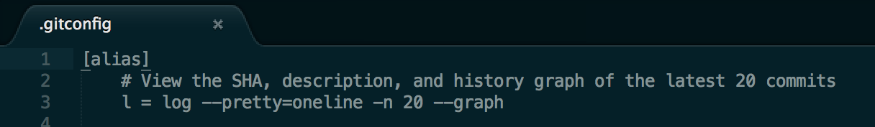
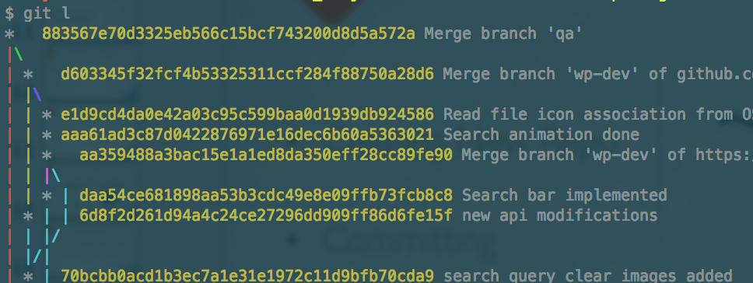
Git Commands
~/.gitconfig
  [alias]
  l = log --pretty=oneline -n 20 --graph
Creating New Repo
Committing
Branching/Merging
Inspection
Cloning a Repo
Updating

Slide 32
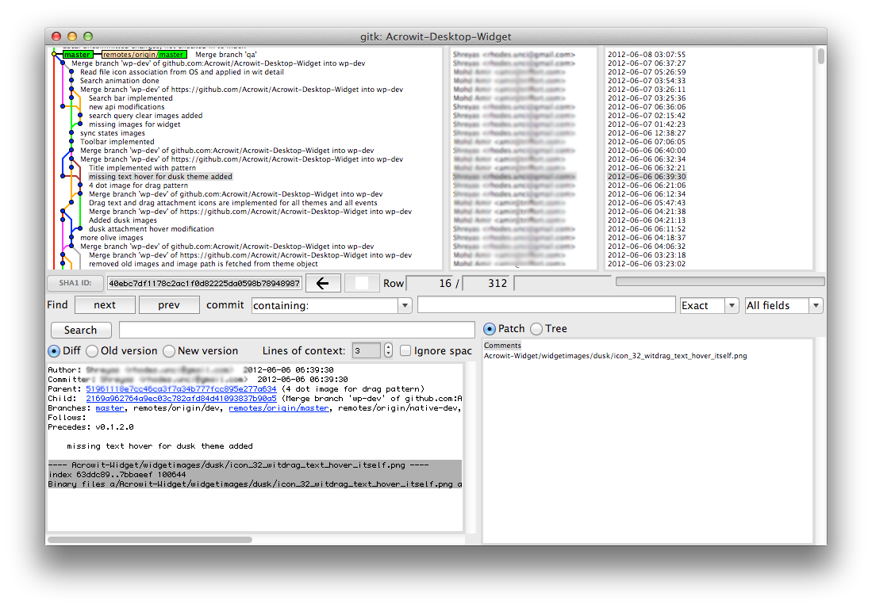
Git Commands
$ gitk
Creating New Repo
Committing
Branching/Merging
Inspection
Cloning a Repo
Updating

Slide 33

Working with others...
github
Creating New Repo
Committing
Branching/Merging
Inspection
Cloning a Repo
Updating

Slide 34

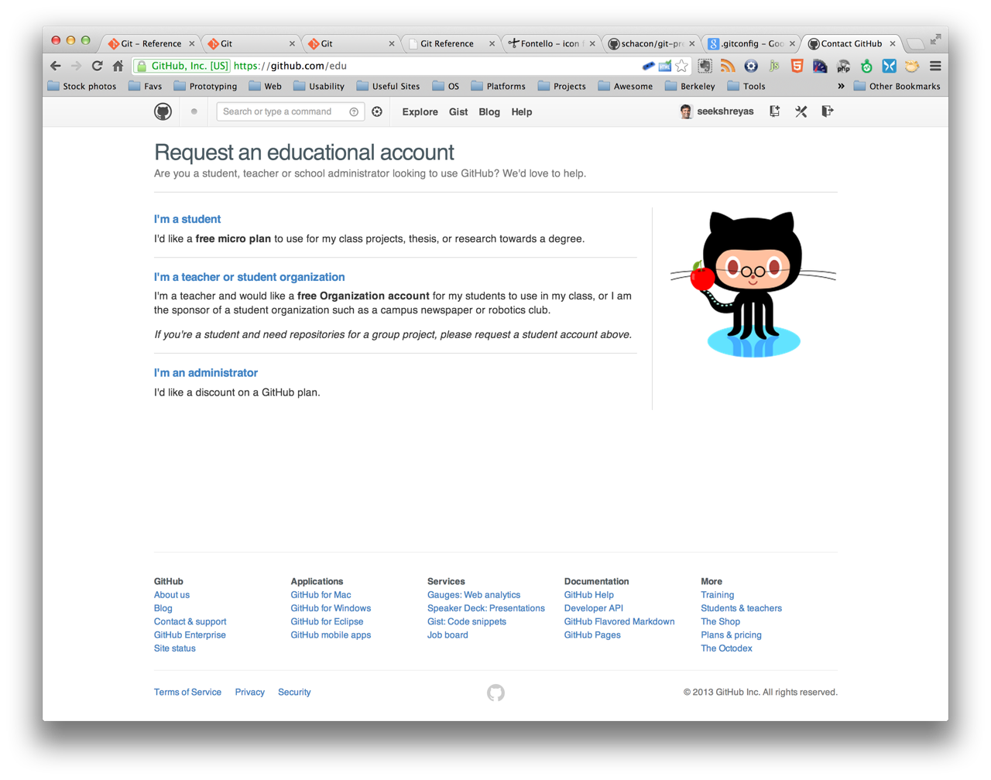
GitHub
create an account
Creating New Repo
Committing
Branching/Merging
Inspection
Cloning a Repo
Updating
www.github.com/edu

Slide 35
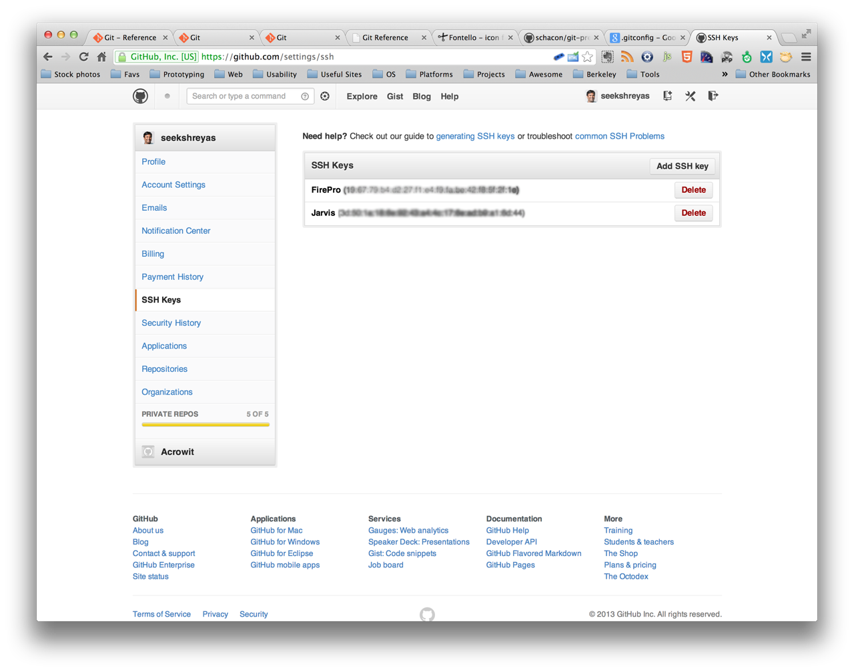
GitHub
add ssh key
Creating New Repo
Committing
Branching/Merging
Inspection
Cloning a Repo
Updating
www.github.com/edu

Slide 36
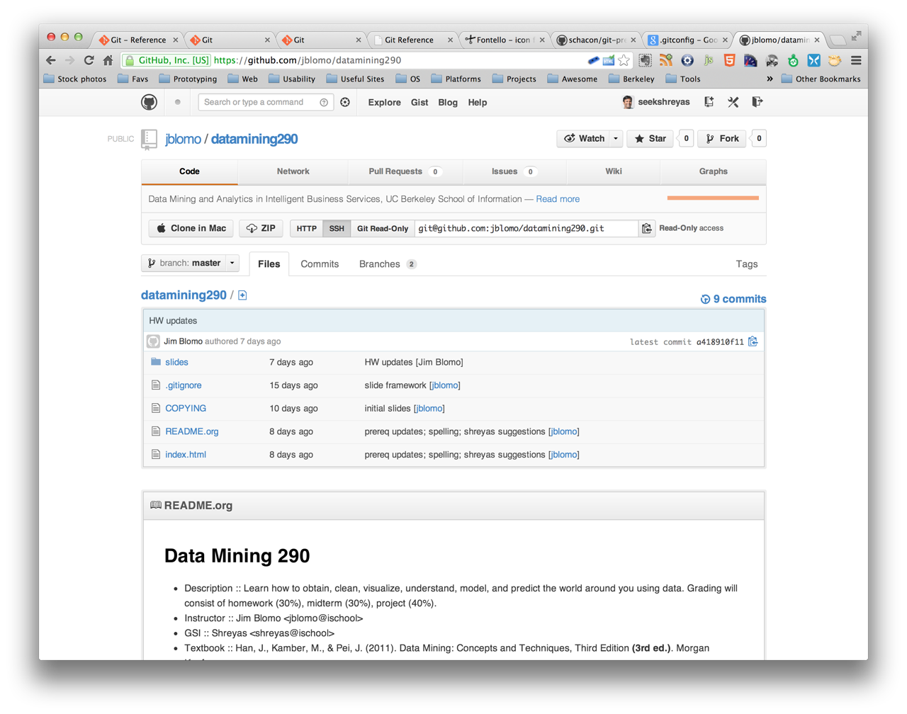
GitHub
$ git clone <url> <name>
Creating New Repo
Committing
Branching/Merging
Inspection
Cloning a Repo
Updating
https://github.com/jblomo/datamining290
Notes:
now do a demo of jim workflow

Slide 37
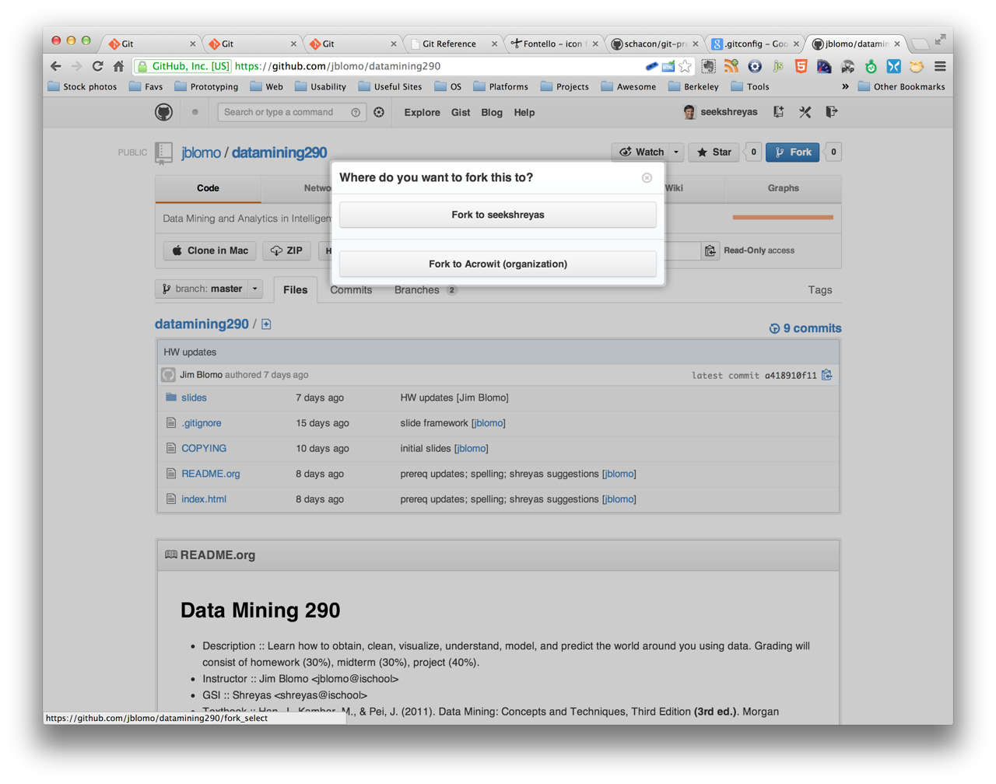
GitHub
Fork a repo
Creating New Repo
Committing
Branching/Merging
Inspection
Cloning a Repo
Updating
Notes:
now show them a demo of creating ssh key on my ischool account

Slide 38
GitHub
$ git pull
Creating New Repo
Committing
Branching/Merging
Inspection
Cloning a Repo
Updating
= git fetch + git merge
$ git push

Slide 39
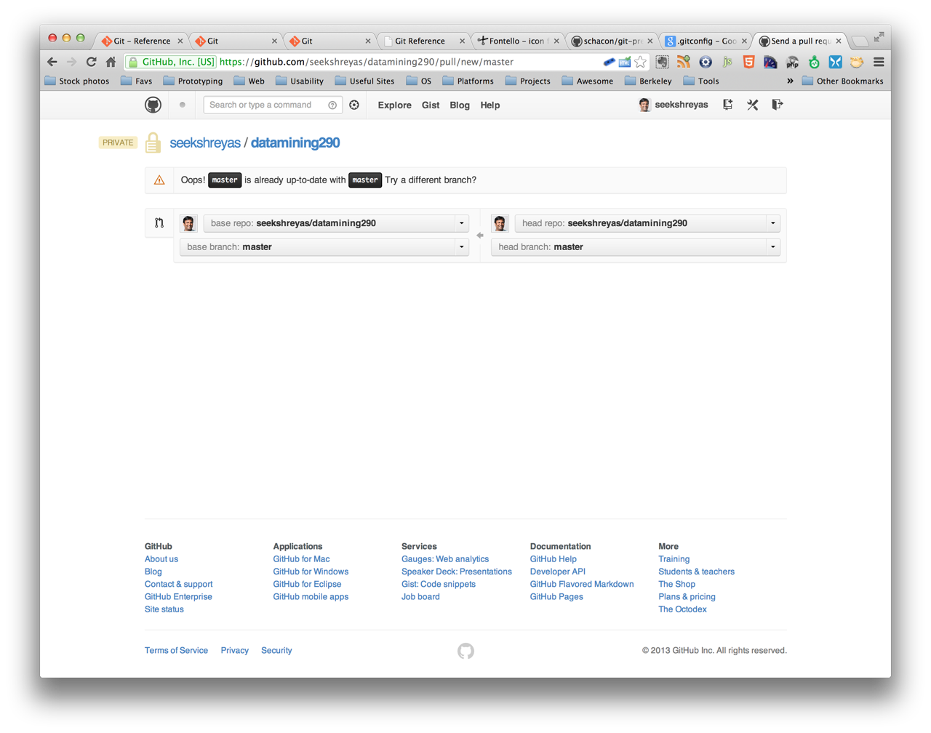
GitHub
GitHub Pull Request
Creating New Repo
Committing
Branching/Merging
Inspection
Cloning a Repo
Updating
Notes:
show the students

Slide 40

GitHub Ninja Features
Markdown
for documentation
Pages
for project hosting
Gist
for project hosting
Service Hooks
‘do something’ on commit
Notes:
show the students

Slide 41


may the Force be with you

