Slide 1
An introduction to MongoDB

Slide 2















In Production
http://www.mongodb.org/about/production-deployments/
Notes:
2009: Initial release
At now: version 2.2.3

Slide 3








NoSQL
Key-value
Graph database
Document-oriented
Column family
Notes:
Huge quantity of data => Distributed systems => expensive joins =>
New fields, new demands (graphs) =>
Different data strucutres:
Simplier or more specific

Slide 4
Document store
RDBMS |  | MongoDB
Database |  | Database
Table, View |  | Collection
Row |  | Document (JSON, BSON)
Column |  | Field
Index |  | Index
Join |  | Embedded Document
Foreign Key |  | Reference
Partition |  | Shard
Notes:
Javascript

Slide 5
Document store
RDBMS |  | MongoDB
Database |  | Database
Table, View |  | Collection
Row |  | Document (JSON, BSON)
Column |  | Field
Index |  | Index
Join |  | Embedded Document
Foreign Key |  | Reference
Partition |  | Shard
> db.user.findOne({age:39})
{
"_id" : ObjectId("5114e0bd42…"),
"first" : "John",
"last" : "Doe",
"age" : 39,
"interests" : [
"Reading",
"Mountain Biking ]
"favorites": {
"color": "Blue",
"sport": "Soccer"}
}
Notes:
Flexible schema
Javascript

Slide 6
CRUD
Create
db.collection.insert( <document> )
db.collection.save( <document> )
db.collection.update( <query>, <update>, { upsert: true } )
Read
db.collection.find( <query>, <projection> )
db.collection.findOne( <query>, <projection> )
Update
db.collection.update( <query>, <update>, <options> )
Delete
db.collection.remove( <query>, <justOne> )
Notes:
Create
The field name _id is reserved for use as a primary key; its value must be unique in the collection, is immutable, and may be of any type other than an array.
The field names cannot start with the $ character.
The field names cannot contain the . character.
Create with save
If the <document> argument does not contain the _id field or contains an _id field with a value not in the collection, the save() method performs an insert of the document.
Otherwise, the save() method performs an update.
sds

Slide 7
CRUD example
> db.user.find ()
{
"_id" : ObjectId("51…"),
"first" : "John",
"last" : "Doe",
"age" : 39
}
> db.user.insert({
first: "John",
last : "Doe",
age: 39
})
> db.user.update(
{"_id" : ObjectId("51…")},
{
$set: {
age: 40,
salary: 7000}
}
)
> db.user.remove({
"first": /^J/
})

Slide 8
Features
Document-Oriented storege
Full Index Support
Replication & High Availability
Auto-Sharding
Querying
Fast In-Place Updates
Map/Reduce
Agile
Scalable

Slide 9
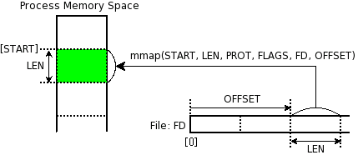
Memory Mapped Files
„A memory-mapped file is a segment of virtual memory which has been assigned a direct byte-for-byte correlation with some portion of a file or file-like resource.”¹
mmap()
1: http://en.wikipedia.org/wiki/Memory-mapped_file
Notes:
http://docs.mongodb.org/manual/faq/storage/

Slide 10

Replica Sets
Host1:10000
Redundancy and Failover
Zero downtime for upgrades and maintenance
Master-slave replication
Strong Consistency
Delayed Consistency
Geospatial features
Host2:10001
Host3:10002
replica₁
Client
Notes:
DC – Data center

Slide 11
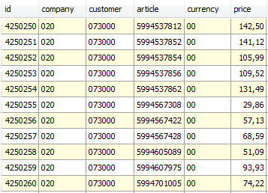
Sharding
Partition your data
Scale write throughput
Increase capacity
Auto-balancing
shard₁
shard₂
Host1:10000
Host2:10010
configdb
Host3:20000
Host4:30000
Client
Notes:
1970 – 2000: Vertical Scalability (scale-up)
Google, ~2000: Horizontal Scalability (scale-out)

Slide 12
Mixed
shard₁
Host1:10000
...
shard_{n}
Host2:10001
Host4:10010
Host3:10002
replica₁
configdb
Host5:20000
Host6:30000
Client
Host7:30000

Slide 13
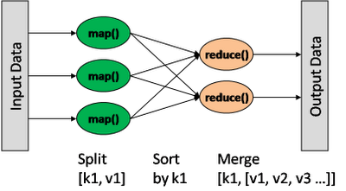
Map/Reduce
db.collection.mapReduce(
<mapfunction>,
<reducefunction>,
{
out: <collection>,
query: <>,
sort: <>,
limit: <number>,
finalize: <function>,
scope: <>,
jsMode: <boolean>,
verbose: <boolean>
}
)
var mapFunction1 = function() { emit(this.cust_id, this.price); };
var reduceFunction1 = function(keyCustId, valuesPrices)
{ return sum(valuesPrices); };
Notes:
http://docs.mongodb.org/manual/reference/method/db.collection.mapReduce/#db.collection.mapReduce

Slide 14
Other features
Easy to install and use
Detailed documentation
Various APIs
JavaScript, Python, Ruby, Perl, Java, Java, Scala, C#, C++, Haskell, Erlang
Community
Open source

Slide 15
Theory of noSQL: CAP
C
Many nodes
Nodes contain replicas of partitions of data
Consistency
all replicas contain the same version of data
Availability
system remains operational on failing nodes
Partition tolarence
multiple entry points
system remains operational on system split
A
P
CAP Theorem: satisfying all three at the same time is impossible

Slide 16

Theory of noSQL: CAP
C
Many nodes
Nodes contain replicas of partitions of data
Consistency
all replicas contain the same version of data
Availability
system remains operational on failing nodes
Partition tolerence
multiple entry points
system remains operational on system split
A
P
CAP Theorem: satisfying all three at the same time is impossible
Notes:
MongoDB
A: What if a primary node is down?

Slide 17
ACID - BASE
Basically
Available (CP)
Soft-state
Eventually consistent (AP)
Atomicity
Consistency
Isolation
Durability
Notes:
ACID
Atomicity. All of the operations in the transaction will complete, or none will.
Consistency. The database will be in a consistent state when the transaction begins and ends.
Isolation. The transaction will behave as if it is the only operation being performed upon the database.
Durability. Upon completion of the transaction, the operation will not be reversed.
BASE
Basically Available: some parts of system remain availabe on failure
Soft-state:
(the information will expire unless it is refreshed )
system will change state without user intervention due to eventual consistency
Eventually consistency:
asynchron propagation
consistancy window

Slide 18
Thank you

