Slide 1


Eclipse

Slide 2
About IDEs
An IDE is an Integrated Development Environment
Different IDEs meet different needs
  BlueJ, DrJava are designed as teaching tools
    Emphasis is on ease of use for beginners
    Little to learn, so students can concentrate on learning Java
  Eclipse, JBuilder, NetBeans are designed as professional-level work tools
    Emphasis is on supporting professional programmers
    More to learn, but well worth it in the long run
We will use Eclipse, but other professional IDEs are similar
The following slides are taken from
www.eclipse.org/eclipse/presentation/eclipse-slides.ppt

Slide 3
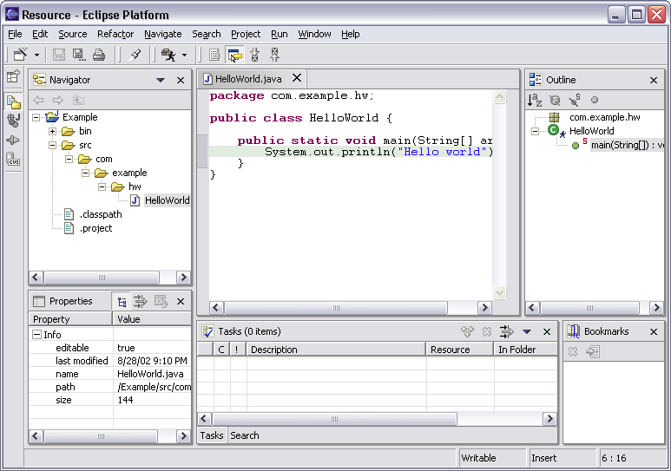
Workbench Terminology
Menu bar
Text
editor
Tool bar
Perspective
and
Fast View
bar
Outline
view
Resource
Navigator
view
Bookmarks
view
Properties
view
Message
area
Editor
Status
area
Stacked
views
Tasks
view
Notes:
[Contains animated elements]

Slide 4
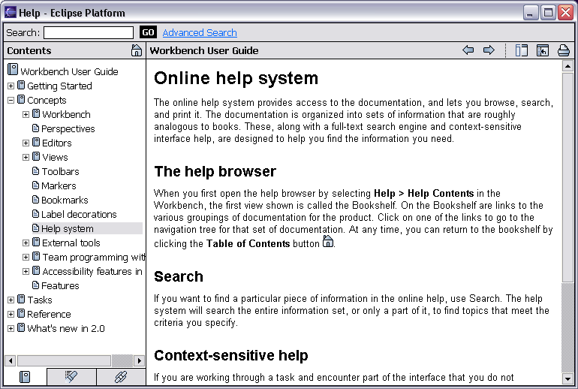
Help Component
Help is presented in a standard web browser

Slide 5
Java Development Tools
JDT = Java development tools
State of the art Java development environment
Built atop Eclipse Platform
  Implemented as Eclipse plug-ins
  Using Eclipse Platform APIs and extension points
Included in Eclipse Project releases
  Available as separately installable feature
  Part of Eclipse SDK drops

Slide 6
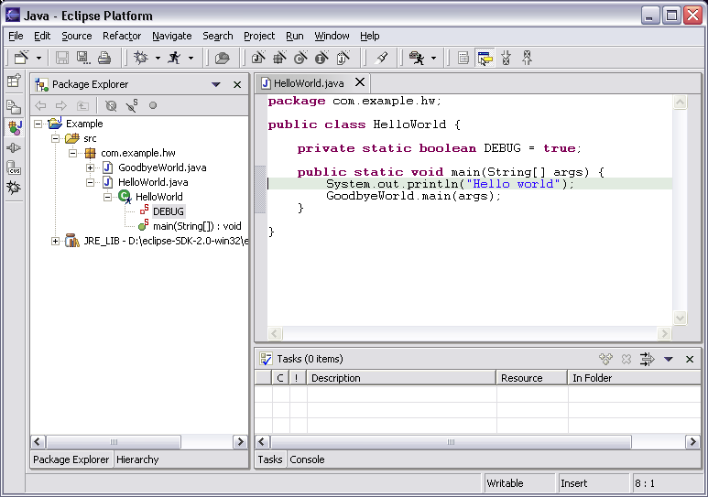
Java Perspective
Java-centric view of files in Java projects
  Java elements meaningful for Java programmers
Java
project
package
class
field
method
Java
editor

Slide 7
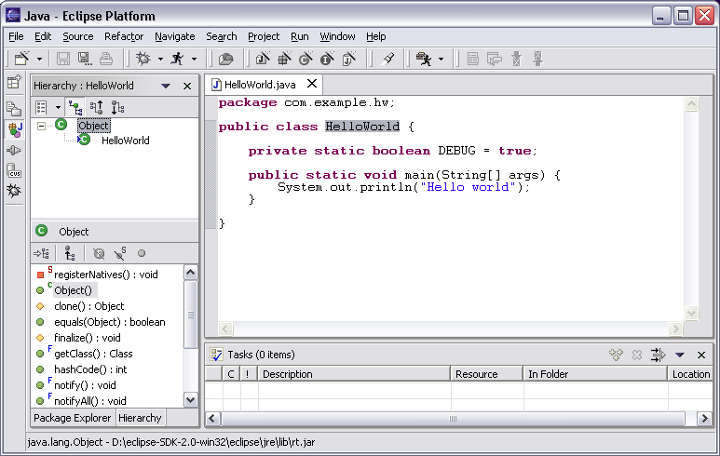
Java Perspective
Browse type hierarchies
  “Up” hierarchy to supertypes
  “Down” hierarchy to subtypes
Type
hierarchy
Selected
type’s
members

Slide 8
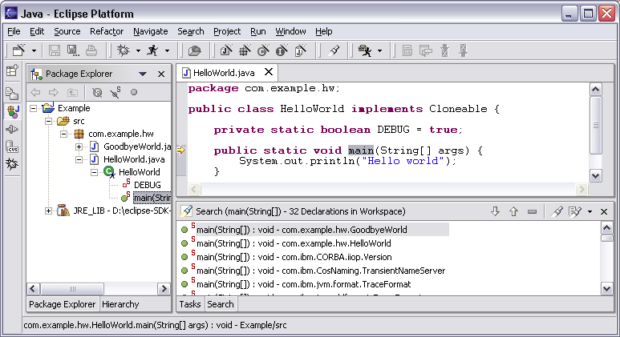
Java Perspective
Search for Java elements
  Declarations or references
  Including libraries and other projects
Hits
flagged
in margin
of editor
All search results

Slide 9
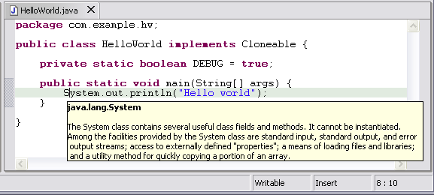
Java Editor
Hovering over identifier shows Javadoc spec
Notes:
[Contains animated elements]

Slide 10
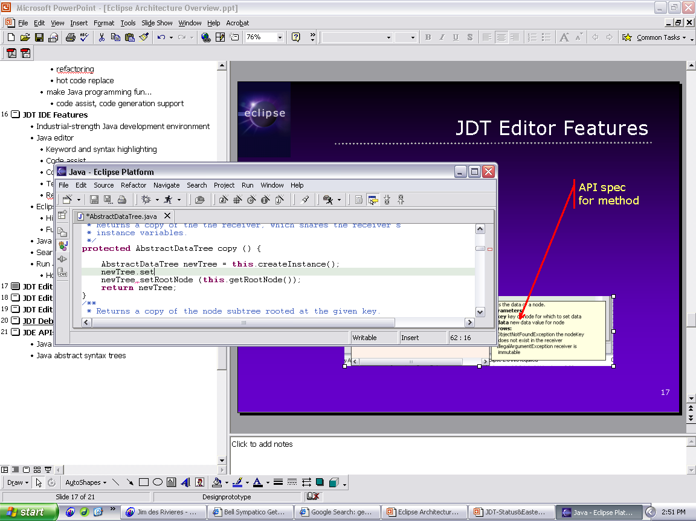
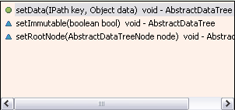
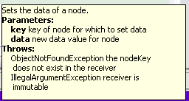
Java Editor
Method completion in Java editor
List of plausible methods
Doc for method
Notes:
[Contains animated elements]

Slide 11
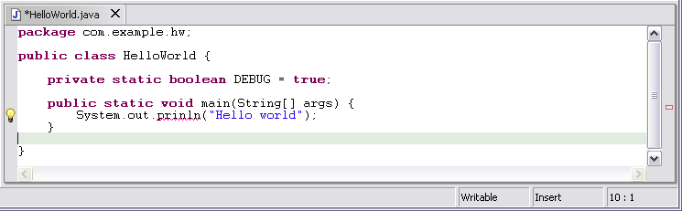
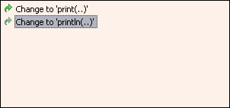
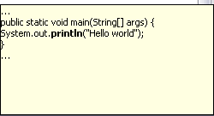
Java Editor
On-the-fly spell check catches errors early
Click
to see
fixes
Problem
Preview
Quick
fixes
Notes:
[Contains animated elements]
Syntax and spell checking are done on-the-fly.
Calls Java compiler to parse source code and resolve names in context.
Developers refer to those wavy red lines as “the red sea” :-).
Problem markers are appear in the left margin of editor.
“Red X” instead of “light bulb” if no proposed corrections.

Slide 12
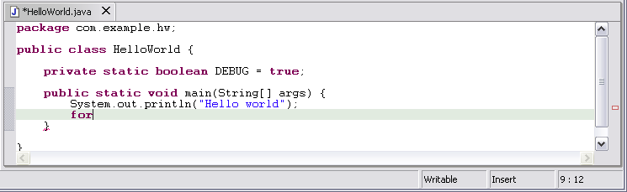
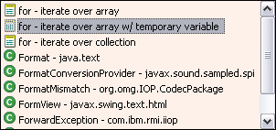
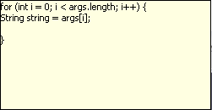
Java Editor
Code templates help with drudgery
Statement
template
Preview
Notes:
[Contains animated elements]

Slide 13

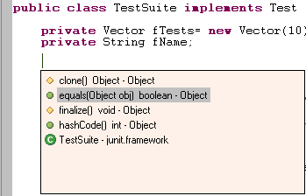
Java Editor
Java editor creates stub methods
Method stub insertion for anonymous inner types
Method stub insertion
for inherited methods
Notes:
[Contains animated elements]

Slide 14
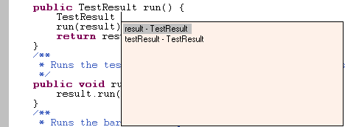
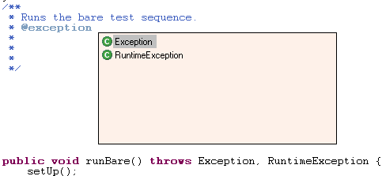

Java Editor
Java editor helps programmers write good Java code
Variable name
suggestion
JavaDoc
code assist
Argument hints and
proposed argument
names
Notes:
[Contains animated elements]

Slide 15
Java Editor
Other features of Java editor include
  Local method history
  Code formatter
  Source code for binary libraries
  Built-in refactoring

Slide 16
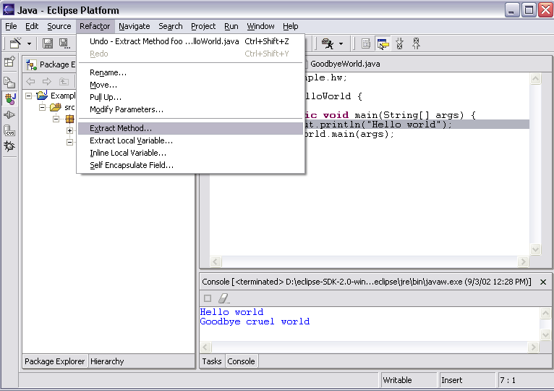
Refactoring
JDT has actions for refactoring Java code

Slide 17
Refactoring
Refactoring actions rewrite source code
  Within a single Java source file
  Across multiple interrelated Java source files
Refactoring actions preserve program semantics
  Does not alter what program does
  Just affects the way it does it
Encourages exploratory programming
Encourages higher code quality
  Makes it easier to rewrite poor code

Slide 18
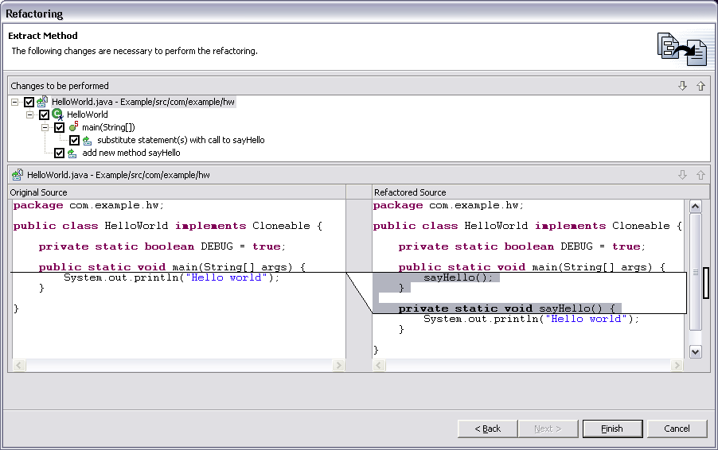
Refactoring
Full preview of all ensuing code changes
  Programmer can veto individual changes
List of changes
“before” vs. “after”
Notes:
Screen shot shows Extract Method applied to the print statement in HelloWorld.main method.

Slide 19
Refactoring
Growing catalog of refactoring actions
  Organize imports
  Rename {field, method, class, package}
  Move {field, method, class}
  Extract method
  Extract local variable
  Inline local variable
  Reorder method parameters

Slide 20
Eclipse Java Compiler
Eclipse Java compiler
  JCK-compliant Java compiler (selectable 1.3 and 1.4)
  Helpful error messages
  Generates runnable code even in presence of errors
  Fully-automatic incremental recompilation
  High performance
  Scales to large projects
Multiple other uses besides the obvious
  Syntax and spell checking
  Analyze structure inside Java source file
  Name resolution
  Content assist
  Refactoring
  Searches
Notes:
Scales to large projects, like Eclipse itself.

Slide 21
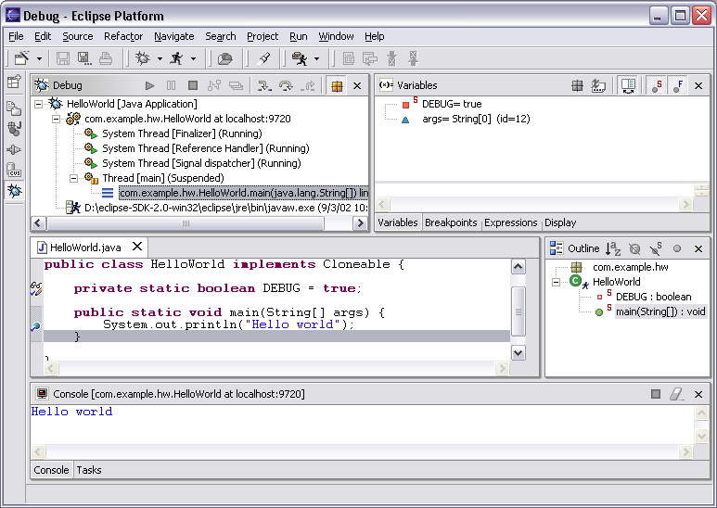
Eclipse Java Debugger
Run or debug Java programs
Local variables
Threads and stack frames
Editor with breakpoint marks
Console I/O

Slide 22
Eclipse Java Debugger
Run Java programs
  In separate target JVM (user selectable)
  Console provides stdout, stdin, stderr
  Scrapbook pages for executing Java code snippets
Debug Java programs
  Full source code debugging
  Any JPDA-compliant JVM
Debugger features include
  Method and exception breakpoints
  Conditional breakpoints
  Watchpoints
  Step over, into, return; run to line
  Inspect and modify fields and local variables
  Evaluate snippets in context of method
  Hot swap (if target JVM supports)

Slide 23
The End

