Slide 1

Spamerly
Naresh
Sandip
Dhwani
Shambo
Prashanthi

Slide 2
Outline
Motivation
Data Preprocessing
SVM
Neural Network
Bayesian
Results

Slide 3
14.5 billion
spam messages per day

Slide 4
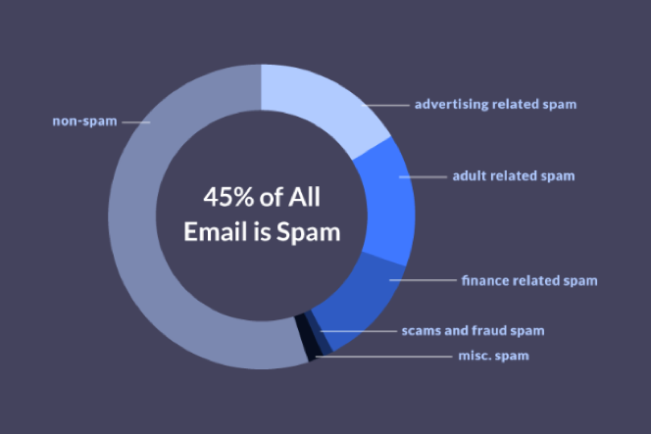
Source: https://www.propellercrm.com/blog/email-spam-statistics

Slide 5
SPAM ≠ SCAM

Slide 6
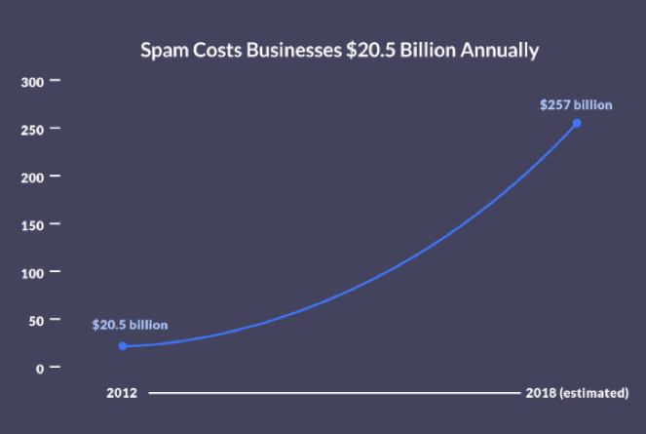
Source: https://www.propellercrm.com/blog/email-spam-statistics

Slide 7

Introducing
Spamerly

Slide 8
Simple
Versatile
Effective

Slide 9
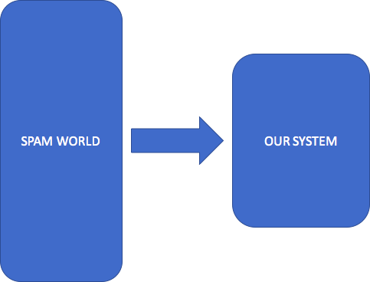

Slide 10
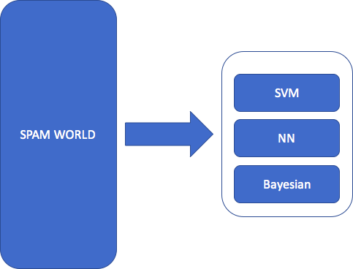

Slide 11
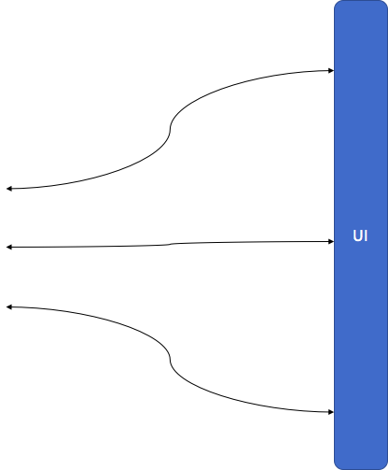

Slide 12
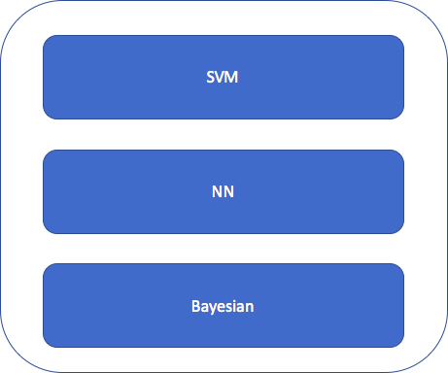

Slide 13


Slide 14


Slide 15


Slide 16
Data Preprocessing - NLP
Extracted the text data into data frame . (Email spam and spam emails extracted from gmail)
Applied word tokenization on the extracted raw data using natural language processing toolkit module.
Removed stop words from text.
Removed some common special characters as (“, “, “.”, “-”).
Used this processed data for feature extraction.

Slide 17
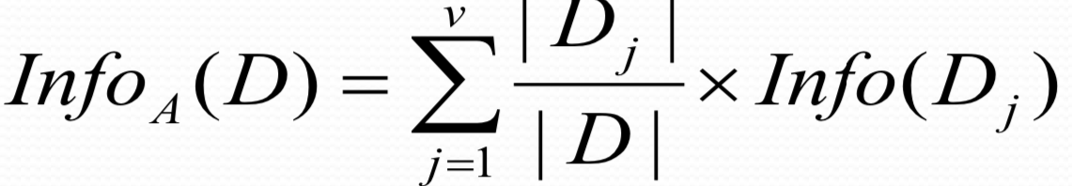
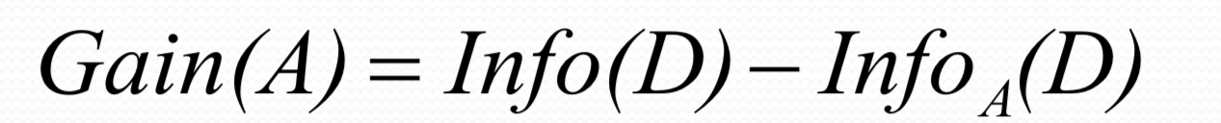
Data Preprocessing - SVM
Feature extraction using information gain.
Applied the concept of information gain from information theory
Information gain have been used as feature ranking technique for numerous text applications.
Information gain = expected information from the required class - information of an attribute to split this class
Info(D)=−∑p log (p)
Words extracted from spam class emails/messages. Each word considered as feature.
Features with highest information gain considered as features for spam classification.

Slide 18
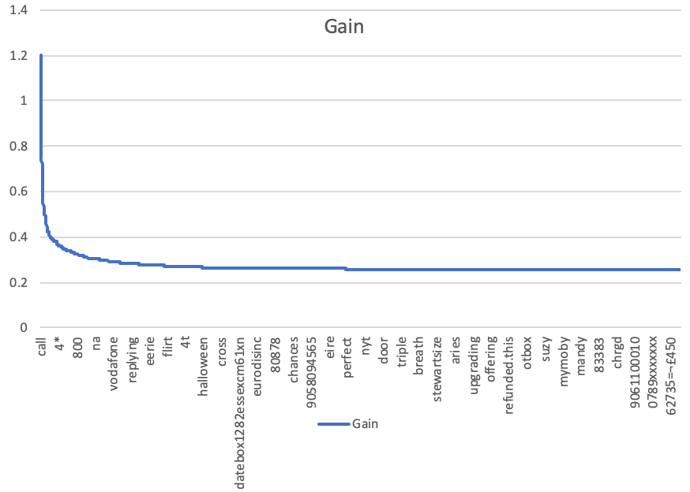
Information Gain
Extracted 1000 features with highest information gain.
Also, tested with different range of features ranked based on the information gain

Slide 19
Support Vector Machine
Widely used in text classification applications .
Designed Support Vector Machine algorithm from scratch.
Applied spam classification on the SVM algorithm with Linear kernel.
Weights and bias information calculated for support vector machine Algorithm.
wTx + b ≥ 0 for di = +1 wTx + b < 0 for di = –1
– w is a weight vector– x is input vector – b is bias
Compared results with existing models in python .
Tested on real time data using user interface.

Slide 20
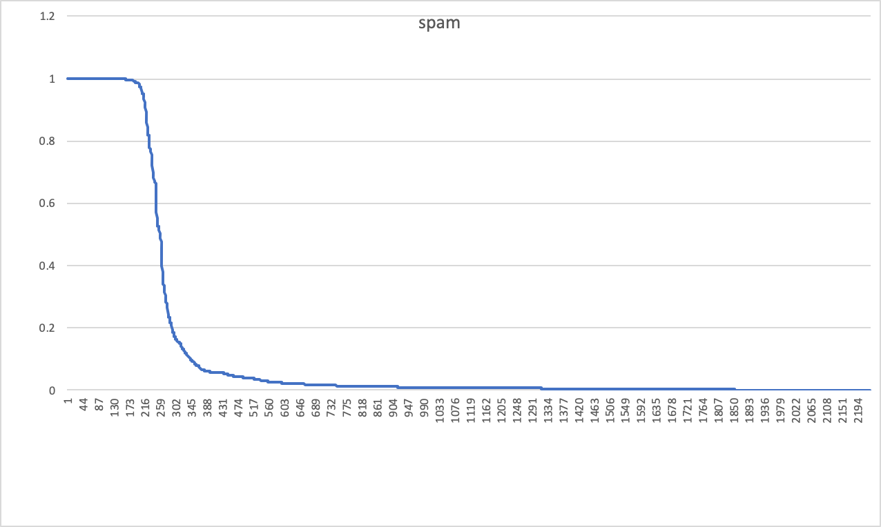
SVM Result:
Results verified based on the metrics accuracy and confusion Matrix.
Accuracy 87% ( Compared metrics with Sklearn SVM Model result).
Accuracy is almost same.
Graph shows the Probability Distribution of SVM classification For Spam
Probability Distribution
Test Input Index(For each entry of Test Data)

Slide 21
Neural Network
Vectorization of text is using TF-IDF.
TF(Term frequency) - Frequency of the words in text corpus.
IDF(Inverse Document frequency) - Computes weights of rare words.
Combining these to get TF-IDF score for each word in the corpus.

Slide 22
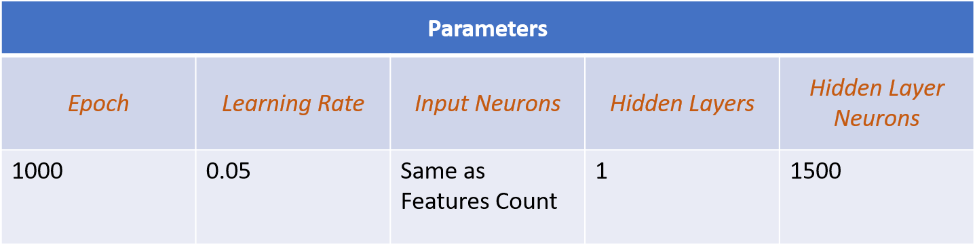
Neural Network
Forward-Backward Propagation :

Slide 23
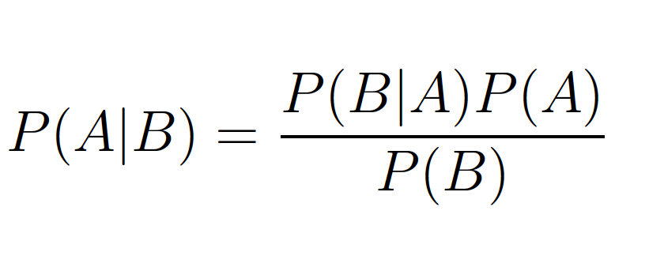
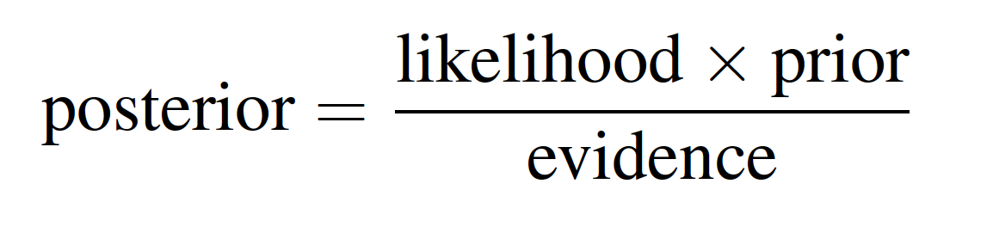
Data Preprocessing - Bayesian
Bayes Rule :

Slide 24
Roadmap to finding probability to predict label of a text
Preparing the Model :
Data Preprocessing
Feature Engineering
Bag of Words(Spam and Not Spam)
Training it on the model
Accuracy : 91% (Good Right?)
Finding Probability of a Test text
Preprocessing of text
Tokenization

Slide 25
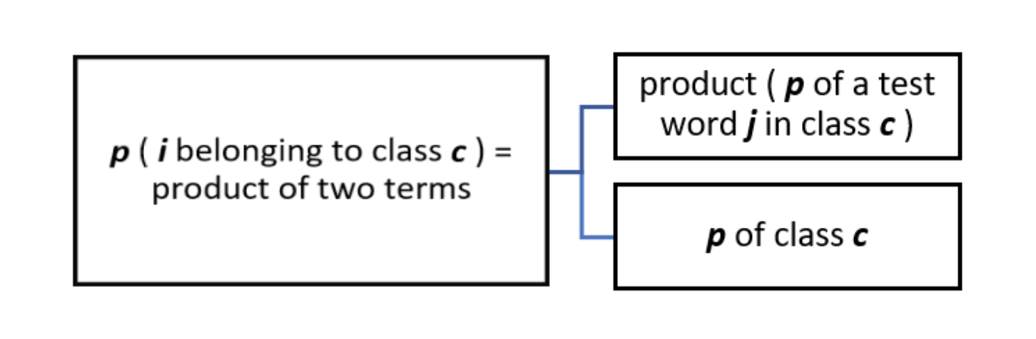
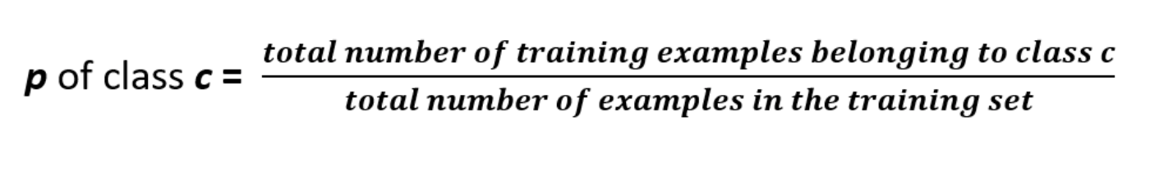
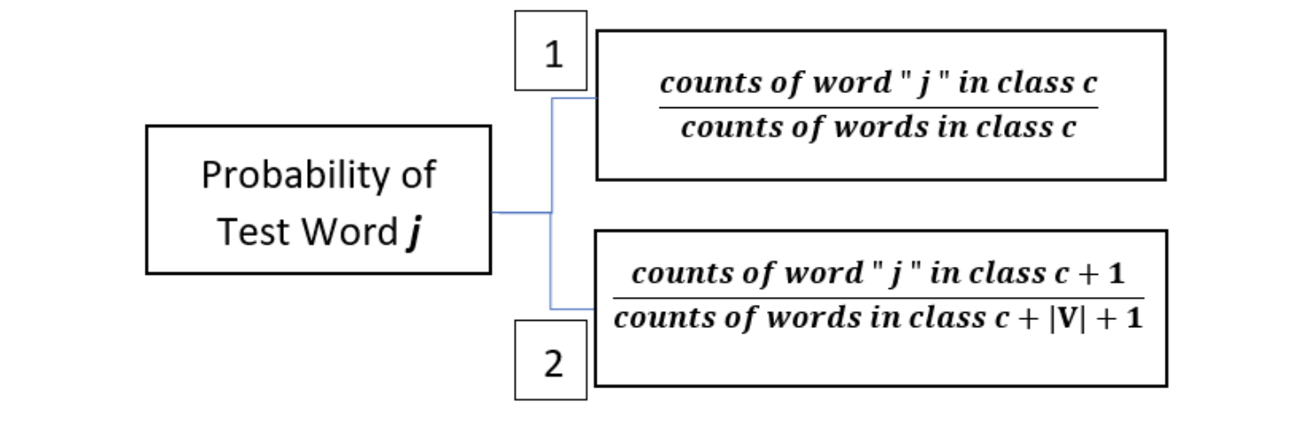
Using Probability to predict label
Label for the text is decided depending on the max probability of the two classes

Slide 26
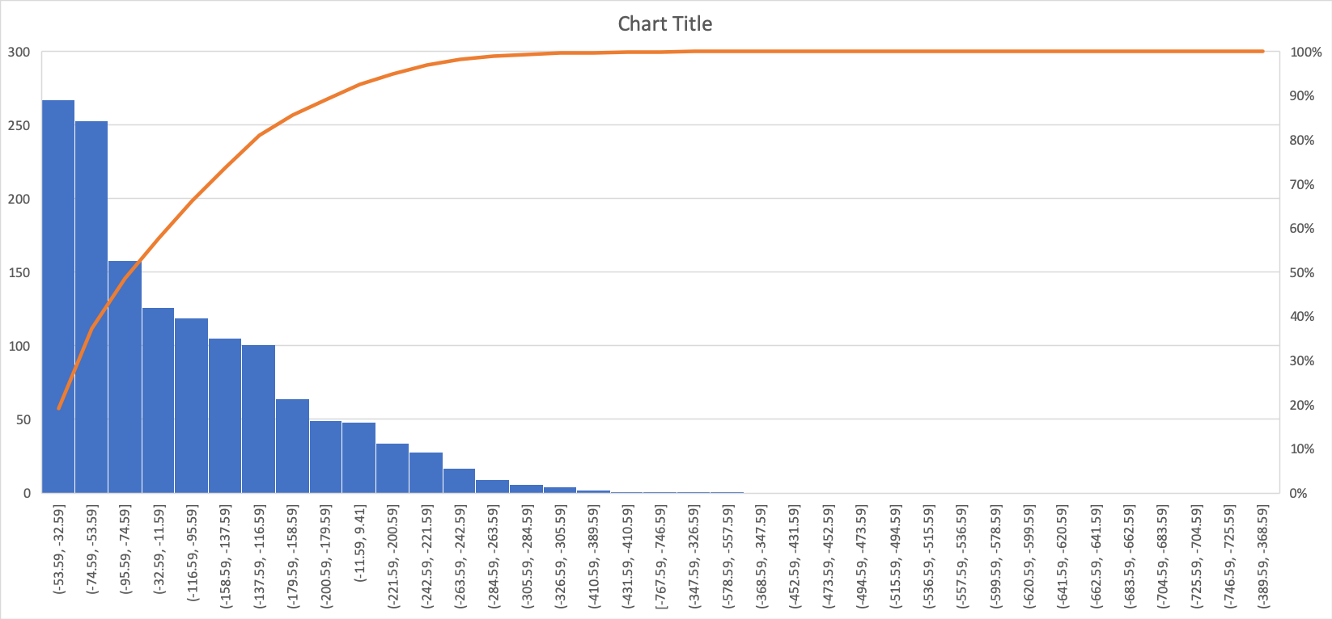
Probability scale of the train data to decide the level of spam - High, Medium, Low and No Spam

Slide 27
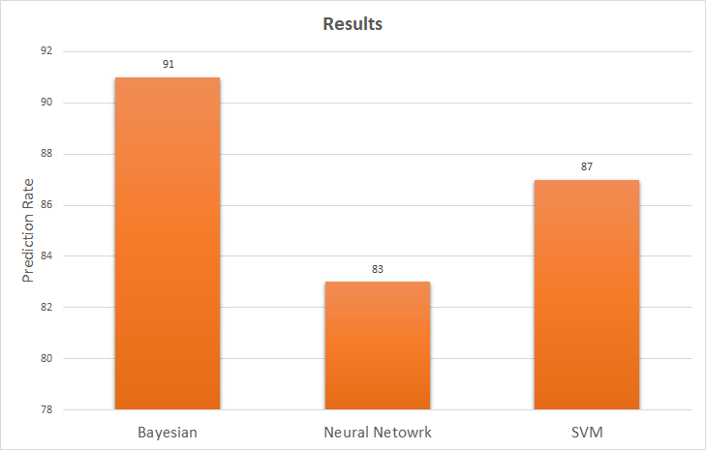
Results

Slide 28

Data Set Considerations 1
Lingspam
Public dataset which contains Spam and Ham Mails.
Thousands of text corpus classified as Spam or not.
Gmail Spam
To increase the Spam count in the dataset and to predict more text.
We created a tool to acquire spam mails from mailbox.
Issues:
HTML & Image: Most modern mails are either image or in HTML format.
Text Corpus and not classified by Line - which we do not need.

Slide 29

Data Set Considerations 2
Our Requirement:
Single Sentences classified as Spam or not.
SMS text classified as Spam or not.

Slide 30
Applications
Filtering:
Remove spam messages or emails.
Detection:
Detect if a text will be filtered as spam or not.
Allow the genuine sender to know, if the message will end up in Junk folder.

Slide 31

Demo

