Slide 1
🗄️
DATABASE MANAGEMENT WORKSPACE
Unified Administration & Auditing for Relational & Document DBs
🚀 OPEN ANIMATED WEB SLIDESHOW (CLICK HERE)
Presented by: Core Engineering Team

Slide 2
WHAT IS THIS APPLICATION?
OVERVIEW
An all-in-one administration and developer environment designed to consolidate multiple database engines into a single secure control plane.
Unified Query Hub
Role & Privilege Orchestrator
Allows developers to write and run queries across MySQL, MongoDB, and PostgreSQL using a single web console.
Provides administrators a UI to manage database roles, grant CREATEDB/CREATEROLE options, and alter passwords.
SaaS Backup Engine
Compliance Auditing Logs
Exports selective schemas or complete server data dumps without requiring native shell CLI tools.
Chronologically logs all logins, query actions, restores, and exports to support enterprise auditing.

Slide 3
WHY SHOULD YOU USE IT?
VALUE PROPOSITION
🚫 Eliminate Tool Context-Switching
🛡️ Mitigate Data Destruction Risks
Stop switching between pgAdmin, Compass, and Command Lines. Run relational SQL and document NoSQL queries side-by-side.
Enforce access rules. Restrict destructive DDL operations (DROP, TRUNCATE) for developer roles, preventing accidental data loss.
📜 Absolute Audit Compliance
🔄 Safe Rollback Restores
Every connection test, query ran, export, and credentials change creates an immutable trail. Indispensable for security certifications.
All database restores execute inside transactional blocks (BEGIN/COMMIT). If a query fails, the system automatically rolls back cleanly.

Slide 4
SYSTEM TECH STACK & CONNECTION POOLS
ARCHITECTURE
React 18 & CSS UI
Express.js & JWT Gate
Interactive SPA (Single Page App) built with stateful panels, CSS animations, and direct download links.
Secure backend handling session tokens, permission verifications, and audit log pipelines.
Driver Pools (pg, mysql2, mongodb)
Audit Storage (Mongoose)
Pre-established, thread-safe connection pools mapped to Postgres, MySQL, and Mongo servers.
Dedicated MongoDB store registering user credentials, configuration secrets, and audit history.

Slide 5
CONNECTION MANAGER & SIDEBAR NAV
KEY FEATURES
Securely register, test, and navigate remote database nodes.
🔗 Multi-Server Registration
⚡ Dynamic Tree Navigation
Connect to remote targets by defining DB Type, Host, Port, Username, and Password.
Automated retrieval of schemas, databases, tables, and collections list on connection load.
💡 Connection Health Test
🔒 Scope Permissions
Instantly validates credentials and network latency prior to saving connection profiles.
Restrict connection scopes so only specific user groups or roles can manage them.

Slide 6
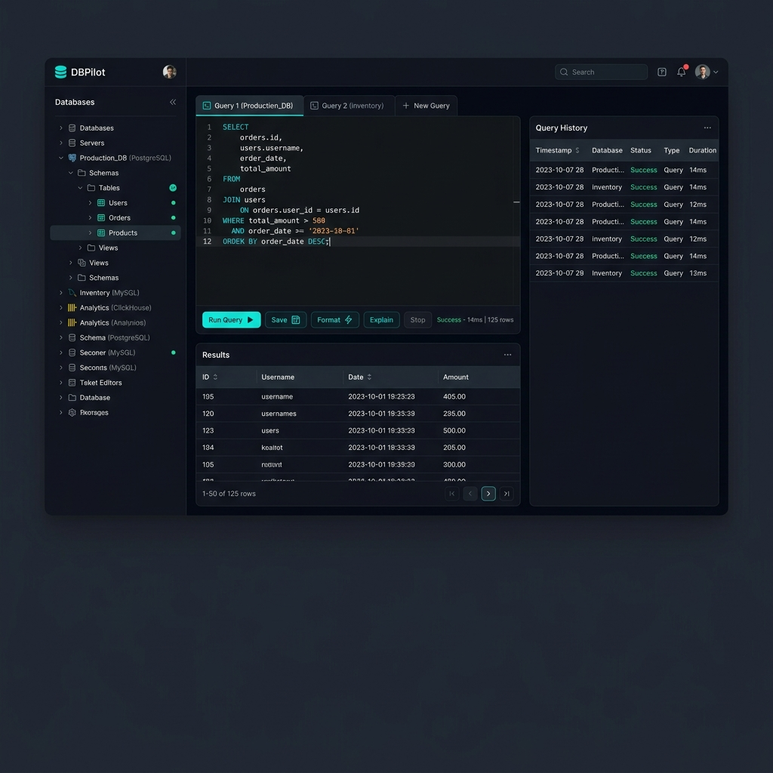
SQL & NOSQL QUERY EDITOR
KEY FEATURES
Console workspace featuring multi-tab execution, full-screen editing, and instant paginated results.
✦ Run SQL/NoSQL queries | ✦ Auto-saves query history | ✦ Fullscreen mode toggles | ✦ Records run speed metrics

Slide 7
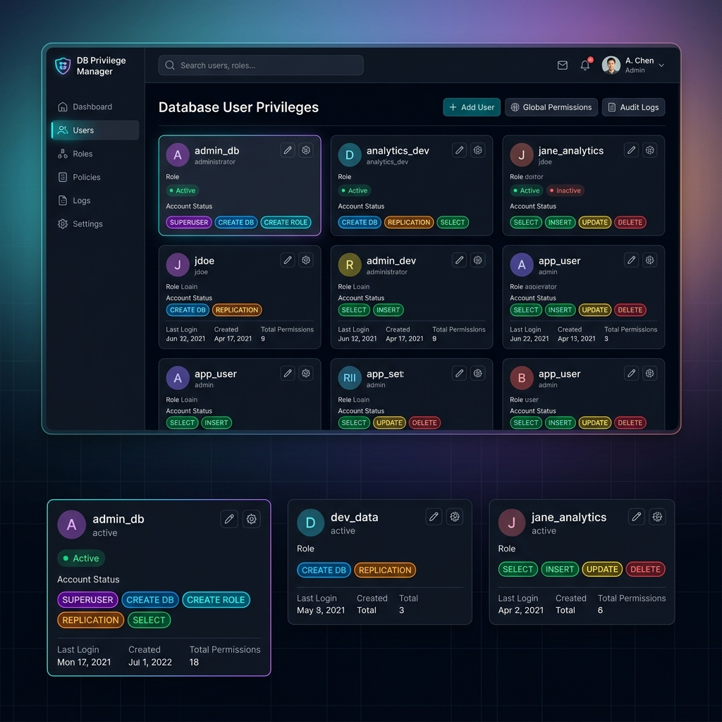
DATABASE USER & ROLE MANAGER
KEY FEATURES
Provision target database credentials, assign built-in access roles, and modify server credentials.
✦ Postgres roles manager | ✦ MySQL accounts provisioning | ✦ MongoDB namespace scope | ✦ Safe credentials reset

Slide 8
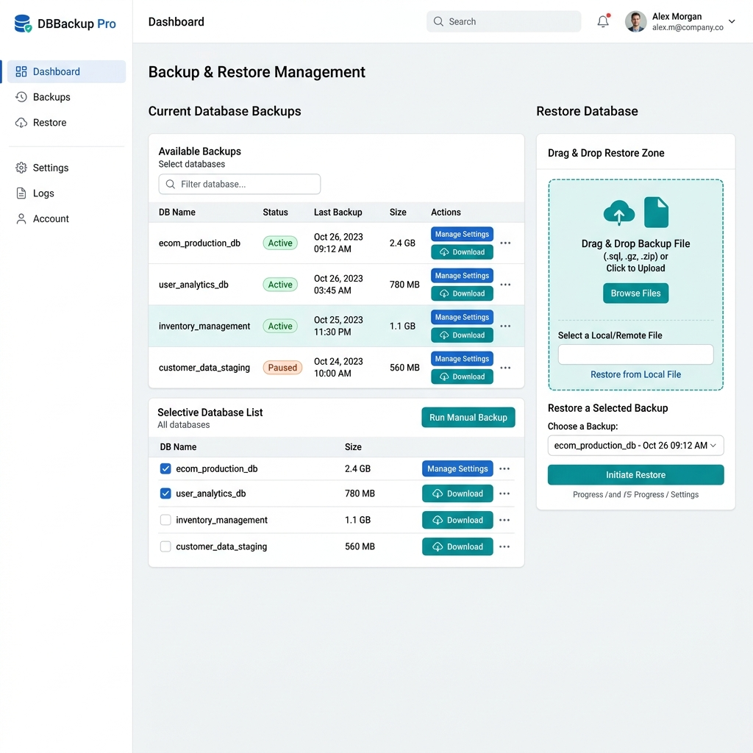
BACKUP & SELECTIVE EXPORTS
DATA SAFETY
Extract and download database structure and table rows into standard SQL files.
✦ Selective database backups | ✦ Pure JS schema extraction | ✦ Table-level configurations | ✦ Document collections JSON dumps

Slide 9
TRANSACTIONAL DATABASE RESTORE
DATA SAFETY
Safe multi-statement SQL script parser that preserves database integrity.
🔄 Transaction Blocks (BEGIN/COMMIT)
🚫 Automated Rollback on Fail
Entire SQL script executes inside a database transaction block. Commits only when all queries succeed.
If any query line in the backup script fails, a ROLLBACK is triggered instantly, leaving target database untouched.
🛠️ Multi-Statement SQL Parser
🍃 MongoDB Collection Reconstructor
Parses complex multi-line INSERT, CREATE, and ALTER commands sequentially via native driver pipelines.
Rebuilds MongoDB collection structures, indexes, and imports documents from structured JSON files.

Slide 10
PERFORMANCE MONITORING & ALERTS
OPERATIONS
Configure disk usage, execution speed thresholds, and receive real-time notifications.
📈 Real-time Health Dashboards
⚙️ Customizable Thresholds
Provides instant insight into active tables count, DB sizing (MB), and daemon statuses.
Define database metrics alerts (e.g. alert when storage utilization crosses 90%).
💬 Slack Webhook Integration
📧 Automated Email Alerts
Integrate Incoming Slack Webhooks to post detailed alerting cards directly to IT operations channels.
Routes warning notification emails automatically to system administrators on warning thresholds.

Slide 11
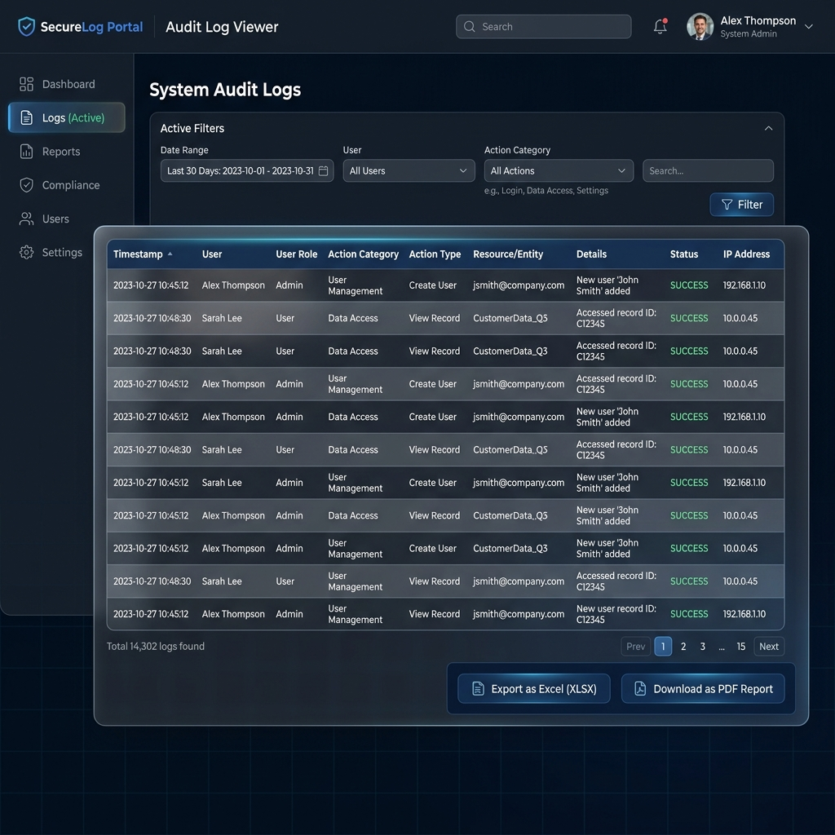
COMPLIANCE & ACTIVITY AUDIT LOGS
GOVERNANCE
Chronological compliance audit trails with support for Excel (CSV), PDF, and printing templates.
✦ Chronological compliance ledger | ✦ User, query & date range filters | ✦ Real-time Slack notifications | ✦ Excel & PDF reports exports

Slide 12
CONCLUSION & THANK YOU
A unified, secure, and audited database workspace.
Questions & Answers

