Slide 1

DATABASE MANAGEMENT SYSTEM
DBMS Enterprise Web Portal
Standard Operating Procedure (SOP) & Proof of Concept (POC)
Application Architecture, End-to-End Workflow & User Guide
Multi-Engine Architecture: MySQL • PostgreSQL • MongoDB • Oracle Database
Version 1.0 | April 2026 | Production Architecture
Confidential — For Internal & Authorized Stakeholders Only

Slide 2
DBMS — Database Management System | SOP & POC
1. Application Overview (Purpose, Features, Tech Stack, Roles)
2. System Architecture & Access Points
3. Admin Portal — Complete Management Flow
3.1 Admin Authentication & Dashboard Overview
3.2 Connection Lifecycle & Multi-Engine Provisioning
3.3 Schema & Database Objects Explorer (Tables, Views, SPs)
3.4 Real-Time Binlog Audit & CDC (Change Data Capture)
3.5 Live Server Telemetry & Health Monitoring
3.6 Automated Slow Query Profiler (>100ms Tuning)
3.7 Logical Database Backups & Restore Engine
3.8 User Role & Fine-Grained Permission Matrix
Table of Contents
Database Management System | Page 2 of 30 | Confidential © 2026

Slide 3
DBMS — Database Management System | SOP & POC
4. Developer Portal — Complete Execution Flow
4.1 Developer Login & Database Selection
4.2 Intelligent Multi-Tab Query Editor (SQL / MQL)
4.3 Smart Autocomplete, Beautifier & Explain Plan
4.4 Table Data Viewer & phpMyAdmin-Style Row Actions
4.5 Live UPDATE, INSERT, DELETE Query Previews
4.6 Query History & Personal Script Library
5. Real-Time Notification & Alert Dispatch Flow
6. Complete Application Workflow (End-to-End)
7. Enterprise Security & Compliance Architecture
8. REST API Reference Summary
9. Multi-Engine Drivers, Rate Limiting & Environment Config

Slide 4
DBMS — Database Management System | SOP & POC
1. Application Overview
The Database Management System (DBMS) is an enterprise-grade, cloud-ready database administration and real-time observability platform. It is engineered to unify multi-engine database management, query development, schema discovery, and change-data-capture auditing into a single high-performance web interface.
Eliminates direct developer credentials to production servers via role-based access proxy and query AST validation.
Centralizes MySQL, PostgreSQL, MongoDB, and Oracle into one consistent workspace, eliminating tool fragmentation.
Security & Proxy Barrier
Unified Polyglot Engine
Database Management System | Page 3 of 30 | Confidential © 2026

Slide 5
DBMS — Database Management System | SOP & POC
Proactive Optimization
Live CDC & Auditability
Continuous slow query detection (>100ms threshold) with automated index and execution plan suggestions.
Real-time WebSocket streaming of Binlog transactions, before-and-after change diffs, and query histories.

Slide 6
DBMS — Database Management System | SOP & POC
1.1 Purpose & 1.2 Key Features
1.1 Strategic Purpose
• Eliminate Multi-Client Complexity: Replaces phpMyAdmin, pgAdmin, Compass, and SQL Developer with a modern browser portal.
• Zero-Trust Credential Isolation: Developers query target databases without knowing raw database passwords or ports.
• Enforce Read-Only Governance: Prevents unintended DROP, TRUNCATE, or UPDATE disasters via automated query validation.
• Real-Time Change Auditing: Captures every data modification with visual before/after row diffs for compliance.
• End-to-End Self-Service: Provides developers with automated query builders, explain plans, and script saving.
Database Management System | Page 4 of 30 | Confidential © 2026

Slide 7
1.2 Core Feature Highlights
• Multi-Tab Query Editor: Hybrid LocalStorage + MongoDB synced tabs with syntax highlighting and auto-complete.
• phpMyAdmin-Style Row Actions: Copy Row, Edit Row, Insert Row, and Direct Delete with live SQL/MQL query previews.
• Live CDC & Binlog Streamer: Websocket-powered audit feed with fine-grained filters for DML, DDL, and Stored Procedures.
• Performance Telemetry: Recharts CPU, memory, connection pools, and database size breakdown graphs.
• Automated Slow Query Capture: Automatic profiling of queries >100ms with actionable optimization recommendations.
• Backup & Restore Engine: Scheduled or on-demand logical database dumps with single-click restoration.

Slide 8
DBMS — Database Management System | SOP & POC
1.3 Technology Stack & 1.4 User Roles
Tier / Layer | Technology Component | Operational Function
Frontend | React 19 + Vite 8 | Ultra-fast Single Page Application, HMR, modular bundle
Styling | Tailwind CSS v3 | Responsive layout, dark/light contrast, custom scrollbars
Charts | Recharts v3 | Interactive real-time CPU, memory, query graphs
Backend | Node.js v24 + Express 5 | Asynchronous non-blocking REST API gateway
WebSockets | Socket.io v4 | Duplex channel for live Binlog CDC and audit streaming
Metadata DB | MongoDB + Mongoose 9 | Stores users, access roles, connections, and audit trails
RDBMS Drivers | mysql2, pg, oracledb | High-throughput native pooled connection drivers
NoSQL Driver | mongodb native v7 | Native MQL query executor, collection pipelines

Slide 9
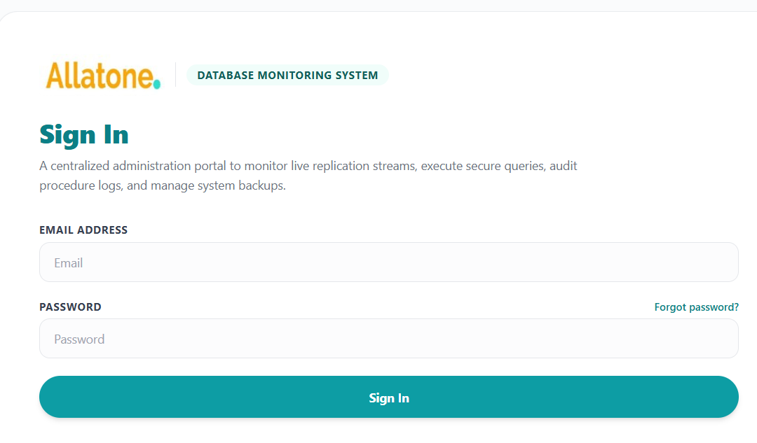
1: Secure User Login
Users sign in to the database management platform using their registered email address and password.
1.2: Login Process
User enters email and password.
System verifies the credentials.
If valid, the system issues an authentication token.
User is redirected to the Dashboard.
Slide 3: Authentication & Access
The token is stored for authenticated API requests.
Protected pages require a valid login.
Admin-only pages check the user’s role.
Invalid credentials display an error message.

Slide 10
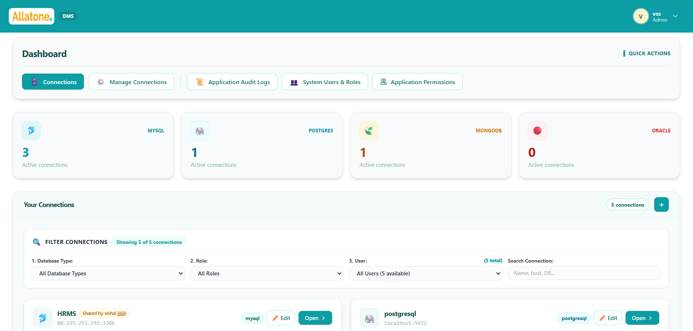
2: Connections Dashboard
The Connections tab gives users a central view of their saved database connections and a quick way to open or manage them.
1.1 Connection Overview
Displays the total number of saved connections.
Shows connection counts by database type: MySQL, PostgreSQL, MongoDB, and Oracle.
Each connection card shows its name, database type, host, and database name where available.

Slide 11
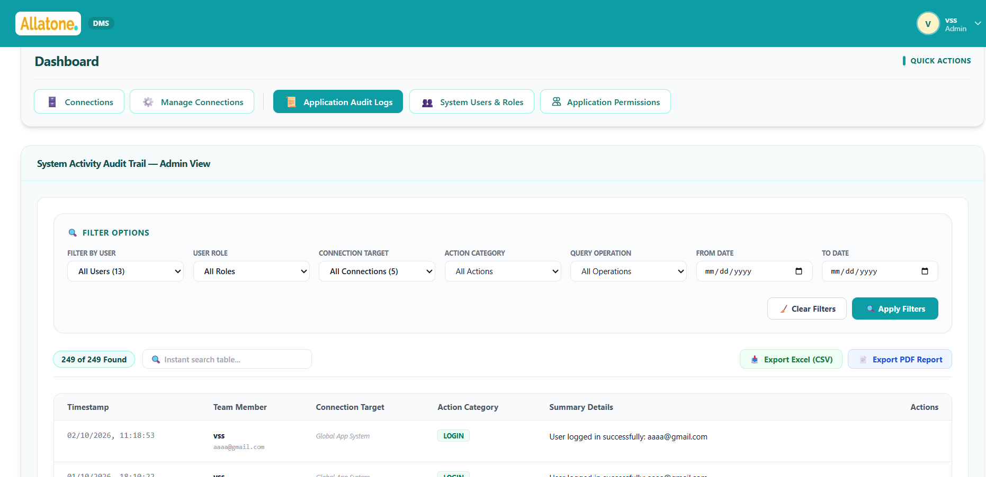
3: Application Audit Logs
A centralized activity trail that helps administrators review important user and database operations across the system.
1.2: What Is Recorded?
Each log can show:
Timestamp
User name, email, and role
Connection or system target
Action category
Operation details
Examples of logged actions include login/logout, query execution, connection changes, backup operations, and database-user management.
3: Search and Filter
Administrators can narrow down the logs by:
    User and role
Connection
Action category
Date range
Query type
Search text
Slide 4: Review and Export
Review matching events in a paginated table.
Expand entries to inspect operation details.
Export the logs as a CSV file or PDF report.

Slide 12
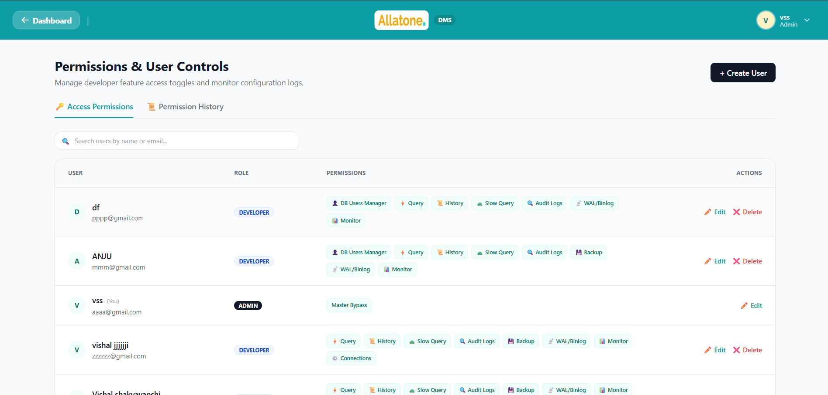
4. Application Permissions
4.1 Control which application features each developer can access. Administrators can grant or revoke permissions for individual users.
Query Editor — Run database queries
Query History — View previous queries
Slow Queries — Review slow-query activity
Audit Logs — View system and database activity
Backup & Restore — Export and restore database backups
WAL / Binlog — Monitor transaction logs
System Monitor — View database health and performance
Manage Connections — Add and manage database connections
Database Users Manager — Manage database users
Access is assigned per user. Administrators retain full access; developers can access only the features enabled for them.

Slide 13
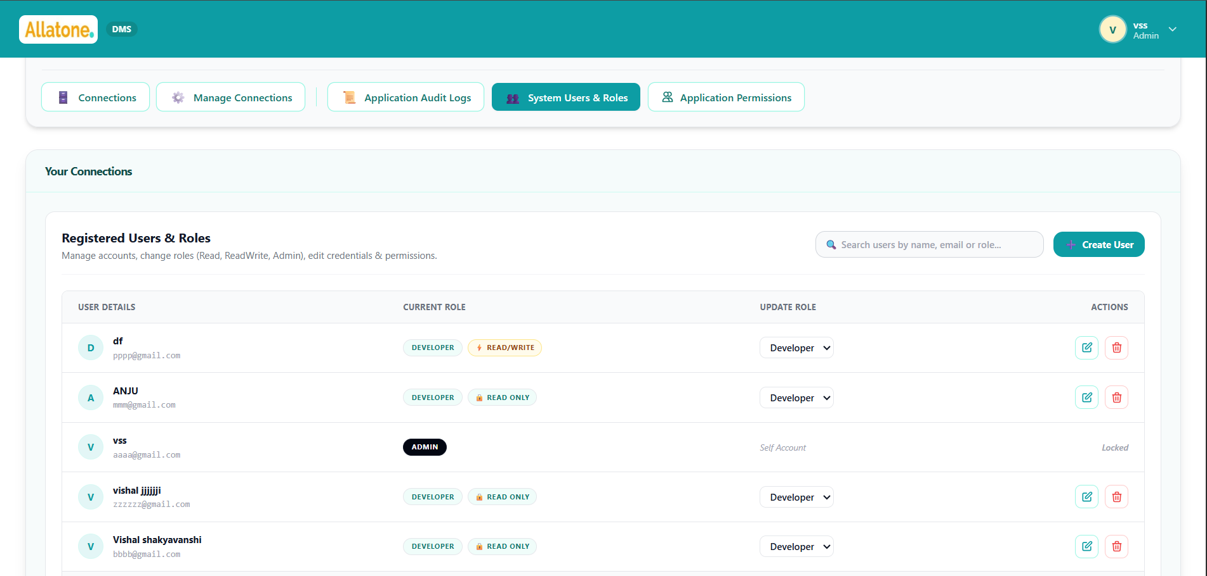
DBMS — Database Management System | SOP & POC
1.4 User Roles & Permissions
1. Super Admin (DBA)
Full system privileges: manages connections, user provisioning, global auditing, server alerts, and backups.
2. Developer (Read-Write)
Operational query access: runs
SELECT, INSERT, UPDATE, DELETE, and GUI row actions on assigned schemas.
3. Developer (Read-Only)
Strictly restricted to SELECT/find() statements. Non-allowed mutation queries are rejected with HTTP 403.

Slide 14
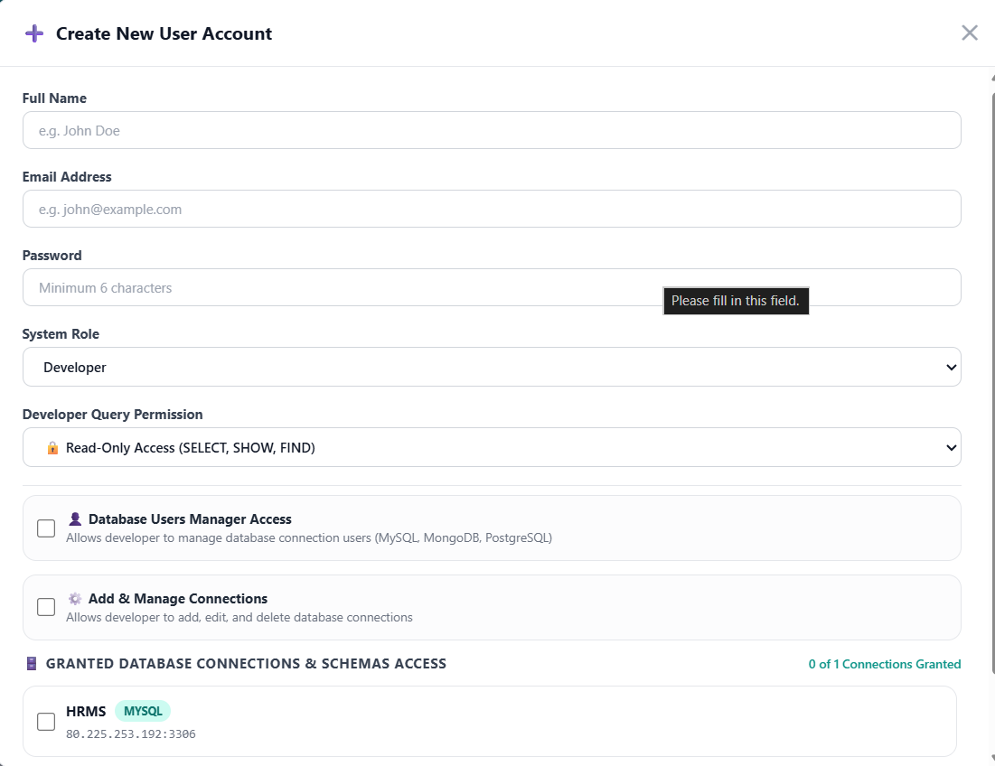
5. Create User
Create a new developer account by entering the user’s name, email address, and password. Choose the appropriate access mode and assign permissions based on the user’s responsibilities.
Administrators can manage users, grant or revoke application permissions, and configure which database connections and databases each user can access.
Key fields
Name
Email
Password
Role
Permission Mode: Read-Only or Read & Write
Application permissions
Allowed connections and databases

Slide 15
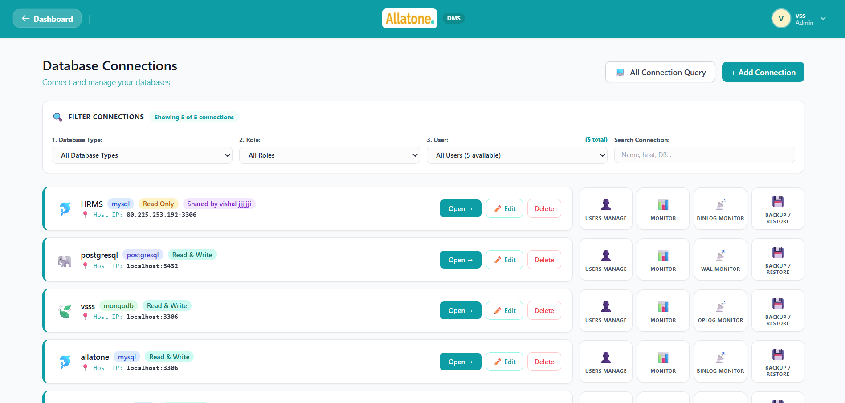
6. Database Connections
The Dashboard provides a central place to view and manage database connections available to the user. Users can add a new connection, browse existing ones, and filter the list by database type, role, or user. Selecting a connection opens its database workspace, where the user can access the features allowed by their permissions.
Key features
View the number of available connections
Add or manage database connections
Filter connections by database type, role, or user
Open a connection to access its database workspace
Access is controlled by user permissions

Slide 16
7. Add Connection
Click + Add Connection to open the connection form.
Enter a Connection Name, such as Company MySQL or Analytics DB.
Select the Database Type: MySQL, PostgreSQL, MongoDB, or Oracle.
Enter the database connection details:
  Host and port
  Username and password
  Default database (optional; Oracle requires a service name or SID)
  For MongoDB, enter the details in structured fields or provide a connection URI.
  Enable SSL/TLS if required by your database provider.
Choose an Access Mode: Read Only or Read & Write.
Click Test Connection to verify that the application can reach the database using the details provided.

Slide 17
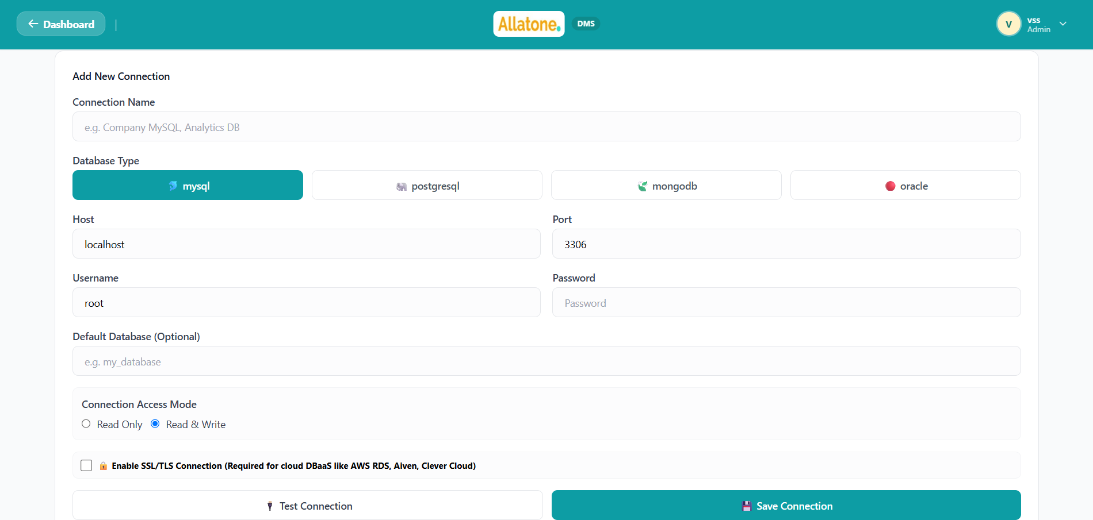
7. Click Save Connection. The application tests the connection again and saves it only if the test succeeds.
8. After saving, the connection appears in the connections list. Open it to access its database workspace.
Note: Adding a connection links the application to an existing database; it does not create a new database. You need Manage Connections permission to add or manage connections.

Slide 18
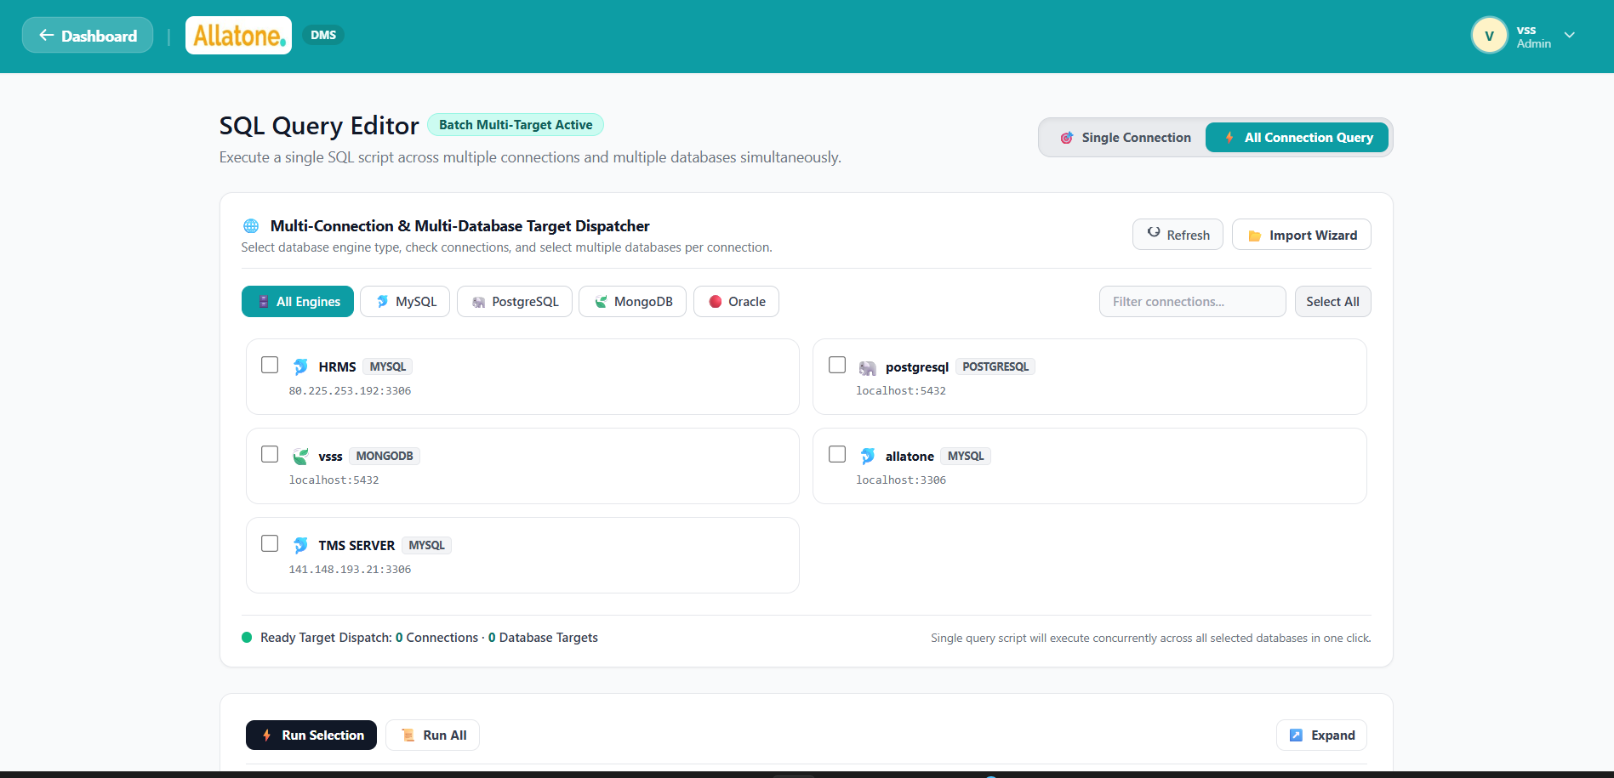
8. All Connection Query
All Connection Query lets users run the same query against multiple selected database connections and databases from one screen.

Slide 19
Process
Open Query Editor and select All Connection Query mode.
Filter connections by database type—MySQL, PostgreSQL, MongoDB, or Oracle—and search or select connections.
For each connection, choose the database(s) to include. The selected connection/database combinations become the query targets.
Enter a query and choose Run Selection to run highlighted text or Run All to run the entire script.
The application runs the query against the selected targets and displays a summary of successful and failed executions, including execution time and result details for each target.
Review individual results and export a target’s returned data as a CSV file when available.
Important: The query is sent to every selected target. Check your connection and database selections carefully before running it, especially for queries that change data. Read-only access restrictions still apply.

Slide 20
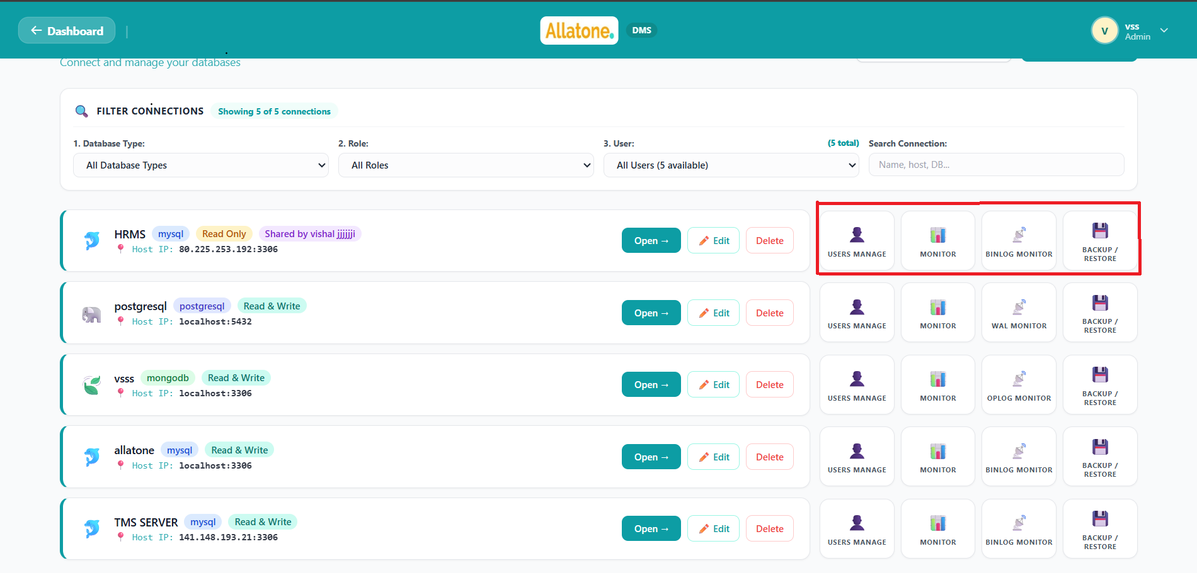
9. Database Management Tabs

Slide 21
Slide 1 — User Management 👤
Purpose: Manage database accounts and their access.
View users associated with a database connection.
Create new users and remove accounts when they are no longer needed.
Manage permissions or roles to control what each user can do.
Available for MySQL, MongoDB, and PostgreSQL connections.
Speaker notes:
“User Management helps administrators control who can access the database and what they’re allowed to do. This supports least-privilege access by giving each user only the permissions required for their work.”
Key takeaway: Manage database access from one place.
Slide 2 — Database Monitoring 📊
Purpose: Check database activity and performance.
View key metrics such as active connections, queries per second, and slow queries.
Review performance trends over time and inspect hourly history.
Filter the monitoring view by time range.
Refresh monitoring data and download a PDF report.
Speaker notes:
“The Monitor tab gives teams a snapshot of database activity, along with trends that can help identify unusual changes or performance concerns. Reports can also be downloaded for sharing or record-keeping.”
Key takeaway: Understand database activity and spot performance changes.

Slide 22
Slide 3 — Transaction Log Monitoring 📡
Purpose: Inspect database change logs.
Select a database or schema to focus the log view.
Monitor the log type used by the database:
  MySQL: Binary log (Binlog)
  PostgreSQL: Write-Ahead Log (WAL)
  MongoDB: Oplog
Review recorded database activity and available event details.
Use filters to narrow down the events shown.
Speaker notes:
“Transaction logs record database changes. This tab provides a way to inspect those records for a selected database, which can help teams understand activity and investigate changes.”
Key takeaway: Review recorded database changes by database type.
Slide 4 — Backup / Restore 💾
Purpose: Export database data and restore it when needed.
Choose databases and, where supported, specific tables or collections for a custom export.
Download a backup file containing the selected data.
Import a backup file into a target database.
Use SQL files for MySQL and PostgreSQL, and JSON files for MongoDB.
Speaker notes:
“Backup and Restore provides flexible data export and import. Teams can export selected database objects or upload a backup file to restore data into a target database. Before importing, confirm the target because matching tables or collections may be overwritten.”
Key takeaway: Export selected data and restore from a backup file.

Slide 23
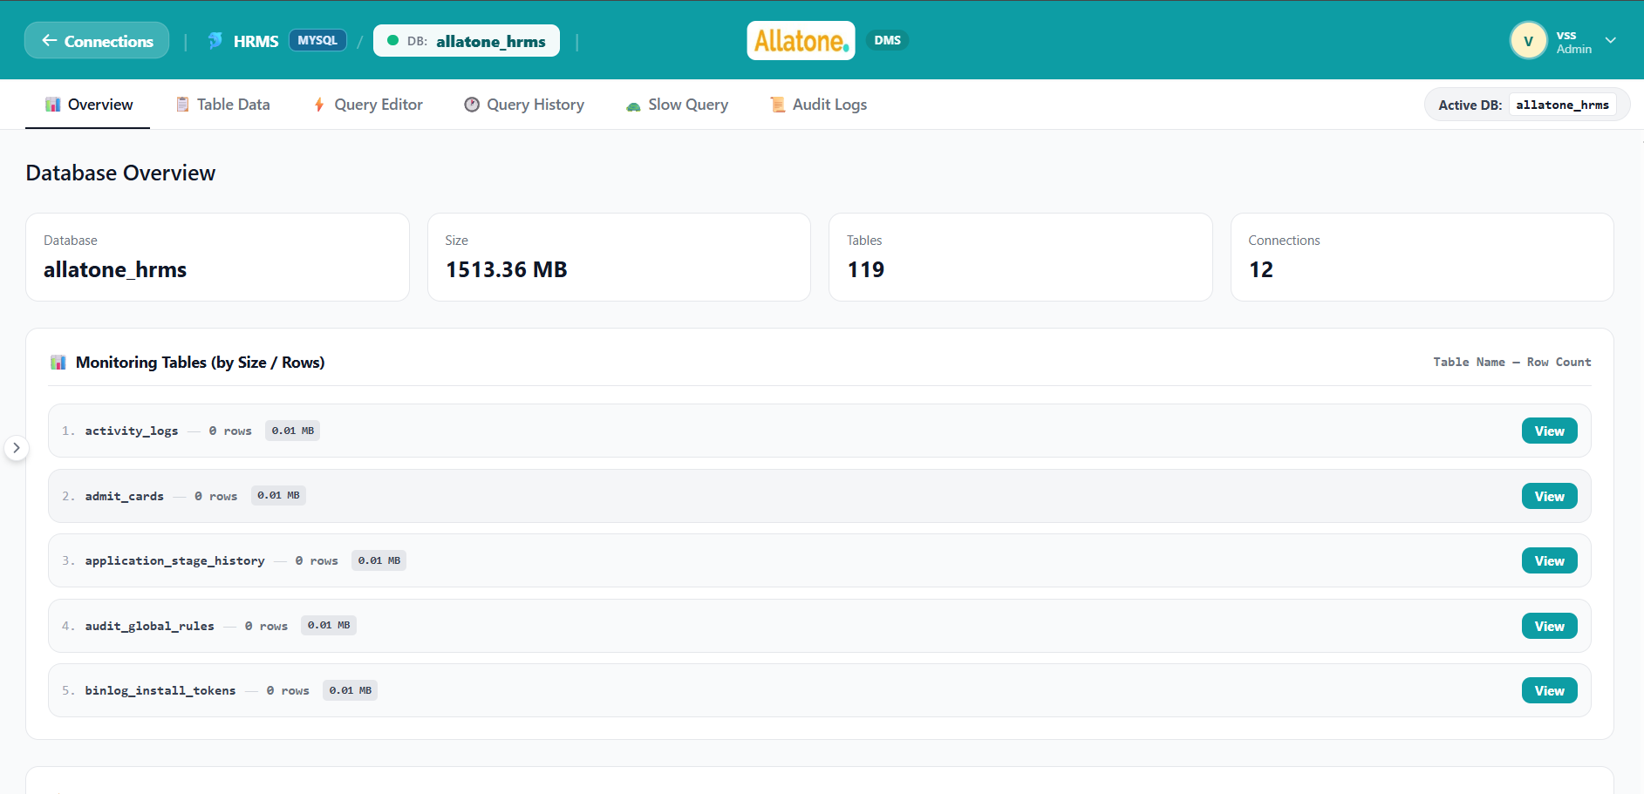
10. Database Dashboard Tabs
— Overview 📊
Purpose: Get a quick summary of the selected database.
Shows key information such as database name, size, and number of tables or collections.
Displays activity metrics such as active connections where supported.
Lists tables with available row-count and size details.
Lets you open a table directly from the overview.
Speaker notes:
“The Overview tab gives users a quick snapshot of the selected database. It highlights useful statistics and provides shortcuts to inspect tables without needing to navigate through the database objects first.”
Key takeaway: Get a quick picture of the database and its contents.

Slide 24
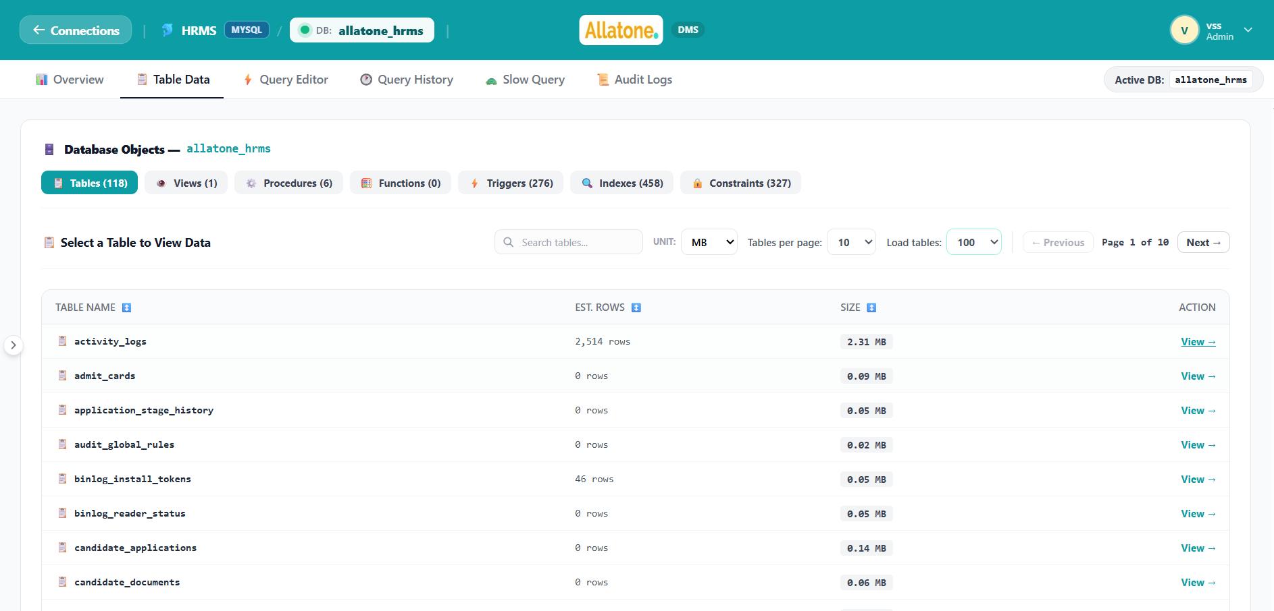
Slide 2 — Table Data 📋
Purpose: Browse database objects and inspect their data.
Browse tables and other supported objects, such as views, procedures, functions, triggers, indexes, and constraints.
Select a table to view its records.
Use the table view to inspect database contents and work with rows.
Search or navigate through available objects and records.
Speaker notes:
“Table Data is where users explore the database structure and the records stored in it. From the object list, they can choose a table and inspect its data.”
Key takeaway: Explore database objects and view table records.

Slide 25
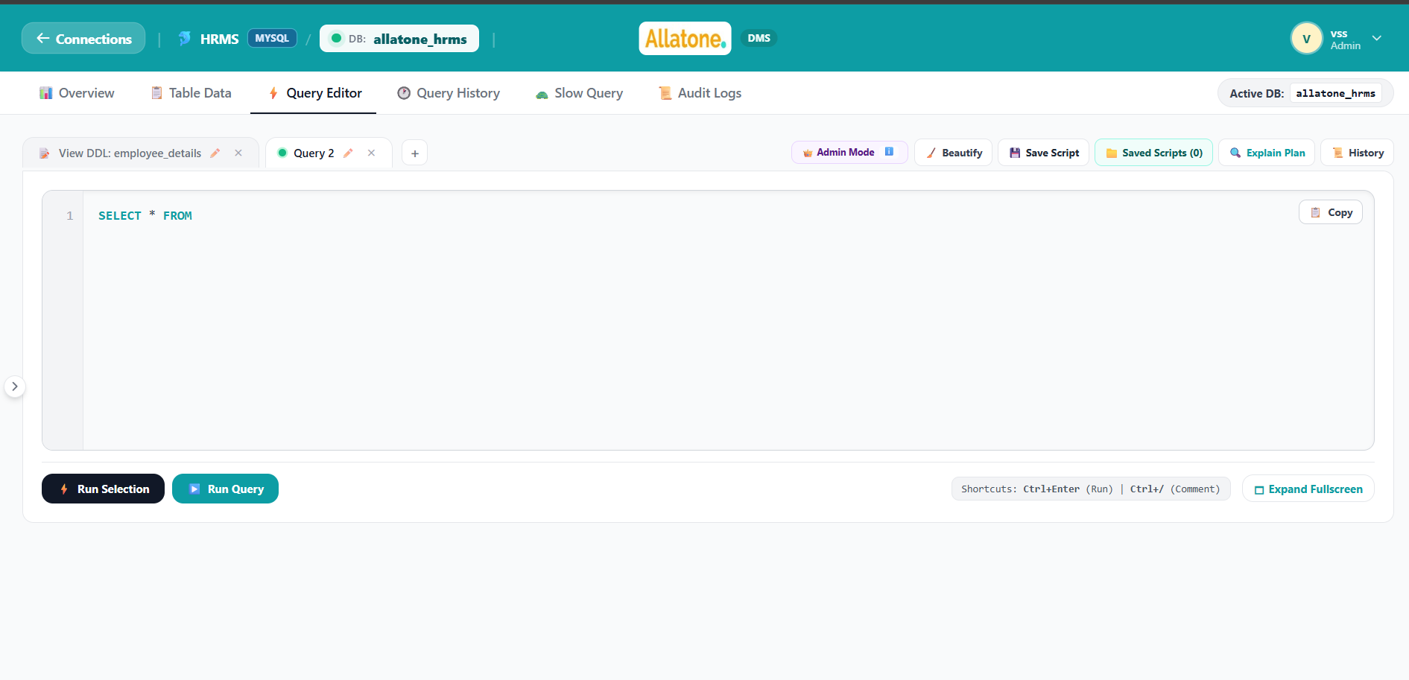
Slide 3 — Query Editor ⚡
Purpose: Write and run queries against the selected database.
Enter a query and run it from the editor.
Work with multiple query tabs and rename them as needed.
View query results or errors after execution.
Reopen saved or historical queries in the editor.
Speaker notes:
“The Query Editor provides a workspace for running database queries. Multiple tabs help users keep separate tasks organized, and query results appear in the dashboard for review.”
Key takeaway: Write, run, and organize database queries

Slide 26
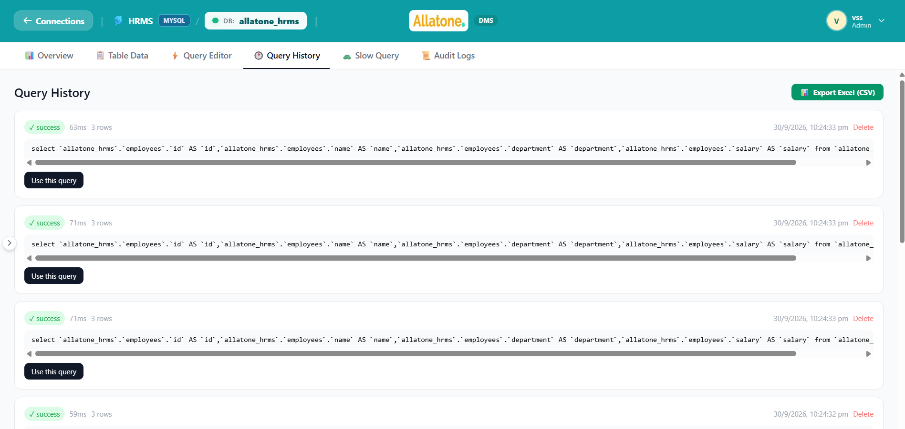
Slide 4 — Query History 🕐
Purpose: Review queries that were previously run.
See each recorded query along with its status and execution time.
Review the number of rows affected and when it ran.
Reopen a past query in the Query Editor.
Delete history entries or export the history as a CSV file.
Speaker notes:
“Query History helps users revisit previous database work. It can be useful for repeating a query, checking whether an earlier run succeeded, or reviewing its execution details.”
Key takeaway: Find and reuse previously run queries.

Slide 27
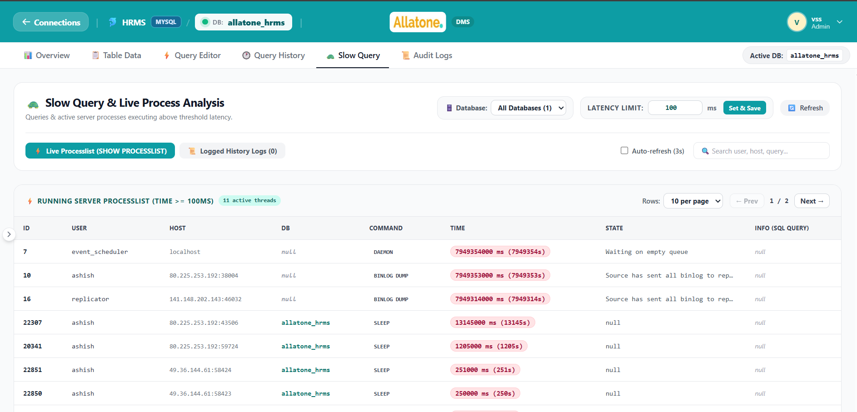
Slide 5 — Slow Query 🐢
Purpose: Identify queries or processes that may be taking too long.
Review live database processes and recorded slow-query history.
Filter results by connection, database, and execution-time threshold.
Enable automatic refresh for the live process view.
Inspect query details and available suggestions; reuse a query in the Query Editor.
Speaker notes:
“The Slow Query tab helps teams investigate potential performance bottlenecks. Users can review active processes or historical slow queries, narrow the results, and use the query details as a starting point for further analysis.”
Key takeaway: Find slow-running database activity to investigate.

Slide 28
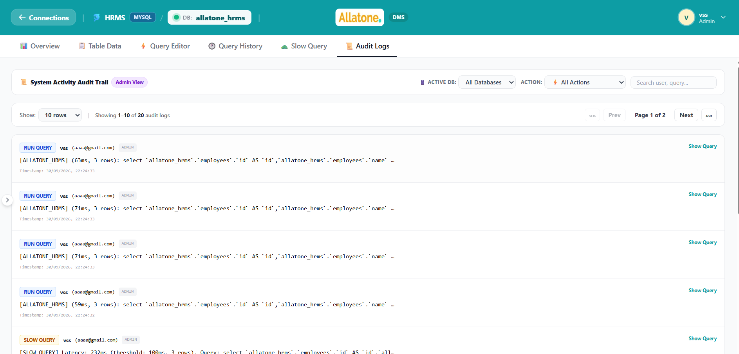
Slide 6 — Audit Logs 📜
Purpose: Review a record of activity performed on the connection.
See recorded actions with the associated user and timestamp.
Search log details and filter by action type or database.
Expand query-related entries to inspect query details.
Move through the results using pagination.
Speaker notes:
“Audit Logs provide an activity trail for the connection. Administrators can use filters and search to find relevant events and review who performed an action and when.”
Key takeaway: Review and filter the connection’s activity trail.

Slide 29
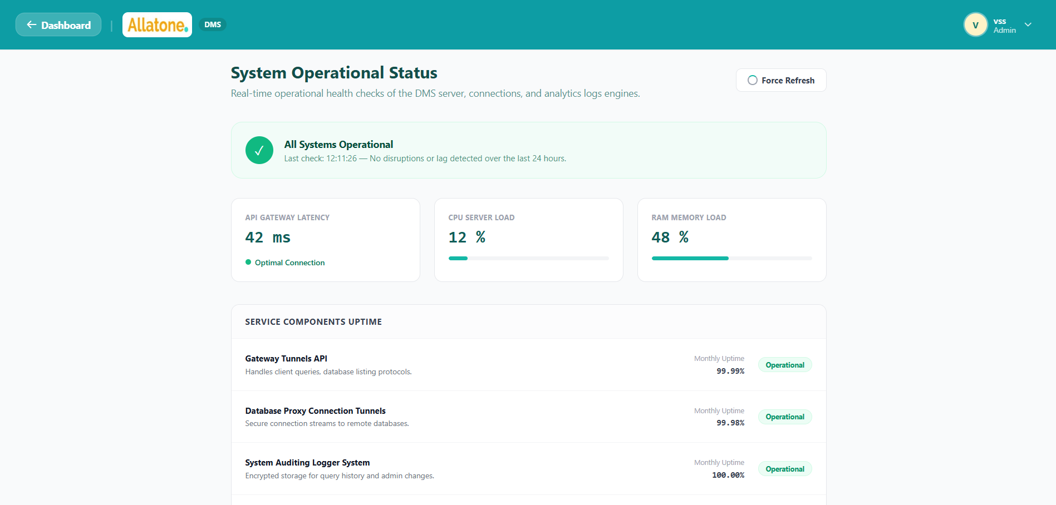
11. System Operational Status 📊
Slide — System Operational Status
Purpose: Provide a quick view of the database management system’s overall health.
Shows a summary status banner indicating whether systems are operational.
Displays performance indicators:
  API Gateway Latency: response time in milliseconds.
  CPU Server Load: processor usage percentage.
  RAM Memory Load: memory usage percentage.
Lists key service components and their displayed status:
  Gateway Tunnels API
  Database Proxy Connection Tunnels
  System Auditing Logger System
  Developer User Management Engine
Includes a Force Refresh control and the time of the last refresh.

Slide 30
Speaker notes:
“The System Operational Status page is designed as a high-level health dashboard. It brings service availability, response latency, and server resource indicators together, so users can quickly see whether the platform appears healthy and which major components are being monitored.”
Key takeaway: Get a quick overview of the platform’s operational health.
Important presentation note
The current page uses simulated metric values that change on refresh, while the service statuses and uptime percentages are fixed display values. Present these as illustrative dashboard indicators, not verified live production monitoring data.

Slide 31
DBMS — Database Management System | SOP & POC
2. System Architecture & Access Points
Portal / Service Endpoint | Default URL / Port | Security / Authentication Protocol
Developer Workspace Portal | http://<host>:5173/login | JWT Token + Role Guarded React Router
Admin Management Portal | http://<host>:5173/users | Admin Role Guard + Bearer Authorization
REST API Base Gateway | http://<host>:5001/api | Express 5 + Helmet + IP Rate Limiter
Real-Time CDC WebSocket | ws://<host>:5001/socket.io | Socket.io Connection Namespace with Auth
Backend Health Endpoint | http://<host>:5001/api/health | Public Liveness / Readiness Probe
Database Management System | Page 6 of 30 | Confidential © 2026

Slide 32
DBMS — Database Management System | SOP & POC
Enterprise Security Proxy Architecture
All communications between client interfaces and target database engines (MySQL, PostgreSQL, MongoDB, Oracle) pass through the centralized Node.js API Gateway. Target database credentials remain encrypted inside the backend Mongoose store and are NEVER exposed to the frontend. Connection pooling manages socket reuse and prevents connection exhaustion on target production servers.

Slide 33
DBMS — Database Management System | SOP & POC
Database Objects & Schema Discovery
• Interactive Sidebar Tree: Collapsible hierarchy organizing database schemas, base tables, views, stored procedures, and triggers.
• MySQL Workbench Category Tabs: Dedicated tab navigation for Tables, Views, Stored Procedures, Functions, Indexes, and Constraints.
• Table Metadata Breakdown: Live record counts, data length, index size, creation time, and storage engine (InnoDB, MyISAM, WiredTiger).
• Stored Procedure Definition Viewer: Built-in syntax modal displaying DDL definitions for procedures, functions, and triggers.
• Index & Constraint Inspector: View index types (BTREE, HASH, UNIQUE), column lists, and foreign key cascade rules.

Slide 34
DBMS — Database Management System | SOP & POC
3.4 Real-Time Binlog Audit & Change Data Capture (CDC)
The Binlog Audit module connects directly to MySQL binary logs and transaction streams, providing real-time Change Data Capture (CDC). Every committed transaction is parsed, categorized, and streamed to active users with visual before/after row diffs.
Live Streaming Feed
Visual Diff Viewer
Granular Event Filtering
Audit Attribution
Duplex WebSockets over Socket.io automatically push transactions to the UI without page reloading.
Displays exact field-level comparison between pre-update values (Old) and post-update values (New).
Filter transactions by event type: DML (INSERT, UPDATE, DELETE), DDL (CREATE, ALTER, DROP), or Stored Procedures.
Tracks binary log coordinates (Log File, Position, Offset), DB User, App User, and exact execution timestamp.

Slide 35
DBMS — Database Management System | SOP & POC
Event Type | Statement Pattern | Captured Audit Diff | Socket Broadcast
INSERT | INSERT INTO employees (name, salary) VALUES (...) | New Data object with populated columns | Instant push to room connection_<id>
UPDATE | UPDATE employees SET salary = 95000 WHERE id = 12 | Old Data: { salary: 85000 } ➔ New Data: { salary: 95000 } | Instant push with field highlight
DELETE | DELETE FROM employees WHERE id = 12 | Old Data: entire deleted employee record | Instant push to audit history
DDL | ALTER TABLE employees ADD COLUMN status VARCHAR(20) | Schema change log with execution coordinates | Instant alert to admin & developers

Slide 36
DBMS — Database Management System | SOP & POC
3.5 Health Telemetry & 3.6 Slow Query Profiler
3.5 Live Server Telemetry & Metrics
3.6 Automated Slow Query Profiler
• Automated Threshold Capture: Queries exceeding latency threshold (default >100ms) are recorded automatically.
• Detailed Execution Diagnostics: Captures exact execution duration (ms), rows examined, rows returned, client IP, and user ID.
• Automated DBA Tuning Engine: Evaluates queries to generate instant optimization advice (e.g. "Add index on column X", "Missing WHERE clause causes full table scan").
• Historical Latency Trends: Analyze recurring slow queries to prioritize database index creation and query refactoring.
• Alert Webhook Integration: Sends threshold breach notifications to Slack, Discord, and Email when queries spike.
• Interactive Recharts Telemetry: Real-time visual monitoring of CPU load, active connections, and memory utilization.
• Database Space Breakdown: Disk storage visualization per database table, distinguishing data bytes from index bytes.
• Background Snapshots: Automated background health daemon taking regular snapshots into MonitoringSnapshot store.
• Connection Pool Health: Monitors active vs. idle connections, preventing pool starvation on high concurrency.
• Multi-Engine Status Metrics: Engine-specific variables: MySQL Threads Connected, Postgres Backend Active, Mongo Oplog/RAM.

Slide 37
DBMS — Database Management System | SOP & POC
4. Developer Portal — Complete Execution Flow
4.1
4.2
4.3
4.4
Developer Login
Connection Selector
Workspace Dashboard
Multi-Tab Query Editor
Secure login, JWT auth, redirect to allowed connections list.
Choose target database instance; switch active schema context on-the-fly.
Quick overview: connection status, table count, recent queries, script shortcuts.
Persistent query tabs with syntax highlight, auto-complete, and Explain Plan.
4.5
4.6
4.7
4.8
Interactive Table Data
Live Query Previews
Apply via Query Editor
Execution History
Explore records, pagination, sort, and sticky phpMyAdmin row action buttons.
Modal previews of generated UPDATE, INSERT, and DELETE queries before running.
Transfer any generated GUI action to Query Editor with single-click execution.
Personal log of executed queries with duration, status, and affected row counts.
Database Management System | Page 11 of 30 | Confidential © 2026

Slide 38
DBMS — Database Management System | SOP & POC
4.4 Intelligent Multi-Tab Query Editor
Multi-Tab Sessions
Contextual Autocomplete
Keyboard Productivity
Work across multiple queries simultaneously. Tabs are saved in LocalStorage and synced to MongoDB cloud sessions.
Live keyword and table/collection name suggestions as you type with keyboard navigation (Up/Down/Enter/Tab).
Ctrl+Enter to run statement, Ctrl+/ to comment lines, Ctrl+Z to undo/uncomment with native DOM undo stack.
SQL Beautifier
Explain Plan Visualizer
Quick Copy Action
Analyzes query execution plan, displaying cost, rows scanned, and key indexes used to detect performance bottlenecks.
Top-right floating copy button to instantly copy all query text or highlighted selection to clipboard.
Single-click query formatter that restructures minified SQL into clean, capitalized keywords and indented clauses.

Slide 39
DBMS — Database Management System | SOP & POC
4.5 Table Data Viewer & phpMyAdmin-Style Row Actions
The Table Data Explorer provides interactive table exploration with pagination, sort, search, and a floating phpMyAdmin-style row action menu for each individual record.
📋
➕
⚡
✏️
🗑️
Edit Row
Insert Row
Delete Row
Open in Editor
Copy Row
Opens modal with editable fields and displays a Live Generated UPDATE query preview.
Opens modal pre-filled with selected row values and displays a Live Generated INSERT query preview.
Opens modal showing row summary and Live Generated DELETE query preview before confirmation.
Transfers targeted row SELECT * query directly into the Query Editor tab.
Copies full row record formatted as JSON to clipboard instantly.
⚡ "Apply & Run in Query Editor" Innovation
Every row action modal (Edit, Insert, Delete) features an "Apply & Run in Query Editor" button. When clicked, the system automatically translates GUI actions into exact SQL or MongoDB MQL queries, loads the script into the Query Editor tab, switches tabs automatically, and executes the operation live—allowing developers to review and inspect queries before execution!
Database Management System | Page 13 of 30 | Confidential © 2026

Slide 40
DBMS — Database Management System | SOP & POC
5. Notification & Alert Dispatch Flow
Triggering Event | Channel / Destination | Payload / Content | Automated Action
Connection Failure / Offline | Email (SMTP) + Slack Webhook | Host, Port, Ping Latency, Error Trace | Alerts DBA immediately to restore connection
High CPU / Memory Threshold | Discord / Slack Webhook | Host, Current Usage (e.g. >90%), Timestamp | Triggers server capacity inspection
Slow Query Spike (>100ms) | Email + Admin Dashboard | Execution Duration (ms), Statement, User | Logs to Slow Query store with tuning tips
Password Reset Request | Email (Nodemailer) | Secure Reset Token + Expiration Link (1 hr) | Permits single-use password reset
Binlog Schema Alteration (DDL) | Real-Time Socket.io + Audit | ALTER / DROP statement, User, Binlog Position | Broadcasts to active developer sessions
Supported Dispatch Protocols
• SMTP / Nodemailer: Configurable transactional emails for alerts and authentication.
• Slack Webhooks: Formatted Slack attachments with color-coded severity badges (Warning/Critical).
• Discord Webhooks: Rich JSON embeds with timestamp and database instance tags.
• Socket.io WebSockets: In-browser live toast notifications for connected team members.

Slide 41
DBMS — Database Management System | SOP & POC
6. Complete Application Workflow (End-to-End)
Phase 1: Connection Provisioning
1
Admin adds target database (MySQL/PostgreSQL/MongoDB/Oracle) with host, port, credentials, and verifies via Test Connection.
Phase 2: RBAC & Mode Assignment
2
Admin creates developer account, assigns connections, and sets security mode: Read-Write or Read-Only.
Phase 3: Schema Discovery & Querying
3
Developer selects database, explores tables/views, executes statements in Query Editor, or uses phpMyAdmin row actions.
Phase 4: Real-Time CDC & Auditing
4
Transactions stream into Binlog CDC feed with row diffs, slow queries are captured, and audit trails are logged.
Database Management System | Page 15 of 30 | Confidential © 2026

Slide 42
DBMS — Database Management System | SOP & POC
7. Enterprise Security & Compliance Features
JWT Token Authentication
Read-Only AST Query Validator
SQL & XSS Sanitization
Helmet & Security Headers
Stateless JSON Web Tokens with secret signing, automatic expiration, and authorization header guards.
Parser blocks INSERT, UPDATE, DELETE, DROP, and ALTER queries for Read-Only roles with HTTP 403.
Query sanitization strips malicious command injections and sanitizes input payloads before driver execution.
Hardened HTTP response headers mitigate XSS, Clickjacking, MIME sniffing, and cross-site leaks.
API Rate Limiting
Bcrypt Password Hashing
Encrypted Credential Storage
Immutable Audit Trail
All user credentials are encrypted with bcrypt salt rounds (10-12) before persistence in MongoDB.
Database connection passwords remain server-side and are never returned in client REST responses.
Every login, query, export, and schema modification is permanently archived for regulatory compliance.
express-rate-limit prevents brute-force login attempts and denial-of-service query flooding.

Slide 43
DBMS — Database Management System | SOP & POC
8. REST API Reference Summary
Method | Endpoint Path | Authentication | Functional Description
POST | /api/auth/login | Public | User login, returns JWT token & role metadata
GET | /api/connections | Bearer JWT | List all database connections accessible to user
POST | /api/connections | Bearer (Admin) | Create a new database connection instance
POST | /api/connections/:id/query | Bearer JWT | Execute SQL/MQL query with AST safety check
GET | /api/connections/:id/objects | Bearer JWT | Fetch tables, views, procedures, and indexes
GET | /api/connections/:id/table/:name | Bearer JWT | Fetch table rows, columns, and pagination
GET | /api/connections/:id/binlog | Bearer JWT | Fetch historical and live Binlog CDC records
GET | /api/connections/:id/stats | Bearer JWT | Fetch live server telemetry and health stats
GET | /api/history | Bearer JWT | Fetch user query execution history and latency
GET | /api/slow-queries | Bearer JWT | Fetch captured slow queries with tuning tips
Database Management System | Page 17 of 30 | Confidential © 2026

Slide 44
DBMS — Database Management System | SOP & POC
10. Multi-Engine Database Drivers & Capabilities
MySQL
PostgreSQL
MongoDB
Oracle Database
mysql2 Pool
pg (node-postgres)
mongodb native v7
oracledb Thin Client
Relationa (RDBMS) l
Object-Relational
Document NoSQL
Enterprise RDBMS
Connection pooling, binary log replication stream, InnoDB schema discovery, explain format=JSON, transaction support.
Search path schemas, JSONB columns, EXPLAIN ANALYZE execution cost, pg_stat_activity monitoring.
MQL shell command execution, find/aggregate pipelines, collections inspector, WiredTiger cache metrics.
USER_OBJECTS metadata queries, user constraints, ROWNUM / FETCH FIRST pagination, auto-commit handling.
Database Management System | Page 18 of 30 | Confidential © 2026

Slide 45
DBMS — Database Management System | SOP & POC
11. Rate Limiting & 12. Environment Reference
11. API Rate Limiting Configuration
12. Environment Configuration Reference
Limiter Policy | Time Window | Max Requests
Global API Routes | 15 Minutes | 100,000 / IP
Authentication (Login) | 15 Minutes | 100 / IP
Query Execution | 15 Minutes | 5,000 / IP
Database Backup / Export | 1 Hour | 50 / IP
Admin Management Routes | 15 Minutes | 10,000 / IP
Variable Key | Purpose / Function
PORT | Backend Express server listening port (Default: 5001)
MONGO_URI | App metadata store (mongodb://127.0.0.1:27017/dbmanager)
JWT_SECRET | Cryptographic secret key for signing auth tokens
FRONTEND_URL | Client origin for CORS whitelist (http://localhost:5173)
SMTP_HOST / USER / PASS | Nodemailer configuration for email alerts
SLACK_WEBHOOK_URL | Slack channel incoming webhook for critical alerts
DISCORD_WEBHOOK_URL | Discord channel webhook for server status alerts
Database Management System | Page 19 of 30 | Confidential © 2026

Slide 46
DOCUMENT INFORMATION & CONCLUSION
Document Attribute | Attribute Specification
Document Title | DBMS — Database Management System — SOP & POC Application Flow
Document Version | Version 1.0 (Production Release)
Release Date | April 2026
Classification | Confidential — Internal & Stakeholders Only
Technical Architecture | React 19, Node.js 24, Express 5, Socket.io, Multi-Engine Pools
Supported Engines | MySQL, PostgreSQL, MongoDB, Oracle Database
Prepared By | DBMS Engineering & DBA Architecture Team
Reviewed By | Technical Lead & Product Management
Summary Statement
This document establishes the official architectural baseline, operational procedure, and functional specification for the Database Management System (DBMS) enterprise platform.

