Slide 1
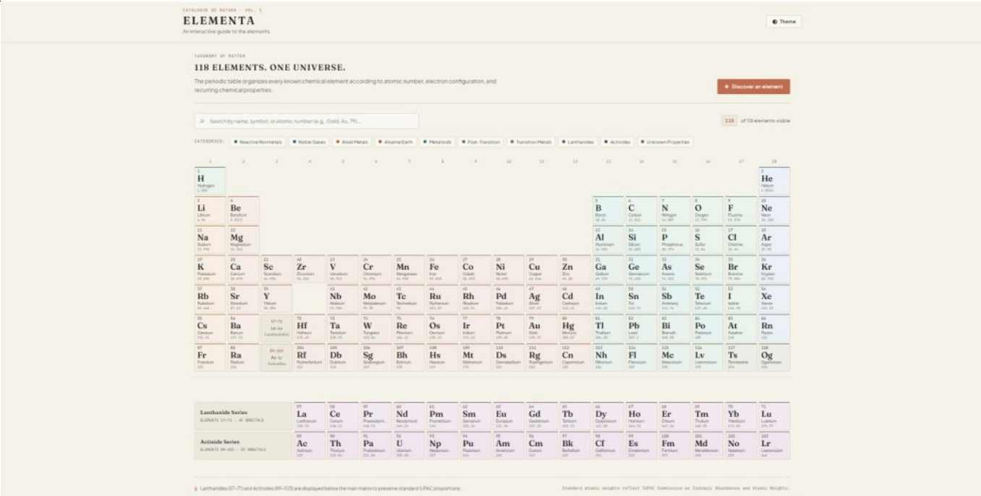
CS23531 / WEB PROGRAMMING
ELEMENTA
An Interactive Guide
to the Elements
A browser-based periodic table for exploring all 118 chemical elements.
SUBMITTED BY
NARESH M
ROLL NO. 241001147
OCTOBER 2026
1
6
8
H
C
O
RAJALAKSHMI ENGINEERING COLLEGE • THANDALAM
26
79
118
Fe
Au
Og

Slide 2
01 / OVERVIEW
Why Elementa?
A simpler, more approachable way to explore the periodic table.
THE CHALLENGE
THE RESPONSE
Many online periodic tables are either dated in design or difficult for students to navigate.
Elementa turns the table into an interactive reference with instant search, filters and detailed element cards.
118
ELEMENTS
10
CATEGORIES
3
STATIC FILES
Full periodic table
Chemical category filters
HTML, CSS and JavaScript
PROJECT SCOPE • CLIENT-SIDE SINGLE-PAGE WEB APPLICATION

Slide 3
02 / FEATURES
What users can do
The main interactions are designed to make discovery quick and straightforward.
01
Explore all 118 elements
02
Search and filter
Every element appears in its correct IUPAC periodic-table position.
Search by name, symbol or atomic number. Combine the search with category filters.
03
Inspect element details
04
Personalise exploration
Open a specimen-style modal with atomic and physical properties, electron configuration and discovery details.
Use the random picker, switch light/dark themes and navigate with the keyboard.
KEYBOARD SUPPORT • ARROW KEYS TO NAVIGATE • ESCAPE TO CLOSE THE MODAL

Slide 4
03 / TECHNOLOGY
Built with a lean front-end stack
Three static files work together inside the user’s browser.
index.html
STRUCTURE
Semantic page layout: header, controls, periodic-grid container and detail modal.
CLIENT-SIDE ONLY
No backend.
No database.
No build tools.
style.css
PRESENTATION
18-column CSS Grid, tile colours, responsive scrolling and light/dark theme styles.
script.js
DATA + LOGIC
The browser runs the application. localStorage keeps the selected theme between visits.
118-element dataset, DOM rendering, search, filters, modal behaviour and theme control.
MODERN BROWSER • ES6+ JAVASCRIPT

Slide 5
04 / WORKING
How the application works
A simple flow connects the element dataset to the interactive interface.
01
02
03
04
Load data
Render the grid
Search and filter
Open details
script.js stores all 118 elements as JavaScript objects, including grid position and scientific properties.
JavaScript creates a tile for each element. CSS Grid places it using gridRow and gridCol.
A unified function checks the search query and selected category, then highlights or dims tiles.
Clicking a tile finds the element by atomic number and fills the detail modal.
THEME PREFERENCE
initTheme() reads the saved value from localStorage. The theme toggle updates the page and saves the new preference.
MODAL NAVIGATION • PREVIOUS / NEXT • ESCAPE OR BACKDROP TO CLOSE

Slide 6
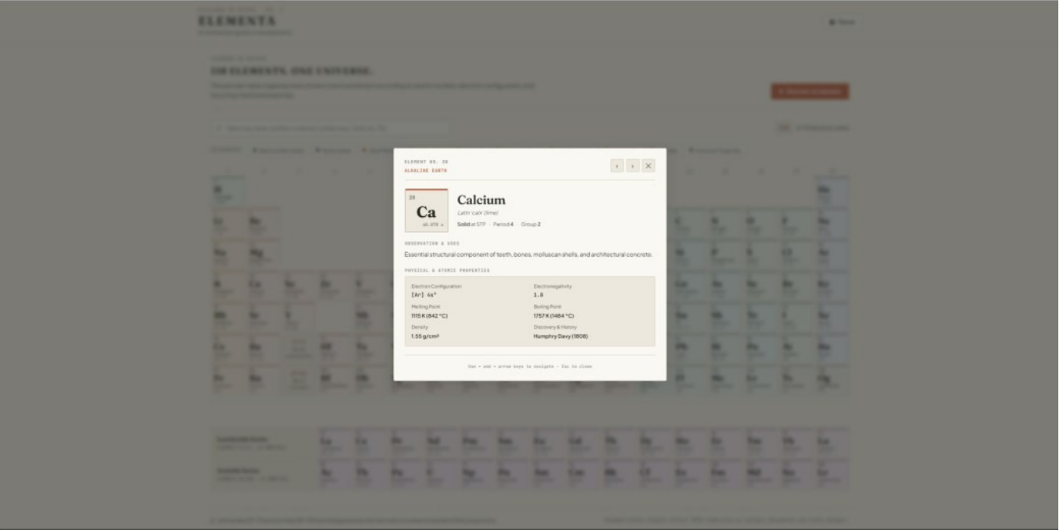
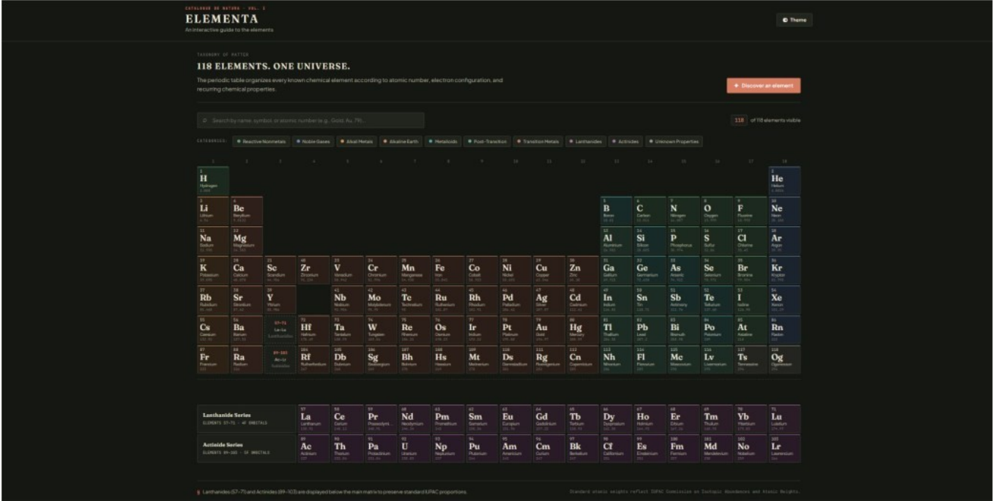
05 / INTERFACE
A look at Elementa
Selected implementation screenshots from the project report.
PERIODIC TABLE
ELEMENT DETAILS
DARK THEME

Slide 7
06 / CONCLUSION
A compact project with room to grow
Elementa demonstrates how core web technologies can create a data-rich learning tool.
DELIVERED
FUTURE WORK
What the project achieves
Possible enhancements
Dynamic rendering of all 118 elements in the correct grid positions.
Compare two elements side by side.
Instant search, category filters and detailed element modals.
Add a quiz mode for students.
Keyboard navigation and a saved light/dark theme preference.
Include more spectral and isotope information.
Practical use of DOM generation, CSS Grid and event-driven JavaScript.
Develop an offline-capable Progressive Web App.
REFERENCES • MDN WEB DOCS • IUPAC • ROYAL SOCIETY OF CHEMISTRY • WEBAIM • GOOGLE FONTS
THANK YOU

