Slide 1
Device Tree

Slide 2
Agenda
Device booting with device tree
How to write device tree
How to read from device tree
Complication of device tree
Configuration in both uboot and kernel
Structure of DTB

Slide 3
Booting of device
The kernel contains the entire description of the hardware
.
The bootloader loads a single binary, the kernel image, and executes it.
uImage or zImage
The bootloader prepares some additional information, called ATAGS, which address is passed to the kernel through register r2 .
Contains information such as memory size and location, kernel command line, etc.
The bootloader tells the kernel on which board it is being booted through a machine type integer, passed in register r1.
U-Boot command: bootm I Barebox variable: bootm.image

Slide 4
Booting with device tree
The kernel no longer contains the description of the hardware,
it is located in a separate binary: the device tree blob
The bootloader loads two binaries: the kernel image and the DTB
Kernel image remains uImage or zImage I
DTB located in arch/arm/boot/dts, one per board
The bootloader passes the DTB address through r2.
It is supposed to adjust the DTB with memory information, kernel command line, and potentially other info. I
No more machine type.
U-Boot command: bootm - I Barebox variables: bootm.image, bootm.oftree

Slide 5
Discoverable vs. non-discoverable hardware
Some hardware busses provide discoverability mechanisms
E.g: PCI(e), USB
One does not need to know ahead of time what will be connected on these busses
Devices can be enumerated and identified at runtime
Concept of vendor ID, product ID, device class, etc.
But many hardware busses do not provide discoverability mechanisms
E.g: I2C, SPI, 1-wire, memory-mapped, etc.
One needs to know what is connected on those busses, and how they are connected to the rest of the system
Embedded systems typically make extensive use of such busses

Slide 6
Describing non-discoverable hardware
Directly in the OS/bootloader code, using compiled data structures, typically in C
How it was done on most embedded platforms in Linux, U-Boot.
Considered not maintainable/sustainable on ARM32, which motivated the move to another solution.
Using ACPI tables
On x86 systems, but also on a subset of ARM64 platforms
Tables provided by the firmware
Using a Device Tree
On most embedded-oriented CPU architectures that run Linux: ARC, ARM64, RISC-V, ARM32, PowerPC, Xtensa, MIPS, etc.
Originates from the PowerPC world, not Linux specific
Now used by Linux, U-Boot, Barebox, TF-A, FreeBSD, etc.
Writing/tweaking a DT is now always necessary when porting Linux to a new board.
The topic of this talk !

Slide 7
Device Tree
A tree data structure describing the hardware is written by a developer in a Device Tree Source file, .dts
Gets compiled to a more eﬀicient Device Tree Blob representation, .dtb by the
Device Tree Compiler, dtc
The resulting .dtb accurately describes the hardware platform in an OS-agnostic
way and:
Can be linked directly inside a bootloader binary (U-Boot, Barebox)
Can be passed to the operating system by the bootloader (Linux)
U-Boot: bootz <kernel-addr> - <dtb-addr>

Slide 8
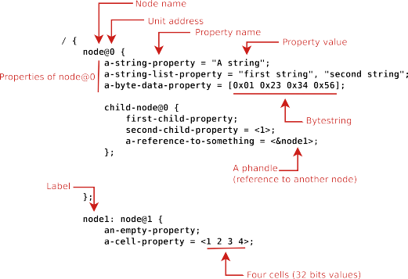
Basic Notation

Slide 9
Device tree complier
The Device Tree Compiler, dtc, takes as input a device-tree in a given format and outputs a device-tree in another format. Typically, the input format is "dts", a human readable source format, and creates a "dtb", or binary format as output.
The currently supported Input Formats are: -
“
dtb": "blob" format. A flattened device-tree block with header in one binary blob.
"dts": "source" format. A text file containing a "source" for a device-tree. –
"fs" format. A representation equivalent to the output of /proc/device-tree where nodes are directories and properties are files.
The currently supported Output Formats are: -
"dtb": "blob" format –
"dts": "source" format –
"asm": assembly language file.

Slide 10
Device Tree organization: top-level nodes
Under the root of the Device Tree, one typically finds the following top-level nodes:
A cpus node, which sub-nodes describing each CPU in the system.
A memory node, which defines the location and size of the RAM.
A chosen node, which defines parameters chosen or defined by the system firmware at boot time. In practice, one of its usage is to pass the kernel command line.
A aliases node, to define shortcuts to certain nodes.
One or more nodes defining the buses in the SoC.
One or mode nodes defining on-board devices.

Slide 11
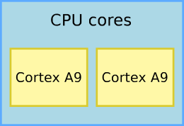
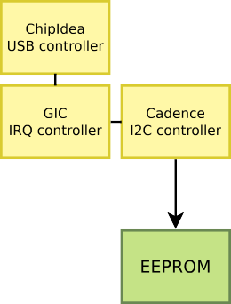
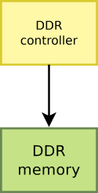
Top level 1
/{
#address-cells = <1>;
#size-cells = <1>;
compatible = "vendor1,board", "vendor2,soc";
cpus { ... };
memory@0 { ... };
chosen { ... };
soc {
intc: interrupt-controller@f8f01000 { ... }; i2c0: i2c@e0004000 { ... };
usb0: usb@e0002000 { ... };
};
};

Slide 12
cpus {
#address-cells = <1>;
#size-cells = <0>;
cpu0: cpu@0 {
compatible = "arm,cortex-a9"; device_type = "cpu";
reg = <0>;
};
cpu1: cpu@1 {
compatible = "arm,cortex-a9"; device_type = "cpu";
reg = <1>;
};
};

Slide 13
Where are Device Tree Sources located?
Even though they are OS-agnostic, no central and OS-neutral place to host Device Tree sources and share them between projects
Often discussed, never done
In practice, the Linux kernel sources can be considered as the canonical location for Device Tree Source files
arch/<ARCH>/boot/dts
≈ 4700 Device Tree Source files in Linux as of 5.10
Duplicated/synced in various projects
U-Boot, Barebox

Slide 14
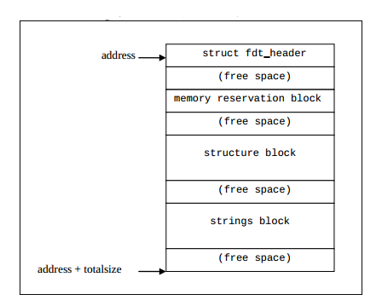
Structure of DTB

Slide 15
Structure of DTB
Header
Structure block
it contains the device tree content .
composed of a sequence of tokens with data,
Tokens are FDT_BEGIN_NODE,FDT_END_NODE,FDT_PROP, FDT_END
magic;
uint32_t totalsize;
uint32_t off_dt_struct;
uint32_t off_dt_strings;
uint32_t off_mem_rsvmap;
uint32_t version;
uint32_t last_comp_version;
uint32_t boot_cpuid_phys;
uint32_t size_dt_strings;
uint32_t size_dt_struct;

Slide 16
Exploring the DT on the target
# ls -l /sys/firmware/devicetree/base/ total 0
In /sys/firmware/devicetree/base, there is a directory/file representation of the Device Tree contents
If dtc is available on the target, possible to ”unpack” the Device Tree using:
dtc -I fs /sys/firmware/devicetree/base

Slide 17
Exploring the DT on the target
Fdtdump utility fdtget ,
fdtdump simple_platform.dtb
$ fdtget simple_platform.dtb /chosen bootargs
root=/dev/sda2
$ fdtget -l simple_platform.dtb /cpus /soc@80000000
cpu@0
cpu@1
interrupt-controller@c00
clock@f00
serial@11100
In boot loader
fdt addr - select FDT to work on
fdt list - print one level
fdt print - recursive print
fdt chosen - fixup dynamic info

Slide 18
Modifying the Device Tree at runtime
U-Boot automatically patches the Device Tree Blob passed to Linux
Sets the RAM base address and size
Sets the kernel command line
Sets MAC address for network interfaces
Additional Device Tree Blob patching in U-Boot can be done
Using fdt commands: fdt set, fdt mknode, fdt rm
Using Device Tree Overlays
fdtput -ts simple_platform.dtb /chosen bootargs 'root=/dev/sda1 rw' $ fdtget simple_platform.dtb /chosen bootargs root=/dev/sda1 rw
Bootloader
fdt mknode - create new nodes
fdt set - set node properties
fdt rm - remove nodes or properties
fdt move - move FDT blob to new address

Slide 19
Properties
Property name: compatible
Value type: <stringlist>
Used client program for device driver selection.
Example:
compatible = "fsl,mpc8641", "ns16550";
Driver side

Slide 20
rproperties
Property name: model
Value type: <string>
Description:
The model property value is a <string> that specifies the manufacturer’s model number of the device
Example:
model = "fsl,MPC8349EMITX";
Property name: phandle
Value type: <u32>
Description:
The phandle property specifies a numerical identifier for a node that is unique within the devicetree. The
phandle property value is used by other nodes that need to refer to the node associated with the property.
Example:
See the following devicetree excerpt:
pic@10000000 {
phandle = <1>;
interrupt-controller;
};
A phandle value of 1 is defined. Another device node could reference the pic node with a phandle value of 1:
another-device-node {
interrupt-parent = <1>;
};

Slide 21
Properties
Property name: status
Value type: <string>
Values may be okay disabled fail
Property name: #address-cells, #size-cells
Value type: <u32>
Default values :
2 for #address-cells, value of 1 for #size-cells.
Example
soc {
#address-cells = <1>;
#size-cells = <1>;
serial {
compatible = "ns16550";
reg = <0x4600 0x100>;
clock-frequency = <0>;
interrupts = <0xA 0x8>;
interrupt-parent = <&ipic>;
};
};

Slide 22
Property name: reg
Property value: <prop-encoded-array>
Example :
reg = <0x3000 0x20 0xFE00 0x100>;
Property name: ranges
Value type: <empty> or <prop-encoded-array>
Property name: dma-ranges
Value type: <empty> or <prop-encoded-array> encoded
Property name: name
Value type: <string>
Property name: device_type
Value type: <string>

Slide 23
Driver example
Getting a reference to the clock
⁾ described by the clocks property
⁾ s->clk = clk_get(&pdev->dev, NULL);
Getting the I/O registers resource
⁾ described by the reg property
⁾ r = platform_get_resource(pdev, IORESOURCE_MEM, 0);
Getting the interrupt
⁾ described by the interrupts property
⁾ s->irq = platform_get_irq(pdev, 0);
Get a DMA channel
⁾ described by the dmas property
⁾ s->rx_dma_chan = dma_request_slave_channel(s->dev, "rx");
⁾ s->tx_dma_chan = dma_request_slave_channel(s->dev, "tx");
Check some custom property
⁾ struct device_node *np = pdev->dev.of_node;
⁾ if (of_get_property(np, "fsl,uart-has-rtscts", NULL))

